Slide 1
A Multi-channel data transfer protocol using asynchronous technology
By William T Czifro
Thesis Advisor: Dr. Carol Taylor

Slide 2
Overview
Motivation
Problem
Preliminary Work
Related Work
Protocol Design
Architecture & Implementation
Testing & Analysis
Challenges & Future Work

Slide 3
Overview
Motivation
Problem
Preliminary Work
Related Work
Protocol Design
Architecture & Implementation
Testing & Analysis
Challenges & Future Work

Slide 4
Motivation

Slide 5
Motivation
Studied Networking as Undergraduate

Slide 6
Motivation
Studied Networking as Undergraduate
High-level Experience with Asynchrony

Slide 7
Motivation
Studied Networking as Undergraduate
High-level Experience with Asynchrony
Aspera Demonstration

Slide 8
Overview
Motivation
Problem
Preliminary Work
Related Work
Protocol Design
Architecture
Implementation
Testing & Analysis
Challenges & Future Work

Slide 9
Problem
End systems are not fast enough
Network connections are faster than hosts

Slide 10
Problem
End systems are not fast enough
Network connections are faster than hosts
Can asynchrony provide any performance gain?

Slide 11
Overview
Motivation
Problem
Preliminary Work
Related Work
Protocol Design
Architecture & Implementation
Testing & Analysis
Challenges & Future Work

Slide 12
Preliminary Work

Slide 13
Preliminary Work
Preparation
Experiments

Slide 14
Preliminary Work
Preparation
Experiments

Slide 15
Preliminary Work
Management Tools

Slide 16
Preliminary Work
Management Tools
Source Control
GitHub

Slide 17
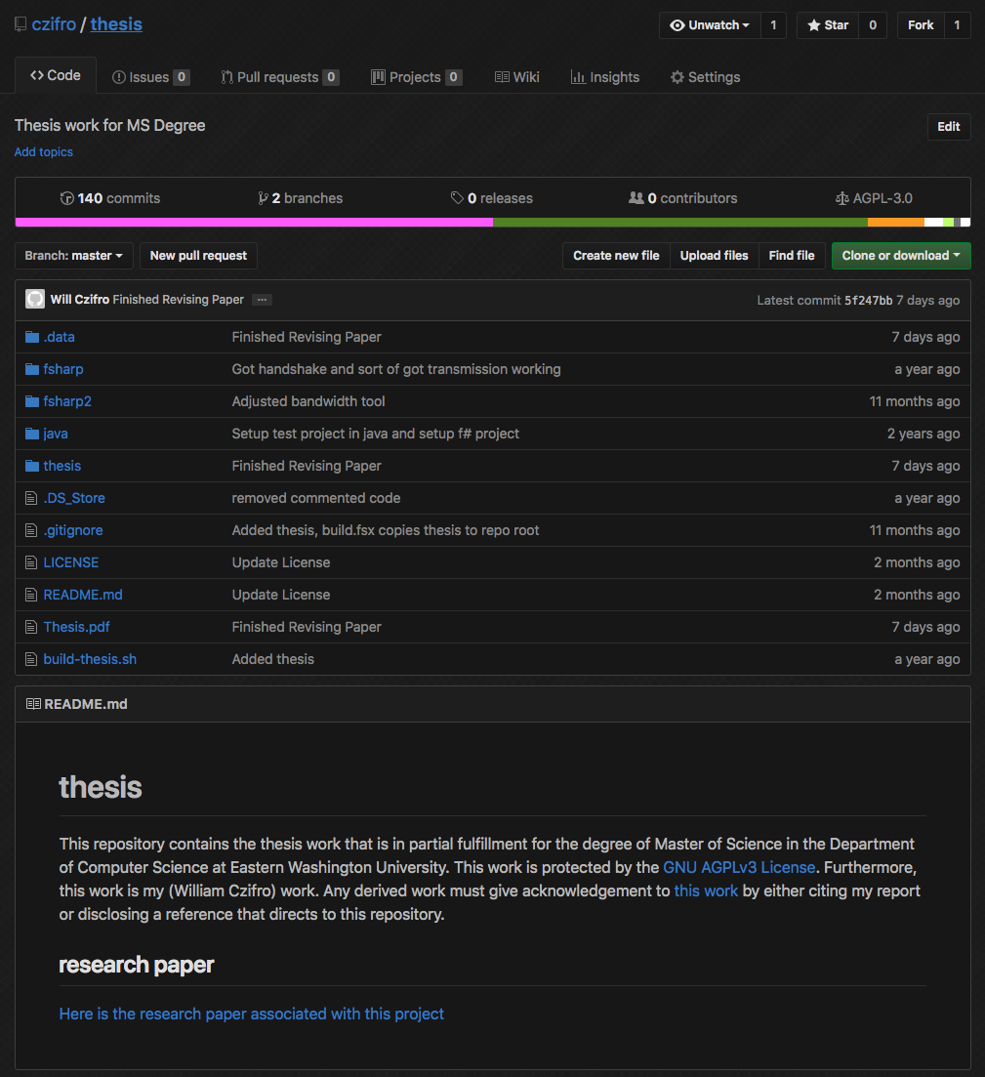
Preliminary Work

Slide 18
Preliminary Work
Management Tools
Source Control
GitHub
Project Management
GitHub Issue Board

Slide 19
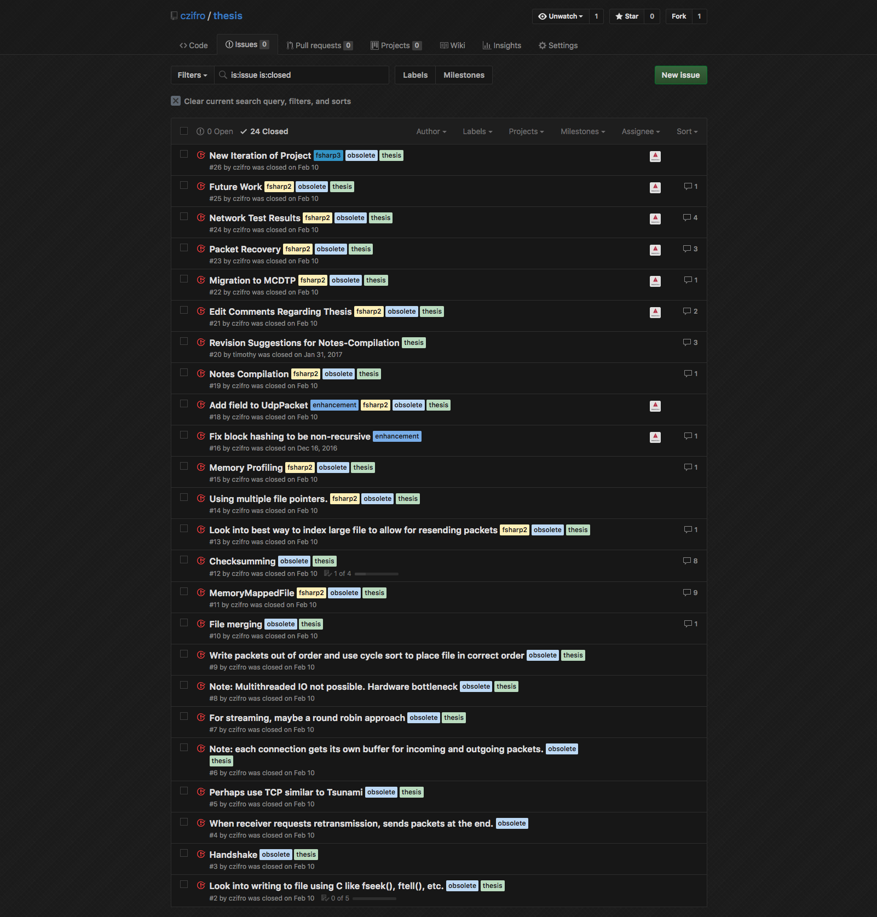
Preliminary Work

Slide 20
Preliminary Work
Preparation
Experiments

Slide 21
Preliminary Work
Multiple File Pointers
Checksumming

Slide 22
Preliminary Work
Multiple File Pointers
Checksumming

Slide 23
Preliminary Work
Goal
Gain Performance with ”ready-to-use” file pointers

Slide 24
Preliminary Work
Goal
Gain Performance with ”ready-to-use” file pointers
Test
Cycle sort file with N lines using single file pointer

Slide 25
Preliminary Work
Goal
Gain Performance with ”ready-to-use” file pointers
Test
Cycle sort file with N lines using single file pointer
Cycle sort file with N lines using 2N file pointers
Separate read and write pointers

Slide 26
Preliminary Work
Goal
Gain Performance with ”ready-to-use” file pointers
Test
Cycle sort file with N lines using single file pointer
Cycle sort file with N lines using 2N file pointers
Separate read and write pointers
Findings
Zero performance gain with N <= 1000
For N > 1000:
Required modifying kernel settings of operating system
Performance gain < 1ms

Slide 27
Preliminary Work
Multiple File Pointers
Checksumming

Slide 28
Preliminary work
Goal
Find optimal solution for block hashing

Slide 29
Preliminary work
Goal
Find optimal solution for block hashing
Test
Incremental block hashing
1KB, 1MB, and 1GB data sources
Buffered block hashing
1KB, 1MB, and 1GB data sources
MD5 hashing
1KB, 1MB, and 1GB data sources

Slide 30
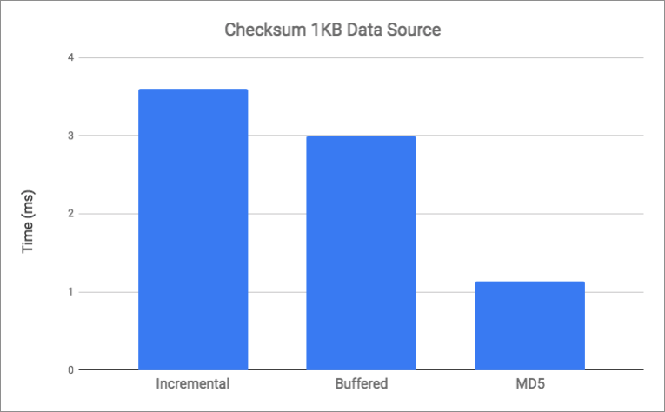
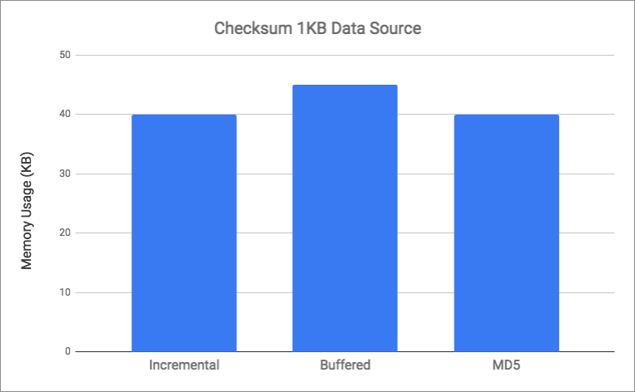
Preliminary Work

Slide 31
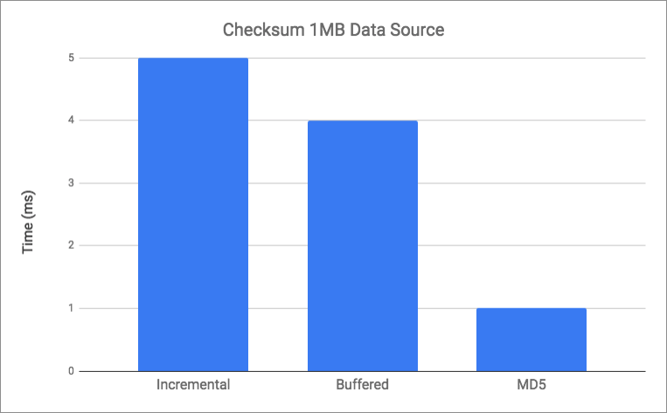
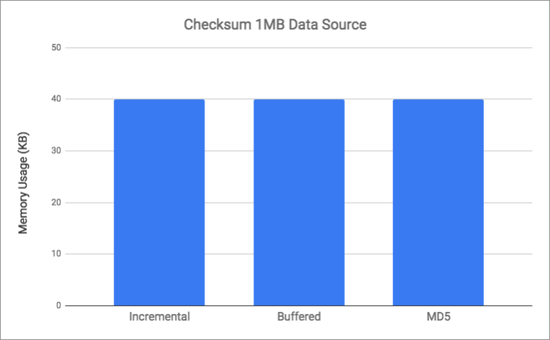
Preliminary work

Slide 32
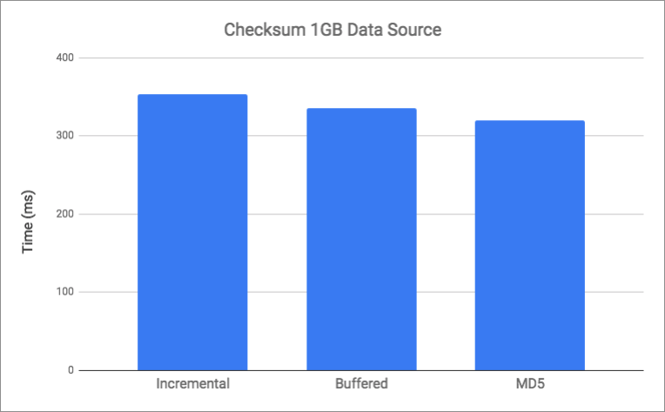
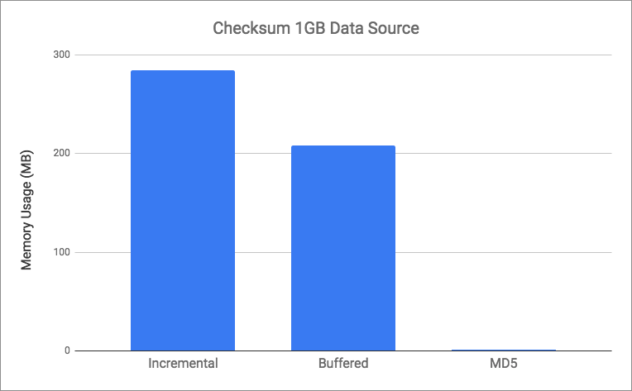
Preliminary work

Slide 33
Overview
Motivation
Problem
Preliminary Work
Related Work
Protocol Design
Architecture & Implementation
Testing & Analysis
Challenges & Future Work

Slide 34
Related Work
Concurrent Solutions
PSockets

Slide 35
Related Work
PSockets
Multiple TCP Sockets
Asynchronous Socket Access
Throughput of > 60 Mbps

Slide 36
Related Work
Concurrent Solutions
PSockets
Multi-Socket FTP

Slide 37
Related Work
Multi-Socket FTP
Parallel TCP Sockets
Peak Performance at 8 Parallel TCP Sockets
Throughput of 1.3 Mbps

Slide 38
Related Work
UDP-based Solutions
Reliable Blast UDP

Slide 39
Related Work
Reliable Blast UDP
Single UDP Connection
Multi-Phase System
Discovered Host Speed Issue
Performance
Throughput > 500 Mbps
< 7% Packet Loss

Slide 40
Related Work
UDP-based Solutions
Reliable Blast UDP
UDP Data Transfer

Slide 41
Related Work
UDP-based Solutions
Reliable Blast UDP
UDP Data Transfer
Aspera’s fasp protocol

Slide 42
Overview
Motivation
Problem
Preliminary Work
Related Work
Protocol Design
Architecture & Implementation
Testing & Analysis
Challenges & Future Work

Slide 43
Protocol Design
Lean
Minimalistic

Slide 44
Protocol Design
Handshakes

Slide 45
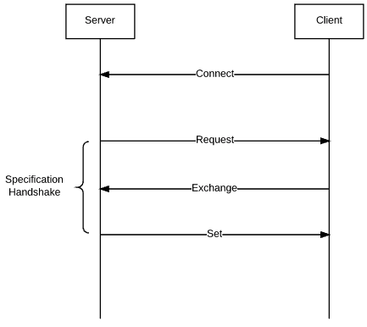
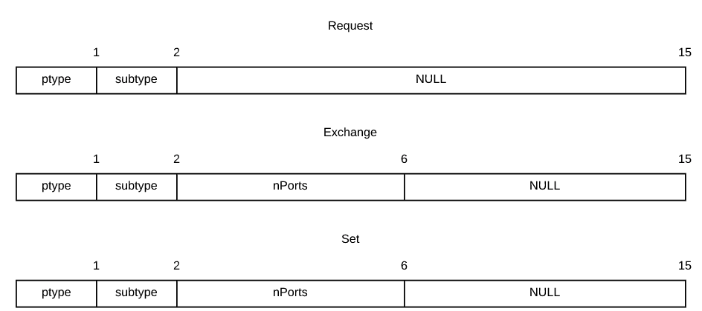
Protocol Design

Slide 46
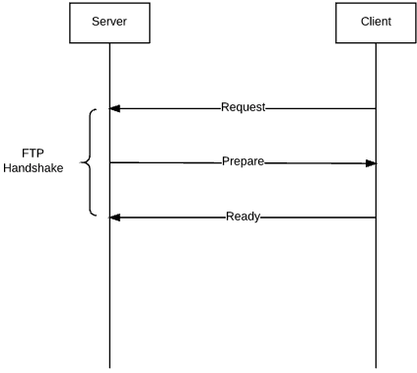
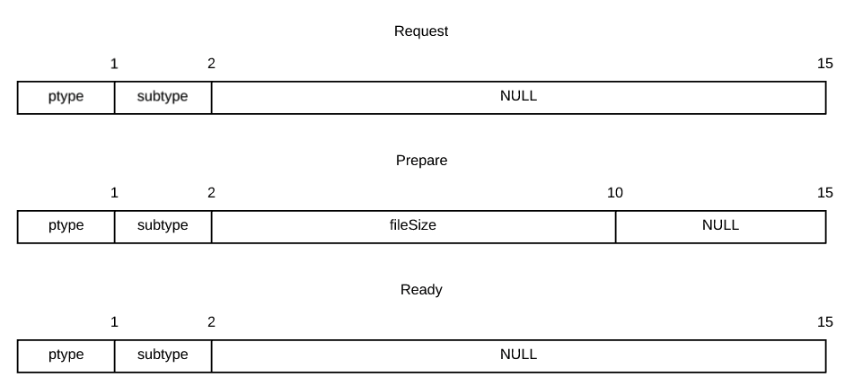
Protocol Design

Slide 47
Protocol Design
Handshakes
Channel Protocol

Slide 48
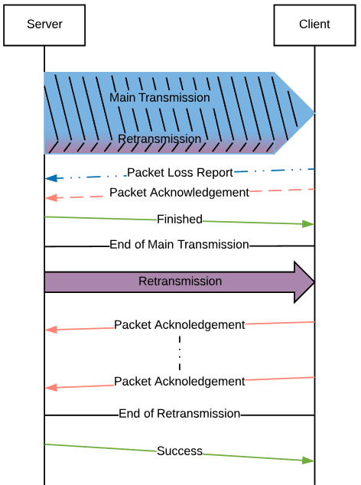
Protocol Design

Slide 49
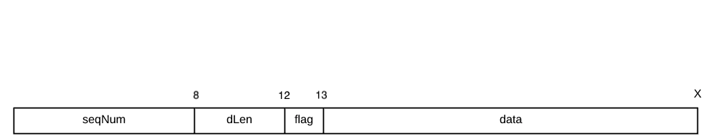
Protocol Design

Slide 50
Protocol Design
Handshakes
Channel Protocol
Retransmission Protocol

Slide 51
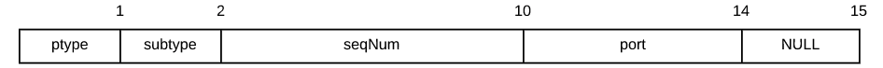
Protocol Design

Slide 52
Protocol Design

Slide 53
Protocol Design
Handshakes
Channel Protocol
Retransmission Protocol
Channel Success

Slide 54
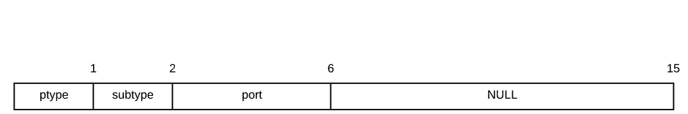
Protocol Design

Slide 55
Overview
Motivation
Problem
Preliminary Work
Related Work
Protocol Design
Architecture & Implementation
Testing & Analysis
Challenges & Future Work

Slide 56
Architecture & Implementation
Architecture
Modular
Asynchronous

Slide 57
Architecture & Implementation
Architecture
Modular
Asynchronous

Slide 58
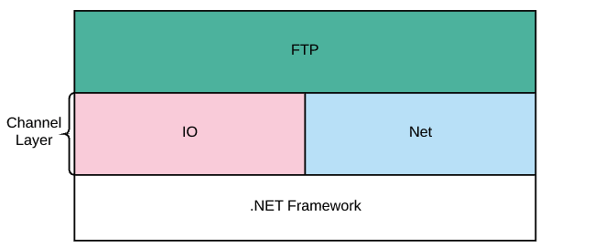
Architecture & Implementation

Slide 59
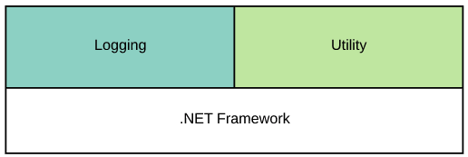
Architecture & Implementation
Helper Modules

Slide 60
Architecture & Implementation

Slide 61
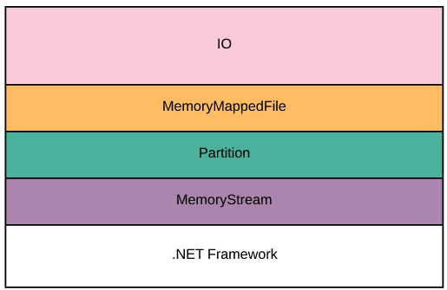
Architecture & Implementation

Slide 62
Architecture & Implementation
Memory Stream Module
Based on .NET Framework data structure
Unbounded Capacity

Slide 63
Architecture & Implementation
Partition Module
Represents a segment of a file
Manages file pointer and buffer
File access is read or write only
Configurable
Minimum buffer size before reading more data
Maximum buffer size before flushing to disk

Slide 64
Architecture & Implementation
Memory Mapped File Module
Top layer in I/O module
Based on .NET Framework data structure
Manages all partitions of a file
Configurable
Number of partitions to create
Partition configuration

Slide 65
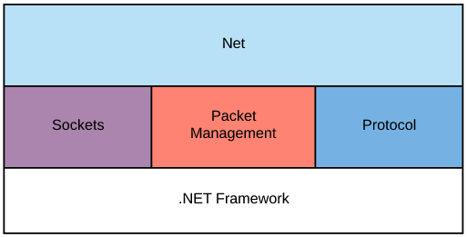
Architecture & Implementation

Slide 66
Architecture & Implementation
Protocol Module

Slide 67
Architecture & Implementation
Architecture
Modular
Asynchronous

Slide 68
Overview
Motivation
Problem
Preliminary Work
Related Work
Protocol Design
Architecture & Implementation
Testing & Analysis
Challenges & Future Work

Slide 69
Testing & Analysis
Testing Environment
Ubuntu 16.04 LTS

Slide 70
Testing & Analysis
Testing Environment
Ubuntu 16.04 LTS
DigitalOcean Specifications
4 CPUs
8GB of RAM
80GB SSD
5TB of transfer

Slide 71
Testing & Analysis
Testing Environment
Ubuntu 16.04 LTS
DigitalOcean Specifications
4 CPUs
8GB of RAM
80GB SSD
5TB of transfer
Two identically configured servers
One in New York, USA
One in Amsterdam, Netherlands

Slide 72
TESTING & ANALYSIS
Test Configurations

Slide 73
TESTING & ANALYSIS
Test Configurations
Channel Count
1, 2, 4, and 8

Slide 74
TESTING & ANALYSIS
Test Configurations
Channel Count
1, 2, 4, and 8
Data Source
1GB in size

Slide 75
TESTING & ANALYSIS
Test Configurations
Channel Count
1, 2, 4, and 8
Data Source
1GB in size
Maximum Transmission Unit
1500 bytes
Using 1400 bytes to account for packet headers

Slide 76
Testing & Analysis
Test Metrics
Throughput
Packet Loss

Slide 77
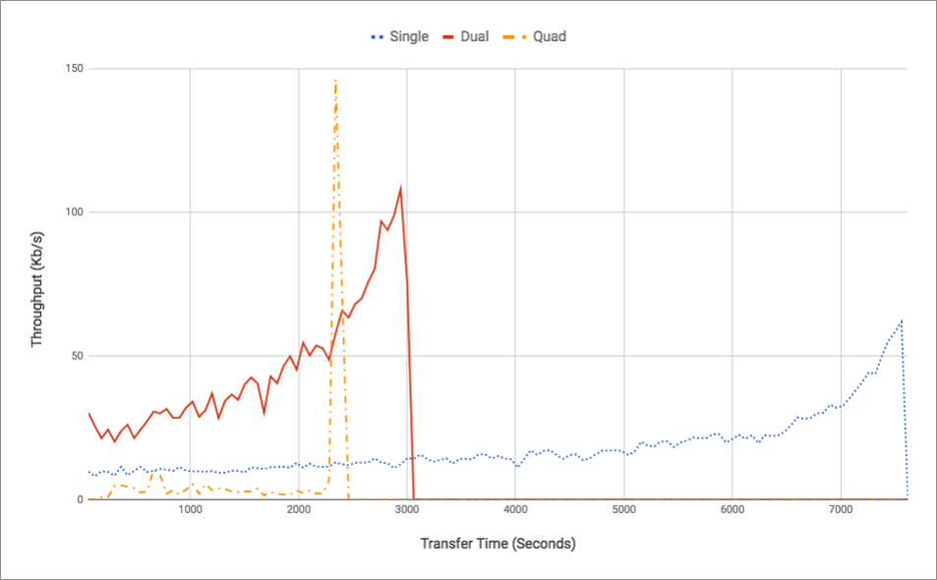
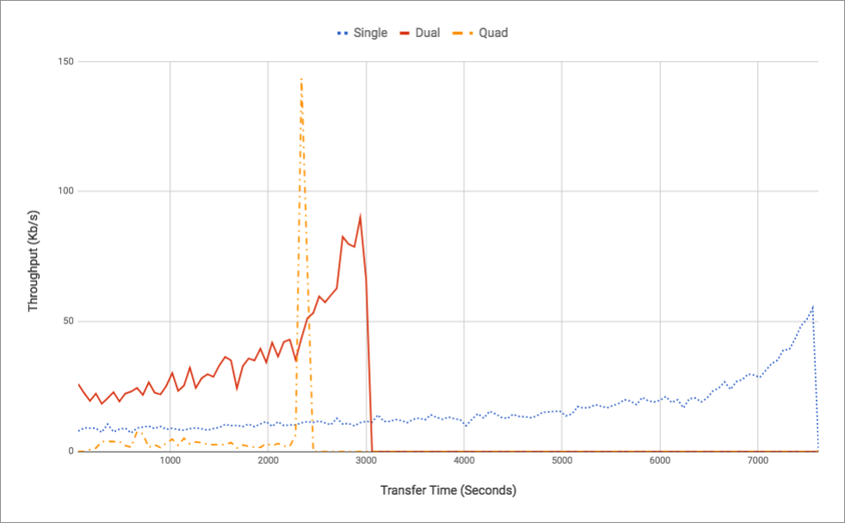
Testing & Analysis
Server Throughput
Client Throughput

Slide 78
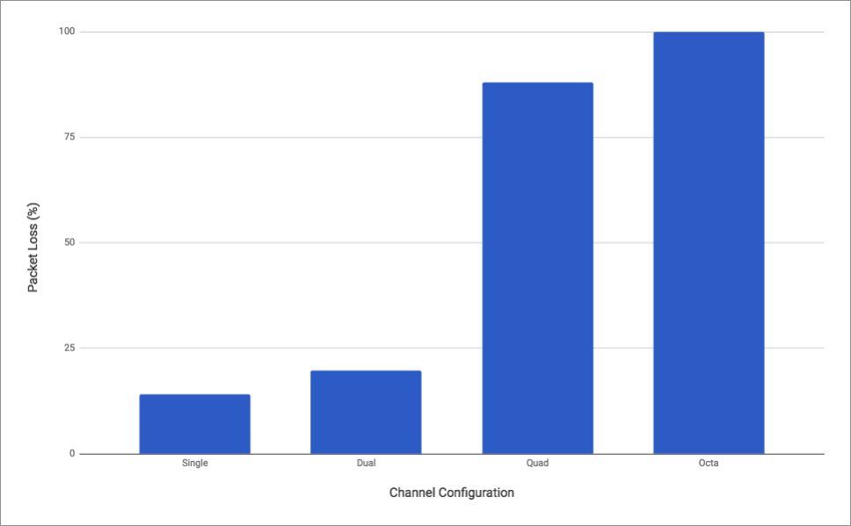
Testing & Analysis
Packet Loss Percentage

Slide 79
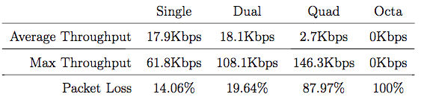
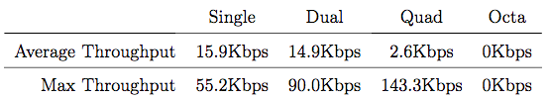
Testing & Analysis
Server Performance
Client Performance

Slide 80
Testing & Analysis

Slide 81
Testing & Analysis
Poor Performance
Low Throughput
High Packet Loss
Not Comparable to Related Work

Slide 82
Testing & Analysis
The Issue
Overuse of Asynchrony

Slide 83
Testing & Analysis
The Issue
Overuse of Asynchrony
Unsubstantiated

Slide 84
Testing & Analysis
.NET Core Asynchrony

Slide 85
Testing & Analysis
.NET Core Asynchrony
TPL Handles all Asynchronous Work
Computation
I/O

Slide 86
Testing & Analysis
Task Parallel Library

Slide 87
Testing & Analysis
Task Parallel Library
Request underlying runtime to handle I/O operations

Slide 88
Testing & Analysis
Task Parallel Library
Request underlying runtime to handle I/O operations
Common Language Runtime (CLR)

Slide 89
Testing & Analysis
Common Language Runtime
Executes Asynchronous Computations

Slide 90
Testing & Analysis
Common Language Runtime
Executes Asynchronous Computations on a Thread Pool
Uses I/O Completion Ports (IOCP) for I/O operations
Kernel-level thread pool

Slide 91
Testing & Analysis
Common Language Runtime
Executes Asynchronous Computations
Uses I/O Completion Ports (IOCP) for I/O operations
Kernel-level thread pool
Only used on Win32 Kernel

Slide 92
Testing & Analysis
Unix-based CLR
Single Thread Pool
Computation
I/O

Slide 93
Testing & Analysis
Unix-based CLR
Single Thread Pool
Computation
I/O
Windows-based CLR
Dual Thread Pool
Computation Thread Pool
I/O Thread Pool
Kernel-level

Slide 94
Testing & Analysis
MCDTP Implementation
Minimum of 5 nested asynchronous tasks per packet

Slide 95
Testing & Analysis
MCDTP Implementation
Minimum of 5 nested asynchronous tasks per packet
1GB is approximately 700,000 packets

Slide 96
Testing & Analysis
MCDTP Implementation
Minimum of 5 nested asynchronous tasks per packet
1GB is approximately 700,000 packets
At least 3.5 million asynchronous tasks per 1GB transfer

Slide 97
Overview
Motivation
Problem
Preliminary Work
Related Work
Protocol Design
Architecture & Implementation
Testing & Analysis
Challenges & Future Work

Slide 98
Challenges & Future Work
Challenges
.NET Core Framework

Slide 99
Challenges & Future Work
Challenges
.NET Core Framework
Architectural Issues

Slide 100
Challenges & Future Work
Future Work
Asynchrony without IOCP vs Asynchrony with IOCP

Slide 101
Challenges & Future Work
Future Work
Asynchrony without IOCP vs Asynchrony with IOCP
Restructure MCDTPi
Minimize utilization of Asynchrony
Create solution to workaround MTU limit

Slide 102
Conclusion
Asynchrony negative performance impact is possible
Requires more methodical usage

Slide 103
References

Slide 104
Questions?

