Slide 1
A Multi-channel data transfer protocol using asynchronous technology
By William T Czifro
Thesis Advisor: Dr. Carol Taylor

Slide 2
Overview
Motivation
Problem
Preliminary Work
Related Work
Protocol Design
Architecture & Implementation
Testing & Analysis
Challenges & Future Work

Slide 3
Overview
Motivation
Problem
Preliminary Work
Related Work
Protocol Design
Architecture & Implementation
Testing & Analysis
Challenges & Future Work

Slide 4
Motivation

Slide 5
Motivation
Studied Networking as Undergraduate

Slide 6
Motivation
Studied Networking as Undergraduate
High-level Experience with Asynchrony

Slide 7
Motivation
Studied Networking as Undergraduate
High-level Experience with Asynchrony
Aspera Demonstration

Slide 8
Overview
Motivation
Problem
Preliminary Work
Related Work
Protocol Design
Architecture
Implementation
Testing & Analysis
Challenges & Future Work

Slide 9
Problem
End systems are not fast enough [1][2][3]
Network connections are faster than hosts

Slide 10
Problem
End systems are not fast enough [1][2][3]
Network connections are faster than hosts
Can asynchrony provide any performance gain?

Slide 11
Overview
Motivation
Problem
Preliminary Work
Related Work
Protocol Design
Architecture & Implementation
Testing & Analysis
Challenges & Future Work

Slide 12
Preliminary Work
Preparation
Experiments

Slide 13
Preliminary Work
Preparation
Experiments

Slide 14
Preliminary Work
Management Tools

Slide 15
Preliminary Work
Management Tools
Source Control
GitHub
Project Management
GitHub Issue Board

Slide 16
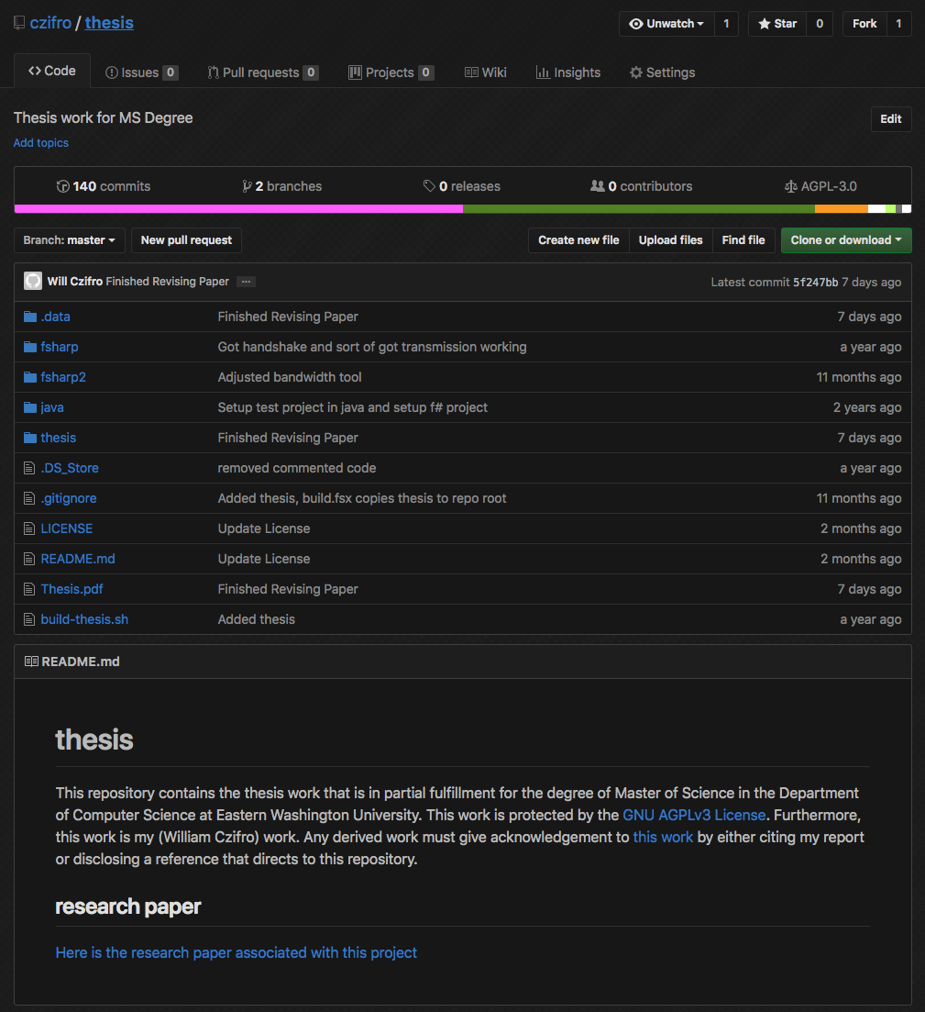
Preliminary Work

Slide 17
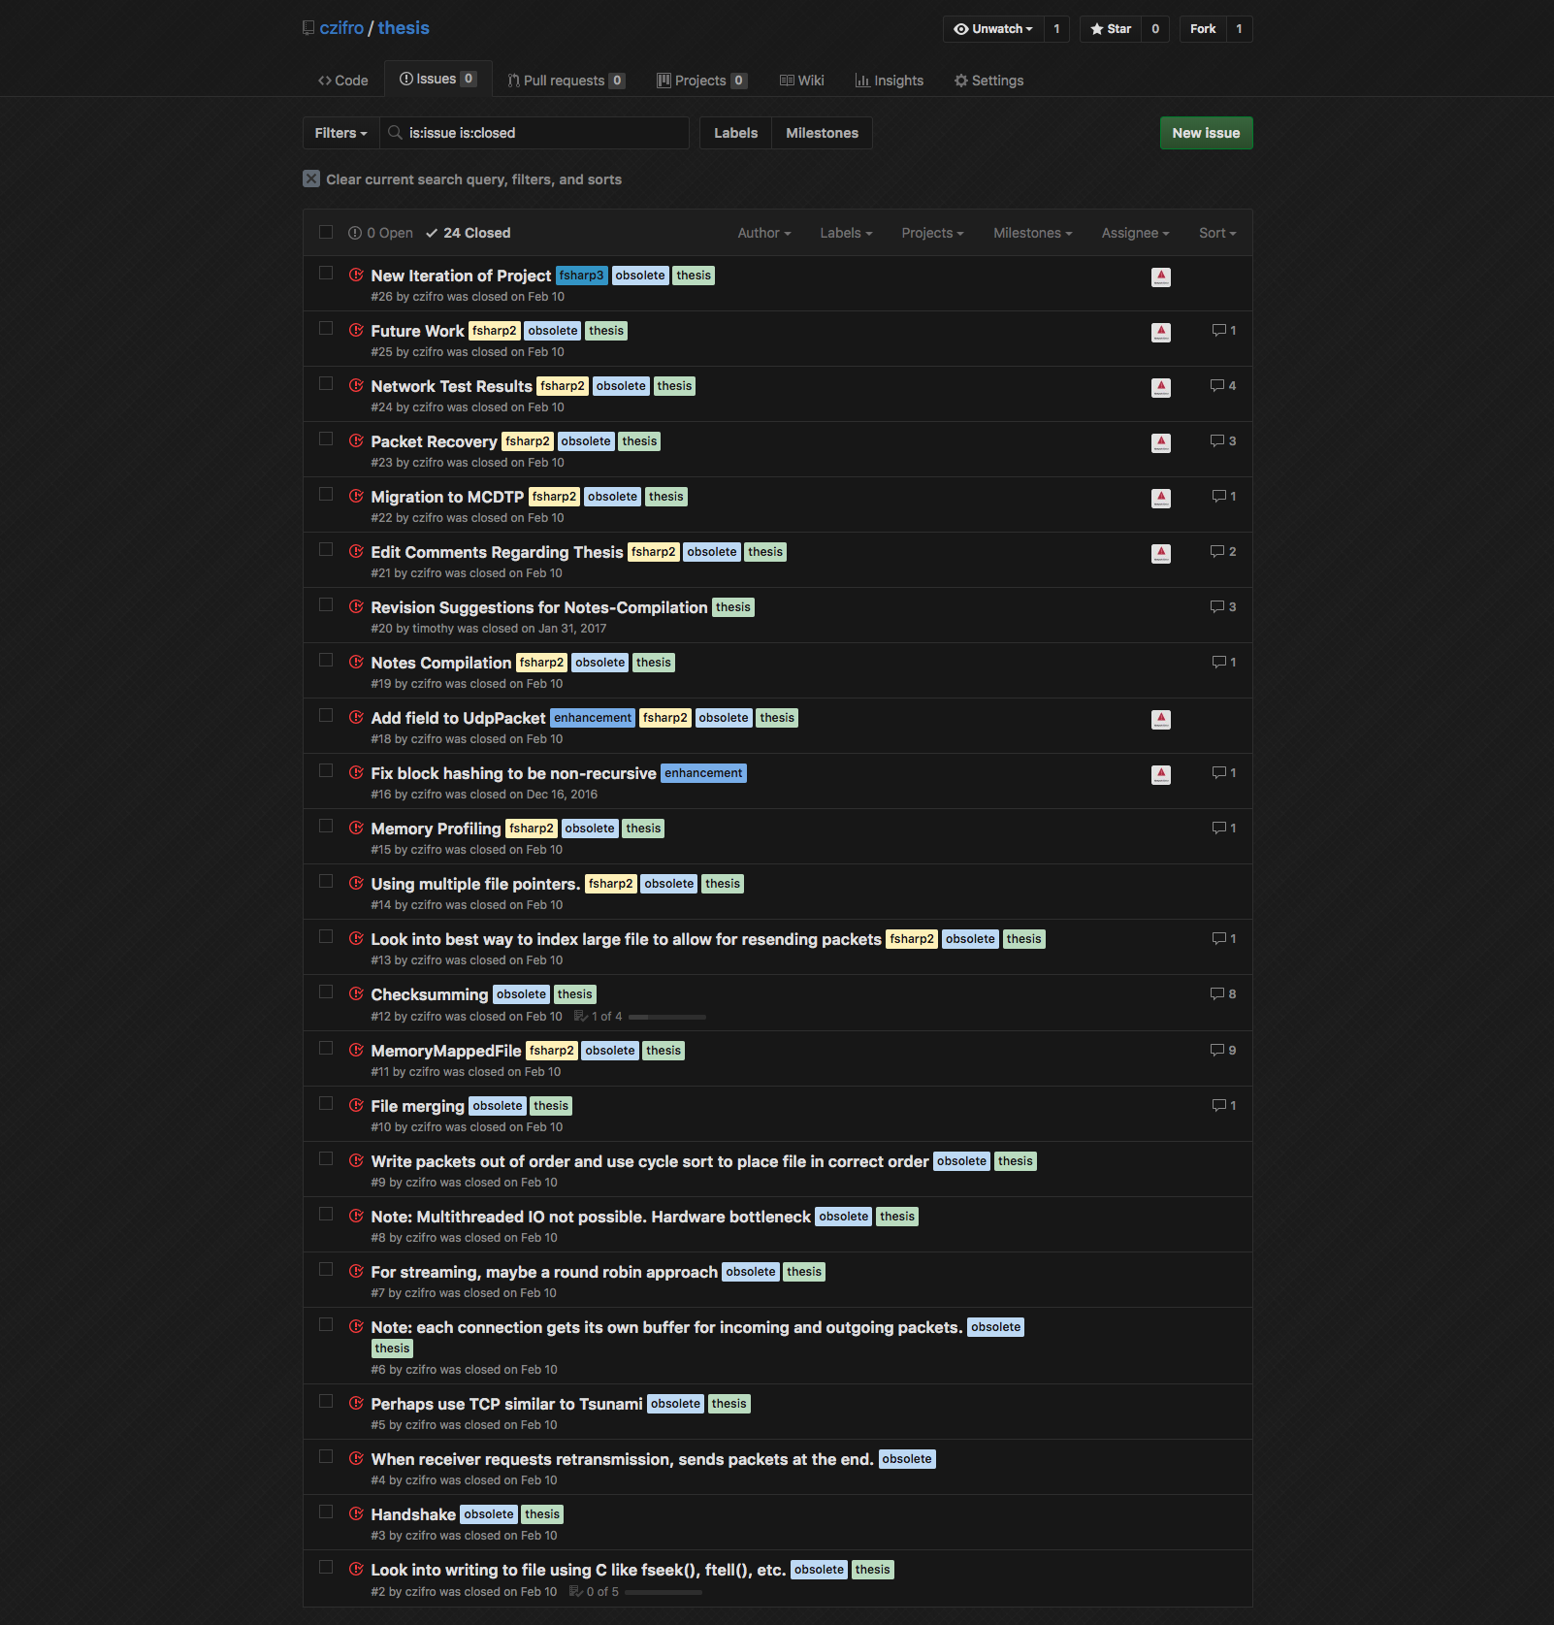
Preliminary Work

Slide 18
Preliminary Work
Management Tools
Source Control
GitHub
Project Management
GitHub Issue Board

Slide 19
Preliminary Work
Preparation
Experiments

Slide 20
Preliminary Work
Multiple File Pointers
Checksumming

Slide 21
Preliminary Work
Multiple File Pointers
Checksumming

Slide 22
Preliminary Work
Goal
Gain Performance with ”ready-to-use” file pointers

Slide 23
Preliminary Work
Goal
Gain Performance with ”ready-to-use” file pointers
Test
Cycle sort file with N lines using single file pointer

Slide 24
Preliminary Work
Goal
Gain Performance with ”ready-to-use” file pointers
Test
Cycle sort file with N lines using single file pointer
Cycle sort file with N lines using 2N file pointers
Separate read and write pointers

Slide 25
Preliminary Work
Goal
Gain Performance with ”ready-to-use” file pointers
Test
Cycle sort file with N lines using single file pointer
Cycle sort file with N lines using 2N file pointers
Separate read and write pointers
Findings
Zero performance gain with N <= 1000
For N > 1000:
Required modifying kernel settings of operating system
Performance gain < 1ms

Slide 26
Preliminary Work
Multiple File Pointers
Checksumming

Slide 27
Preliminary work
Goal
Find optimal solution for block hashing

Slide 28
Preliminary work
Goal
Find optimal solution for block hashing
Test
Incremental block hashing
1KB, 1MB, and 1GB data sources
Buffered block hashing
1KB, 1MB, and 1GB data sources
MD5 hashing
1KB, 1MB, and 1GB data sources

Slide 29
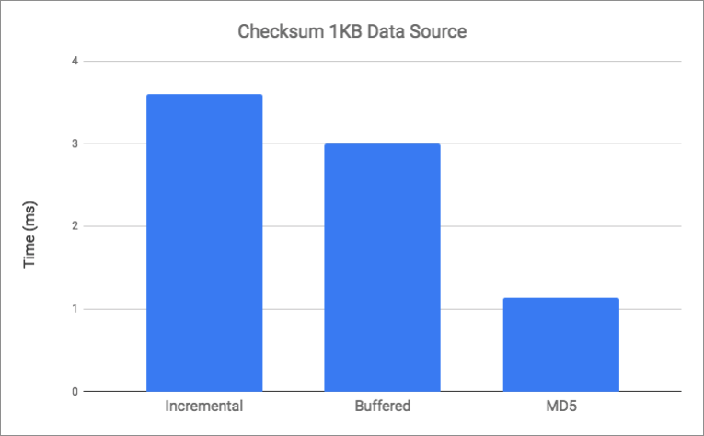
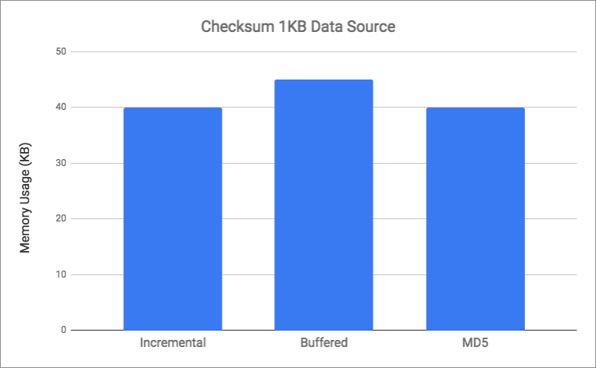
Preliminary Work

Slide 30
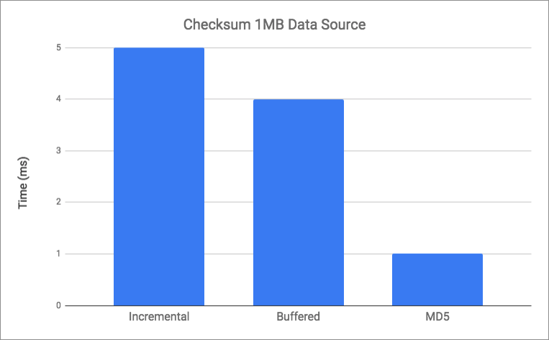
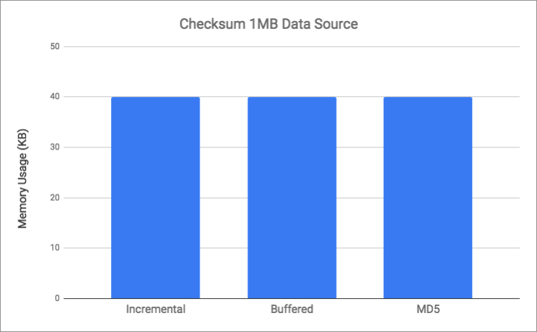
Preliminary work

Slide 31
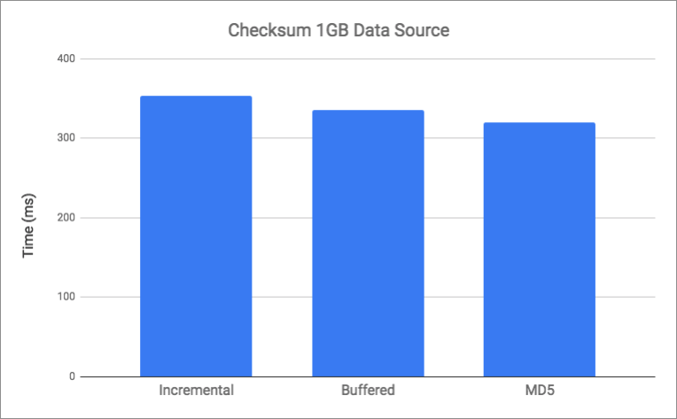
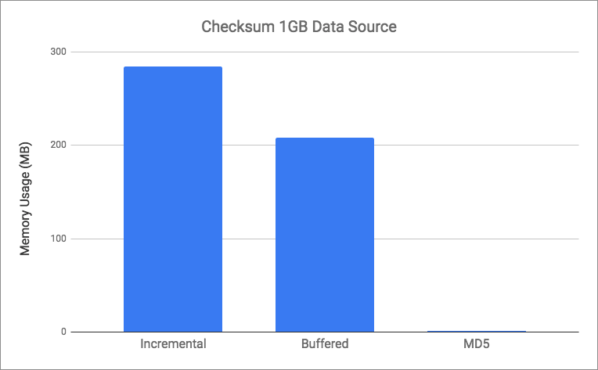
Preliminary work

Slide 32
Overview
Motivation
Problem
Preliminary Work
Related Work
Protocol Design
Architecture & Implementation
Testing & Analysis
Challenges & Future Work

Slide 33
Related Work
Concurrent Solutions
Psockets [4]

Slide 34
Related Work
Psockets [4]
Multiple TCP Sockets
Asynchronous Socket Access
Throughput of > 60 Mbps

Slide 35
Related Work
Concurrent Solutions
Psockets [4]
Multi-Socket FTP [5][6]

Slide 36
Related Work
Multi-Socket FTP [5][6]
Parallel TCP Sockets
Peak Performance at 8 Parallel TCP Sockets
Throughput of 1.3 Mbps

Slide 37
Related Work
UDP-based Solutions
Reliable Blast UDP (RBUDP) [3]

Slide 38
Related Work
RBUDP [3]
Single UDP Connection
Multi-Phase System
Discovered Host Speed Issue
Performance
Throughput > 500 Mbps
< 7% Packet Loss

Slide 39
Related Work
UDP-based Solutions
Reliable Blast UDP (RBUDP) [3]
UDP-based Data Transfer (UDT) [7]

Slide 40
Related Work
UDT [7]
Strictly UDP-based protocol
Congestion Control
Rate Control
Window-based Flow Control
Performance:
Throughput of 940 Mbps

Slide 41
Related Work
UDP-based Solutions
Reliable Blast UDP (RBUDP) [3]
UDP-based Data Transfer (UDT) [7]
Tsunami [8]

Slide 42
Related Work
Tsunami [8]
Data transfer over UDP
Rate-Controlled Protocol
Feedback loop over TCP
Performance:
Average Throughput of 850 Mbps

Slide 43
Related Work
UDP-based Solutions
Reliable Blast UDP (RBUDP) [3]
UDP-based Data Transfer (UDT) [7]
Tsunami [8]
Aspera’s fast and secure protocol (fasp) [1][2]

Slide 44
Related Work
fasp [1][2]
Data transfer over UDP
Rate-Controlled Protocol
Feedback loop over TCP
Retransmission over TCP
Custom End-System Hardware
Performance:
Throughput > 950 Mbps

Slide 45
Overview
Motivation
Problem
Preliminary Work
Related Work
Protocol Design
Architecture & Implementation
Testing & Analysis
Challenges & Future Work

Slide 46
Protocol Design
Multi-Channel Data Transfer Protocol (MCDTP)
Lean
Minimalistic

Slide 47
Protocol Design
Handshakes

Slide 48
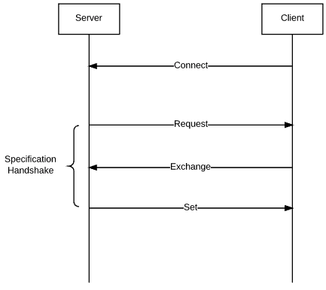
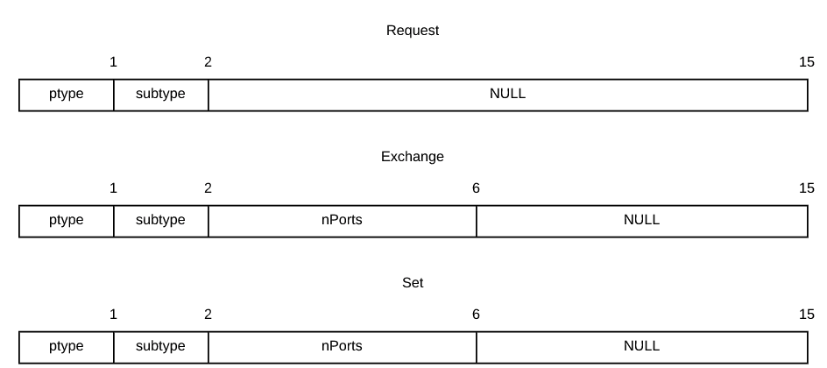
Protocol Design

Slide 49
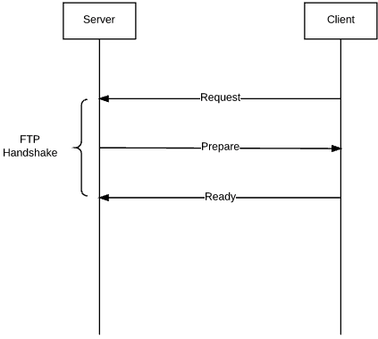
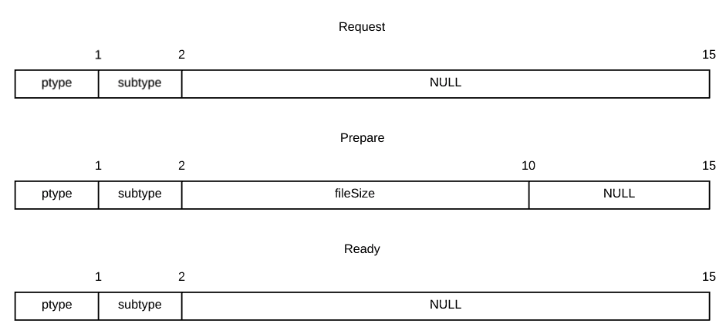
Protocol Design

Slide 50
Protocol Design
Handshakes
Channel Protocol

Slide 51
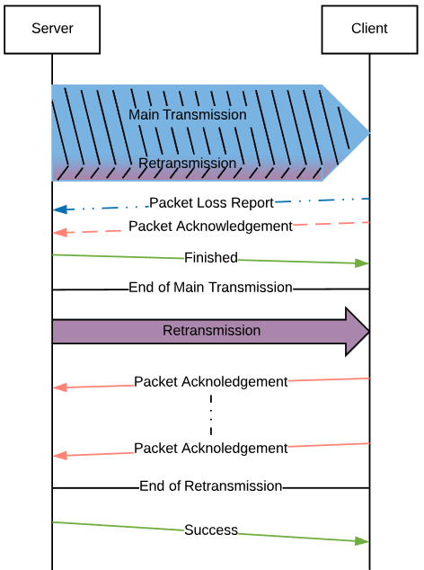
Protocol Design

Slide 52
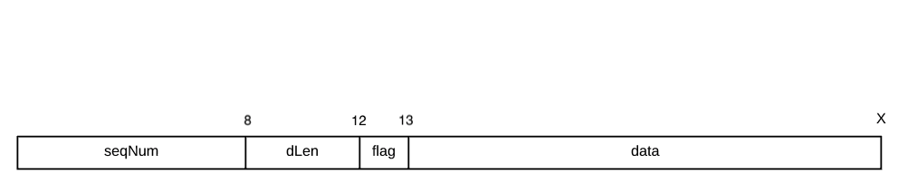
Protocol Design

Slide 53
Protocol Design
Handshakes
Channel Protocol
Retransmission Protocol

Slide 54
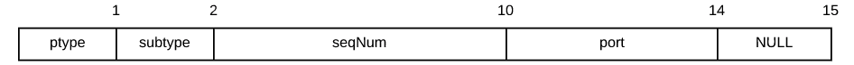
Protocol Design

Slide 55
Protocol Design

Slide 56
Protocol Design
Handshakes
Channel Protocol
Retransmission Protocol
Channel Success

Slide 57
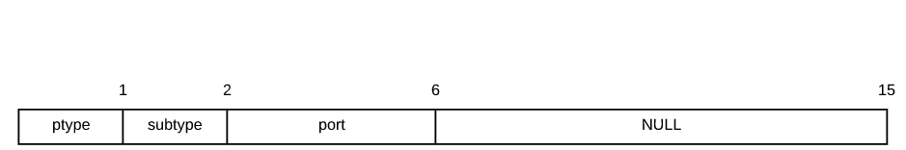
Protocol Design

Slide 58
Overview
Motivation
Problem
Preliminary Work
Related Work
Protocol Design
Architecture & Implementation
Testing & Analysis
Challenges & Future Work

Slide 59
Architecture & Implementation
MCDTP Implementation (MCDTPi) Architecture
Modular
Asynchronous

Slide 60
Architecture & Implementation
MCDTP Implementation (MCDTPi) Architecture
Modular
Asynchronous

Slide 61
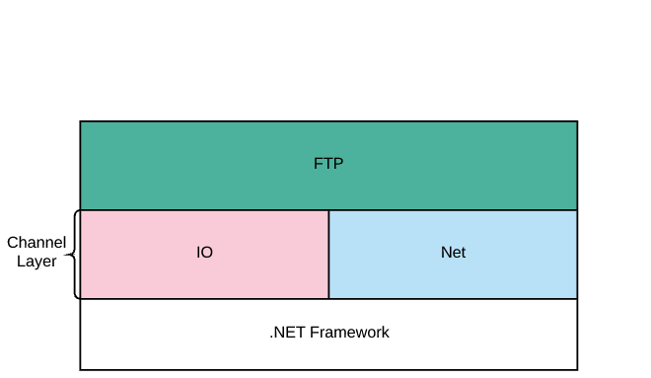
Architecture & Implementation

Slide 62
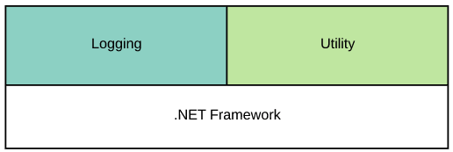
Architecture & Implementation
Helper Modules

Slide 63
Architecture & Implementation

Slide 64
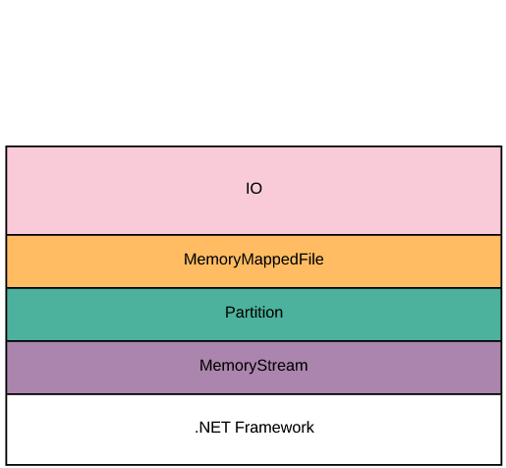
Architecture & Implementation

Slide 65
Architecture & Implementation
Memory Stream Module
Based on .NET Framework data structure [9]
Unbounded Capacity

Slide 66
Architecture & Implementation
Partition Module
Represents a segment of a file
Manages file pointer and buffer
File access is read or write only
Configurable
Minimum buffer size before reading more data
Maximum buffer size before flushing to disk

Slide 67
Architecture & Implementation
Memory Mapped File Module
Top layer in I/O module
Based on .NET Framework data structure [9]
Manages all partitions of a file
Configurable
Specify file to open
Number of partitions to create
Partition configuration

Slide 68
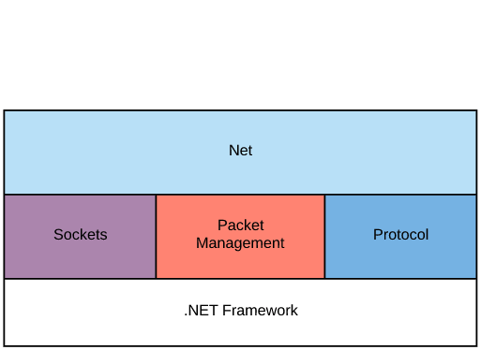
Architecture & Implementation

Slide 69
Architecture & Implementation
Protocol Module
Handles packet parsing and composing
TCP Packets
UDP Packets

Slide 70
Architecture & Implementation
Sockets Module
Manages Socket connection
Queues Packets
Configurable
Specify TCP or UDP
Set pre- and post-I/O-operations

Slide 71
Architecture & Implementation
Packet Management Module
Buffers and prepares packets
Tracks UDP packets for single channel
Multi-phase Transfer
Bulk Transfer
Retransmission
Configurable
Buffer thresholds for flushing and replenishing

Slide 72
Architecture & Implementation

Slide 73
Architecture & Implementation
FTP Module
Manages data transfer channels
Performs handshakes per MCDTP specification
Connects all submodules together
Configurable
Specify configurations for configurable submodules
Specify client or server

Slide 74
Architecture & Implementation
MCDTPi Architecture
Modular
Asynchronous

Slide 75
Architecture & Implementation
Asynchronous
I/O module and Net module are non-blocking

Slide 76
Architecture & Implementation
Asynchronous
I/O module and Net module are non-blocking
.NET Core Framework [9][10][11]
Task Parallel Library (TPL)

Slide 77
Overview
Motivation
Problem
Preliminary Work
Related Work
Protocol Design
Architecture & Implementation
Testing & Analysis
Challenges & Future Work

Slide 78
Testing & Analysis
Testing Environment
Ubuntu 16.04 LTS

Slide 79
Testing & Analysis
Testing Environment
Ubuntu 16.04 LTS
DigitalOcean Specifications
4 CPUs
8GB of RAM
80GB SSD
5TB of transfer

Slide 80
Testing & Analysis
Testing Environment
Ubuntu 16.04 LTS
DigitalOcean Specifications
4 CPUs
8GB of RAM
80GB SSD
5TB of transfer
Two identically configured servers
One in New York, USA
One in Amsterdam, Netherlands

Slide 81
TESTING & ANALYSIS
Test Configurations

Slide 82
TESTING & ANALYSIS
Test Configurations
Channel Count
1, 2, 4, and 8

Slide 83
TESTING & ANALYSIS
Test Configurations
Channel Count
1, 2, 4, and 8
Data Source
1GB in size

Slide 84
TESTING & ANALYSIS
Test Configurations
Channel Count
1, 2, 4, and 8
Data Source
1GB in size
Maximum Transmission Unit
1500 bytes
Using 1400 bytes to account for packet headers

Slide 85
Testing & Analysis
Test Metrics
Throughput
Packet Loss

Slide 86
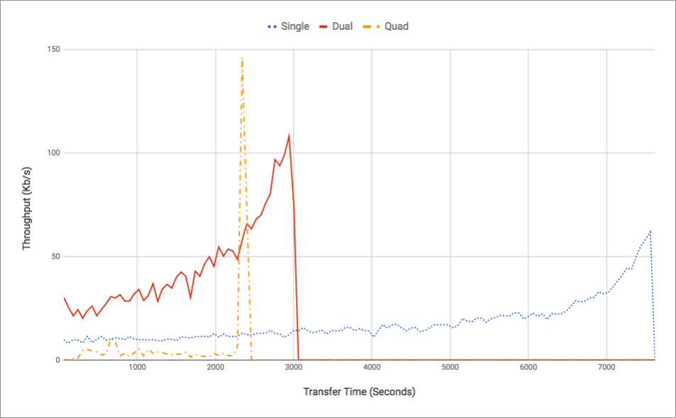
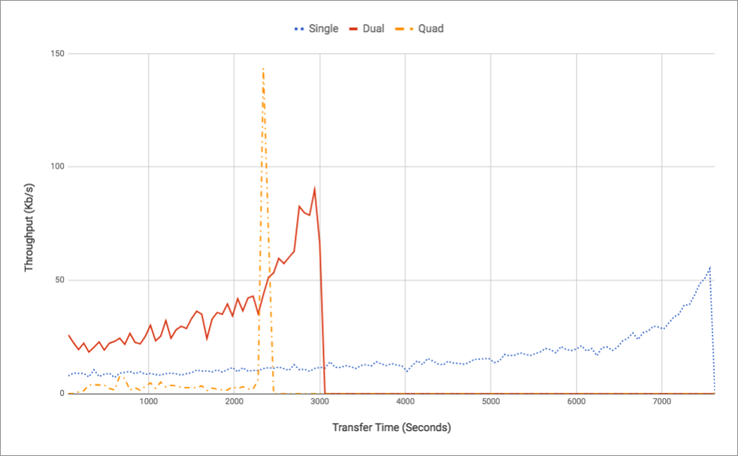
Testing & Analysis
Server Throughput
Client Throughput

Slide 87
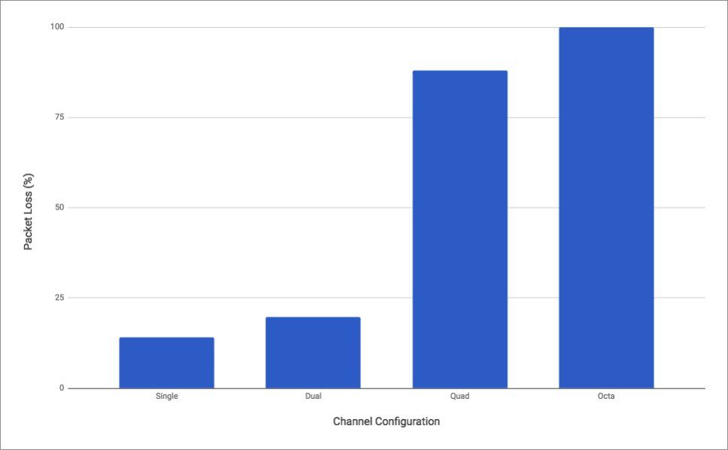
Testing & Analysis
Packet Loss Percentage

Slide 88
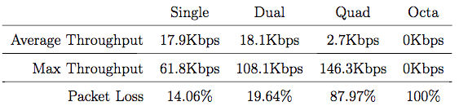
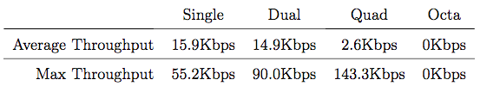
Testing & Analysis
Server Performance
Client Performance

Slide 89
Testing & Analysis

Slide 90
Testing & Analysis
Poor Performance
Low Throughput
High Packet Loss
Not Comparable to Related Work

Slide 91
Testing & Analysis
The Issue

Slide 92
Testing & Analysis
The Issue
Overuse of Asynchrony [12]

Slide 93
Testing & Analysis
The Issue
Overuse of Asynchrony [12]
Unsubstantiated

Slide 94
Testing & Analysis
.NET Core Asynchrony

Slide 95
Testing & Analysis
.NET Core Asynchrony
TPL Handles all Asynchronous Work [10]
Computation
I/O

Slide 96
Testing & Analysis
Task Parallel Library

Slide 97
Testing & Analysis
Task Parallel Library
Request underlying runtime to handle I/O operations [9][13]

Slide 98
Testing & Analysis
Task Parallel Library
Request underlying runtime to handle I/O operations [9][13]
Common Language Runtime (CLR)

Slide 99
Testing & Analysis
CLR [13]
Executes Asynchronous Computations on a Thread Pool

Slide 100
Testing & Analysis
CLR [13]
Executes Asynchronous Computations on a Thread Pool
Uses I/O Completion Ports (IOCP) for I/O operations
Kernel-level thread pool

Slide 101
Testing & Analysis
CLR [13]
Executes Asynchronous Computations on a Thread Pool
Uses I/O Completion Ports (IOCP) for I/O operations
Kernel-level thread pool
Only used on Win32 Kernel

Slide 102
Testing & Analysis
Unix-based CLR
Single Thread Pool
Computations & I/O

Slide 103
Testing & Analysis
Unix-based CLR
Single Thread Pool
Computations & I/O
Windows-based CLR
Dual Thread Pool
Computation Thread Pool
I/O Thread Pool
Kernel-level

Slide 104
Testing & Analysis
MCDTPi
Minimum of 5 nested asynchronous tasks per packet

Slide 105
Testing & Analysis
MCDTPi
Minimum of 5 nested asynchronous tasks per packet
1GB is approximately 700,000 packets

Slide 106
Testing & Analysis
MCDTPi
Minimum of 5 nested asynchronous tasks per packet
1GB is approximately 700,000 packets
At least 3.5 million asynchronous tasks per 1GB transfer

Slide 107
Overview
Motivation
Problem
Preliminary Work
Related Work
Protocol Design
Architecture & Implementation
Testing & Analysis
Challenges & Future Work

Slide 108
Challenges & Future Work
Challenges
.NET Core Framework

Slide 109
Challenges & Future Work
Challenges
.NET Core Framework
Architectural Issues

Slide 110
Challenges & Future Work
Future Work
Asynchrony without IOCP vs Asynchrony with IOCP

Slide 111
Challenges & Future Work
Future Work
Asynchrony without IOCP vs Asynchrony with IOCP
Restructure MCDTPi
Minimize utilization of Asynchrony

Slide 112
Challenges & Future Work
Future Work
Asynchrony without IOCP vs Asynchrony with IOCP
Restructure MCDTPi
Minimize utilization of Asynchrony
Create solution to workaround MTU limit

Slide 113
Conclusion
Can asynchrony provide any performance gain?

Slide 114
Conclusion
Can asynchrony provide any performance gain?
Negative performance is possible with asynchrony
Requires a more methodical use

Slide 115
References
[1] X. Fan and M. Munson. Patebytes in Motion : Ultra High Speed Transport of Media Files. In SMTP Annual Technical Conference, pages 2-13, 2010.
[2] Aspera. Aspera FASP High Speed Transport – A Critical Technology Comparison. 2016.
[3] E. He, J. Leigh, O. Yu, and T. A. DeFanti. Reliable Blast UDP: Predictable high performance bulk data transfer. Proceedings - IEEE International Conference on Cluster Computing, ICCC, 2002-January(March):317–324, 2002.
[4] Harimath Sivakumar, Stuart Bailey, and Robert L Grossman. Psockets: The case for application-level network striping for data intensive applications using high speed wide area networks. In Proceedings of the 2000 ACM/IEEE conference on Super-computing, page 37. IEEE Computer Society, 2000.
[5] M. Allman and S. Ostermann. DATA TRANSFER EFFICIENCY OVER SATEL-LITE CIRCUITS USING A MULTI-SOCKET EXTENSION TO THE FILE TRANSFER PROTOCOL (FTP). Proceedings of the ACTS Result Conference,1995.
[6] M. Allman and S. Ostermann. Multiple Data Connection FTP Extensions. Technical report, 1997.
[7] Y. Gu and R.L. Grossman. UDT: UDP-based data transfer for high-speed wide area networks. Computer Networks, 51(7):1777–1799, 2007.
[8] M. Meiss. Tsunami: A high-speed rate-controlled protocol for file transfer. pages 1–10, 2004.
[9] NET Foundation. .NET Core 1.0.3 Source Code, 2016.
[10] Daan Leijen, Wolfram Schulte, and Sebastian Burckhardt. The design of a task parallel library. ACM SIGPLAN Notices, 44(10):227, 2009.
[11] D. Syme, T. Petricek, and D. Lomov. The F# asynchronous programming model. In International Symposium on Practical Aspects of Declarative Languages, pages175–189. Springer, 2011.
[12] Eric Lippert. Asynchrony in C # 5 Part Five: Too many tasks, November 2010.
[13] Jeffrey Richter.CLR via c#. Pearson Education, 2012.

Slide 116
Questions?

