Slide 1
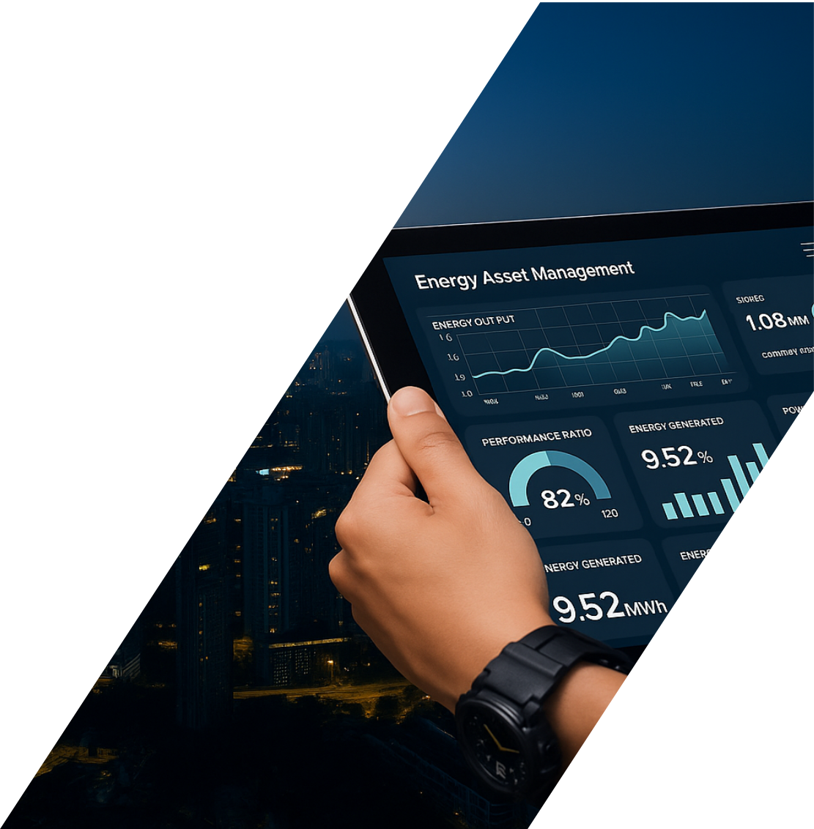

Energy Scenario Scan
6AM NV
[client] Park [location]
BESS + PV + GenSet +
Grid connection
Date March 16th 2026
© Bluepeak.energy B.V. | Confidential – For intended recipient only.
No liability accepted for use of this document.
Notes:
Could you create a list of icons (as used in slide 23) and send them separately for:

Slide 2
Executive Summary
Please check
3
760 MWH
225 kVa
Reliable
Analysed scenario's
annual consumption supported
peak demand supported
Grid connection
Summary
Bluepeak.energy assessed potential energy system configurations for [client], where the available grid connection is limited to 55 kVA and a previously requested 1.5 MVA connection was rejected due to grid congestion. The objective was to identify a reliable and economically viable solution capable of supporting the site’s expected annual consumption of approximately 760 MWh and winter peak demand of around 225 kVA
Two system configurations combining solar PV, battery storage (BESS), backup generation and the existing grid connection were evaluated. The analysis shows that the configuration with a 100 kVA generator is not adequate, as it cannot reliably cover peak loads and introduces operational risks.
The configuration including a 500 kVA generator combined with a BESS (1 MW / 2.3 MWh) and approximately 1.5 MWp of solar PV provides a technically reliable solution under the current grid constraints.
The 55 kVA grid connection remains the primary system constraint, requiring careful system control and local balancing of generation and demand. Larger PV or BESS configurations would significantly increase CAPEX while providing only limited improvement in local energy utilization
Under the current conditions, Solution 2 represents the most robust and economically balanced configuration, with potential for further optimization if grid feed-in capacity or local energy demand increases.
Notes:
Our findings, conclusions and recommendations

Slide 3
Assignment
Description
Solution 1
Bluepeak.energy has been engaged by 6AM N.V. to assess and advise on a reliable and economically viable energy solution for the logistics development [client] Park [location] (approximately 23,000 m²). The project currently has a limited 55 kVA grid connection, while a previous request for a 1.5 MVA connection was rejected due to grid congestion, with no confirmed timeline for capacity expansion.
The objective of the assignment is to determine how the project can achieve the required power availability of 225 kVA during winter peak demand and support an estimated annual electricity consumption of approximately 760 MWh, despite the grid constraint.
To achieve this, Bluepeak will independently evaluate and compare two proposed system configurations that combine on-site solar PV, battery energy storage (BESS), backup generation and the existing grid connection. The assessment will focus on technical reliability, alignment with Dutch best practices for energy systems in grid-congested areas, and the ability of each solution to meet the required power and consumption parameters.
In addition, Bluepeak will analyze whether an optimized alternative configuration could better match the project’s energy profile (225 kVA peak power and 760 MWh annual consumption).
BESS: 1,000 kW / 3,374 kWh
PV: 1,000 kW / 1,500 kWp
Generator: 100 kVA
Grid connection: 55 kVA
Solution 2
BESS: 1,000 kW / 2,330 kWh
PV: 1,035 kW / 1,449 kWp
Generator: 500 kVA
Grid connection: 55 kVA
Notes:
Asset setup and contextual factors impacting performance and value

Slide 4
Assignment
2 Profiles
For the development and calculation of the different scenarios, Bluepeak received two electricity demand profiles: [X] and [Y]. These profiles were processed and adapted to create representative load profiles suitable for the scenario modelling and system simulations.
[X] profile
Crosswood Profile (scaled to 23,000 m²)
Year consumption: 1,325.6 MWh
Year consumption: 760.0 MWh
Peak demand: 424 kVA*
Peak demand: 477 kVA*
(*) Including 20% overshoot
(*) Including 20% overshoot
Notes:
Asset setup and contextual factors impacting performance and value

Slide 5
Case description
Property
Project name [client] [location]
Location [location], The Netherlands
Est. energy use profile Standard warehouse
Contracted grid capacity
load capacity 55 kW
feed-in capacity 0 kW
Local energy use (load)*
Max. load ~424 kW⁽¹⁾ / ~477 kW⁽²⁾
Local use ~1,326 MWh ⁽¹⁾ / ~760 MWh ⁽²⁾
* Notes:
⁽¹⁾ [X]
⁽²⁾ [Y]
Notes:
Asset setup and contextual factors impacting performance and value

Slide 6
Scenario 1: Solution 1 with [X] profile
Technical installation
Installed capacity PV(DC) 1,500 kWp
Installed capacity PV inverters PV 1,000 kVa
Installed capacity BESS 1,000 kW / 3,374 kWh
Installed capacity generator 100 kVa
Consumption
Total use 1,325 MWh/yr
Est. grid use 289 MWh/yr (21.8%)
Est PV use 526 MWh/yr (39.7%)
Est. BESS use 335 MWh/yr (25.2%)
Est. generator use 176 MWh/yr (13.3%)
Production
Est. production solar PV 1,165 MWh/yr
Est. local use of solar PV 526 MWh/yr (45.2%)
Est stored in BESS 335 MWh/yr (28.7%)
Est. curtailment 304 MWh/yr (26.1%)
Notes:
Asset setup and contextual factors impacting performance and value

Slide 7
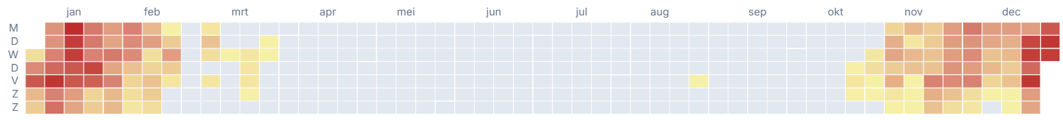
Scenario 1: Solution 1 observations
System capacity sizing criteria
System sizing requirements
To ensure operational reliability and system resilience, the inverter capacity of the BESS and the generator capacity should be designed to handle at least 120% of the anticipated peak load.
This margin is required to:
Accommodate short-duration peak demand spikes
Prevent overloading of critical system components
Maintain voltage and frequency stability
Provide operational flexibility under dynamic load conditions
Mitigate risks associated with degradation and performance losses over time
This requirement is particularly relevant for systems with relatively small grid connections compared to overall consumption and peak load. In such configurations, the available grid capacity provides limited buffering, increasing the importance of sufficient inverter and generator headroom to ensure stable and reliable operation.
Designing system capacity at or below the expected peak load introduces significant operational risk, particularly in systems with fluctuating demand profiles or fast-response requirements.
Accordingly, a minimum sizing criterion of 120% of peak load should be applied as a baseline engineering standard for future system configurations.
This solution does not comply. During the winter months, the system does not provide sufficient energy to reliably meet operational demand. Furthermore, the system experiences energy overload on 129 days per year, with a maximum overload of 110 kW and a total cumulative overload of 57.3 MWh.
The 55 kVA connection has limited capacity. If the rated load is exceeded, the fuses may trip and interrupt the connection. It is therefore important to ensure that the load is evenly distributed across all three phases.
If the 55 kVA connection is operated as a grid-forming source, this introduces additional operational risk. Sudden load steps, phase imbalances, or transient events would need to be accommodated within the limited capacity of the connection.
In the event of a grid outage, the 100 kVA generator does not provide sufficient capacity to cover peak load demand. Consequently, it cannot function as an emergency power supply.
Notes:
Asset setup and contextual factors impacting performance and value

Slide 8
Scenario 2: Solution 1 with [X] profile
Technical installation
Installed capacity PV(DC) 1,499 kWp
Installed capacity PV inverters PV 1,000 kVa
Installed capacity BESS 1,000 kW / 2,330 kWh
Installed capacity generator 500 kVa
Consumption
Total use 1,325 MWh/yr
Est. grid use 247 MWh/yr (18.6%)
Est PV use 535 MWh/yr (40.4%)
Est. BESS use 301 MWh/yr (22.7%)
Est. generator use 242 MWh/yr (18.3%)
Production
Est. production solar PV 1,092 MWh/yr
Est. local use of solar PV 536 MWh/yr (49.5%)
Est stored in BESS 301 MWh/yr (27.8%)
Est. curtailment 245 MWh/yr (22.6%)
Notes:
Asset setup and contextual factors impacting performance and value

Slide 9
Scenario 2: Solution 2 observations
Operational risks
Connection operating concept
The 55 kVA grid connection has limited operational tolerance and may trip if voltage, current, or phase imbalance limits are exceeded. Operating the connection in grid-forming mode increases this risk, as it would be required to absorb load steps, inrush currents, and phase imbalances within a very limited capacity margin.
A more robust configuration is to operate the BESS in grid-forming mode, providing local stabilization of voltage and frequency, while the 55 kVA grid connection remains in grid-following mode and operates within a defined power limit. This approach reduces operational stress on the connection and significantly lowers the risk of fuse tripping.
This solution meets the requirements, as sufficient energy is available during the winter months to reliably meet the operational power requirements.
The 55 kVA connection has limited capacity. If the rated load is exceeded, the fuses may trip and interrupt the connection. It is therefore important to ensure that the load is evenly distributed across all three phases..
If the 55 kVA connection is operated as a grid-forming source, this introduces additional operational risk. Sudden load steps, phase imbalances, or transient events would need to be accommodated within the limited capacity of the connection.
In the event of a grid outage, the 500 kVA generator is capable of accommodating the peak load demand and can therefore function as an emergency power supply.
Note: EMS settings are essential for determining how an energy system will respond. Bluepeak has only checked whether sufficient energy is available during the different seasons.
Notes:
Asset setup and contextual factors impacting performance and value

Slide 10
Scenario 3: Solution 2 with [Y] profile
Technical installation
Installed capacity PV(DC) 1,499 kWp
Installed capacity PV inverters PV 1,000 kVa
Installed capacity BESS 1,000 kW / 2,330 kWh
Installed capacity generator 500 kVa
Consumption
Total use 760 MWh/yr
Est. grid use 152 MWh/yr (20.0%)
Est PV use 352 MWh/yr (46.3%)
Est. BESS use 227 MWh/yr (29.8%)
Est. generator use 29 MWh/yr (3.8%)
Production
Est. production solar PV 1,092 MWh/yr
Est. local use of solar PV 352 MWh/yr (32.2%)
Est stored in BESS 227 MWh/yr (20.7%)
Est. curtailment 514 MWh/yr (47.0%)
Notes:
Asset setup and contextual factors impacting performance and value

Slide 11
Scenario 3: Solution 2 observations
Operational risks
Connection limitations and operating concept
The 55 kVA grid connection has limited operational tolerance and may trip if voltage, current, or phase imbalance limits are exceeded. Operating this connection in grid-forming mode increases the associated risk, as the connection would need to absorb load steps, inrush currents, and phase imbalances within a very limited capacity margin.
A more robust configuration is to operate the BESS in grid-forming mode, providing local stabilization of voltage and frequency, while the 55 kVA connection remains in grid-following mode and operates within a defined power limit. This approach reduces operational stress on the grid connection and significantly lowers the risk of fuse tripping.
BESS sizing option
For the [Y] consumption profile, a smaller BESS configuration of 500 kVA / 1,000 kWh is technically feasible. In this configuration, generator utilization is expected to increase to approximately 46.2 MWh, while PV curtailment is projected to increase by approximately 5%.
This solution meets the requirements., as sufficient energy is available during the winter months to reliably meet the operational power requirements.
The 55 kVA connection has limited capacity. If the rated load is exceeded, the fuses may trip and interrupt the connection. It is therefore important to ensure that the load is evenly distributed across all three phases.
If the 55 kVA connection is operated as a grid-forming source, this introduces additional operational risk. Sudden load steps, phase imbalances, or transient events would need to be accommodated within the limited capacity of the connection.
In the event of a grid outage, the 500 kVA generator is capable of accommodating the peak load demand and can therefore function as an emergency power supply.
Note: EMS settings are essential for determining how an energy system will respond. Bluepeak has only checked whether sufficient energy is available during the different seasons.
Notes:
Asset setup and contextual factors impacting performance and value

Slide 12
Remarks and appendices
Considerations
Attachments
Additional scenarios with a larger BESS and an expanded solar PV system were briefly evaluated. These options result in substantially higher CAPEX, while providing only limited improvement in the local energy utilization profile.
Energy load profile [X] (.xlsx)
Energy load profile [Y] 2(.xlsx
Further optimization becomes financially viable only if the local consumption profile changes significantly and/or additional grid feed-in capacity becomes available.
We note that, if desired, we can contribute to assessing the value of the locally consumed solar energy and the associated grid capacity utilized. Based on this assessment, it can be explored how this value can be translated into a transparent and workable arrangement or allocation mechanism with the tenant.
The financial performance of the system is highly dependent on the local consumption profile. Changes in operational demand or additional electrified loads could significantly increase on-site utilization of solar generation and improve the overall business case.
The limited grid connection capacity remains a primary design constraint. System operation and component sizing should therefore prioritize local balancing of generation and demand to minimize overload risks and maintain operational stability.
The proposed configuration allows for future optimization if grid conditions change, additional feed-in capacity becomes available, or the site’s energy demand evolves.
Notes:
Asset setup and contextual factors impacting performance and value

Slide 13
Disclaimer
Copyright Notice©
bluepeak.energy B.V. All rights reserved.
This document and its contents are confidential and proprietary to bluepeak.energy B.V. (“Bluepeak”).No part of this document may be reproduced, distributed, transmitted, or disclosed to third parties, in whole or in part, without the prior written consent of Bluepeak, except as required by law or explicitly agreed otherwise.
Disclaimer
This document has been prepared by Bluepeak for informational and advisory purposes only and is based on information made available at the time of preparation. While Bluepeak has exercised reasonable care and professional diligence in the compilation and analysis of the information contained herein, no representation or warranty, express or implied, is made as to the accuracy, completeness, or suitability of the information for any specific purpose.
The analyses, findings, recommendations, and scenarios presented are indicative and should not be construed as legal, financial, tax, or investment advice. Decisions taken based on this document are the sole responsibility of the recipient. Bluepeak shall not be liable for any direct or indirect loss, damage, or expense arising from the use of, or reliance on, this document or its contents.
This document does not constitute a binding offer, commitment, or agreement. Any engagement, implementation, or commercial arrangement shall be subject to separate contractual agreements.

Slide 14
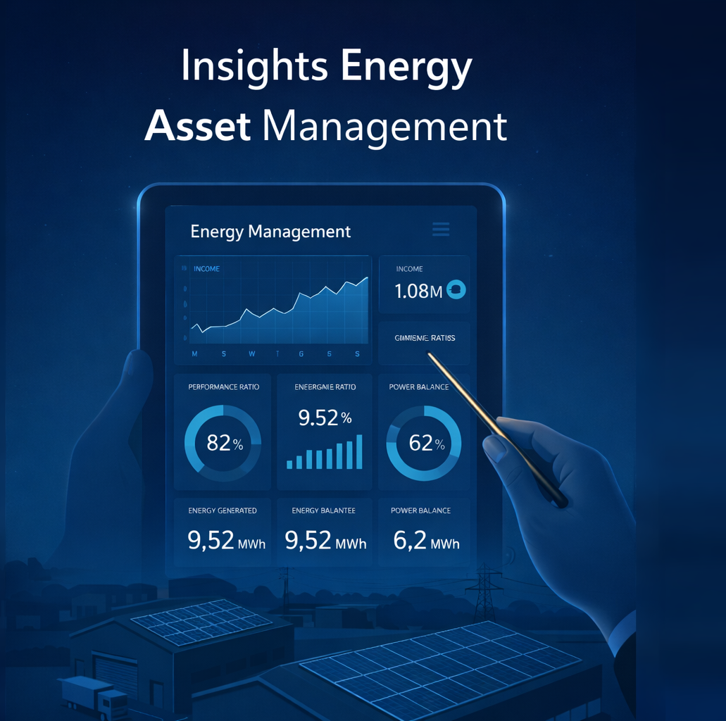

Let’s reshape energy as a business asset by asset
Contact
www.bluepeak.energy
info@bluepeak.energy

