Slide 1
FANTASY FOOTBALL DATA EXPLORATION
BY: David Primrose, Connor Gendron, Courtney zimmer-bartels, rohit mareddy, AND TYler mcafee

Slide 2
Project Introduction
Our project will be a deep dive into an NFL statistics dataset with the goal of gaining deeper insight into fantasy football production by players throughout the history of the league. Fantasy football is where fans ”draft” a roster of players across the league with the goal being to amass the most “fantasy points”.
These points will be the focus of our analysis, there are different formulas for points depending on the format of game that you are playing in but all of them involve some weighting of rushing yards, passing yards, touchdowns from each player on your roster.
In recent years with the federal rollback of sports gambling prohibition, leaving the decision to individual states, there has been a surge in the popularity of weekly fantasy games for money on sites like fanduel and draftkings. With the monetization of fantasy football comes a greater demand for an analytical edge over the competition.

Slide 3
Motivation
As alluded to in the end of the project introduction, the primary motivation for our project is to use historic NFL data to gain a competitive edge in for-money fantasy football competitions.
These formats provide the best opportunity to use analytics because the drafts are constrained by a “salary cap” system, rather than drafting against other players.
This format means that you can pick any roster you want if the combined cost of players is under the salary cap. We believe this format is best because it demands constrained optimization rather than making picks based from who is left available.
There is money to be made in sports gambling but fantasy sports gives you more control over the outcomes if you can use the data to your advantage. We believe our analysis can provide that advantage.

Slide 4
PROBLEM STATEMENT
Use the NFL dataset to develop:
A formula to generate fantasy point predictions for players
Classes and Clusters of NFL players based on the era in which they played
Optimal drafting strategies to generate returns.

Slide 5
DATA DETAILS
NFL-Statistics-Scrape
Here are the basic statistics, career statistics and game logs provided by the NFL on their website (http://www.nfl.com) for all players past and present.
Summary
The data was scraped using a Python code. The code can be located at Github: https://github.com/kendallgillies/NFL-Statistics-Scrape
Explanation of Data
The first main group of statistics is the basic statistics provided for each player. This data is stored in the CSV file titled Basic_Stats.csv along with the player’s name and URL identifier. If available the data pulled for each player is as follows:
Number
Position
Current Team
Height
Weight
Age
Birthday
Birth Place
College Attended
High School Attended
High School Location
Experience
The second main group of statistics gathered for each player are their career statistics. While each player has a main position they play, they will have statistics in other areas; therefore, the career statistics are divided into statistics types. The statistics are then stored in CSV files based on statistic type along with the player name, URL identifier and position (if available). The following are the career statistics types and accompanying CSV file names:
Defensive Statistics – Career_Stats_Defensive.csv
Field Goal Kickers - Career_Stats_Field_Goal_Kickers.csv
Fumbles - Career_Stats_Fumbles.csv
Kick Return - Career_Stats_Kick_Return.csv
Kickoff - Career_Stats_Kickoff.csv
Offensive Line - Career_Stats_Offensive_Line.csv
Passing - Career_Stats_Passing.csv
Punt Return - Career_Stats_Punt_Return.csv
Punting - Career_Stats_Punting.csv
Receiving - Career_Stats_Receiving.csv
Rushing - Career_Stats_Rushing.csv
The final group of statistics is the game logs for each player. The game logs are stored by position and have the player name, URL identifier and position (if available). The following are the game log types and accompanying CSV file names:
Quarterback – Game_Logs_Quarterback.csv
Running back – Game_Logs_Runningback.csv
Wide Receiver and Tight End – Game_Logs_Wide_Receiver_and_Tight_End.csv
Offensive Line – Game_Logs_Offensive_Line.csv
Defensive Lineman – Game_Logs_Defensive_Lineman.csv
Kickers – Game_Logs_Kickers.csv
Punters – Game_Logs_Punters.csv

Slide 6
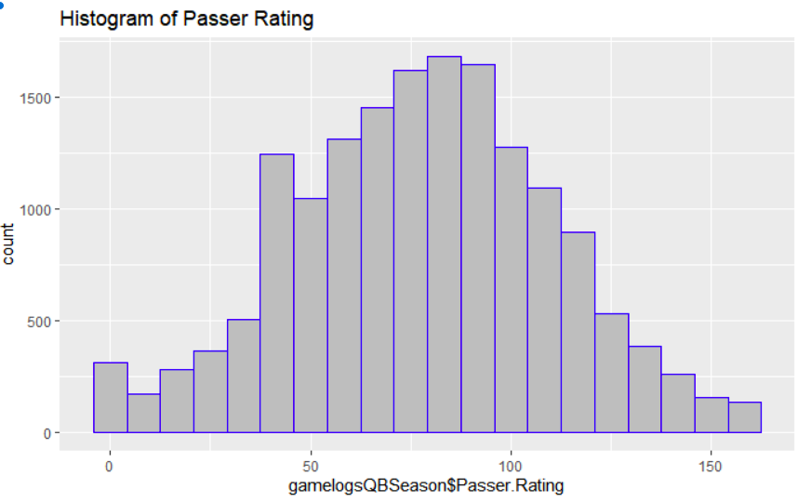
Game logs qb Passer rating
Here we can see that the passer rating pretty closely resembles a normal distribution.
Data clusters towards the middles.
One anomalous spike around a QB passer rating of 40.

Slide 7
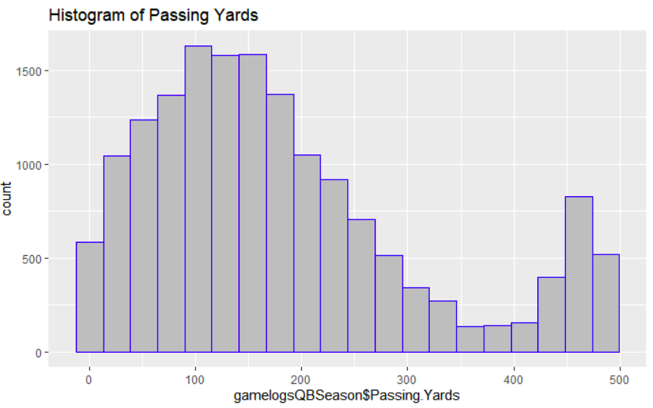
Game logs qb Passing yards
This distribution is heavily skewed to the left.
Games between 300 and 425 yards seem to be the most rare.
There is a big jump in frequency of games with 450-500 passing yards.

Slide 8
Data Preparation
QB Fantasy=(PassYards * .04) + (TD* 6) + (Ints * (-1)) + ((RushYards - SackYards)*.1)
RB/WR/TE Fantasy=(Rec * .5) + (RecYards * .1) + (TDs * 6) + (RushYards * .1)
Cost= 3500 + (326.086957*Fantasy)
After initial review we decided to focus on career stats and game logs for QB’s, Running Backs, Wide Receivers, and Tight Ends.
For simplicity sake we combined game logs for Running Backs, Wide Receivers and Tight ends into one table because they had the same columns.
In order to clean the data we converted the columns to numeric and replaced N/A’s with 0.
From here we were able to calculate Fantasy points for each game log using formulas derived from the FanDuel scoring system.
Using known player costs we were also able to generate a cost prediction formula based on the output from our Fantasy point formula

Slide 9
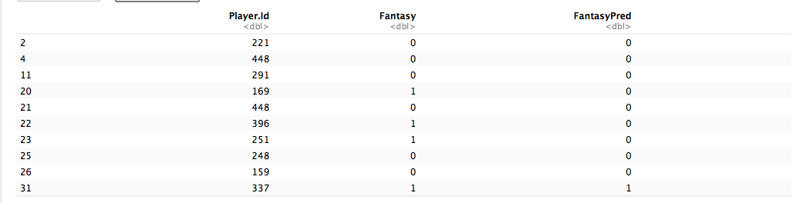

svm
The goal of the SVM was to be able to predict, given historical data, whether a player would score more or less than 15 fantasy points in any given game.
The immense size of the dataset was a huge burden on the SVM process and resulted in subsetting the data into more manageable sizes.
After running the SVM on a subset of the QB game logs and grading by correct predictions over total results arrived at a grade of approximately 55.47%
GRADE:

Slide 10
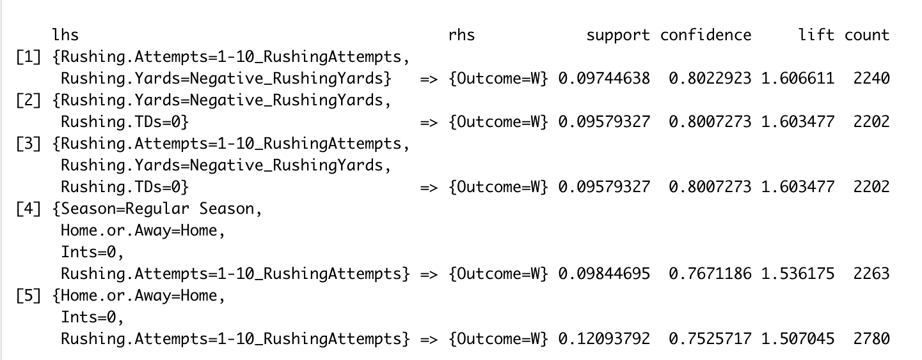
Association Rule mining
The below table is our top 5 rules for the association rule mining done on the game log dataset for
Quarterbacks.
Our goal was to identifying an association between variables in our dataset, such as home/away games,
type of season, interceptions, touchdown passes, passes completed and winning games.
Our top rules for the QB dataset have lift well above 1 and strong confidence suggesting that there is a
good association with the left- and right-hand side of our rules.
Rushing attempts in the range of 1-10 appear in 4/5 of our top rules, suggesting that is a good indicator that the
game will result in a win. Another factor that appears in many of our rules is that
home games are more likely to lead to a winning game than away games.

Slide 11
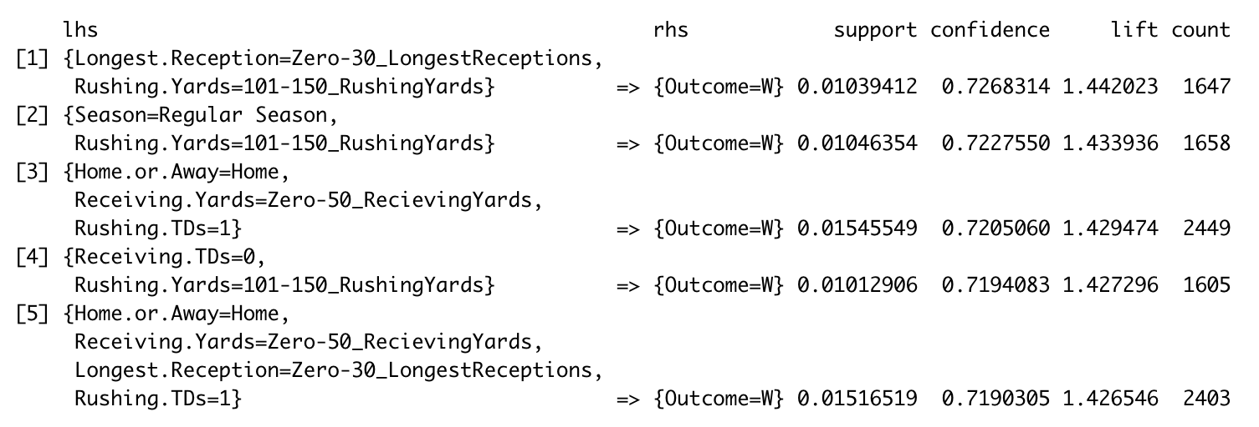
Association Rule mining
The below table is our top 5 rules for the association rule mining done on the game log dataset for Running backs and Wide-Receivers.
Again, our goal was to find an association between variables in this dataset and game outcome = winning.
For our rules we weren’t able to get the same level of lift, confidence and support that we achieved in our QB dataset, but are very happy with the outcome. Our left-hand variables also have much more variation than with our QB ARM rules.

Slide 12
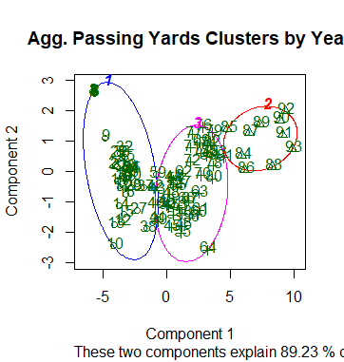
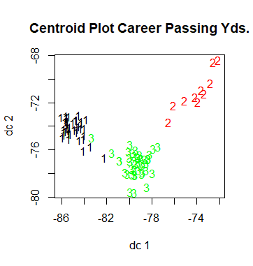
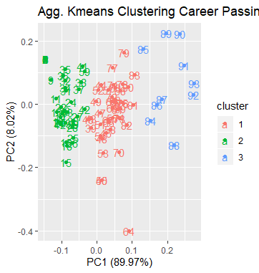
Clustering QB Career Stats

Slide 13
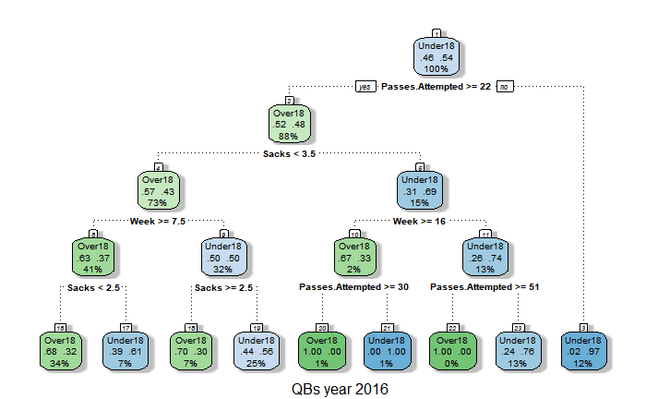
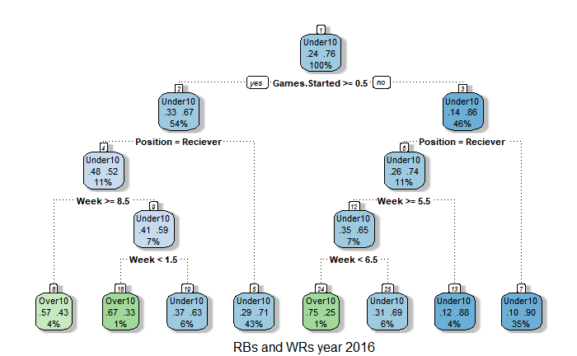
DECISION TREE
In 2016 for a given game, if passes attempted was over 21, sacks was 2 or less, and it was week 8 or further in the season, then there is a 68% chance that a QB will have 18 or more fantasy points. 34% of the original data supported this.
In 2016 for a given game, if a player started the game and was not a receiver (ie was a running back), then there is a 71% percent chance that the running back will score 10 or more fantasy points. 43% of the original data supported this. Also, if the player did not start and was a running back (had at least one attempt), then there is a 90% chance that the running back will score 10 or more fantasy points. 35% of the original data supported this.
**This highlights the fact that running backs are better performers for fantasy teams in general.

Slide 14
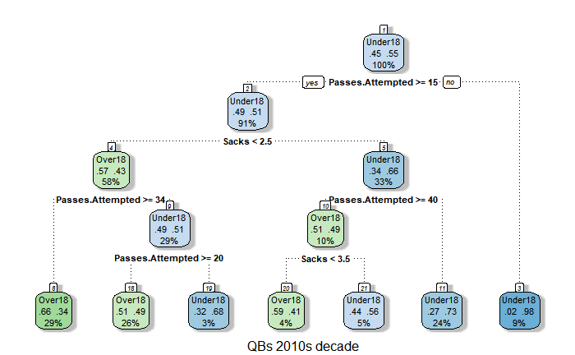
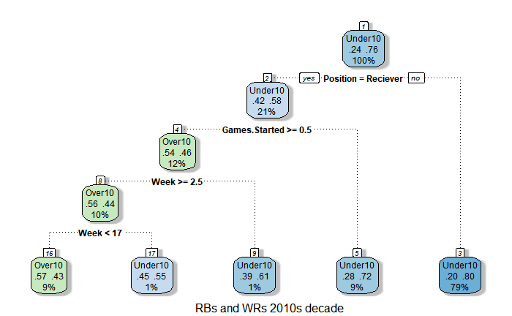
In the 2010 decade, for a given game, if passes attempted was over 33, sacks was 2 or less, then there is a 66% chance that a QB will have 18 or more fantasy points. 29% of the original data supported this. This is a pretty intuitive findings, showing that if defenses are susceptible to pass plays, then a QB will have a good game.
In the 2010 decade, for a given game, if a player was a running back (had more than one rushing attempt), then nothing else is needed to be able to make a decision about fantasy points. There is an 80% chance that the running back will score 10 or more fantasy points.
**This again highlights the fact that running backs are better performers for fantasy teams throughout the years 2010-2016. This is because typically there will only be one star running back on a team. But there may be multiple WR targets for the QB to disperse passes too (running back may even be included in these).

Slide 15
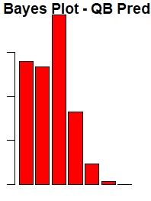
Naïve bayes
Density QB’s
Fantasy Point Bins
-50 0 10 20 30 40 50

Slide 16
Naïve Bayes-QB
Accuracy is 66.4% certainly not super high but decent.
The p-value is significant
Across all 10 folds (and subsequent graphs) there were significant variations in the location of bin Fantasy Points.
Ultimately the bin for Fantasy 10 points remained the highest and most dense of there ranges. Bin -50 was
second highest.
Clearly the prediction that given the QB_Test set most QBs will be in the Fantasy point range of 0-10.

Slide 17
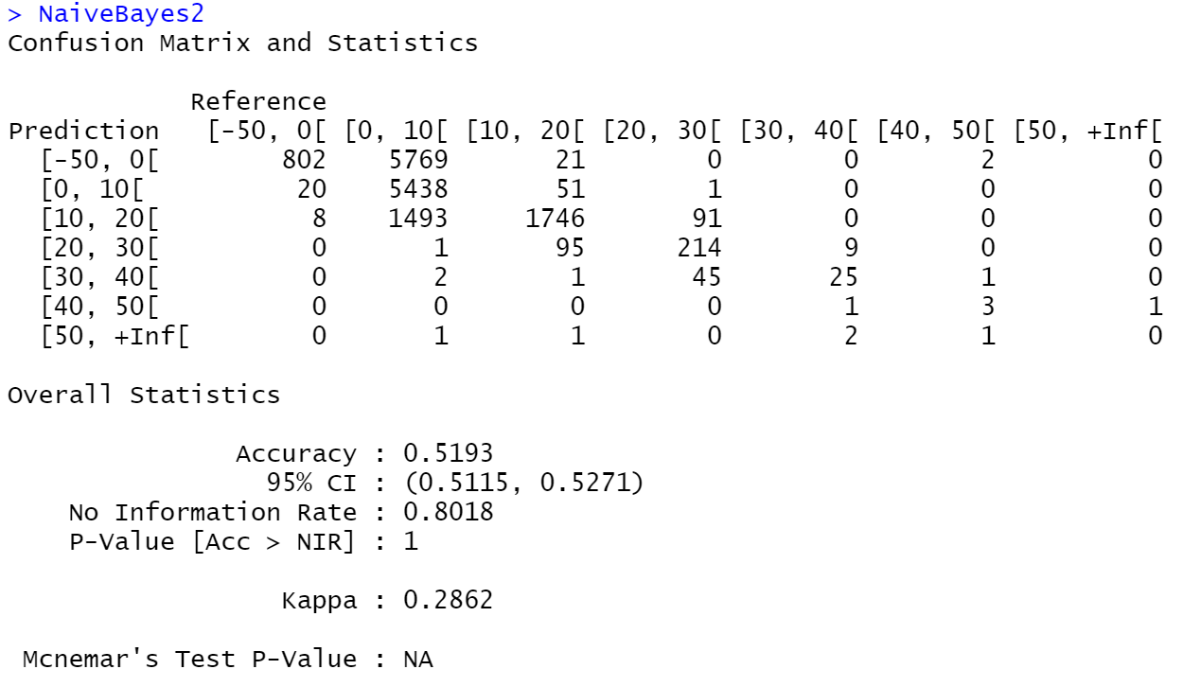
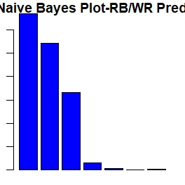
Naïve bayes
Density RB/WR’s
Fantasy Point Bins
-50 0 10 20 30 40 50

Slide 18
Naïve Bayes-RB/WR
Accuracy is a low 51.9% and remained constant over the 10 folds. This would need refinement.
The p-value is NOT significant. Therefore we need to recalibrate the mashup of the RB, TE, WR stats
Across all 10 folds (and subsequent graphs) there minor variations in the location of bin Fantasy Points.
Ultimately the bin for Fantasy -50 points remained the highest and most dense of there ranges. Bin 0 was
second highest.
Clearly an accurate prediction here would be unreliable. Nevertheless I doubt model refinement would
change the outcome. But that is a guess.

