Slide 1

GMSr
Software Management

Slide 2
Core Terminology
SoftwareProduct
SoftwareEntry
SoftwareLicense

Slide 3
SoftwareProduct
Examples of SoftwareProducts:
    Photoshop CS4
    Photoshop CS5
    JRebel Standard 4.0
The following do NOT represent SoftwareProducts:
    UPG from Photoshop CS4 to CS5
    MNT (2 y) for Photoshop CS4
    MNT RNW (1 y) for Photoshop CS4

Slide 4
SoftwareProduct
So in a way a software product is ‘independent’
    (A UPG or MNT are NOT independent → e.g. when you buy a UPG for PhotoShop CS4 to PhotoShop CS5 and you did not already bought PhotoShop CS4 then the UPG is useless. The same is true for an MNT for PhotoShop CS4)

Slide 5
SoftwareProduct
The list of software products says NOTHING about what we have purchased and what not.
In theory this list could contain all software products in the world.
The list of software products is just a catalog that we can refer to when we are adding licenses.
The more complete this list is → the more convenient it is when we are adding licenses.

Slide 6
SoftwareProduct
Properties:
    Name
    Version
    Company
    Other Info
    Status
        Operational (Evaluation)
        Operational
        Not-Operational (Phase-Out)
        Not-Operational (Decommissioned)
        N/A
    Comment
    (Detected Product)

Slide 7
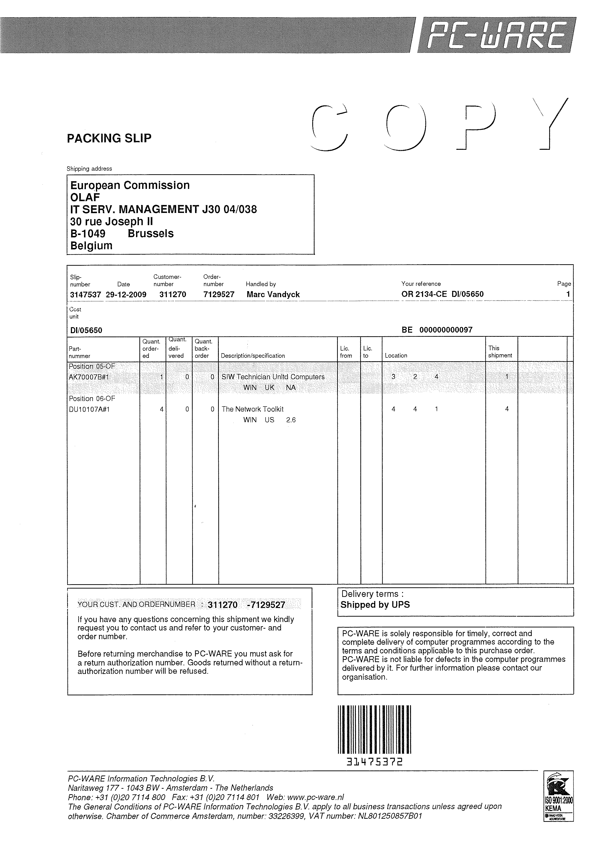
Order
SoftwareEntry
Type: License(s)
SoftwareEntry
Type: Maintenance
SoftwareEntry
Type:License(s)

Slide 8
SoftwareEntry
What and How acquired:
- The entries represent what softwareproducts we have acquired.
- But more importantly they also say how we have acquired them.

Slide 9
SoftwareEntry
Example:
Let’s assume the following:
We apparently have 6 licenses for PhotoShop CS5.
2 of them have a maintenance of 2 years and the other 4 a maintenance of 1 year.
How did we acquire this stuff?
- pack of 4 and pack of 2?
- was the maintenance included or did we order it seperately at a later date?
- did we order a maintenance of 2 years? Or was it 1 year + a renewal of 1 year?
- which ones are upgrades from PhotoShop CS4?
- what orders are involved here?

Slide 10
SoftwareEntry
Three types of entries:
    License(s)
    Upgrade License(s)
    Maintenance

Slide 11
SoftwareEntry
Properties:
    Type
        License(s)
        Upgrade License(s)
        Maintenance
    Olaf Ref
    Comment

Slide 12
SoftwareLicense
Represents only what we have on the level of the ‘smallest unit’ (=license level)
The assigning is done on the license level.
E.g.: Suppose we bought a pack of 60 licenses of PhotoShop CS4 with MNT(1yr). And a pack of 25 licenses of PhotoShop CS4 without MNT.
  This results in:
    → 3 software entries (2 packs and 1 maintenance)
    → 120 software licenses

Slide 13
SoftwareLicense
Properties:
    Serial No
    Type
        Enterprise License
        Free License
        Multi User License
        Network Dongle License
        Server License
        Single User License
        Volume License
    File
    Comment

Slide 14
Example
Orders
1
2
3
4
5
6
7
8
9
10
SoftwareProducts
SoftwareEntries
SoftwareLicenses

Slide 15
Example
1) Maintenance renewal for one license
2) Maintenance for one license
3) One license (maintenance (2) was included ((2) and (3) point to the same order))
4) Maintenance for five licenses (=pack)
5) Five upgrade licenses (=pack) for five licenses (=pack)
6) One upgrade license for one license
7) One license ((5), (6) and (7) were ordered together)
8) One license that has an upgrade license
9) Five licenses (=pack) that has five upgrade licenses (=pack)
10) One license that does not have an order. E.g.: FireFox

Slide 16
Use Cases
A) Add license(s) for FireFox 3.6
B) Add license(s) for PhotoShop CS4
C) Add maintenance (2y) for (B)
D) Add upgrade license(s) for (B) to PhotoShop CS5
E) Add license(s) for PhotoShop CS5
F) Add maintenance (1y) for (E)
G) Add maintenance renewal (1y) for (F)
H) Add maintenance (1y) for (D) (this is actually a maintenance renewal because it already has a maintenance that it has inherited from PhotoShop CS4)

