Slide 1


Slide 2
Users
Users
User Modifications
Groups
Open Tickets
Resolved & Closed Tickets
Software License Assignments
Hardware Items
Loans

Slide 3
Hardware
Hardware Items
Hardware Item Modifications
Software License Assignments
Detected Software Installations
Detected Software Uninstallations

Slide 4
Software
Core Terminology:
    SoftwareProduct
    SoftwareEntry
    SoftwareLicense

Slide 5
SoftwareProduct
Examples of SoftwareProducts:
    Photoshop CS4
    Photoshop CS5
    JRebel Standard 4.0
The following do NOT represent SoftwareProducts:
    UPG from Photoshop CS4 to CS5
    MNT (2 y) for Photoshop CS4
    MNT RNW (1 y) for Photoshop CS4

Slide 6
SoftwareProduct
So in a way a software product is ‘independent’
    (A UPG or MNT are NOT independent → e.g. when you buy a UPG for PhotoShop CS4 to PhotoShop CS5 and you did not already bought PhotoShop CS4 then the UPG is useless. The same is true for an MNT for PhotoShop CS4)
The list of software products says nothing about what we have purchased and what not.

Slide 7
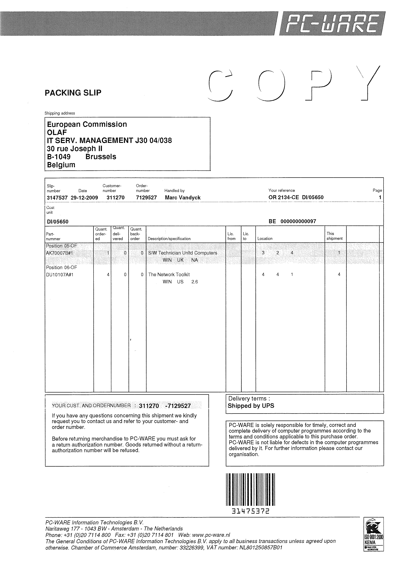
SoftwareEntry
Order
SoftwareEntry
Type: License(s)
SoftwareEntry
Type:License(s)
SoftwareEntry
Type: Maintenance
SoftwareEntry
Type: Upgrade License(s)

Slide 8
SoftwareEntry
The entries tell us how we have acquired the licenses.
  e.g. License pack of 50 licenses
  → 50 licenses
  → 1 entry

Slide 9
SoftwareLicense
Represents only what we have on the level of the ‘smallest unit’ (=license level)
The assignments are done on the license level.
E.g.: Suppose we bought a pack of 60 licenses of PhotoShop CS4 with MNT(1yr). And a pack of 25 licenses of PhotoShop CS4 without MNT.
  This results in:
    → 3 software entries (2 packs and 1 maintenance)
    → 120 software licenses

Slide 10
Reports

Slide 11
GMSr Administration

Slide 12
Contracts

Slide 13
Services

