Slide 1

STAT 503
Final Project Presentation
Group 21
Conclusion
EDA
Improve
Results
Methods
DATA
Xiaohan Qiu
Xiao Wang
Zhijun Cai
Zilu Wang

Slide 2

Key Question
Classification of popular or unpopular news and finding the key factors that affect the popularity of online news
Conclusion
EDA
Improve
Results
Methods
DATA

Slide 3

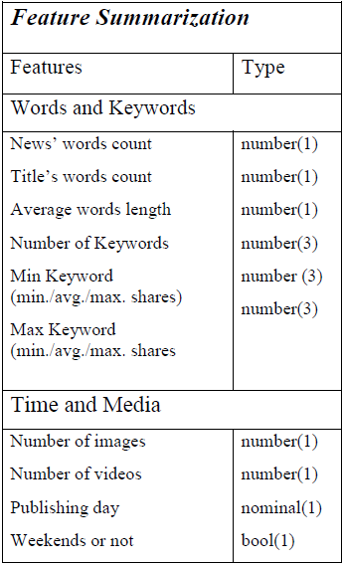
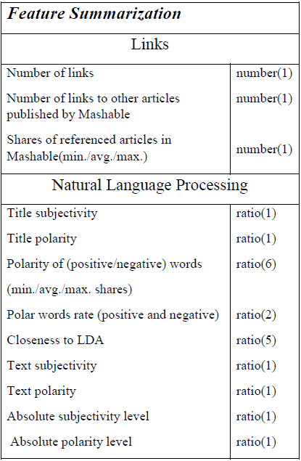
Online News Popularity Data
Size of Data
39644 Observations
61 Variables
Feature Summarization
Conclusion
EDA
Improve
Result
Method
DATA

Slide 4

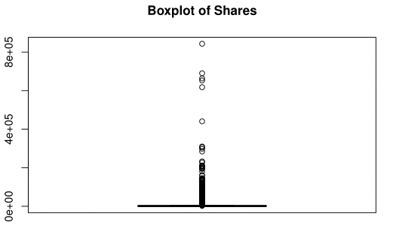
Data Preprocessing
Removing Outliers
Conclusion
EDA
Improve
Result
Method
DATA
Standardize Data

Slide 5

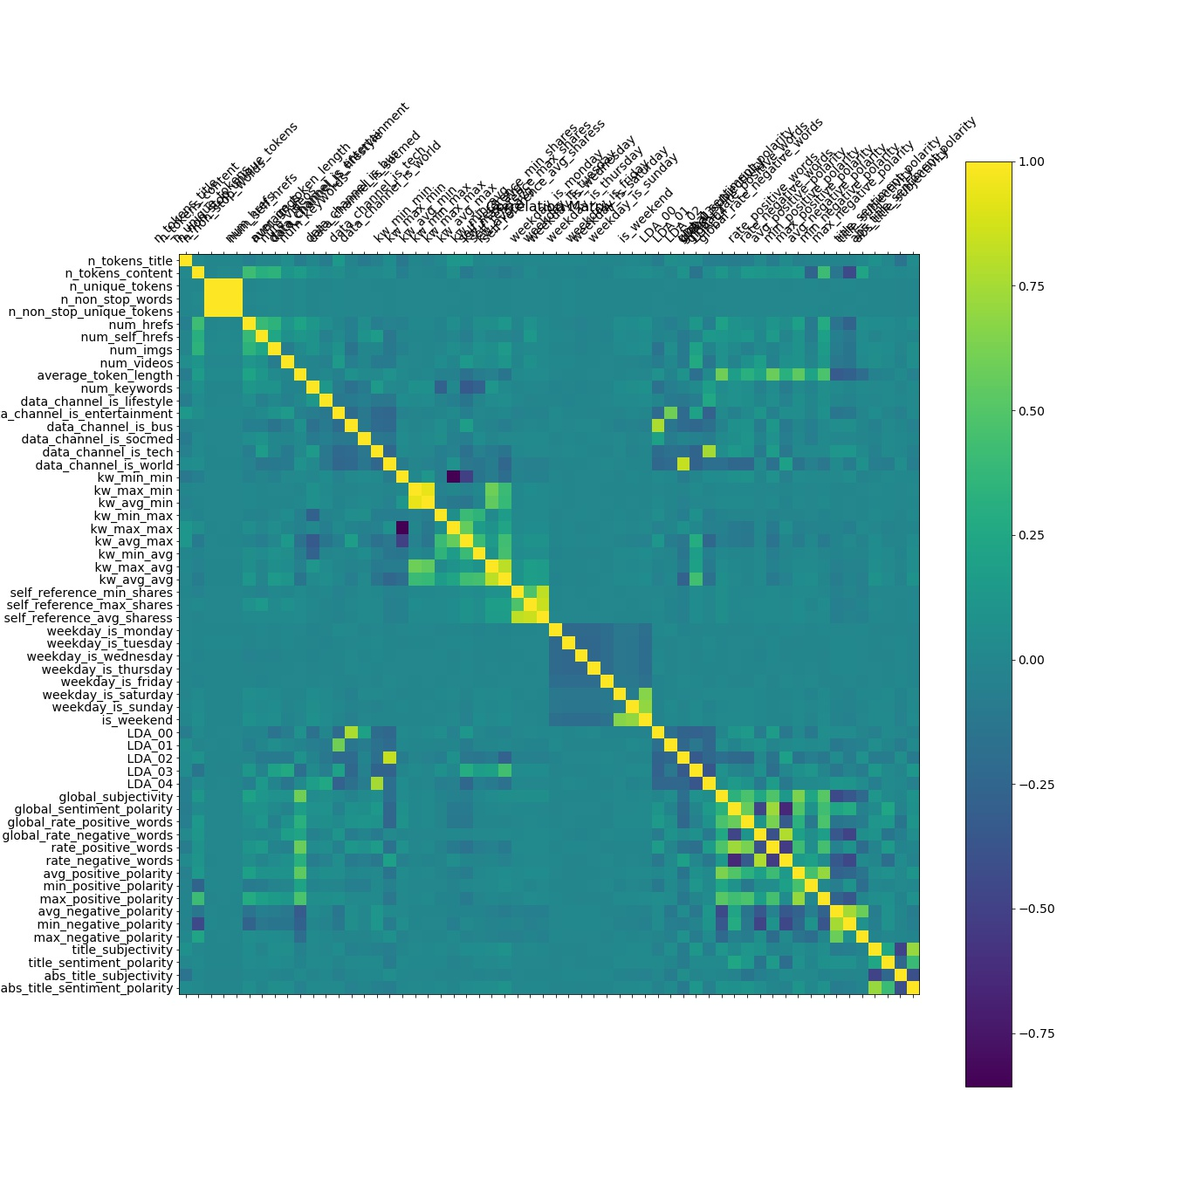
Correlation between variables
Conclusion
EDA
Improve
Result
Method
DATA

Slide 6
Highly Correlated Variables
n_unique_tokens 1.000000
n_non_stop_words 0.999572
n_non_stop_unique_tokens 0.999852
data_channel_is_world 1.000000
LDA_02 0.836618
kw_min_min 1.000000
kw_max_max 0.857226
kw_max_min 0.940529
kw_avg_min 1.000000
kw_max_avg 1.000000
kw_avg_avg 0.811864
self_reference_min_shares 0.818907
self_reference_max_shares 0.853480
self_reference_avg_sharess 1.000000
Word Counts
Topic
Conclusion
EDA
Improve
Result
Method
DATA
Keywords
Shares of reference article

Slide 7
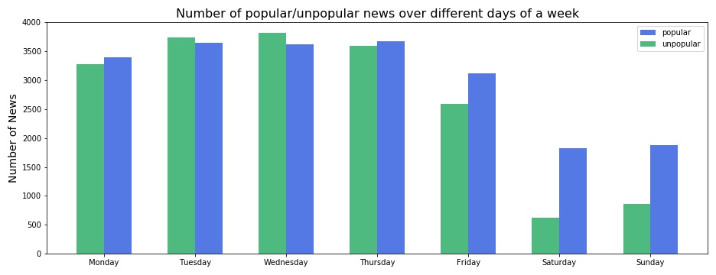
Popularity relates with the posting day
Conclusion
EDA
Improve
Result
Method
DATA

Slide 8
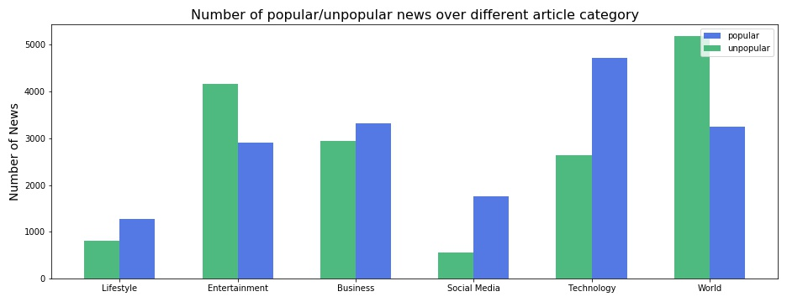
Popularity relates with the data channel
Conclusion
EDA
Improve
Result
Method
DATA

Slide 9

Methods
Logistic Regression
Naïve Bayes
K-Nearest Neighbor (5-Fold Cross Validation)
Random Forest (ntree = 500, mtry = # of variables)
Xtreme Gradient Boosting (Grid Search)
Convolution Neural Network (epoch=20, batch_size=10)
Method
EDA
Improve
Method
Method
Conclusion
DATA
Result

Slide 10
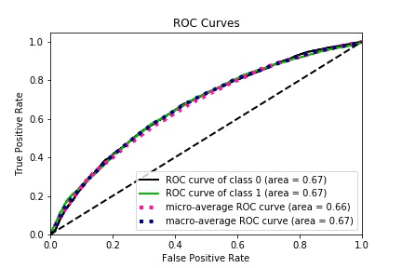
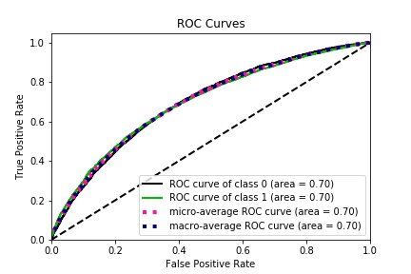
ROC curve of Naive Bayes
ROC curve of Logistic Regression
Method
EDA
Conclusion
Method
Method
Improve
Result
DATA

Slide 11
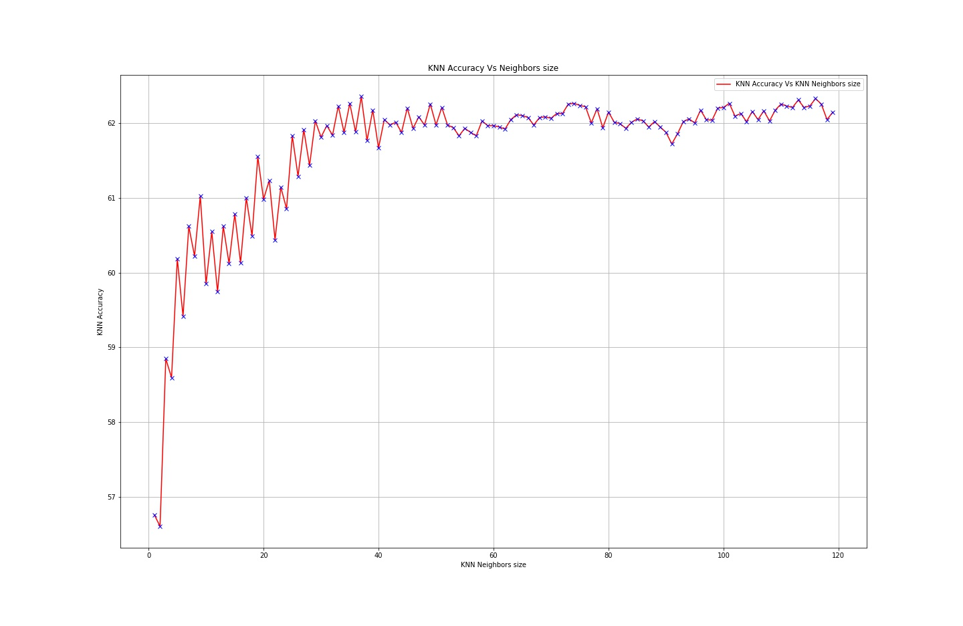
Accuracy with Different K in KNN
ROC curve of KNN
Conclusion
Method
EDA
Improve
Method
Method
DATA
Result
K=36, highest accuracy

Slide 12
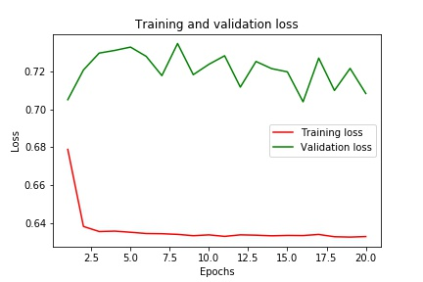
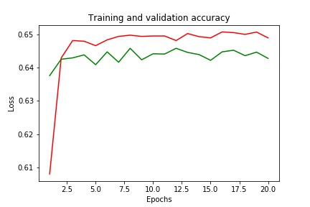
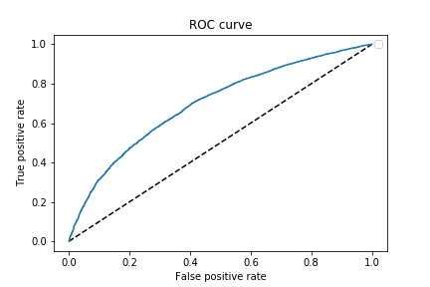
CNN, epoch=20, batch_size=10
Conclusion
Method
EDA
Improve
Method
Method
DATA
Result

Slide 13
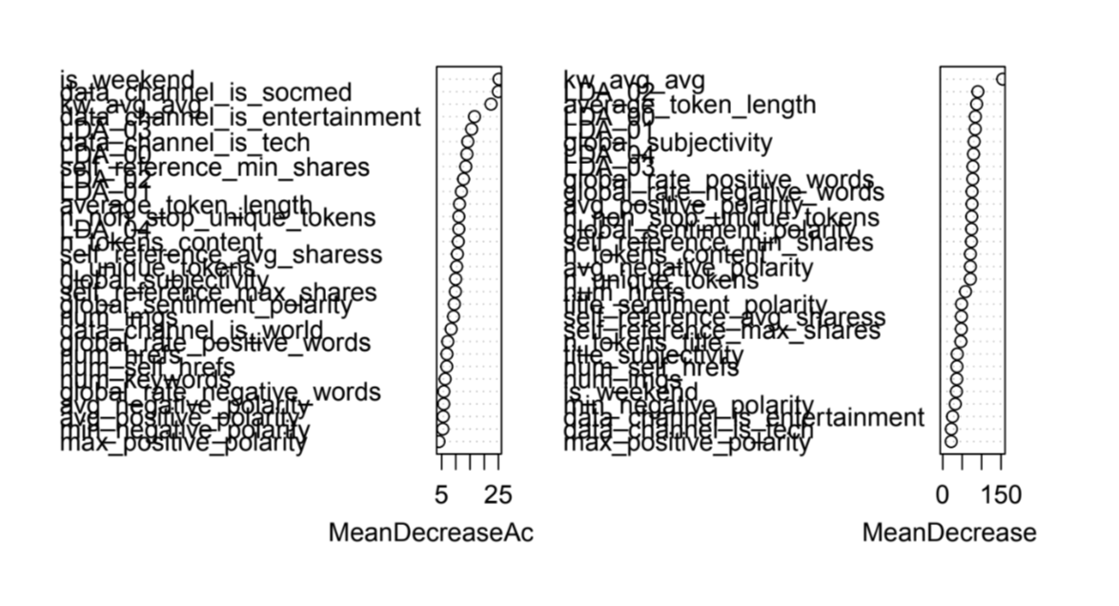
Random Forest
Conclusion
EDA
Improve
Result
Method
DATA

Slide 14
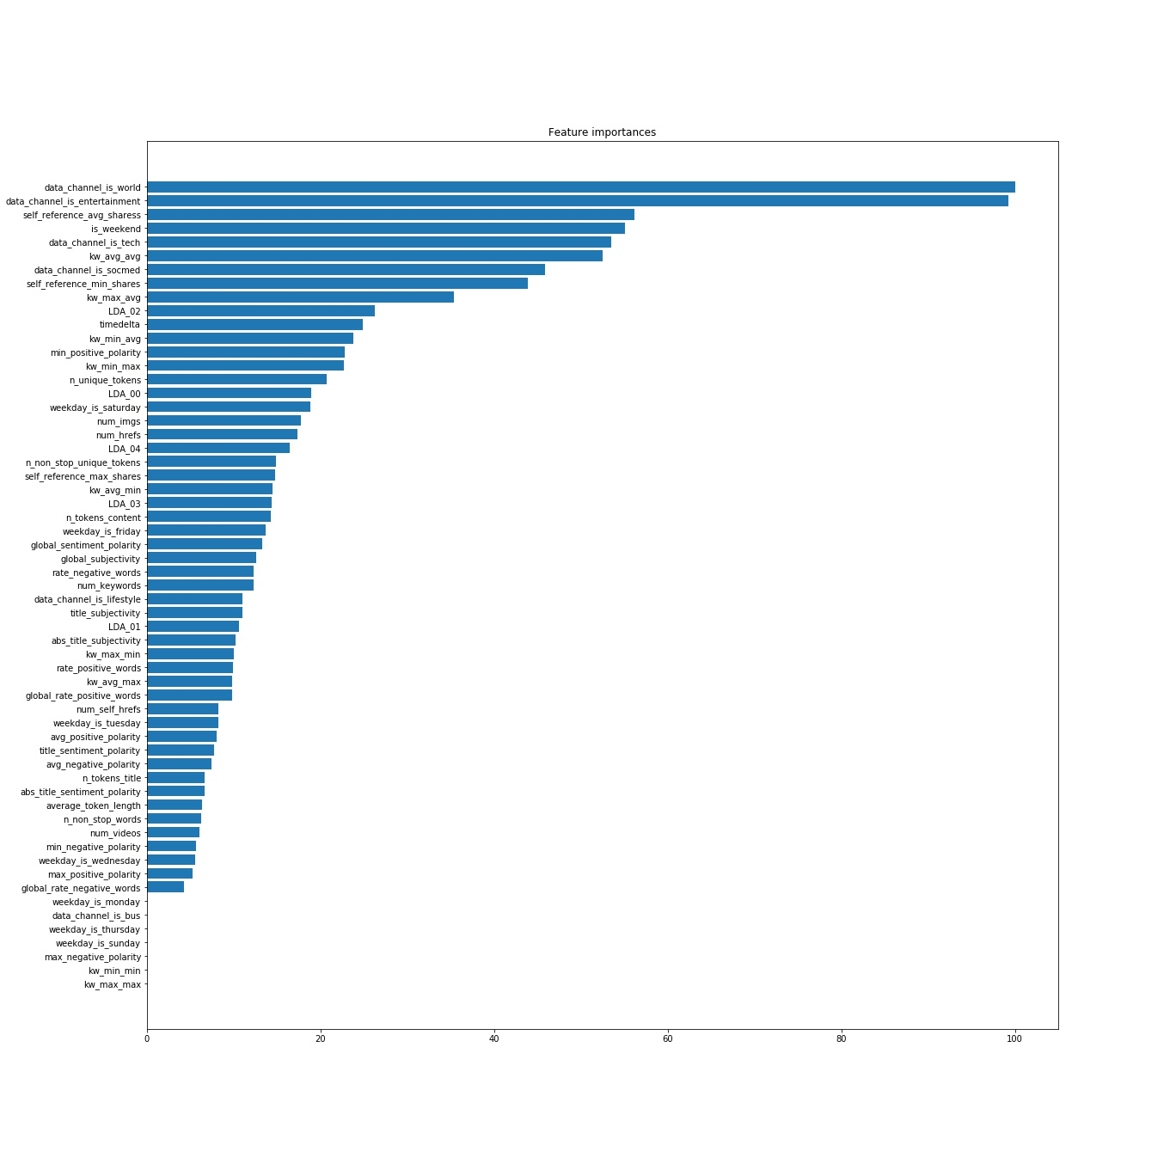
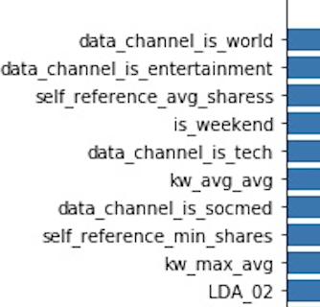
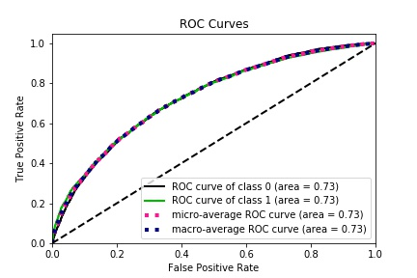
XGBoost feature importance
Conclusion
EDA
Improve
Result
Method
DATA

Slide 15

Evaluation
Model | Accuracy | MSE | AUC
Logistic Regression | 0.644 | 0.356 | 0.70
Naïve Bayes | 0.615 | 0.385 | 0.67
Random Forest | 0.636 | 0.38 | 0.67
Adaboost | 0.618 | 0.39 | 0.6535
XGBoost | 0.667 | 0.33 | 0.73
CNN | 0.645 | 0.221 | 0.697
KNN | 0.618 | 0.381 | 0.67
Conclusion
EDA
Improve
Result
Method
DATA

Slide 16
Methods that we recommend: XGBoost or Convolution Neural Network
Factors that influence the popularity
Improve
Result
EDA
Method
DATA
Different data channel of the news
Posting day
Number of shares of reference article
Number of Keywords
Conclusion

Slide 17
More to investigate on...
What kinds of Channels will have positive effect on the news popularity and what kinds will have negative impact?
What time frame is the best to post the feed to have more shares?
Conclusion
EDA
Improve
Result
Method
DATA

