Slide 1
GraphDB Web App
Clemens Lee, Chris Martin, Taylor Ellis

Slide 2
Project Overview
Using the graph database Neo4j alongside APEX and a RESTful service (written in PHP), we implemented a service to allow users to view and share free events with other users.
url: https://apex.oracle.com/pls/apex/f?p=77063:1

Slide 3
Specifications
Based on a user’s liked categories, events will be recommended to them that contain those tags
Users -
can follow other users, and see events those users are planning to attend
can create new events, which will be visible to all other users
have a dynamically created dashboard that is populated with data from the database
can search within the application for users and events, and view the pages for them

Slide 4
Graph database -- Neo4j
Graph database - everything represented as node or link between nodes
Ability to better represent the complex relationships between nodes.

Slide 5
Database Comparison
Graph - Neo4j
Relationships are built into the database, same quality as nodes
Data remains represented in real-world style
Node labels
Single Node
Node Properties
Queries using Cypher
Relational - Oracle
Implied relationships (through foreign keys, etc.)
Data has to be abstracted to a large degree
Entity Table
Row in the Table
Column in the Table
Queries using SQL

Slide 6
Neo4j Specifics
Neo4j
node-property database
edges AND nodes can have properties
Most Other Graph DBs
RDF database
only nodes have properties, edges are just connections

Slide 7
EVENT
USER1
username
userbio, uid
first, last
like1, like2, like3
attend
follows
USER2

Slide 8
day-num
USER
on_day_num
follow
EVENT1
eid, title
description
time, address, startdate, enddate
month
on_month
tag
tag
on_year
year
on_day_name
day_name

Slide 9
Cypher Example
match (n {username: "pcannata"})-[]->(m)
set n.last = "Cannata"
return n, m
This query finds the node with the username “pcannata,” sets the last property of that node to “Cannata”, then returns that node, as well as all edges and nodes directly connected to it.

Slide 10
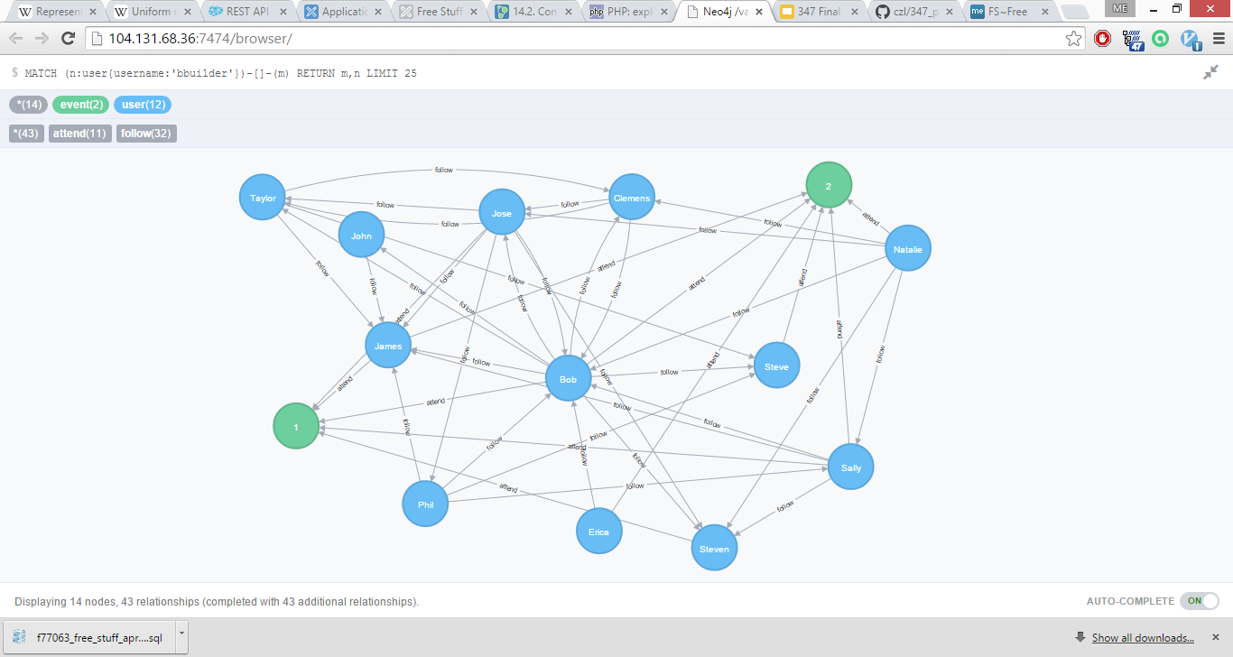
Another Cypher Example

Slide 11
RESTful Service Intro
Representational State Transfer
software architecture style to allow for scalable, distributed, maintainable web system
GET, POST, PUT, DELETE, etc…
web browser communication with server

Slide 12
Our RESTful Service
PHP RESTful service built on top of Neo4j ‘RESTful’
cleaner calls from APEX
cleaner results
conform to RESTful guidelines

Slide 13
RESTful Communication
RESTful Service
server-side
PHP
‘RESTful’ Service
server-side
Cypher
APEX Client
Neo4j graphDB
Results
Results
Results
requests
requests
requests

Slide 14
Web Services Shared Components

Slide 15
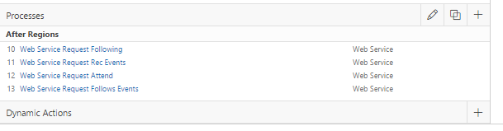
Web Service Processes

Slide 16
Web Service Processes
select title as "Event Title", description, eid
from xmltable (
'/json/row'
passing apex_json.to_xmltype((select clob001 from apex_collections where collection_name = 'P50_DOREST_RESULTS_REC_EVENTS'))
columns
title varchar(255) path '/row/title',
description varchar(4000) path '/row/description',
eid varchar(255) path '/row/eid');

Slide 17
Preview Slides

Slide 18
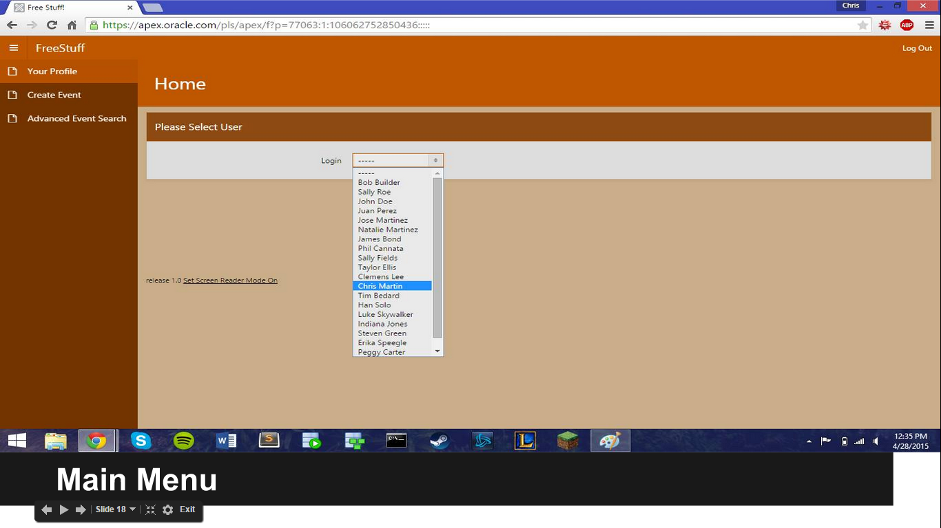
Main Menu

Slide 19
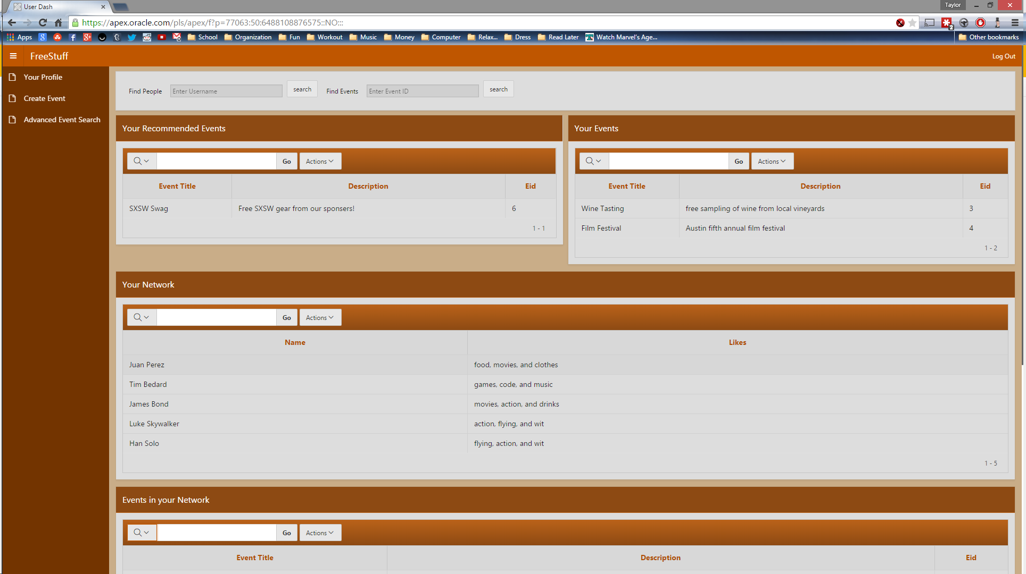
User Dashboard -

Slide 20
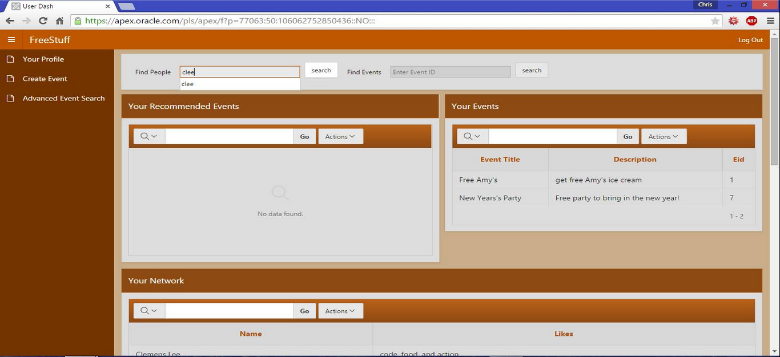
People Search

Slide 21
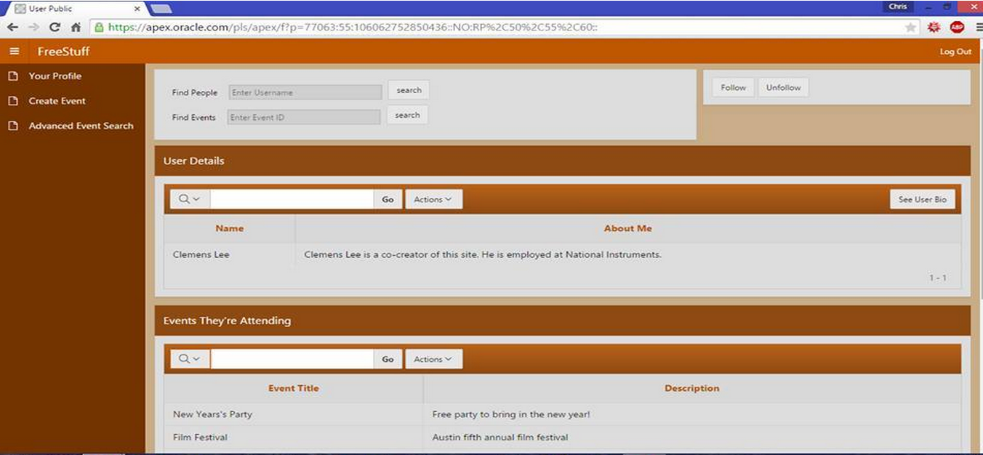
Public Profile

Slide 22
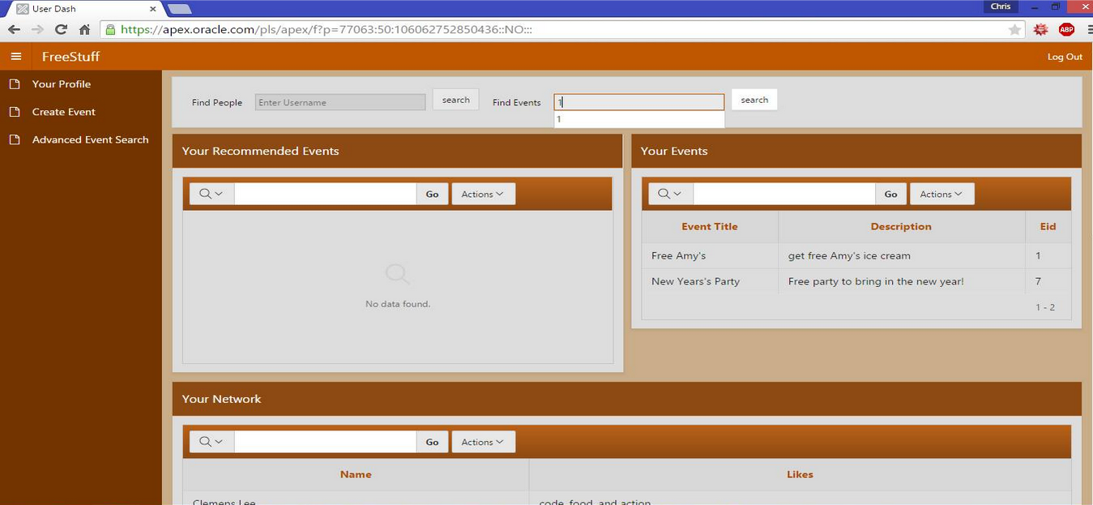
Event Search

Slide 23
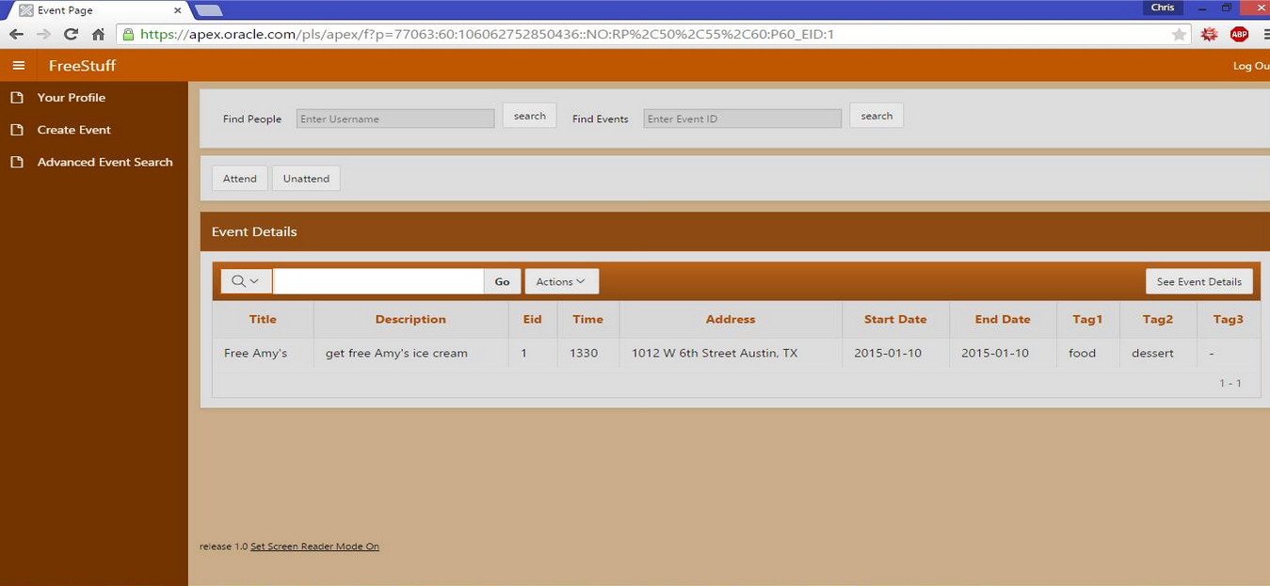
Event Page

Slide 24
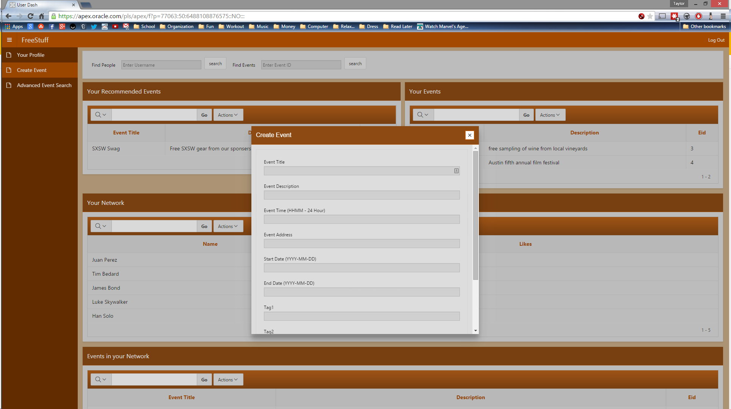
Event Creation

Slide 25
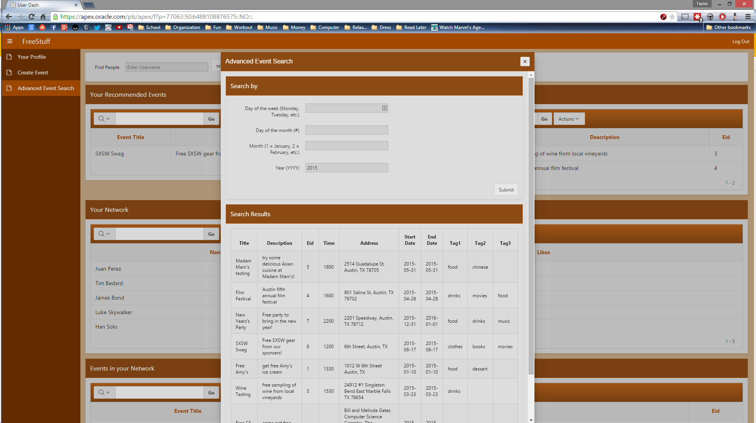
Advanced Searching

Slide 26
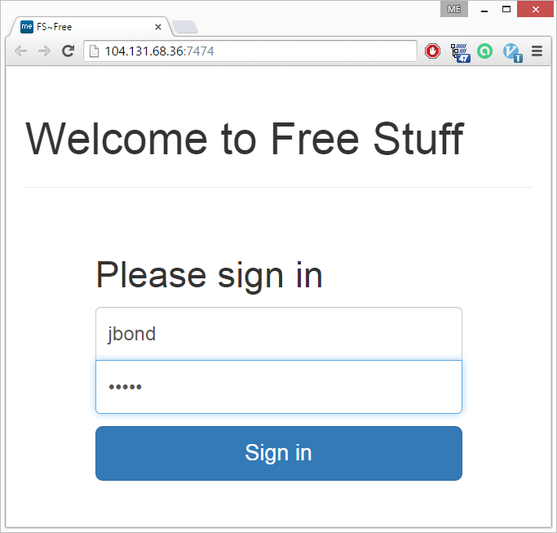
non-APEX login page

Slide 27
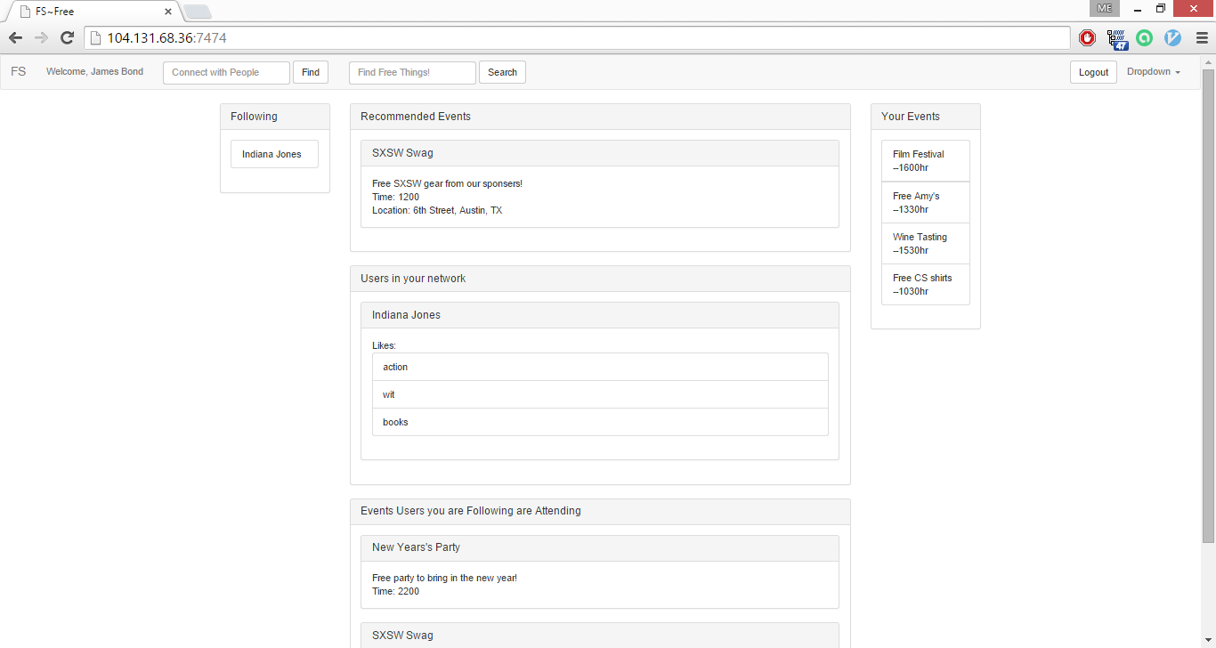
non-APEX user dash

Slide 28
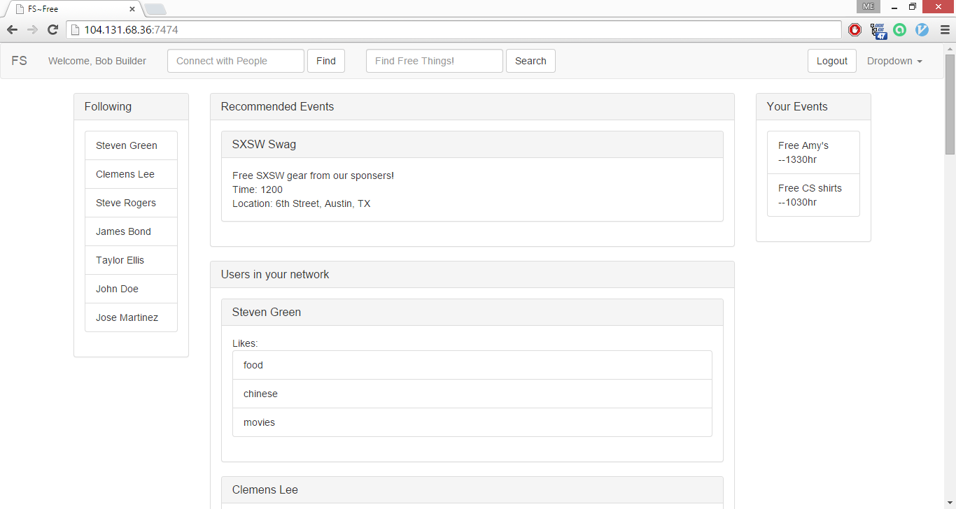
non-APEX user dash

Slide 29
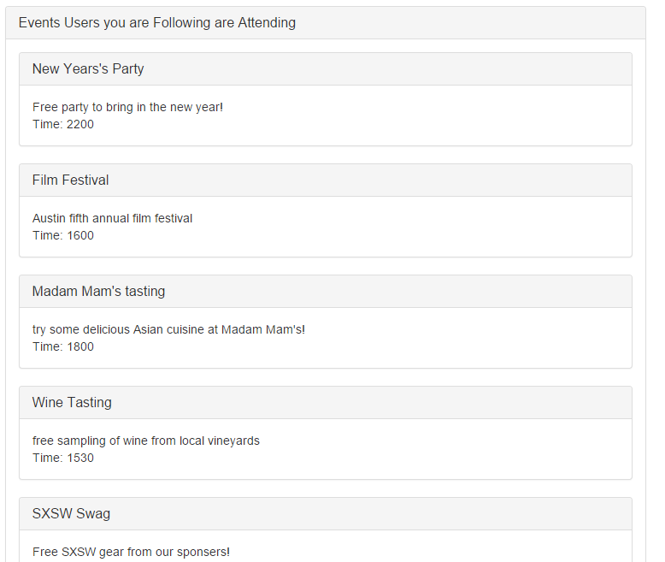
non-APEX Events in your Network

