Slide 1
!done
-
in_valid
counter = 0
!done
Store in_image to raw_pixel
IDLE
PXL_IN
done
counter = 0
Clear hist[0] ~ hist[7]
done
out_valid = 0
DUMP
STAT
!done
out_image = H(·) ∀ hist[i]
!done
Accumulate
done
counter = 0
out_image = H(·) ∀ hist[i]
out_valid = 1

Slide 2
!done
-
in_valid
counter = 0
!done
Store in_image to raw_pixel
IDLE
PXL_IN
done
counter = 0
Clear hist[0] ~ hist[7]
done
out_valid = 0
DUMP
STAT
!done
out_image = H(·) ∀ hist[i]
out_valid = 1
!done
Accumulate
!in_valid
counter = 0

Slide 3
img_in
raw_pixel[7]
…
raw_pixel[0]

Slide 4
raw_pixel[i]
img_in
sel[i]
decoder
3
8
x8
Counter
sel

Slide 5
in_image <= raw_pixel[i]
&
~&hist[i]
x8
+
hist[i]

Slide 6
hist[0]
…
hist[7]
x
/
-
out_image
937
4093
1
(with boundary check)
Hist data
(from hist[7])

Slide 7


[9:0]
x
[19:0]
/
-
[7:0]
[9:0]
[7:0]
$$f$$
937
4093
1
$$max⁡(0, floor\left(×937÷4093−1\right))$$

Slide 8
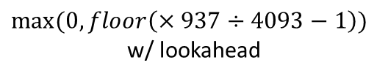


$f$’
[9:0]
[7:0]
$$f$$
$max⁡(0, floor\left(×937÷4093−1\right))$
w/ lookahead

Slide 9
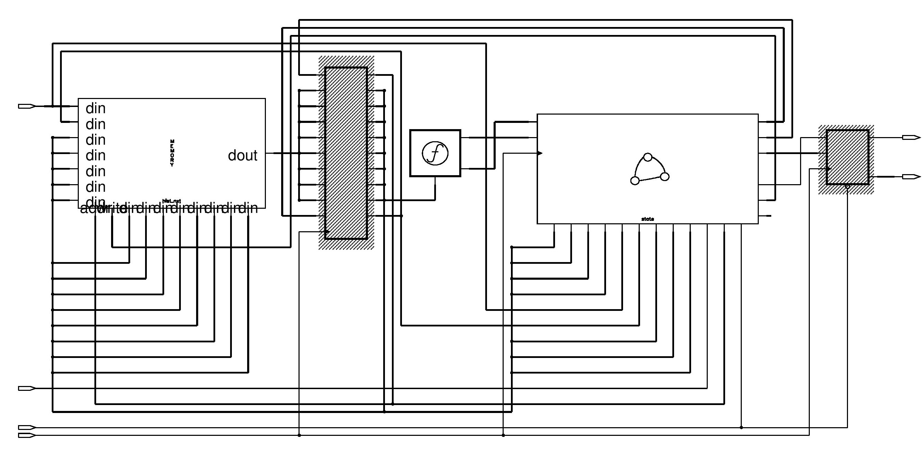
transfer
function
output
register
controller
hist & raw_pixel
hist &
raw_pixel

