Slide 1
Speech Sentiment Analysis System
Team member : LIXINGLIANG ,
CHENZHANGLIN,
YEYA

Slide 2
CONTENTS
1.Introduction
2.Project Execution
3.Risk Plan
4.Project Component
5.Test
6.Conclusion
7.Future Plan
8. Lessons learned

Slide 3
INTRODUCTION
This project takes charge of the server of the translation system and emotion analysis system.
The purpose of the project is to translate speech into text and analyze the text sentiment.

Slide 4
INTRODUCTION
The objectives of the project are listed as follow:
Ensure that speech recognition can be translated into text in 3 seconds.
Ensure that the accuracy of sentiment analysis can reach to 80%.
Ensure that the whole running time can be controlled in 5 seconds.

Slide 5
INTRODUCTION
The objectives of the project are listed as follow:
Ensure that users can understand the design process.
Accomplish project goals and objectives within pre-defined budget and time.
Ensure the final quality of products can be accepted.

Slide 6
INTRODUCTION
How to do it?
The users select and upload audio files to the server through web.
The server receives and processes the audio，reducing the interference of environmental noise.

Slide 7
INTRODUCTION
Continue
The server translates denoised audio into Chinese Pinyin, converts them into corresponding Chinese character text and analyzes the sentiment of text.
The server sends result back to web, which can be separated into ‘positive’, ‘negative’ and ‘neutral’.

Slide 8
INTRODUCTION
Feasible Detection
The speech sentiment analysis system based on artificial intelligence is a challenging issue. So the project is not easy to be realized, but its value is extraordinary, and it has great practical value and market.
The project has a wide range of applications, such as Voice Information Query system, medical diagnosis, on-board system and so on

Slide 9
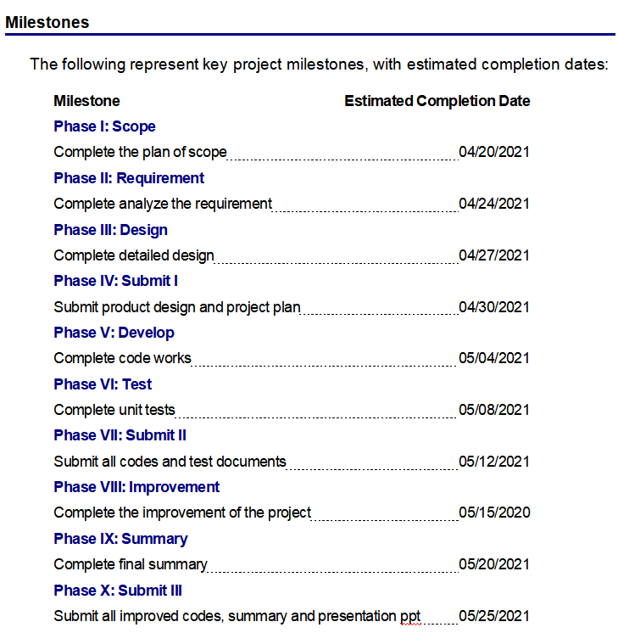
PROJECT EXECUTION

Slide 10
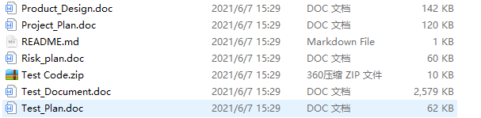
PROJECT EXECUTION

Slide 11
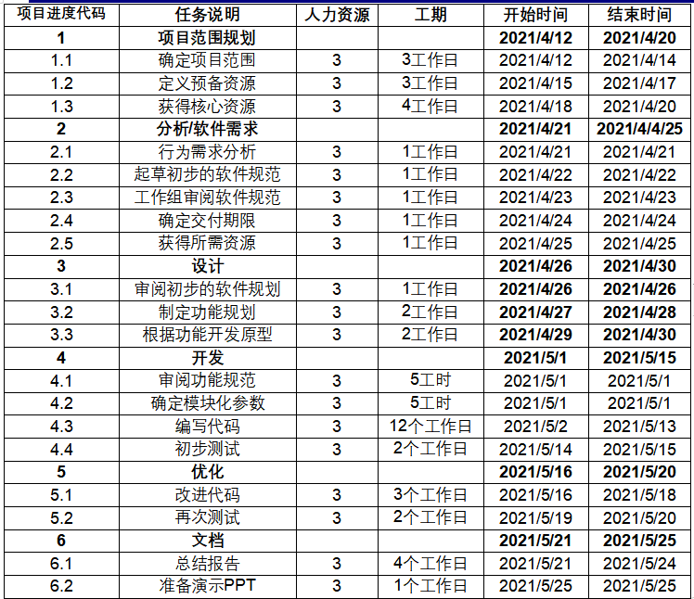
PROJECT EXECUTION

Slide 12
RISK PLAN
 | Risk event | Possi-bility | Influe-nces | The measures which is taken
l | Not enough time for product developing | 60％ | 50％ | Take overtime methods Modify the plan to remove some of the tasks Discuss with customers to extend some time
2 | There is no suitable test case for the demand | 20％ | 20％ | Modular development, each function individually tested
3 | Adoption of new technology may lead to delays in progress | 30％ | 10% | Training developers Looking for experts to guide Take both development and learning methods, require them to master the technology within the specified time
4 | Uncertain need lead to the demand change | 80% | 20% | make an agreement with the other team that if there is somewhere need to be modified, they should first try to apply these changes to their own module.

Slide 13
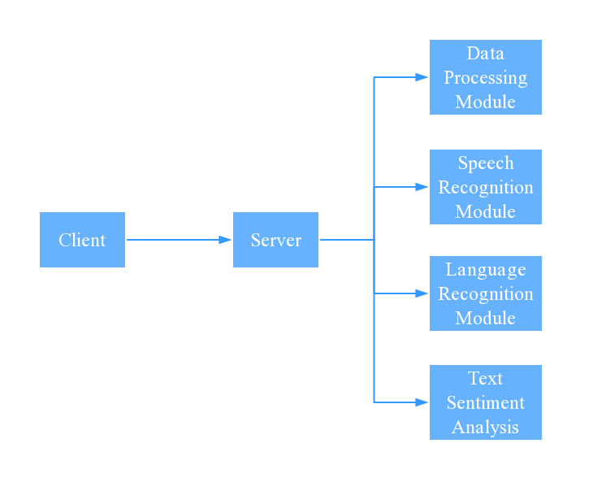
PROJECT COMPONENT

Slide 14
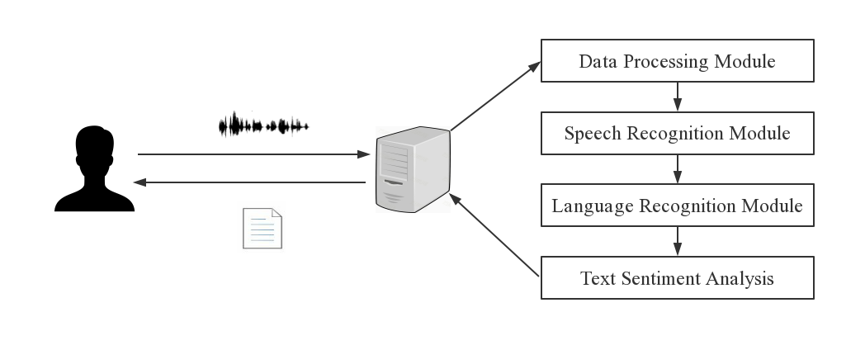
PROJECT COMPONENT

Slide 15
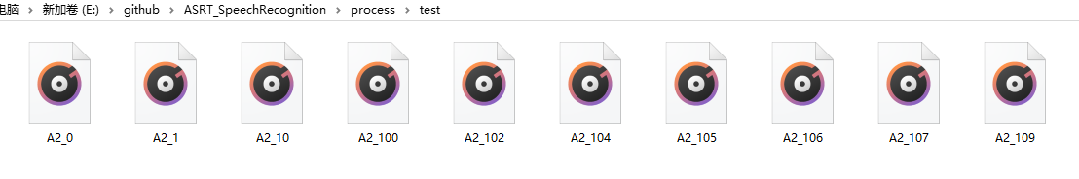
PROJECT COMPONENT-Data Process Module
This module is used for reducing the interference of environmental noise.

Slide 16
PROJECT COMPONENT-Data Process Module
In the processing module, it includes loading the phonetic symbol list and calculating the voice features. By reading the audio file under the test folder, we can get their frame number, channel number, frame rate and other features, and then we can get the final feature data by adding time window and translation to the read voice features.

Slide 17
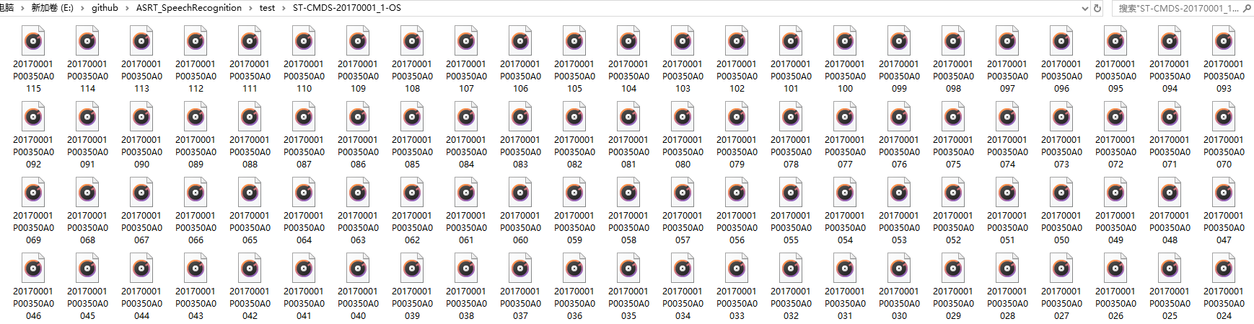
PROJECT COMPONENT - Speech Recognition Module
This module is used to convert audio into Chinese Pinyin for further editing and processing.

Slide 18
PROJECT COMPONENT - Language Recognition Module
This module is used to convert Chinese Pinyin into corresponding Chinese character text.

Slide 19
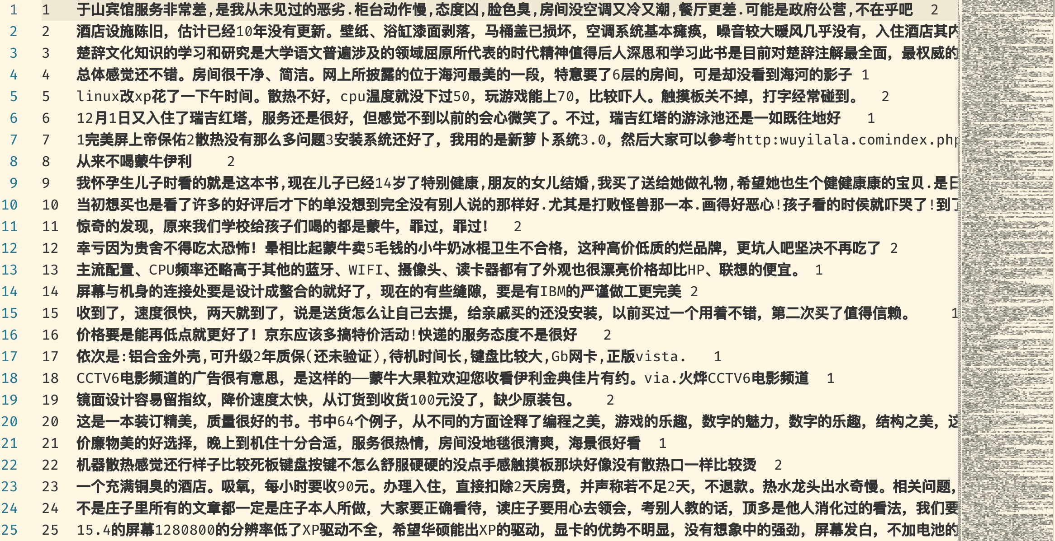
PROJECT COMPONENT - Text Sentiment Analysis Module

Slide 20
PROJECT COMPONENT - Text Sentiment Analysis Module
This module contributes to analyze the sentiment of text converted from speech. The sentiments can be separated into ‘positive’, ‘negative’ and ‘neutral’.
Test cases for text sentiment analysis module can be divided sentiment into three parts: ‘positive’, ‘negative’ and ‘neutral’. By analyzing the scores of three kinds of sentiments, we can give the final classification.

Slide 21
TEST-Test Plan
1. Introduction
1.1 Purpose
1.2 Background
1.3 Scope
2. Test Approach
2.1 Testing Stages
2.2 Testing Types
3. Test Deliverables
4. Environmental Needs
4.1 Hardware
4.2 Software 5. Staffing
5.1 Responsibilities
6. Dependencies/Risks
7. Schedule
8. Approvals

Slide 22
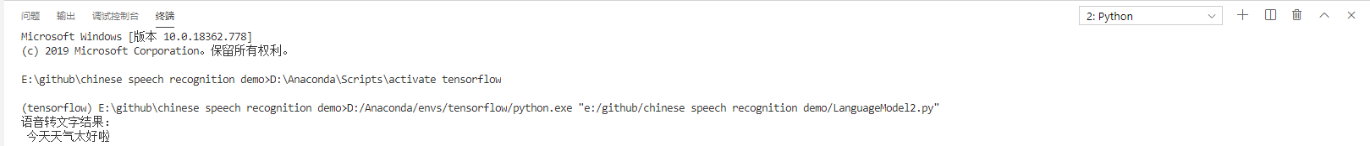
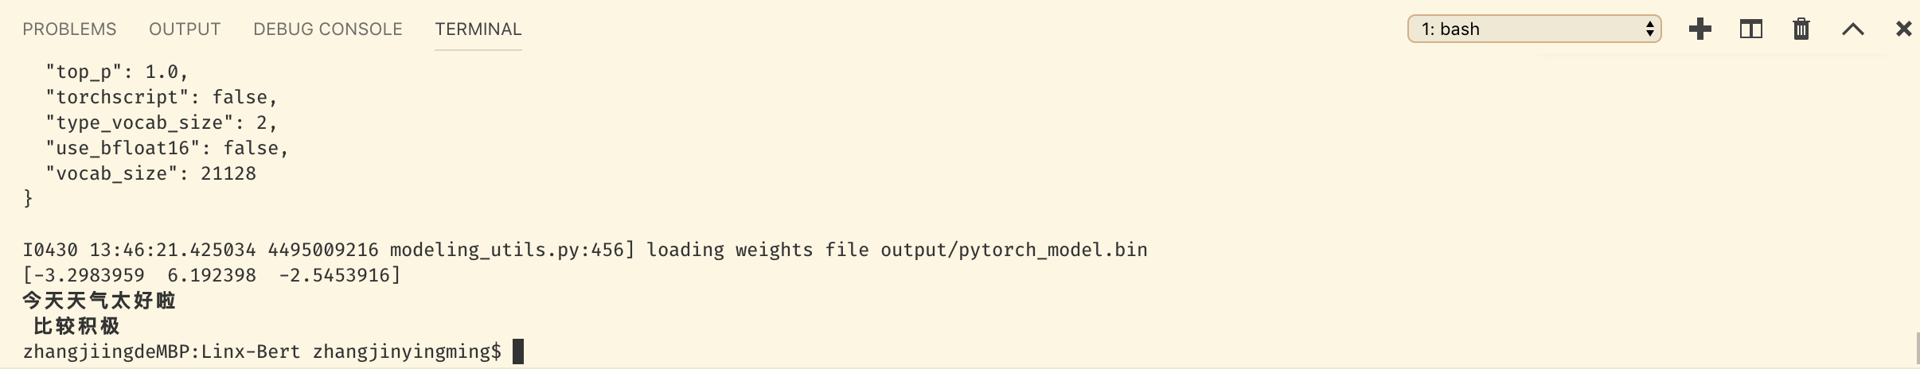
TEST

Slide 23
TEST
Our purpose is to reach 80% on the performance of accuracy of speech recognition, ensure that audio can be uploaded in 2 second , ensure that Chinese Pinyin can be recognized at 90% accuracy ,ensure that Chinese character text can be recognized at 80% accuracy and ensure that text sentiment can be separated into ‘positive’, ‘negative’ and ‘neutral’
According to our test, upload time was less than 2 seconds and the recognize accuracy achieve 92%. Besides the final analysis performance reach 0.35604851901473483 in BLEU score, which is good among the other Speech Sentiment Analysis System.

Slide 24
CONCLUSION
Detailed planning should be done before project development, rather than blind development
We should strengthen the communication of team members so that we can keep abreast of the latest project progress and help to develop the next plan.

Slide 25
FUTURE PLAN
Add features to make it more comprehensive
Add some more user-friendly features, such as screen wording, dictionary enhancements, and translation while providing focus.
More convenient operation
Faster product startup, faster translation, and compatibility with more systems and hardware devices.

Slide 26
FUTURE PLAN
Translation for professional fields
Add vocabulary for different professional fields, such as the professional vocabulary of the port and the professional vocabulary of artificial intelligence, which makes the translation more accurate when applied to professional translation.
Multilingual translation
Increase the types of languages that can be translated to achieve multilingual translation.

Slide 27
Lessons learned
To develop a detailed plan and execute it in strict accordance with the plan
Prioritize tasks
Communication is the foundation of decision making and planning
We should have good psychological quality and resistance to stress.

Slide 28
THANKS!

