Slide 1
Access Group - Individual exercise
Access GTDS
From : May
Classification: Public

Slide 2
Approach 1:
Manual Data Entry

Slide 3
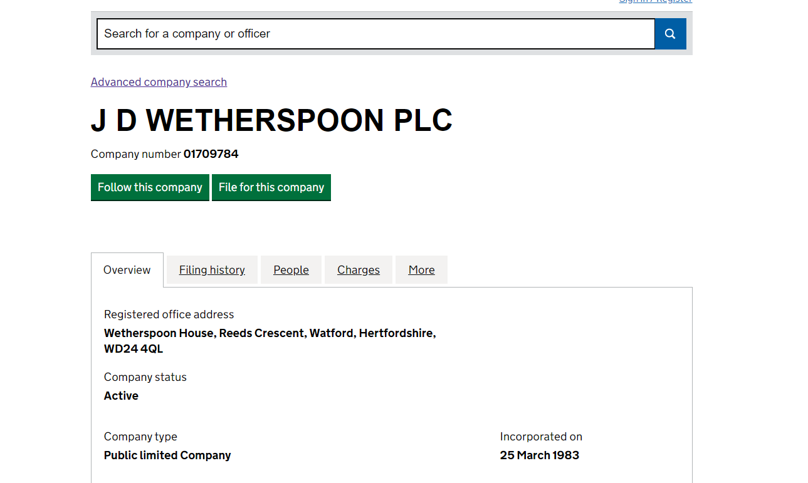
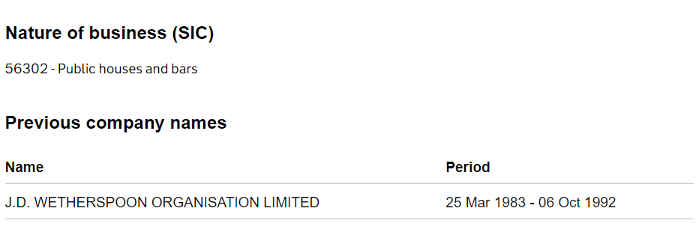
Step 1: Company Look Up
Information captured
Company Number
Company Address
Company Status
Nature of Business

Slide 4
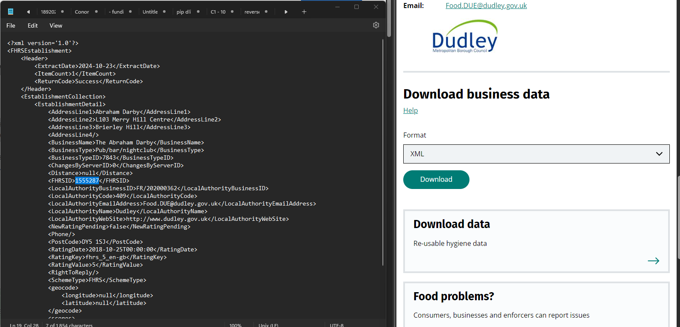
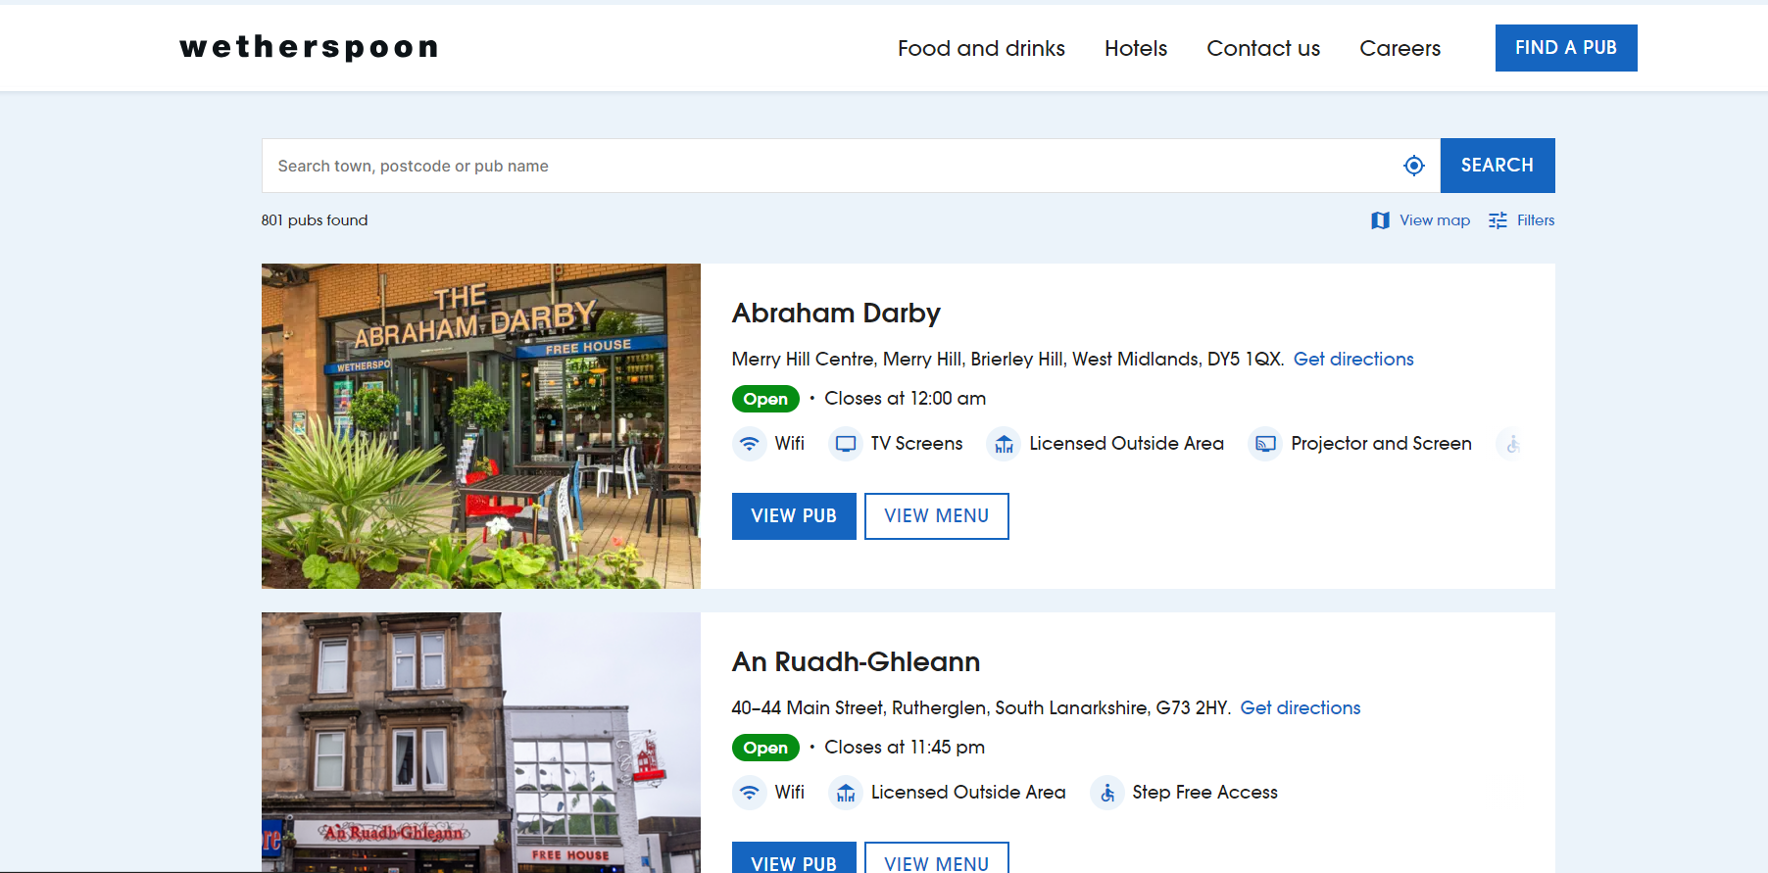
Step 2: Food Standards Agency
Download data in XML/JSON from FSA
Information captured
Business Name
Business Type
Address Line 1
Address Line 2
Address Line 3
Address Line 4
Post Code
Rating Value
Rating Date
FHRS ID
Local Authority Name
Local Authority Email
Local Authority Website
Phone

Slide 5
Step 3: Manual Data Entry
Example of Data Entry of company's information -Business under Wetherspoon

Slide 6
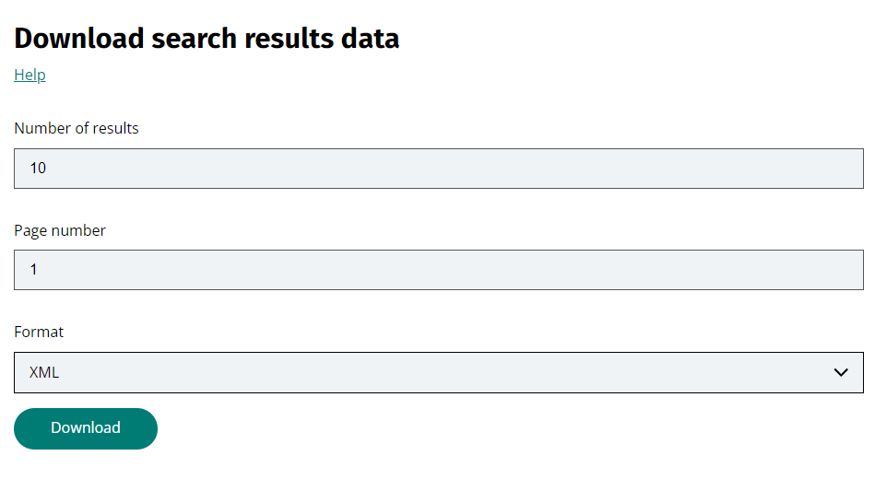
Thought Process of This Approach
Takes some time to populate the data entry to excel within the time frame given
Then I found the xml file on the Food Standard Agency that I could download that might be able to use scripts and automate it.
Hence, I have also tried out the second method

Slide 7
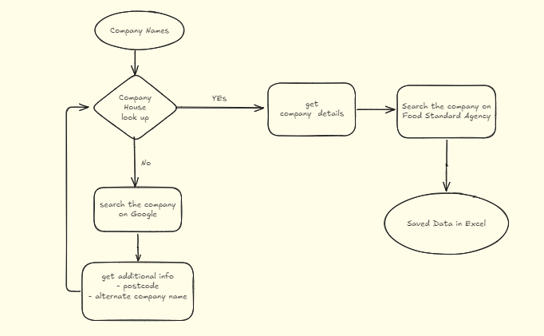
Flowchart

Slide 8
Approach :
Data Entry With Scripts

Slide 9
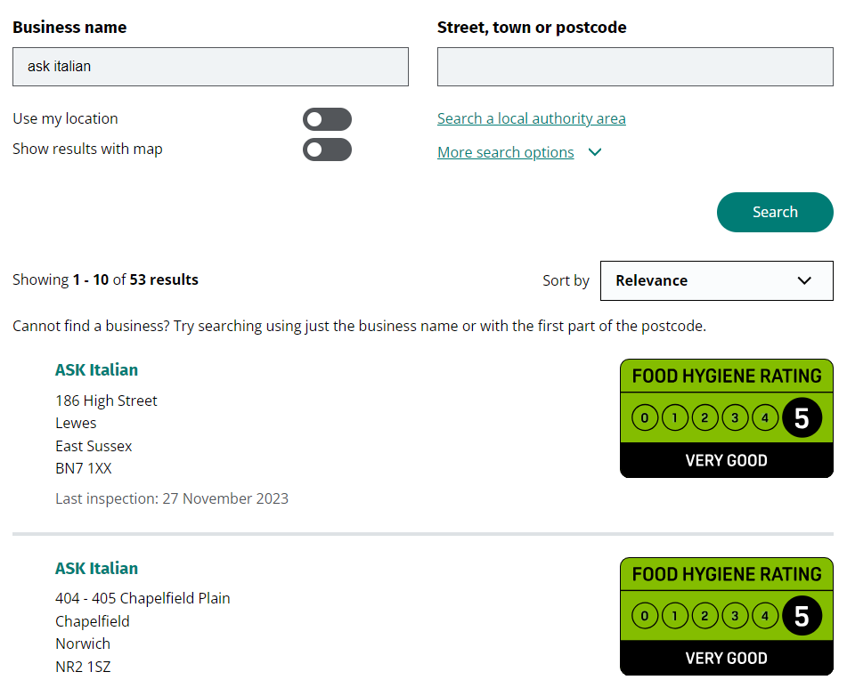
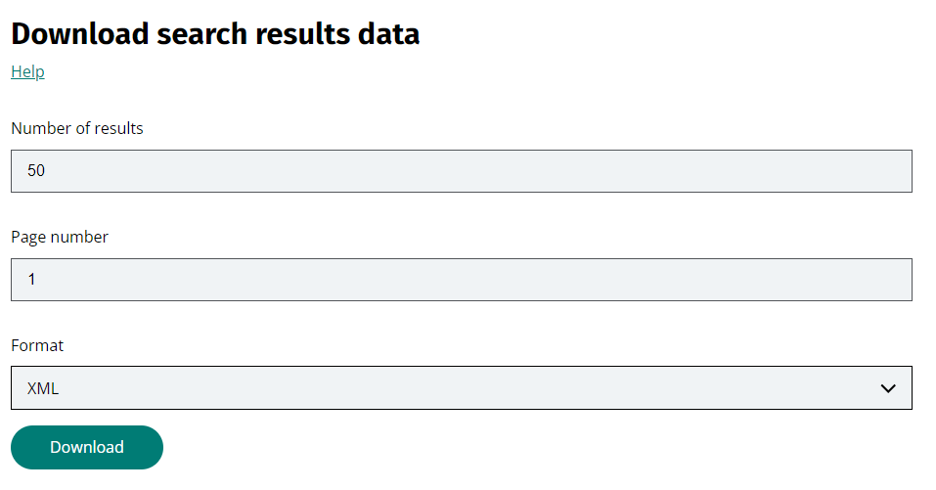
Step 1: Food Standard Agency

Slide 10

Step 2: The ElementTree XML API
Extract the data from the xml file using

Slide 11
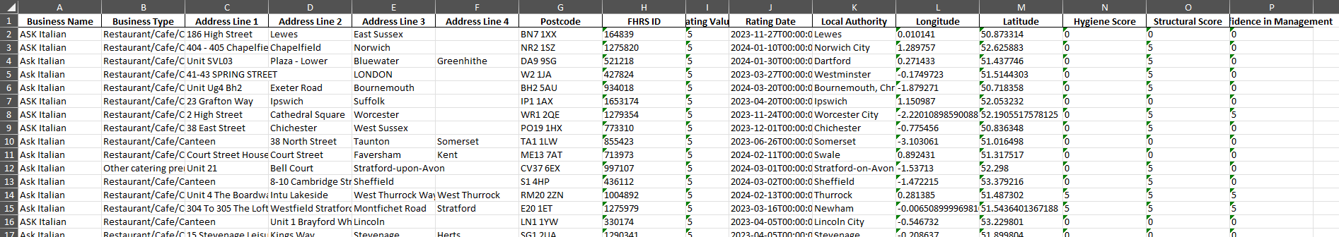
Step 3: Get the results in Excel
Snippet of the data parsed and saved into excel

Slide 12
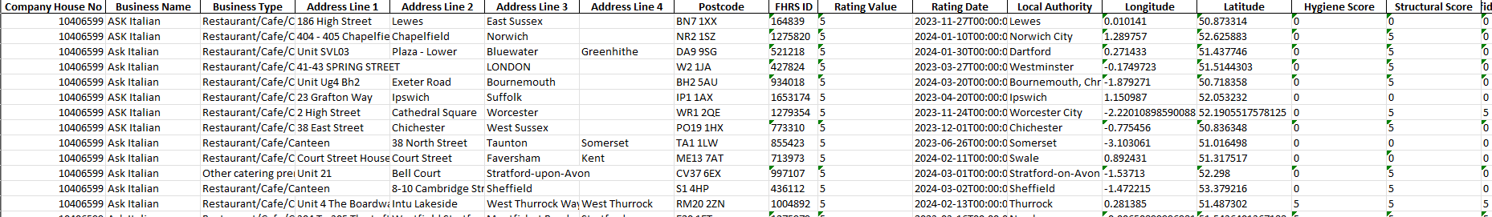
Step 4: Adding company house number
Added a column for Company House Number:

Slide 13
Thought Process of This Approach
This method will get more entries of data from each hospitality company but might miss out on some details
Company House number
Company status
Some details will need to be entered manually. There might be a better way to do it, but given the time frame, this is the best I can come up with.

Slide 14
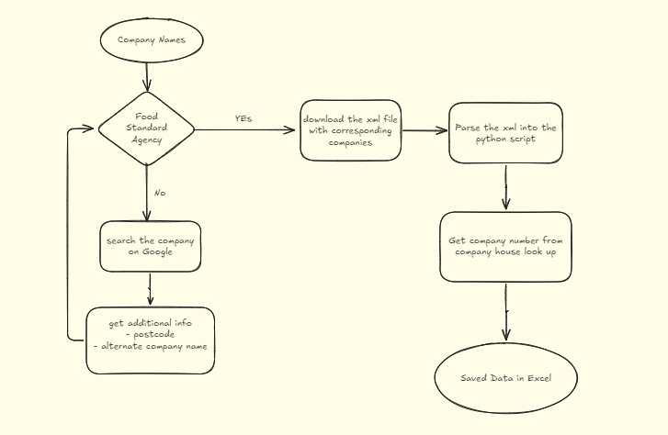
Flowchart

