Slide 1
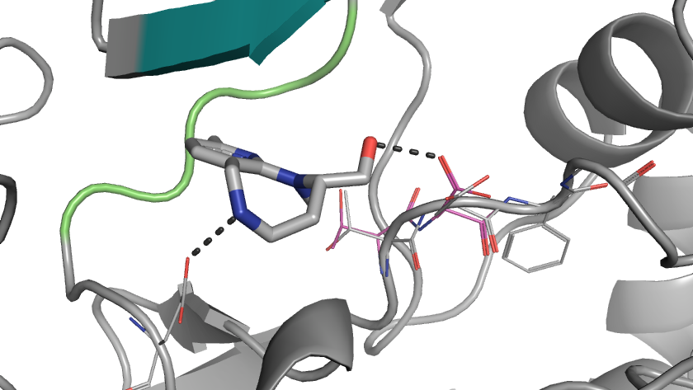
G-Loop
Hinge
FRG274
Asp184
Gly186
Thr183
Glu127
Phe185

Slide 2
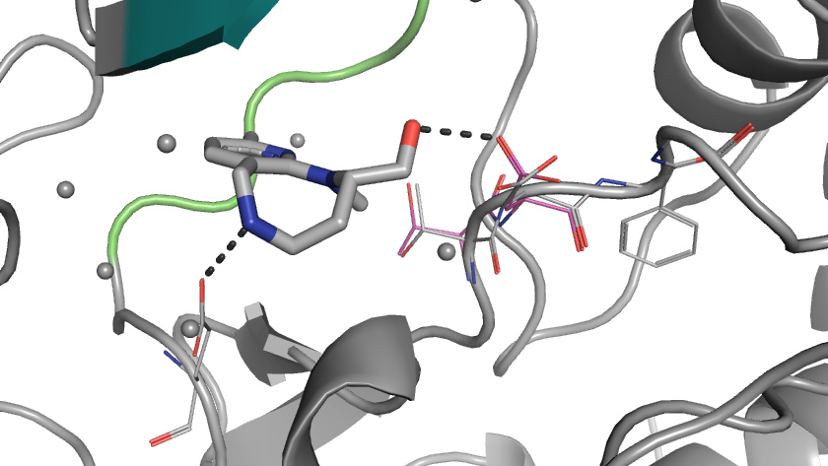
G-Loop
Hinge
FRG274
Asp184
Gly186
Thr183
Phe185
Glu127

Slide 3
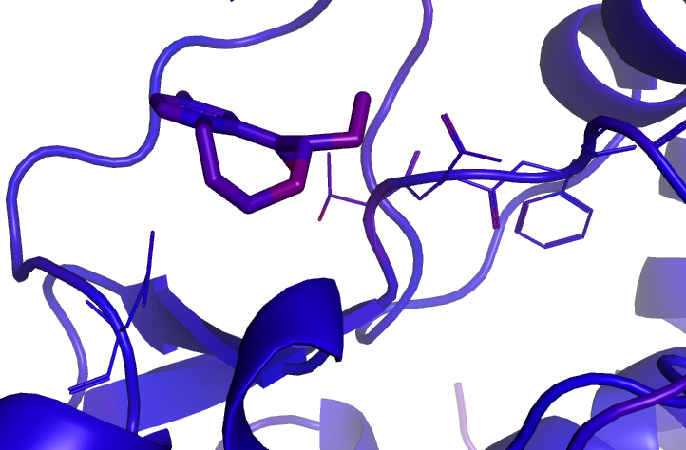
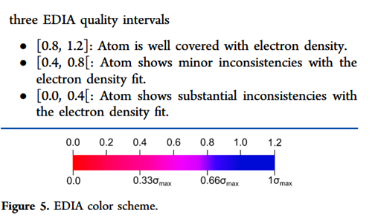
ABAminus conformation
Hinge
1.2
1.0
0.8
0.6
0.4
0.2
0.0
FRG274
Asp184
Gly186
Thr183
Glu127
Phe185
EDIA

