Slide 1
SOAK
The performance & soak test framework for IDH
DSD Big Data QA PRC

Slide 2
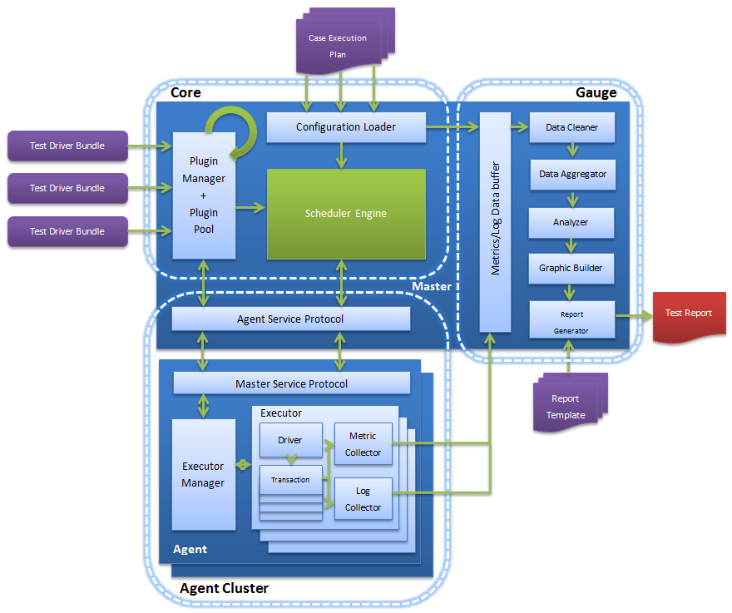
What’s SOAK?
Soak, a distributed soak/scale test framework, is designed for convenient and flexible testing to Hadoop.
Benchmarks as plugins into the framework which provides flexible scheduler strategy, comprehensive data collection mechanism, deepness data analysis and automatic report.
Usage:
Hadoop Performance Evaluation
Performance Tuning.
Customer Case Simulator

Slide 3



Why SOAK?
Support tests for distributed applications
Pluggable components for strong expandability
Configuration-based test scenario definition
Flexible and configurable scheduler engine to provide different scheduler strategies
Extensible metric system and lots of built-in metrics
Benchmarks and metrics aimed at Hadoop ecosystem
…
YCSB
HiBench
TPC-H
Notes:
e.g. HiBench covers part of mahout features. We can write some benchmark cases, if the current Benchmark case is not suit for the feature, we can do some modification. Benchmark Enhancements

Slide 4

Distributed Test System
Distributed Test Services
Customized Protocol

Slide 5
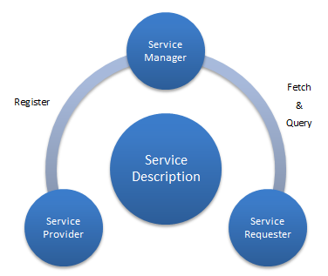
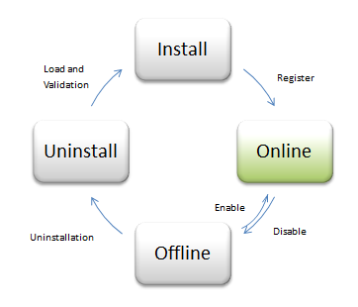
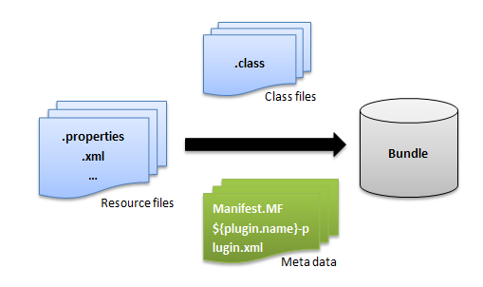
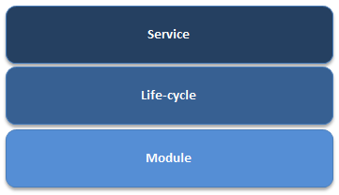
Plugin System & Demo
3 Tiers
Notes:
Why it’s easy to add test suits? Industry, why select this?

Slide 6
YCSB Demo
Yahoo! Cloud System Benchmark
Workload A: Update heavy workload
Application example: Session store recording recent actions
Read/update ratio: 50/50
Default data size: 1 KB records (10 fields, 100 bytes each, plus key)
Notes:
Soak: reliability, performance
New IM rest api : functional test IM automation rate will be improved huge. Manually configuration before, now Rest API coverage will be high, full-index test old cases can be imported to RestAPI
Integration test: full index, cross –site. Combined features integration test – new phase 2
POC, QA on common environment, read/write 20%/80%
Run case in Intel lab? Or can be test on user environment.

Slide 7
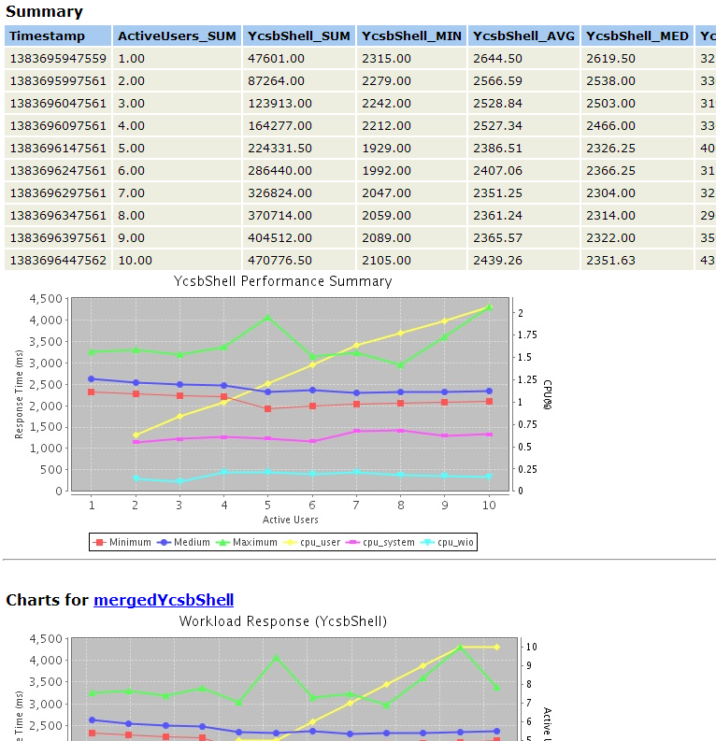
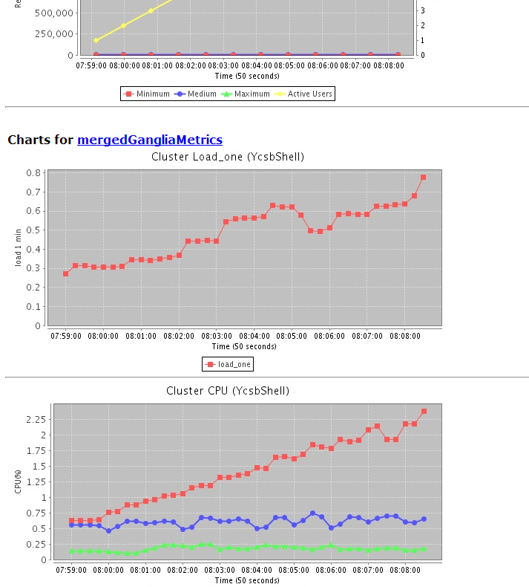
Report
Notes:
Soak: reliability, performance
New IM rest api : functional test IM automation rate will be improved huge. Manually configuration before, now Rest API coverage will be high, full-index test old cases can be imported to RestAPI
Integration test: full index, cross –site. Combined features integration test – new phase 2
POC, QA on common environment, read/write 20%/80%
Run case in Intel lab? Or can be test on user environment.

Slide 8
Resource
Wiki:
http://bigdata-wiki.ic.intel.com/wiki/Soak
Source Code:
https://sh-ssvn.sh.intel.com/ssg_repos/svn_hadoop/hadoop/hadoop/QA/soak/
Notes:
Soak: reliability, performance
New IM rest api : functional test IM automation rate will be improved huge. Manually configuration before, now Rest API coverage will be high, full-index test old cases can be imported to RestAPI
Integration test: full index, cross –site. Combined features integration test – new phase 2
POC, QA on common environment, read/write 20%/80%
Run case in Intel lab? Or can be test on user environment.

Slide 9
Q & A

Slide 10
Thanks!

