Slide 1

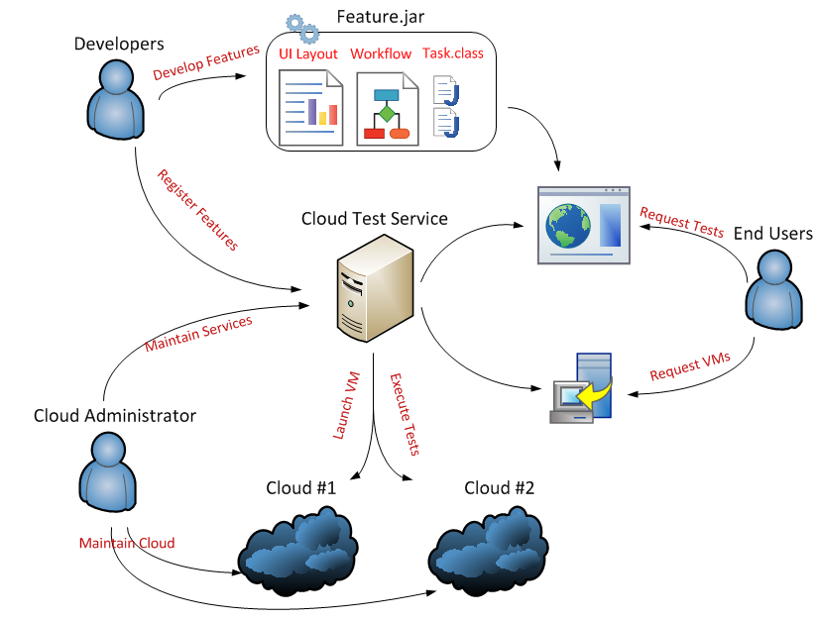
Modern Testing framework:
Intel Software Professionals Conference
Results
Collaborate. Innovate. Advance.
Support more than 100 virtual machines based on Eucalyptus Cloud with 13 physical nodes
Cover most used Linux and Windows distributions in enterprise
Migrated a legacy long running test framework to Cloud Test Service, and reduced 60% of over all testing duration with 4 Virtual Machines.
Launch a virtual hadoop cluster in several minutes
Enabled scalable load testing for typical web applications
Test Driven Development
Engage regression testing
Enable continuous integration
Unit tests are fundamental
Reload Tests to Cloud
Powered by ASIP team (PRC SWSD/SSG)
Abstract
Methods
Dynamically scheduling resources across multiple clouds
Unified web portal to manage resources, testing, and configurations
Extensibility to build various testing features as plugin
Abstracted API for various clouds (EC2 for now)
Virtual Machines are managed in a pool
Expose simplified Java API to build a feature as plugin
XML declaration to layout and render the feature’s web layout
HTTP based remote control interface to pass through firewall
Consumer-producer parallel execution model to dispatch test requests to pooled virtual machines
However …
Are the hardware resources balanced for various product testing?
Are you still rely on command line tool to do your tests?
Are you still maintaining different scripts for various platforms?
Do you want to accelerate your so many long running test cases?
Next Steps
Enrich manageability features
Support other widely-deployed Clouds such as OpenStack
Invent more innovative ways to improve software quality
Try now:
http://cloudtest.sh.intel.com

