Slide 1
Cloud Test Services Design Overview
Reloading tests to cloud …

Slide 2
Why Cloud Test Service
Main defects of team’s test services:
Ad hoc resource allocation for various projects
Machine resource is not balanced across projects
Machine resource suffers overloaded for some demanding projects
Different test framework for various projects
QA developers must be experts of several main stream programming languages: Java, C++, Perl, Shell …
Difficult to support reporting, re-producing, on-demanding, regression checking…

Slide 3
Cloud Test Service --- not only a cloud
Manage hardware resources agilely
Design for multiple computing clouds
Connect both public clouds and corporate private clouds
Unified server pool for virtual and physical machines
Selfhelp testing service
Design for extensible
On-demand testing
Unified storage service
Automatic computing/storage resource management
Automatic test scripts distributing and updating
Common framework for reporting, failure reproducing, etc
Develop and deploy customized tests

Slide 4
Cloud Test Service Overview

Slide 5
Cloud Test Services
Managed Virtual Instance
Managed Virtual Instance
Un-Managed Virtual Instance
Un-Managed Virtual Instance
Cloud Test Services
Runtime
Common API & Format (EC2, EBS, S3/Walrus)
Private Cloud IaaS
Eucalyptus
Public Cloud
Amazon AWS
User
Manager
Cloud Manager
Instance Manager
Instance
Scheduler
Extensive Engine
Storage
Manager

Slide 6
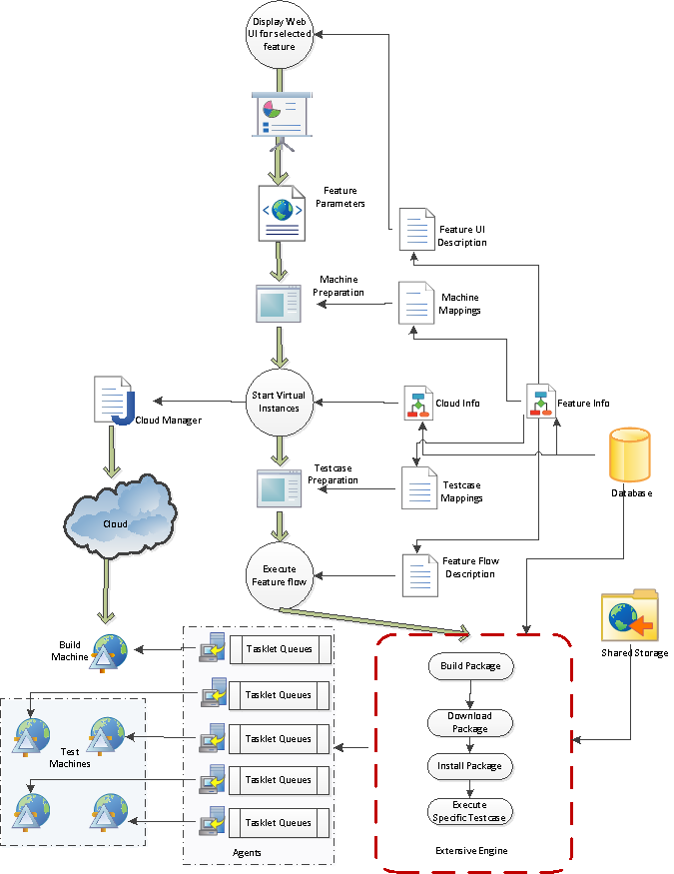
Cloud Test Services Runtime

Slide 7
Extensive Engine
Feature and Tasklet
Feature is a manageable application to implement a test
Tasklets are the executable entities to compose tasks
Feature has UI and task descriptions
Managed Virtual Instance
Started/terminated by the engine
Shared across running tests determined by scheduler
Rich control functions e.g. remote file access, automatic software install/uninstall
Unmanaged Virtual Instance
Started/terminated by user
Managed by the Eucalyptus or AWS cloud

Slide 8
Tasklet
A java application both for the engine and virtual instance
The application is required to implement pre-defined ITaskRunner interface
Dispatched by the engine, and runs on the virtual instance
XML specification:
<tasklet public="true" id="xml.cpp.conformance.runner" sharable="full">
<desc>XML Library (C++) Conformance Tester</desc>
<contributer>SOAP Conformance and Performance Team</contributer>
<provider>com.intel.cedar.features.cppConf.XMLCppConformanceRunner</provider>
</tasklet>

Slide 9
Feature Application
UI descriptor (simplified): <parameters>
<input name=“os” init=“Windows”/>
<list name=“components” type=“multiple” init=“parser|validator|transfomer|xpath”/>
</parameters>
Task descriptor (simplified):
<feature>
<sequence>
<tasklet id=“core.builder”/>
<parallel>
<tasklet id=“cpp.conformance.test”/>
</parallel>
</sequence>
</feature>

Slide 10
Customized Feature
Feature could provide its own test report implementation
Feature could provide its own progress presentation implementation
Feature application is required to implement various interface for the customizations:
ITaskItemProvider /* to provide TaskItems */
IReportProvider /* to provide a customized report */

Slide 11
Planned Functionalities
Infrastructure setup
Bootstrap Eucalyptus DONE
Network configuration DONE
Machine Image preparation DONE
Remote agent implementation DONE
Cloud Management
Web UI Partially Done
User Manager
Data model construction Done
Abstract Cloud Management API Done
Abstract Storage Management API Done
Test Management
Web UI Done
Feature Application Management Done
Extensible Runtime Done
Instance Management Partially Done

Slide 12
More ideas
Automatic Cloud node installation
Automatic physical server installation
Web UI to manage shared storage
Web UI to install OS on virtual machine

Slide 13
Selfhelp Engine
Engine
Test Type A
task1
task2
task3
Agent
Agent
Agent
Test Type B
task4
task5
task6
Test Type C
task7
task8
task9

Slide 14
Extensive Engine
Agent
Test Type A
task1
task2
task3
Engine
test1
test2
Test Type B
task4
task5
task6
test3
test4
Test Type C
task7
task8
task9

