Slide 1
Build a Cloud with Test Services
Reloading tests to cloud …

Slide 2
Our Mission
Develop Intel Expressway Cloud Access 360
Support multiple mainstream platforms
Support almost all web browsers
Integrated with other on-premise solutions
Establish Performance leadership
Maintain XML Component for Intel Expressway Service Gateway
No emerging features, many enhancements
Many enforced conformance cases
Notes:
For more product information of ASIP/SWSD, please navigate to http://www.intel.com/content/www/us/en/software-developers/cloud-identity-and-api-security.html

Slide 3
Problems Arise
Limited hardware resource
Require over 10 mainstream platforms
Require at least 4 types of browsers
Require at least 20 independent machines for stress and performance tests
…
Usability of testing
Tedium command line based test
Complicated configuration
Test is running slowly
...

Slide 4
A Quick Idea
Virtualization
Balanced Resource
Dist. Computing
Enhanced Usability
Web Service

Slide 5
Test Services
“Cloud” Aware
Application
Application
Runtime
Services
Application
Building
Blocks
Application
Lifecycle
Management
“Cloud” Portal
“Cloud” Services
Foundation
Middleware
for Test Services
Data Persistence
Services
Service
Scheduler
Demand
Management
Resource Manager
Scaling,
Load Balancing
& Failover
QoS/SLA
Manager
“Cloud” File
System
Provided by
Cloud Infrastructure Vendors
(e.g. Eucalyptus, OpenStack, AWS)
Infrastructure
Physical Systems
Manager
Logical Systems
Manager
Infrastructure Manager
Physical HW
Manager
Power
Manager
Space
Manager
Thermal
Manager
Server Pool
Manager
Storage Pool
Manager
Connection
Manager
Facility
Physical Layer
Servers
Storage
Network

Slide 6
Design Goals
Integrated Resource Management Center
A user-friendly web portal for multiple private and public clouds
A unified solution to manage both virtual and physical machines
Efficient Task Processing System
A middleware to execute concurrent tasks
Easy to use programming interface to develop plugins and published as test services

Slide 7
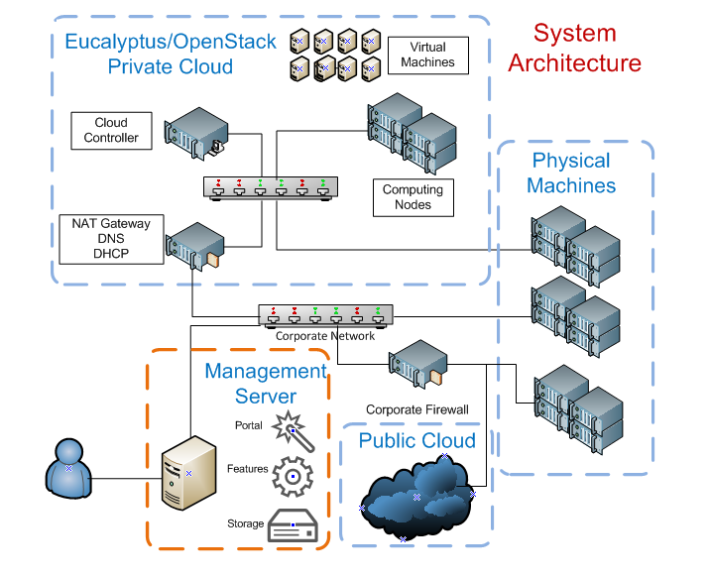

Slide 8
Implementation
Presentation Tier
Dynamic User Interface using Ajax
Uses GWT for sophisticated management console
Jetty – Built-in Light Weight Servlet Container
Business Logic Tier
Light weight framework built using plain Java classes
Event driven, and loosely coupled with Presentation and Persistence to improve reusability of the logic
Persistence Tier
Uses Hibernate framework for Object to Relational Mapping and improve database portability
HyperSQL – Built-in Light Weight Database

Slide 9
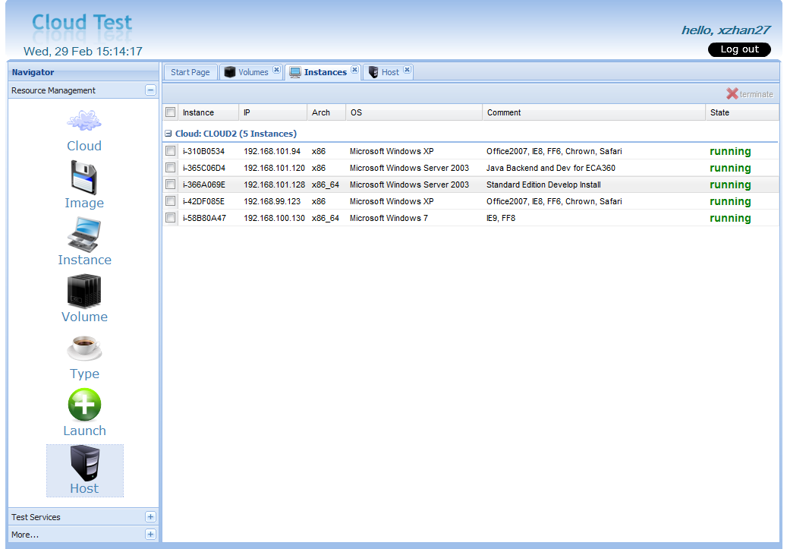
DEMO
Notes:
The unified resource portal really enhanced team’s testing efficiency for various client and server platforms.

Slide 10
Characteristics of Testing
Confidentially executed for commercial products
Runs on a specific machine or OS
Requires privileged access to the platform for installation and execution
Requires sufficient machine resource
Can be divided to multiple stages
A single stage may be required to execute multiple test cases
Some stages can execute concurrently

Slide 11

Staged Distributed Computing
Task flow
Prepare and Build
Install and Startup
Execute specified test cases
Terminate and Uninstall
Collect Result
Middleware
test cases
Engine
Resource Pool

Slide 12
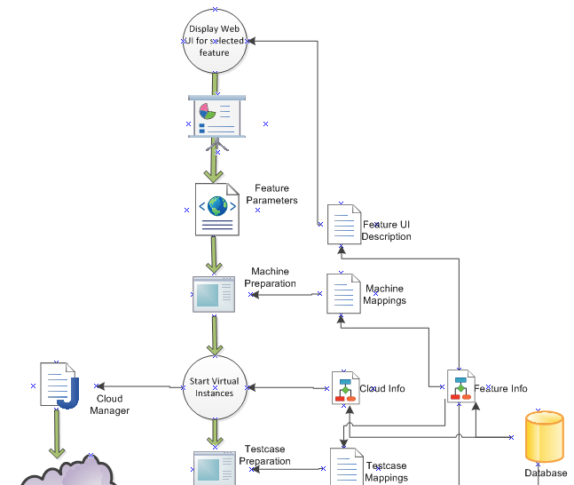
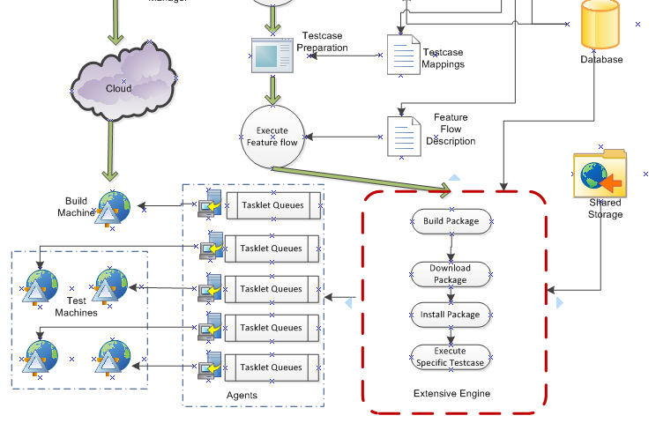
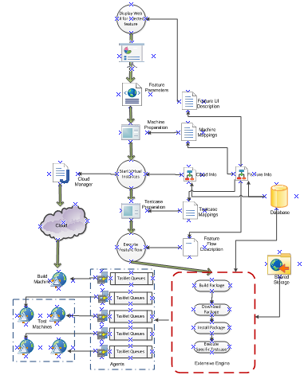
Middleware Runtime

Slide 13
Receive Task Parameters
A task has pre-defined parameters
Some parameters are provided by users
A parameter is abstracted as a Variable
A Variable is a List of atomic values
<variable name="platform">
<values>
<value>Win32</value>
<value>Win64</value>
<value>Linux32</value>
<value>Linux64</value>
</values>
</variable>

Slide 14
Dynamic Web Layout
A task can specify a web layout for parameters
Middleware Engine renders a form dynamically
Any UI element is bound to a Variable
<form>
<combo label="OSName" id="os" bind="OS"/>
<combo label="Arch" id="arch" bind="ARCH"/>
<checkboxgroup label=“Cases" id=“cases“ bind=“cases" />
<textfield label=“desc” id=“desc” bind=“desc” />
</form>

Slide 15
Descriptive Task Flow
A task flow contains at least 1 task stage
A task stage is abstracted as a tasklet
A task stage follows ‘producer-consumer’ execution model
Task stages can be sequential or parallel
<sequence>
<parallel>
<tasklet>
…
</tasklet>
<tasklet>
…
</tasklet>
</parallel>
</sequence>

Slide 16
Tasklet
A Java class which implements pre-defined ITaskRunner interface
Dispatched by the engine, and runs on the target machines
A Tasklet can implement a special function to provide a list of customized TaskItem
A Tasklet can specify Machine requirements
<machine>
<properties><property name="CPP" value="true"/></properties>
<count>2</count>
<cpu>4</cpu>
<mem>2</mem>
</machine>

Slide 17
Test Service
Merge all the UI layout, task flow, and tasklet definition into feature.xml
Implement all required Java applications
Bundle the Java classes, feature.xml and all required configuration files into a single JAR
The JAR file can be published as a Test Service

Slide 18
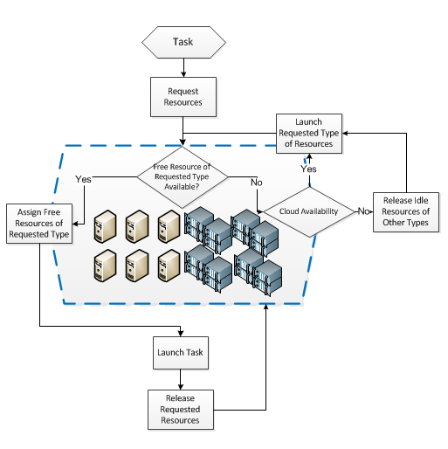
Resource Schedule
Tasks compete for machine resources
Middleware maintains a pool for all available virtual and physical machines
Virtual Machine may be polluted by accomplished tasks
User requested resource is not considered

Slide 19
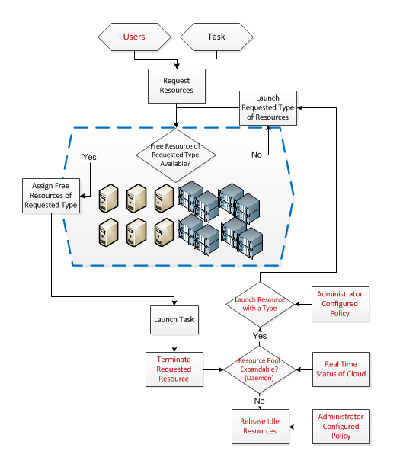
Enhanced Scheduler

Slide 20
Q & A

Slide 21
Reference
Cloud Computing Overview by Honesty(TLC 2009)
IT on Cloud Computing (TLC 2009)
Open Source Eucalyptus

Slide 22
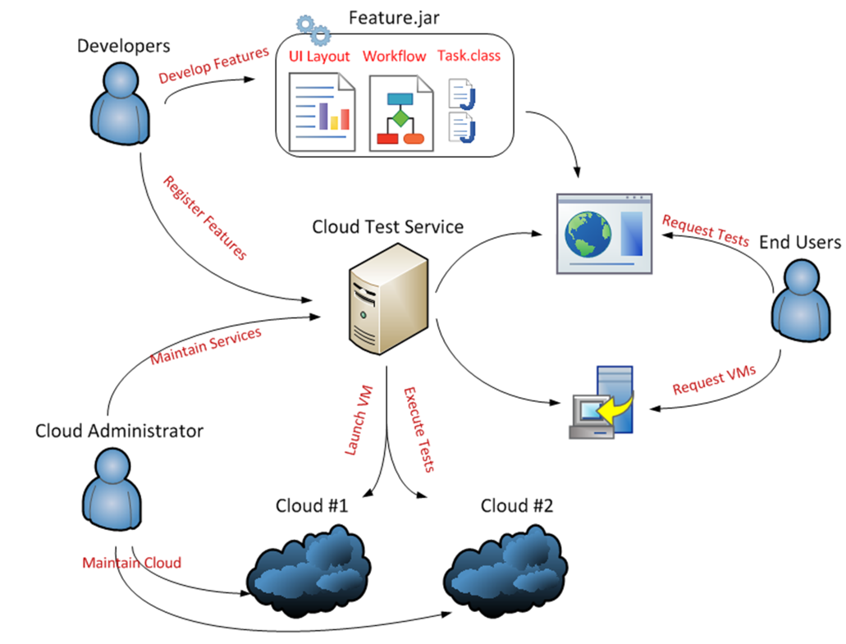
Backup

Slide 23

Is the “cloud” new?
Prior Innovations
…cloud advances:
Virtualization
Consolidation & VM Migration
Automated provisioning & data migration
Grid Computing
Batch scheduling across homogeneous resources
Increased multi-tenancy
Internet-based Services
Seamless scaling
Pay as you go
On-demand applications & services
Cloud is new – but builds upon years of technology evolution
Notes:
Speak to why the cloud is

Slide 24
Selfhelp Engine
Engine
Test Type A
task1
task2
task3
Agent
Agent
Agent
Test Type B
task4
task5
task6
Test Type C
task7
task8
task9

Slide 25
Cloud with Test Services
Agent
Test Type A
task1
task2
task3
Engine
test1
test2
Test Type B
task4
task5
task6
test3
test4
Test Type C
task7
task8
task9

