Slide 1


Real-world Translator Retrieval Framework
Navid Rekabsaz (rekabsaz@ifs.tuwien.ac.at)
Mihai Lupu (lupu@ifs.tuwien.ac.at)

Slide 2

Agenda
Motivation
Translation Expert Retrieval Platform
Proficiency Estimator
Document Aggregation Methods
Experimental Results
Translator Search
Data Annotation
Learning to Rank Methods
Experimental Results
Conclusion

Slide 3

Motivation
A real-world, unmet, need:
Translation expert retrieval
Specific issues:
Proficiency estimation
Factor in other real-world aspects
Context:
Existing online platform
Freelance translators

Slide 4
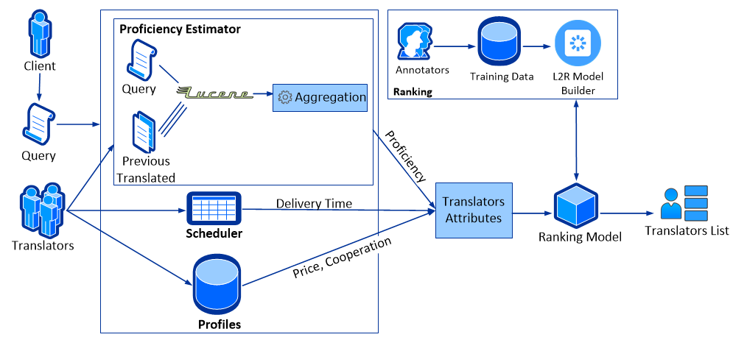
Translation Expert Retrieval Platform

Slide 5
Translation Expert Retrieval Platform

Slide 6
Translation Expert Retrieval Platform

Slide 7





Proficiency Estimator
10 language combinations
20 to 30 potential translators for each order
Using Lucene for document similarity
How to aggregate the documents in order to estimate translator's proficiency?

Slide 8
Document Aggregation Methods
Top1
The most related document

Slide 9
Document Aggregation Methods
Top1
The most related document
Top5
Aggregate the top five relevant documents
Usually by averaging

Slide 10
Document Aggregation Methods
Top1
The most related document
Top5
Aggregate the top five relevant documents
Usually by averaging
GP2
Cummins et al. (2010)
Study on expert search task of TREC
GP2 formula achieved by Genetic Programming
Effect of document's rank among all

Slide 11
Aggregation Methods – Golden Data
181 purchased orders
The quality of each translation is assessed by a proof-reader
Assessment from 1 (very poor) to 5 (great) from different translation aspects

Slide 12
Aggregation Methods – Golden Data
181 purchased orders
The quality of each translation is assessed by a proof-reader
Assessment from 1 (very poor) to 5 (great) from different translation aspects
Proof-readers’ assessments as golden-data

Slide 13
Aggregation Methods – Golden Data
181 purchased orders
The quality of each translation is assessed by a proof-reader
Assessment from 1 (very poor) to 5 (great) from different translation aspects
Proof-readers’ assessments as golden-data
Comparing the correlation of each algorithm with the golden-data
Correlation coefficient
Pearson rho
Kendall tau

Slide 14
Aggregation Methods – TOP1
Example of five purchased orders
Proof-readers' assessments vs. TOP1
Purchased Order ID | TOP1 | Assessment
O1 | 14.291 | 4.8
O2 | 0.765 | 4.6
O3 | 0.339 | 4.4
O4 | 1.345 | 3.8
O5 | 9.588 | 4
... | ... | ...

Slide 15
Aggregation Methods – TOP5
Example of five purchased orders
Proof-readers' assessments vs. TOP5
Purchased Order ID | TOP5 | Assessment
O1 | 11.284 | 4.8
O2 | 0.615 | 4.6
O3 | 0.133 | 4.4
O4 | 1.232 | 3.8
O5 | 8.083 | 4
... | ... | ...

Slide 16
Aggregation Methods – GP2
Example of five purchased orders
Proof-readers' assessments vs. GP2
Purchased Order ID | GP2 | Assessment
O1 | 0.101 | 4.8
O2 | 0.11 | 4.6
O3 | 0.088 | 4.4
O4 | 0.081 | 3.8
O5 | 0.91 | 4
... | ... | ...

Slide 17
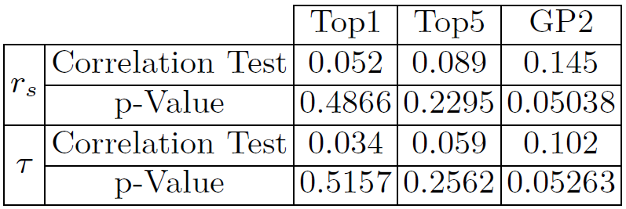
Proficiency Estimator - Results

Slide 18
Proficiency Estimator - Results
Both measures show similar behaviors
GP2 is least likely to be independent of proof-readers' assessments
GP2 has the best correlation though still weak

Slide 19
Translation Expert Retrieval Platform

Slide 20
Data Annotation
Annotation system presents three translators, randomly
Each with four criteria (price, delivery time, proficiency and number of cooperations)
Translators' pictures and names are removed
8 annotators familiar with company's business
Annotators rank the three translators
400 annotated lists (1200 records)
Annotated data available on github

Slide 21
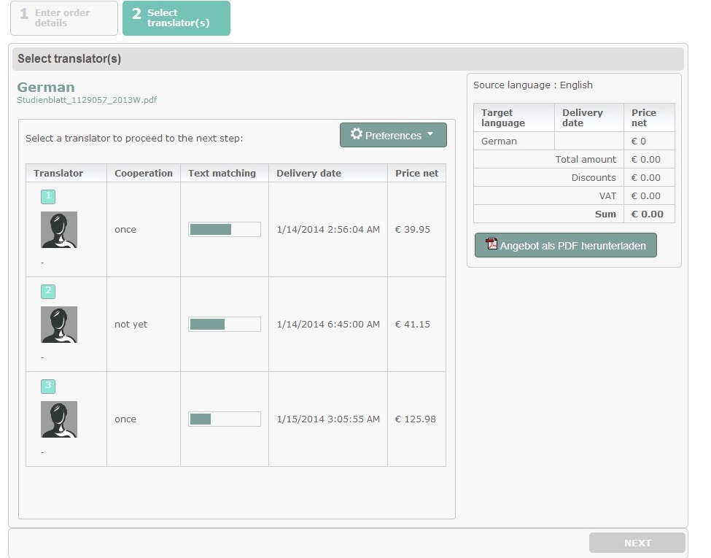
Data Annotation

Slide 22
Learning to Rank
Pointwise: linear regression
Pairwise: RankNet, RankBoost, LambdaRank, LambdaMART
Listwise: AdaRank, ListNet

Slide 23
Learning to Rank
Pointwise: linear regression
Pairwise: RankNet, RankBoost, LambdaRank, LambdaMART
Listwise: AdaRank, ListNet
Evaluation
NDCG
ERR
5-Fold Cross Validation

Slide 24
Learning to Rank
Pointwise: linear regression
Pairwise: RankNet, RankBoost, LambdaRank, LambdaMART
Listwise: AdaRank, ListNet
Evaluation
NDCG
ERR
5-Fold Cross Validation
Two baselines
Random generated data
Random ranker

Slide 25
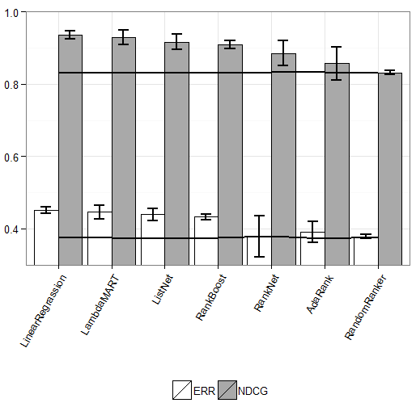
Learning to Rank - Experimental Results

Slide 26
Learning to Rank - Experimental Results
Linear Regression shows the best performance

Slide 27
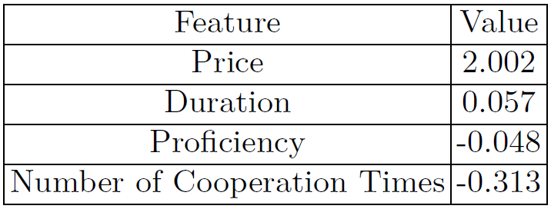
Learning to Rank - Experimental Results
Linear Regression shows the best performance
Feature comparison based on linear regression coefficients

Slide 28
Learning to Rank - Experimental Results
Linear Regression shows the best performance
Feature comparison based on linear regression coefficients
Price and duration much more important
Proficiency not effective, maybe because it's guaranteed by the company

Slide 29
Conclusion
Expert-Translator Retrieval
Price
Duration
Proficiency
Number of cooperation times
Proficiency estimator
Document aggregation
GP2 algorithm
Ranking model
Linear Regression
Price and time more important

Slide 30
Thank you!
Questions?

