Slide 1


Real-world Translator Retrieval Framework

Slide 2

Agenda
Translator Recommendation
Aggregation Functions
Methods and Related Work
Experimental Results
Learning To Rank
Methods and Related Work
Experimental Results
Conclusion

Slide 3
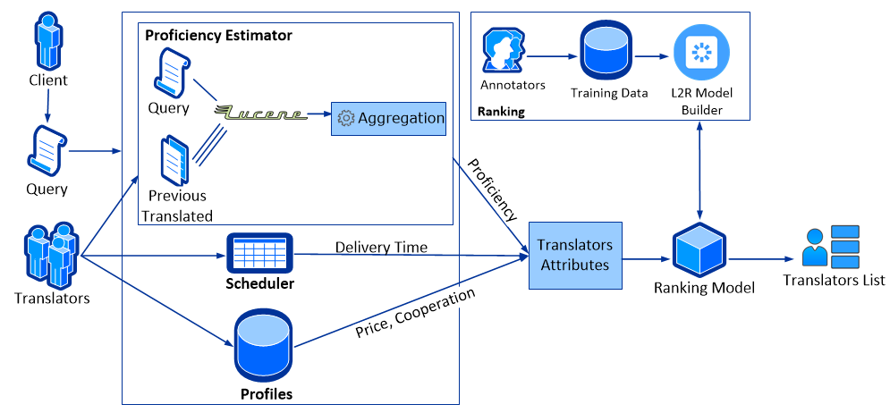
Translator Recommendation

Slide 4
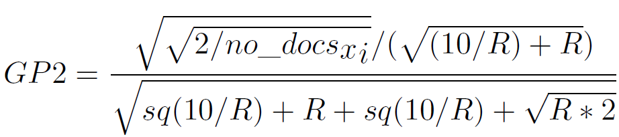
Aggregation Functions - Methods
Top1
Top5
GP2: Using rank of document among all

Slide 5
Aggregation Functions- Experimental Results
All purchased orders (181) + Top1, Top5 and GP2 => Three lists
Assumption: Proof-readers’ assessments as golden-data (why?)
One golden-data list
Task: comparing the list of each algorithm with the golden-data list.
The more similar to the golden-data list, the more appropriate for us

Slide 6
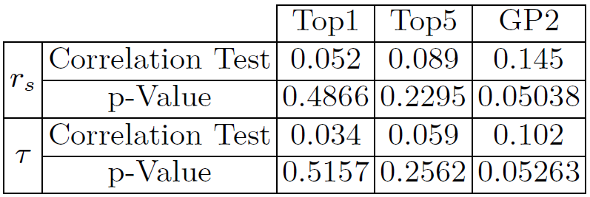
Aggregation Functions- Experimental Results

Slide 7
Learning to Rank - Methods
Pointwise: linear or polynomial regression
Pairwise: RankNet, RankBoost, LambdaRank, LambdaMART
Listwise: AdaRank, ListNet
Evaluation
MAP
[N]DCG*
MRR
ERR (Expected Reciprocal Rank)*
* Used for graded relevance

Slide 8
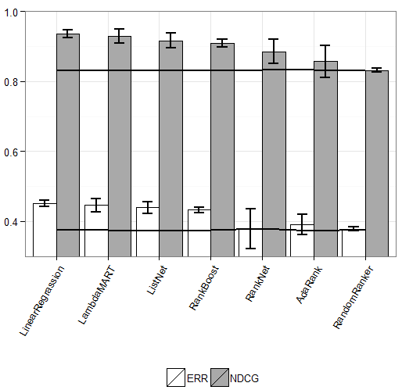
Learning to Rank - Experimental Results

Slide 9
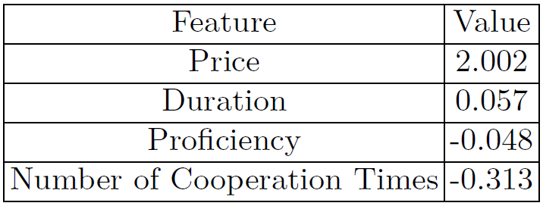
Learning to Rank – Features

Slide 10
Conclusion
Translator Retrieval price, duration, proficiency and number of cooperation times
GP2 outperforms while approximately weak correlation
Linear Regression
Price and Time much more important

