Slide 1
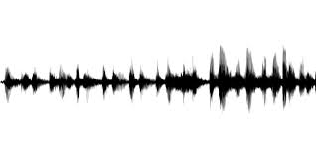
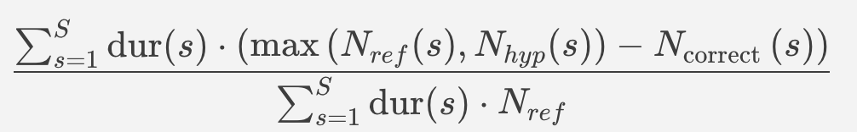

Ref:
Hyp:
Error Type:
No
SPK
No
No
Miss
No
SPK
FA
Duration:
t1
t2
t3
t4
t5
t6
t7
t8
$N_{ref}$:
1
2
2
1
1
0
0
0
Score Time:
1 * t1
2 * t2
2 * t3
1 * t4
1 * t5
0 * t6
0 * t7
0 * t8
Error Time:
0 * t1
1 * t2
0 * t3
0 * t4
1 * t5
0 * t6
1 * t7
1 * t8
DER =
Error Time
=
Score Time

Slide 2
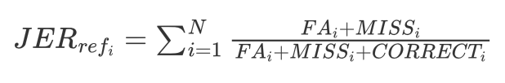

Spk1 union time:
FA
CORRECT
MISS
MISS
Ref:
Hyp:
Spk2 union time:
CORRECT
MISS
FA
JER for each reference speaker:
JER:

