Slide 1
Applied Statistics, Probability theory and mathematical statistics
Attila Barta, Sándor Pecsora
Combinatorics

Slide 2
Discription to this presentation
After solving each exercise with „pen and paper”, also solve them with Matlab as well.
If the title of the exercise is red, skip on the laboratory class, that is part of the lecture slide!

Slide 3

Permutations
The number of permutation without repetition is:
$P_{n}=n!=n⋅\left(n−1\right)⋅…⋅2⋅1$
The number of permutation with repetition is:
$P_{n}^{r_{1},r_{2},…,r_{s}}=\frac{n!}{r_{1}!⋅r_{2}!⋅…⋅r_{s}!}$
Where $r_{i}$ is the number of repetitions of element $i$.

Slide 4
Permutations in Matlab
All possible Permutations of 3 distinguishable elements:
perms([1 2 3])
ans =
3 2 1
3 1 2
2 3 1
2 1 3
1 3 2
1 2 3
The number of possible Permutations of 3 distinguishable elements:
factorial(3)
ans =
6

Slide 5
Permutations in Matlab
All possible Permutations with repetition:
unique(perms([1 1 3]),'rows')
ans =
1 1 3
1 3 1
3 1 1
All possible Permutations with repetition:
unique(perms([repelem(2,3)repelem(1,2)repelem(3,1)]),'rows')

Slide 6

Ordered selections
The number of ordered selections without repetition is:
$$V_{n}^{k}=n⋅\left(n−1\right)⋅\left(n−2\right)⋅…⋅(n−k+1) =\frac{n!}{\left(n−k\right)!}$$
The number of ordered selections with repetition is:
$$V_{n}^{k,r}=\underset{k}{\underbrace{n⋅n⋅…⋅n}}=n^{k}$$

Slide 7
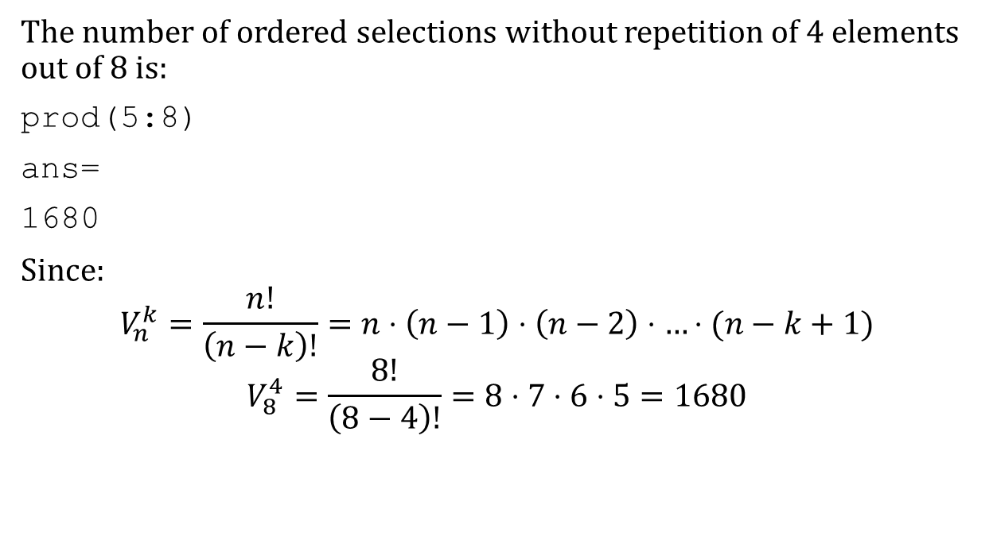
Ordered selections in Matlab
The number of ordered selections without repetition of 4 elements out of 8 is:
prod(5:8)
ans=
1680
Since:
$$V_{n}^{k}=\frac{n!}{\left(n−k\right)!}=n⋅\left(n−1\right)⋅\left(n−2\right)⋅…⋅(n−k+1)$$
$$V_{8}^{4}=\frac{8!}{\left(8−4\right)!}=8⋅7⋅6⋅5=1680$$

Slide 8
Ordered selections in Matlab
The number of ordered selections with repetition of 4 elements out of 8 is:
With caret symbol (ascii code: alt+94=^):
8^4
ans=
4096
power(8,4)
ans=
4096

Slide 9

Combinations
The number of combinations without replacement is:
$$C_{n}^{k}=\left(\begin{matrix}n \\ k\end{matrix}\right)=\frac{n!}{k!⋅\left(n−k\right)!}$$
The number of combinations with replacement is:
$$C_{n}^{k,r}=\left(\begin{matrix}n+k−1 \\ k\end{matrix}\right)=\frac{\left(n+k−1\right)!}{k!⋅\left(n−1\right)!}$$

Slide 10
Combinations in Matlab
Number of combinations
b = nchoosek(5,4)
b =
5
Number of combinations
v = 2:2:10;
C = nchoosek(v,4)
C = 5×4
2 4 6 8
2 4 6 10
2 4 8 10
2 6 8 10
4 6 8 10

Slide 11
Combinations in Matlab
Number of combinations
v = uint16([10 20 30]);
C = nchoosek(v,uint16(2))
C = 3x2 uint16 matrix
10 20
10 30
20 30
Number of combinations
C = combnk(1:4,2)
C = 6×2
3 4
2 4
2 3
1 4
1 3
1 2

Slide 12




Exercise 1.2
Find the number of possible arrangements of 8 castles on the chess board in a way
that they do not hit each other?
What is the result if we can distinguish between the castles?
$$P_{8}=8!$$
$$P_{8}⋅P_{8}$$
Help:

Slide 13

Exercise 1.3
How many real four digit numbers (they can not start with zero) can be formed from
digits 0, 1, 2, 3, 4, 5, 6?
$$V_{6}^{1}⋅V_{6}^{3}$$

Slide 14


Exercise 1.4
We have 12 books on the shelf. How many ways can the books be arranged on the shelf if 3 particular books must to be next to each other
if the order of the three books does not count?
if the order of the three books does count?
$P_{10}=10!$
$P_{10}⋅P_{3}=10!⋅3!$

Slide 15




Exercise 1.6
$$P_{6}=6!$$
In how many ways can 7 people be arranged around a round table?
Hint:
A
D
C
B
D
B
$$≈$$
C
A
$$≈$$
B
D
$$≈$$
A
C
C
B
A
D

Slide 16

Exercise 1.7
In how many ways can 5 men and 5 women be arranged around a round table if neither two men, nor two women can sit next to each other?
$$P_{4}⋅P_{5}=4!⋅5!$$

Slide 17

Exercise 1.9
Three postmen must deliver six letters. Find the number of possible distribution of the letters.
$$V_{3}^{6,r}=3^{6}$$

Slide 18

Exercise 1.11
Find the number of possible fillings of a lottery coupon (5 numbers from 90).
$$C_{90}^{5}=\frac{90!}{5!⋅\left(90−5\right)!}$$

Slide 19

Exercise 1.12
Find the number of possible paths from the origin to the point (5; 3) if we can walk only on points with integer coordinates and we can step only upwards and right.
$$P_{8}^{3,5}$$
Hint:

Slide 20





Exercise 1.20
A deck of ordinary cards is shuffled, and 10 cards are dealt.
In how many cases will we have aces among the 10 cards?
Exactly one ace?
At most one ace?
Exactly two aces?
At least two aces?
$$C_{52}^{10}−C_{48}^{10}$$
$$C_{48}^{9}⋅C_{4}^{1}$$
$$C_{48}^{9}⋅C_{4}^{1}+C_{48}^{10}⋅C_{4}^{0}$$
$$C_{48}^{8}⋅C_{4}^{2}$$
$C_{48}^{8}⋅C_{4}^{2}+C_{48}^{7}⋅C_{4}^{3}$+$C_{48}^{6}⋅C_{4}^{4}$
Or
$C_{52}^{10}−\left(C_{48}^{9}⋅C_{4}^{1}+C_{48}^{10}⋅C_{4}^{0}\right)$

Slide 21
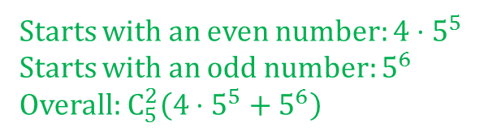
Exercise 1.22
Find the number of real six digit numbers having three odd and three even digits.
Starts with an even number: $4⋅5^{5}$
Starts with an odd number: $5^{6}$
Overall: $C_{5}^{2}\left(4⋅5^{5}+5^{6}\right)$
Hint:
First digit is odd
1,3,5,7,9
First digit is even
0,2,4,6,8

Slide 22

Exercise 1.25
In how many ways we can distribute 7 apples and 9 peaches among 4 kids?
$$C_{4}^{7,r}⋅C_{4}^{9,r}$$

Slide 23
Literature
Ágnes Baran: Mathematics for engineers 1. (Laboratory slides)
Sándor Baran: Probability theory and statistics
Fazekas István: Valószínűségszámítás, Debreceni Egyetemi Kiadó, 2009
Fazekas István: Bevezetés a matematikai statisztikába, Debreceni Egyetemi Kiadó, 2009
Matlab examples: https://www.mathworks.com/help/examples.html

