Slide 1
Applied Statistics, Probability theory and mathematical statistics
Attila Barta, Sándor Pecsora
Independence of events
Discrete random variables,
Parameters of discrete random variables

Slide 2
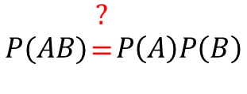





Exercise 6.1 (M1)
A coin is tossed ten times. Let A denote the event that there are both heads and tails among the results, while B denotes the event that there is at most one tail among them. Are A and B independent?
$$A−there is at least a head and at least a tail \\ B−there is at most one tail$$
$$P(AB)\begin{matrix}? \\ = \\ \end{matrix}P\left(A\right)P\left(B\right)$$
$$P\left(AB\right)=\frac{10}{2^{10}}$$
$$P\left(A\right)=1−\frac{2}{2^{10}}=\frac{2^{9}−1}{2^{9}}$$
$$\frac{10}{2^{10}}≠\frac{11}{2^{10}}×\frac{2^{9}−1}{2^{9}}$$
$$P\left(B\right)=\frac{1+10}{2^{10}}=\frac{11}{2^{10}}$$

Slide 3
Exercise 6.1 (M1) MATLAB solution
N = 10^7;
A = 0;
B = 0;
AB = 0;
for i=1:N
sim = randi(2,1,10)-1;
s = sum(sim);
if s>0 & s<10
A = A+1;
end
if s<=1
B = B+1;
end
if s==1
AB = AB+1;
end
End
(A/N) * (B/N)
AB/N

Slide 4


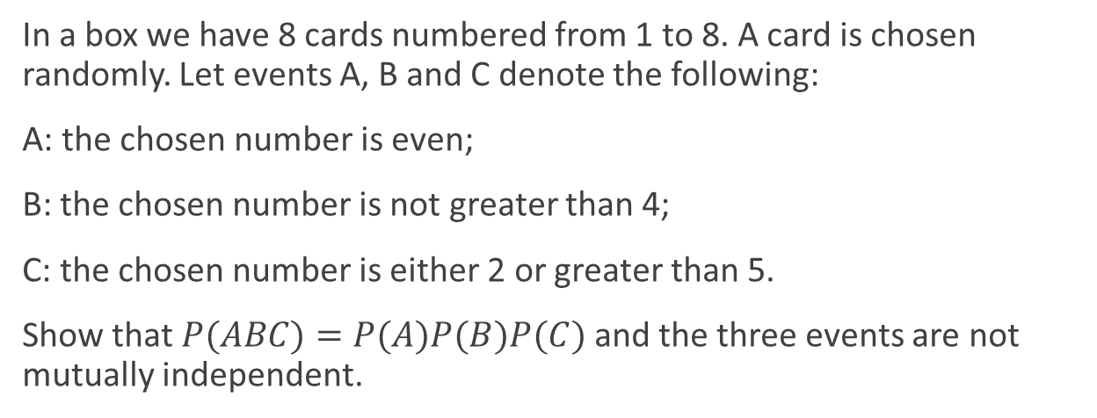



Exercise 6.3
In a box we have 8 cards numbered from 1 to 8. A card is chosen randomly. Let events A, B and C denote the following:
A: the chosen number is even;
B: the chosen number is not greater than 4;
C: the chosen number is either 2 or greater than 5.
Show that$P(ABC)=P(A)P(B)P(C)$ and the three events are not mutually independent.
$$P\left(A\right)=\frac{1}{2}$$
$$P\left(ABC\right)=\frac{1}{8}$$
$$P\left(B\right)=\frac{1}{2}$$
$$P\left(AC\right)≠P\left(A\right)P\left(C\right)$$
$$P\left(C\right)=\frac{1}{2}$$

Slide 5


Exercise 6.7 (M2)
Two soldiers shoot on a target in turn until the first hit. The probability that the starter hits it is 0.2, while the second hits it with probability 0.3. What is the probability that the first successful shot belongs to the soldier who started the shooting?
$$p−the probability, that the first soldier hits the target first$$
$$P_{1}\left(H_{i}\right)−the probability, that the first soldier hits the target in round i$$
$$P_{2}\left(H_{i}\right)−the probability, that the second soldier hits the target in round i$$
$$P_{1}\left(H_{1}\right)=\frac{2}{10}$$
$$P_{1}\left(H_{2}\right)=\frac{8}{10}×\frac{7}{10}×\frac{2}{10}$$
$${p=P}_{1}\left(H_{1}\right)+P_{1}\left(H_{2}\right)+…=\sum_{k=0}^{∞}{0.2×{0.8}^{k}×{0.7}^{k}}=0.2×\sum_{k=0}^{∞}{{0.8}^{k}×{0.7}^{k}}=0.2×\frac{1}{1−0.56}$$

Slide 6
Exercise 6.7 (M2) MATLAB solution
f = 0;
s = 0;
n = 1000;
for i=1:n
while true
if rand()<.2
f = f+1;
break;
elseif rand()<.3
s = s+1;
break;
end
end
end
f/n
0.2 / 0.44

Slide 7

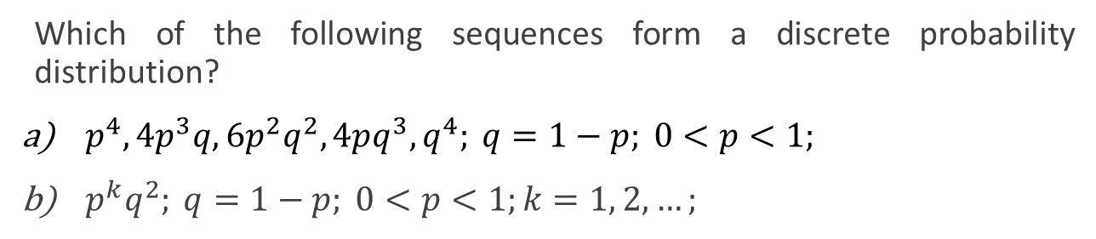
Exercise 7.1
Which of the following sequences form a discrete probability distribution?
$p^{4}, 4p^{3}q, 6p^{2}q^{2}, 4pq^{3}, q^{4}; q=1−p; 0<p<1;$
$p^{k}q^{2}; q=1−p; 0<p<1;k=1, 2, …;$
$${a) \left(p+q\right)}^{4}={\left(p+\left(1−p\right)\right)}^{4}=1$$
$$b) \sum_{k=1}^{∞}{p^{k}q^{2}}={\left(1−p\right)}^{2}\sum_{k=1}^{∞}{p^{k}}={\left(1−p\right)}^{2}p\sum_{k=0}^{∞}{p^{k}}={\left(1−p\right)}^{2}p\frac{1}{1−p}=\left(1−p\right)p≠1$$

Slide 8
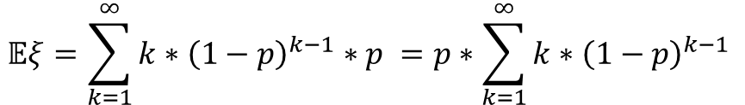
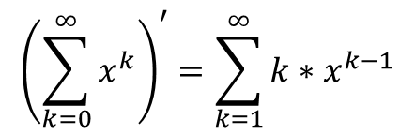
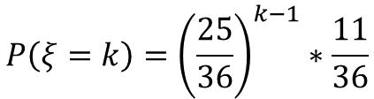
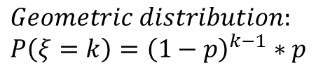
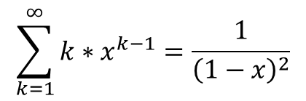
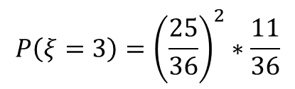

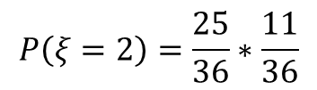
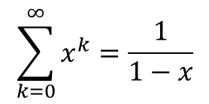
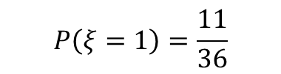
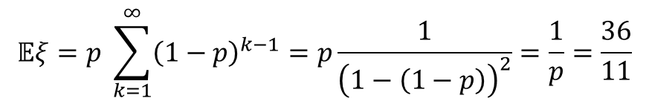
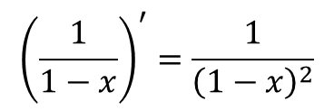
Exercise 8.1 (M3) Just in Matlab
Two dice are rolled till the first six appears on one of them. What is the mean number of rolls required, inclusive the last one?
$$ξ−number of rolls till the first 6 appeares$$
$$P\left(ξ=1\right)=\frac{11}{36}$$
$$\sum_{k=0}^{∞}{x^{k}}=\frac{1}{1−x}$$
$$0<x<1$$
$$P\left(ξ=2\right)=\frac{25}{36}∗\frac{11}{36}$$
$${\left(\sum_{k=0}^{∞}{x^{k}}\right)}^{′}=\sum_{k=1}^{∞}{{k∗x}^{k−1}}$$
$${\left(\frac{1}{1−x}\right)}^{′}=\frac{1}{{\left(1−x\right)}^{2}}$$
$$P\left(ξ=3\right)={\left(\frac{25}{36}\right)}^{2}∗\frac{11}{36}$$
$$\sum_{k=1}^{∞}{{k∗x}^{k−1}}=\frac{1}{{\left(1−x\right)}^{2}}$$
$$P\left(ξ=k\right)={\left(\frac{25}{36}\right)}^{k−1}∗\frac{11}{36}$$
$$𝔼ξ=p \sum_{k=1}^{∞}{{\left(1−p\right)}^{k−1}}=p\frac{1}{{\left(1−\left(1−p\right)\right)}^{2}}=\frac{1}{p}=\frac{36}{11}$$
$$Geometric distribution: \\ P\left(ξ=k\right)={\left(1−p\right)}^{k−1}∗p$$
$$𝔼ξ=\sum_{k=1}^{∞}{k∗{\left(1−p\right)}^{k−1}∗p }=p∗\sum_{k=1}^{∞}{k∗{\left(1−p\right)}^{k−1} }$$

Slide 9
Exercise 8.1 (M3) MATLAB solution
n = 10^7;
s = 0;
for i=1:n
while true
s=s+1;
if rand()<1/6 | rand()<1/6
break;
end
end
end
s/n
36/11

Slide 10



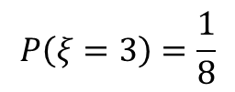
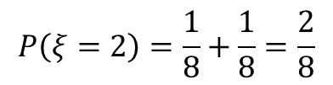
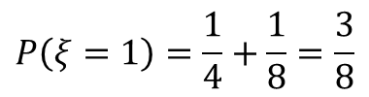
Exercise 8.4 (M4)
A coin is tossed. If the result is a head, it is tossed two more times, otherwise it is tossed one more time. What is the mean number of heads obtained?
$$ξ−number of heads$$
$$P\left(ξ=0\right)=\frac{1}{4}$$
C
$$P\left(ξ=1\right)=\frac{1}{4}+\frac{1}{8}=\frac{3}{8}$$
H
T
$$P\left(ξ=2\right)=\frac{1}{8}+\frac{1}{8}=\frac{2}{8}$$
H
T
H
T
H
T
H
T
$$P\left(ξ=3\right)=\frac{1}{8}$$
$$𝔼ξ=0∗\frac{1}{4}+1∗\frac{3}{8}+2∗\frac{2}{8}+3∗\frac{1}{8}=\frac{5}{4}$$

Slide 11
Exercise 8.4 (M4) MATLAB solution
n = 10^6;
s = 0;
for i=1:n
if rand()<1/2
s=s+1;
if rand()<1/2
s=s+1;
end
if rand()<1/2
s=s+1;
end
else
if rand()<1/2
s=s+1;
end
end
end
s/n
5/4

Slide 12

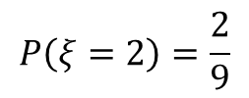
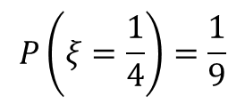


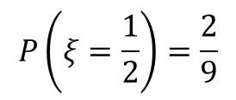
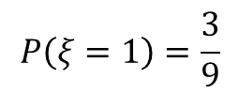

Exercise 8.7 (M5)
The nominal value of a share is one golden galleon. In a year the value either can doubled, or halved or remain the same - each of the events has the same probability. On the next year the same happens, independently of the events of the previous year. Find the distribution of the value of the share after two years. What is the mean and the variance of the value?
$$P\left(ξ=4\right)=\frac{1}{9}$$
$$𝔼ξ=\frac{49}{36}$$
$$P\left(ξ=2\right)=\frac{2}{9}$$
$$P\left(ξ=1\right)=\frac{3}{9}$$
$$𝔼ξ^{2}=16∗\frac{1}{9}+4∗\frac{2}{9}+1∗\frac{3}{9}+\frac{1}{4}∗\frac{2}{9}+\frac{1}{16}∗\frac{1}{9}=\frac{49}{16}$$
$$P\left(ξ=\frac{1}{2}\right)=\frac{2}{9}$$
$$𝔻ξ^{2}=𝔼ξ^{2}−{\left(𝔼ξ\right)}^{2}=\frac{98}{81}$$
$$P\left(ξ=\frac{1}{4}\right)=\frac{1}{9}$$

Slide 13
Exercise 8.7 (M5) MATLAB solution
n = 10^7;
x = 0;
xs = 0;
for i=1:n
g = 1;
for j=1:2
r = rand();
if r<1/3
g = g*2;
elseif r>2/3
g = g/2;
end
end
x = x+g;
xs = xs+g^2;
end
x_mean = x/n
x_var = xs/n - x_mean^2

Slide 14
Literature
Ágnes Baran: Mathematics for engineers 1. (Laboratory slides)
Sándor Baran: Probability theory and statistics
Fazekas István: Valószínűségszámítás, Debreceni Egyetemi Kiadó, 2009
Fazekas István: Bevezetés a matematikai statisztikába, Debreceni Egyetemi Kiadó, 2009
Matlab examples: https://www.mathworks.com/help/examples.html

