Slide 1
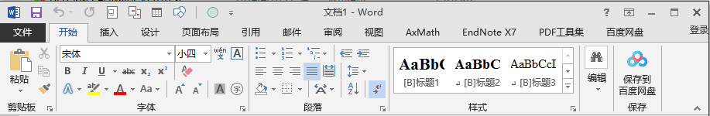
SARibbonBar::OfficeStyle Ribbon模式示例
SARibbonQuickAccessBar
SARibbonTabBar
titleBar
window title
_
□
×
Pannel Title
applicationButton
Pannel
Category

Slide 2
SARibbonBar::WpsLiteStyle Ribbon模式示例
applicationButton
SARibbonTabBar
titleBar
SARibbonQuickAccessBar
window title
_
□
×
Pannel Title
Pannel
Category

Slide 3
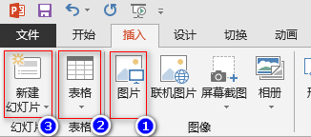

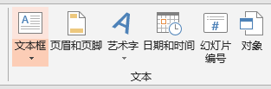
3行模式下的按钮尺寸
ICON
ICON
ICON
Text Line1
Text Line2
Text Line1
Text Line1
Text Line2
三行模式下的按钮
三行模式下的按钮，文本不换行，带下拉引导
三行模式下的按钮，文本换行，带下拉引导

Slide 4
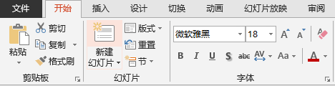
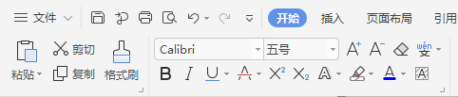
SARibbonPannel : 3Row
spacing
contentsMargins
3行模式下，Medium占两行，Office示例
Pannel Title
Large
Small
Medium
Large
Small
Medium
OptionAction
SARibbonPannel : 2Row
2行模式下，Medium和Small一样，不做区分
WPS示例
spacing
contentsMargins
Large
Small
Medium
Large
Small
Medium
OptionAction

Slide 5
SARibbonBar::WpsLiteStyle Ribbon模式示例
applicationButton
SARibbonTabBar
titleBar
SARibbonQuickAccessBar
window title
_
□
×
Pannel Title
Pannel
Category

Slide 6
SARibbonBar层级关系
Window Button Bar
Right Button Group
Quick Access Bar
Window Title
_
□
×
Application Button
TabBar
window title
Window Icon
Tab2
Tab3
Tab1
SARibbonBar
Category
Pannel
Pannel Title

Slide 7
SARibbonBar层级关系
Window Button Bar
Right Button Group
Quick Access Bar
_
□
×
TabBar
Window Title
Application Button
Window Icon
window title
Tab2
Tab3
Tab1
SARibbonBar
Category
Pannel
Pannel Title

