Slide 1
Home Value & Income
Relationship of Median Values by State
2004-2023

Slide 2
Data
Zillow Home Value Index for All Homes Including Single-Family Residences, Condos, and CO-OPs in the United States
Median Household Income in the United States
Datasets acquired via API from Federal Reserve Economic Data (FRED)
https://fred.stlouisfed.org/
Time series 2004-2023 (income data for 2024 not available)
2004 Home Value data excludes Montana and North Dakota (not available)

Slide 3
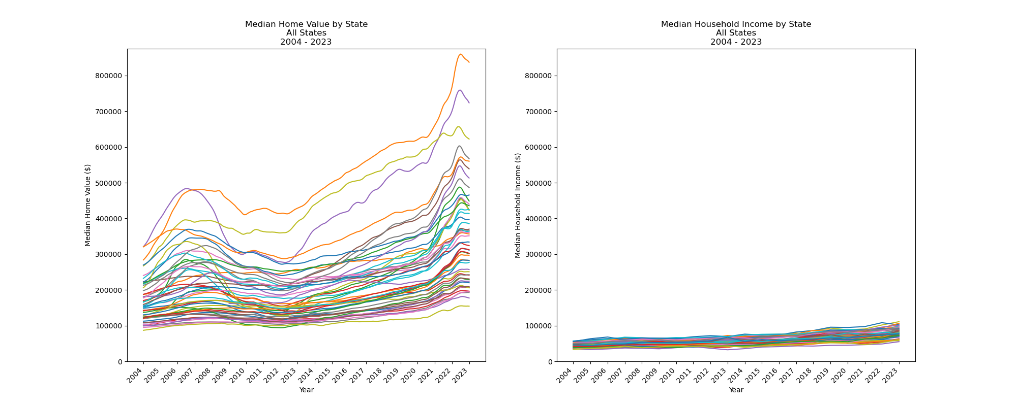
Median home values and median household incomes, 2004-2023

Slide 4
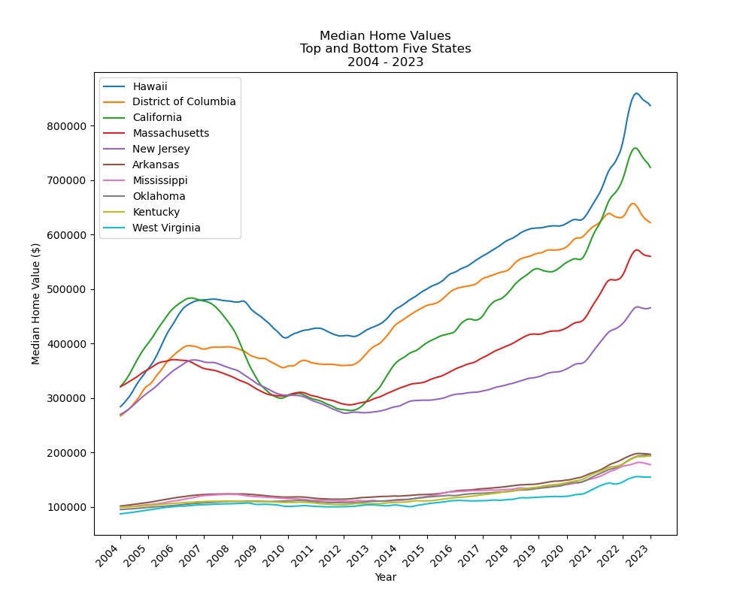
Top and Bottom 5 states by mean Median Home Value

Slide 5
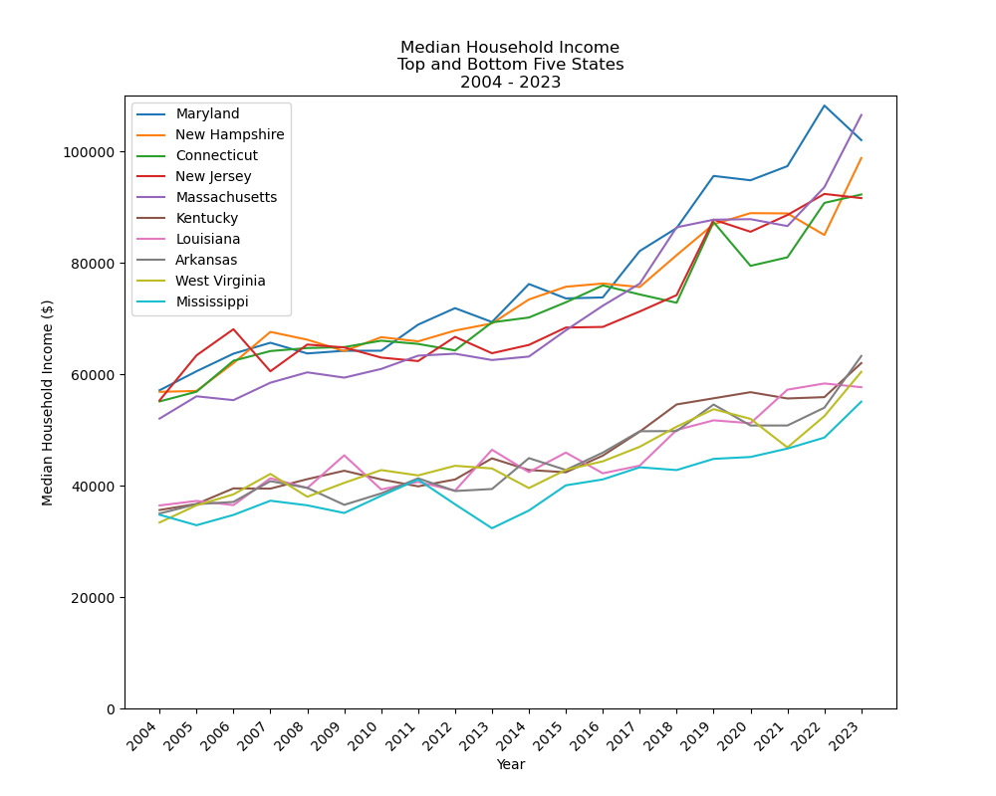
Top and Bottom 5 states by mean Median Household Income

Slide 6
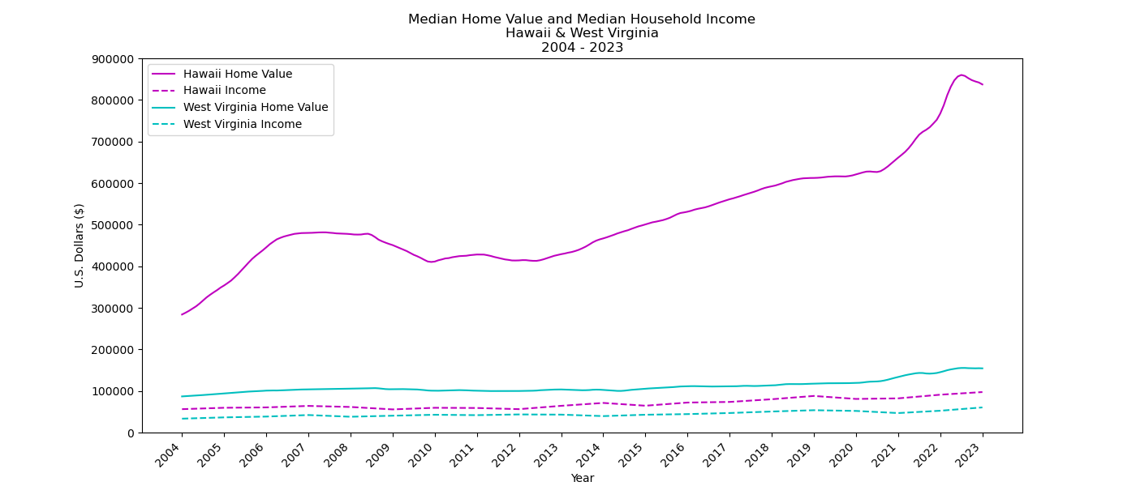
Highest and lowest mean Median Home Value, 2004-2023

Slide 7
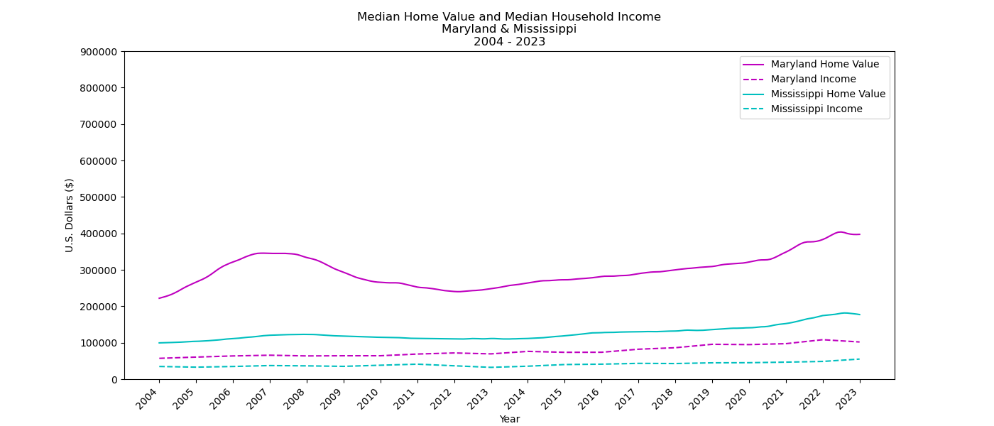
Highest and lowest mean Median Household Income, 2004-2023

Slide 8
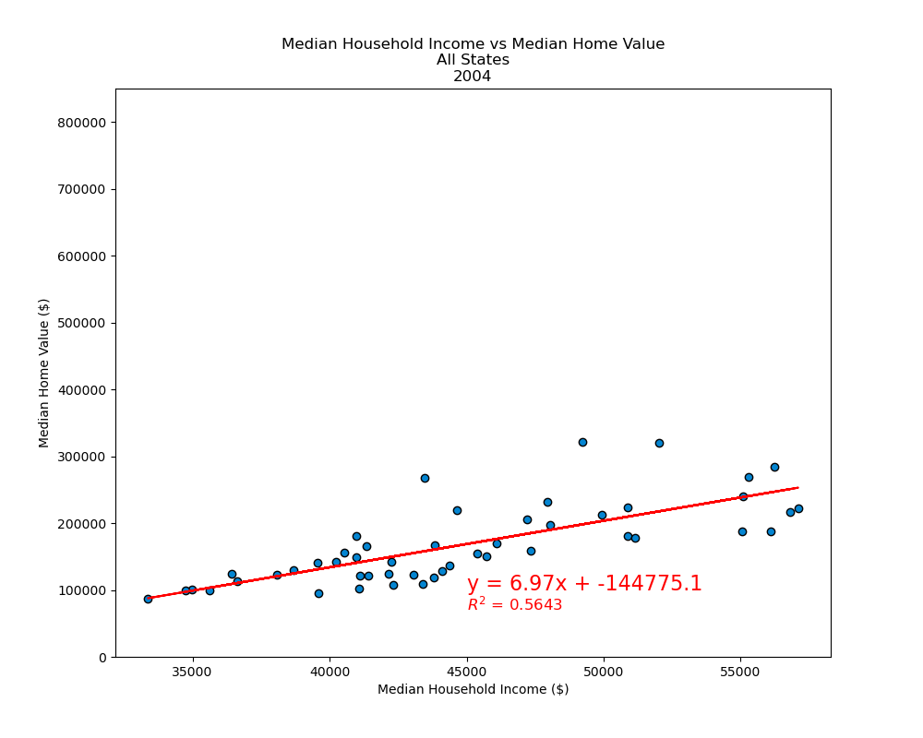
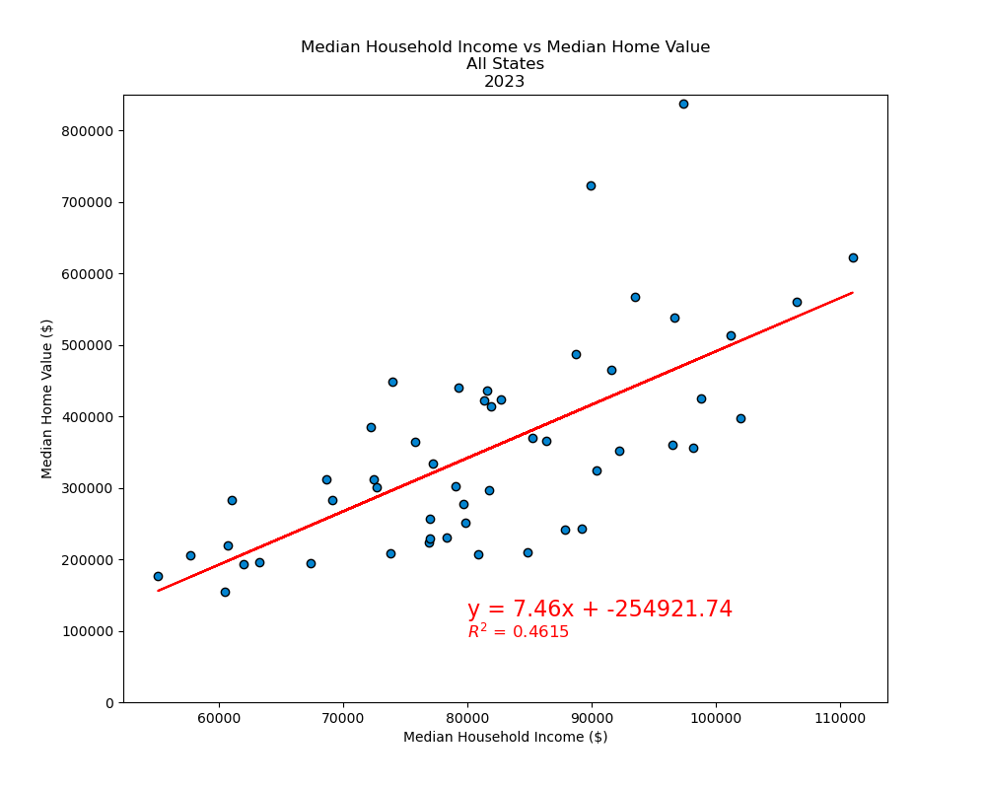
Linear Regression Models
How well does a state’s Median Household Income predict its Median Home Value?

Slide 9
Home Affordability
We can calculate home affordability as the ratio of Median Household Income to Median Home Value
Affordability =
Median Household Income
Median Home Value

Slide 10
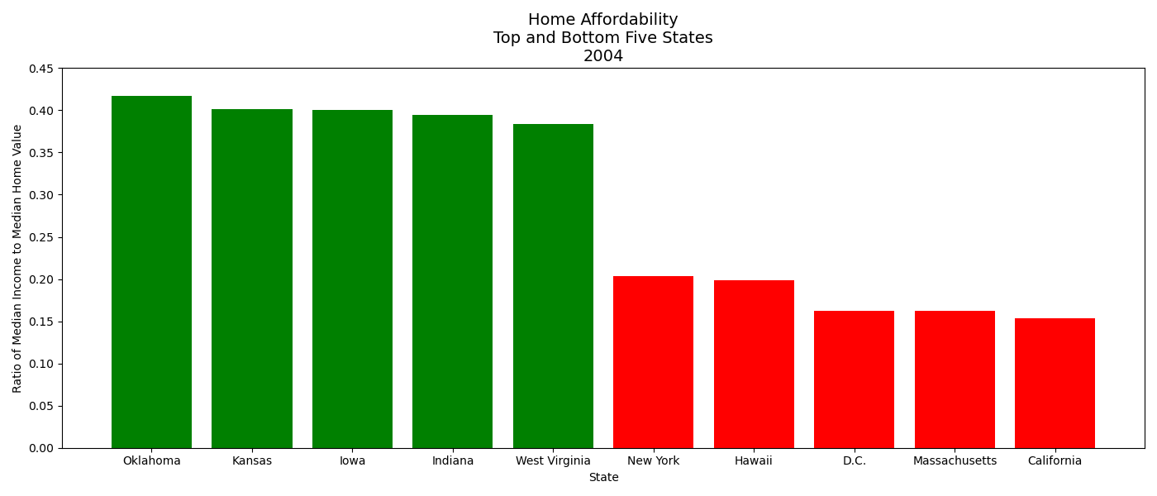
Home Affordability 2004

Slide 11
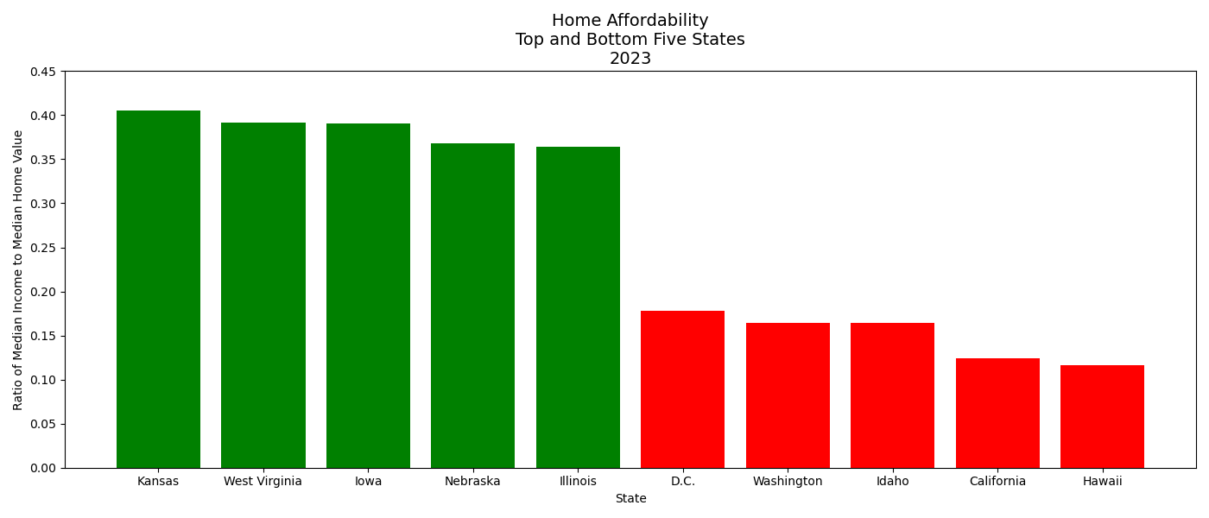
Home Affordability 2023

Slide 12
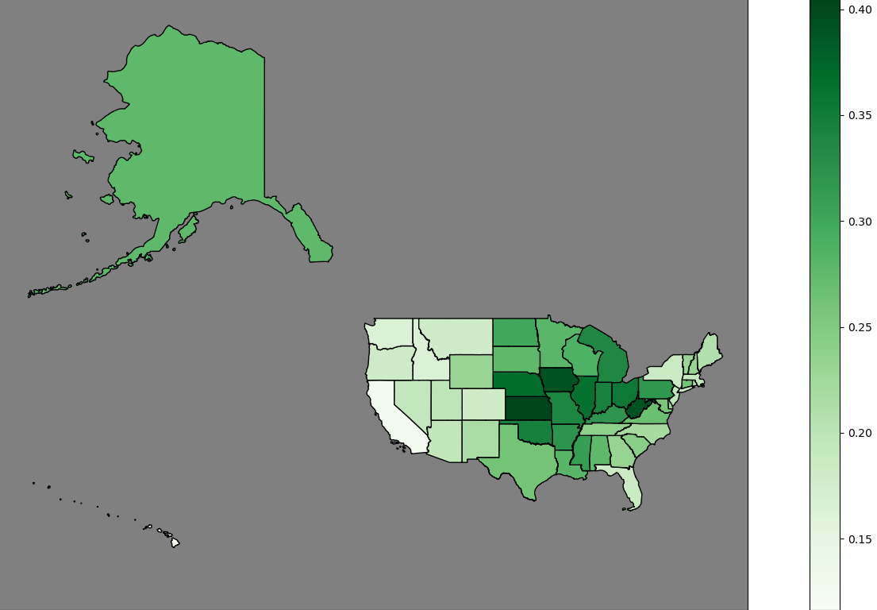
Home Affordability 2023

Slide 13
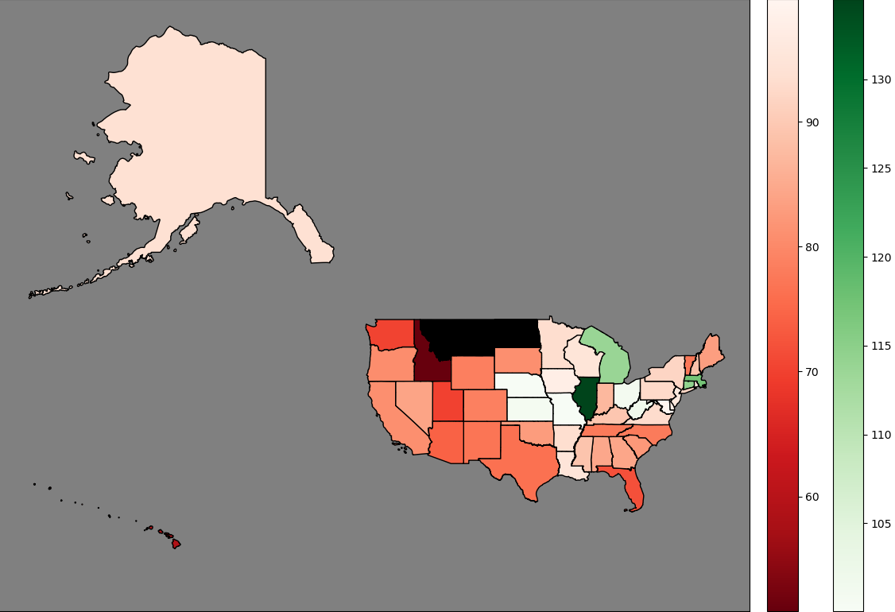
Home Affordability Percent Change 2004-2023

