Slide 1

Exploration Of Housing Data
Housing Data And Higher Education over Time

Slide 2
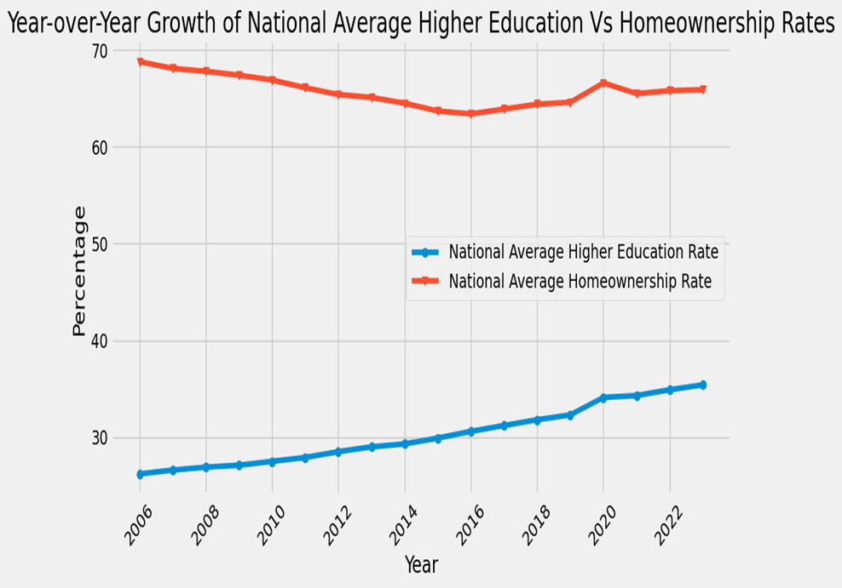
Analysis of Trend Over Time
Peaks:
Home ownership: peaks at around 2006
Higher education: peaks at around 2020
Trough:
Home ownership: was at it’s lowest around 2016
Higher education: No significant decline was observed
Overall Observations:
Higher Education shows consistent growth over time
Homeownership has faced steady decline
No correlation between seen

Slide 3
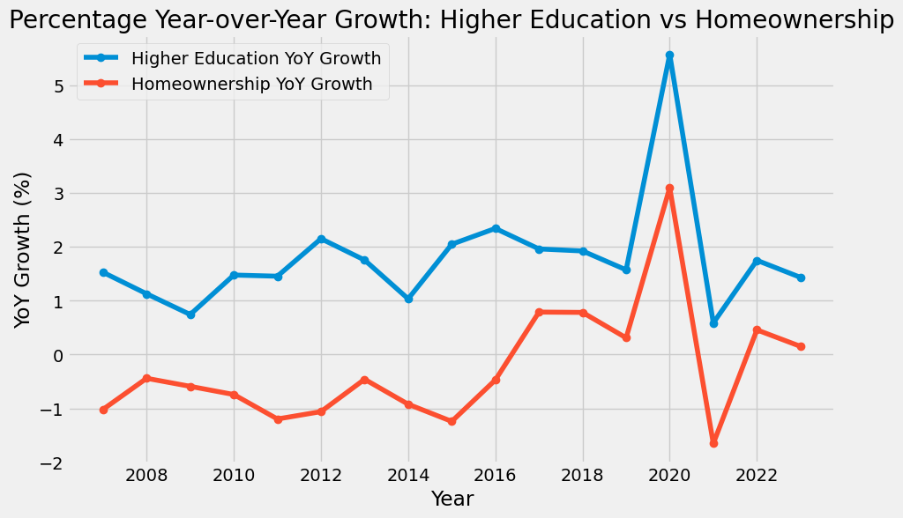
Analysis of Percentage Year Over Year Change
Periods of Growth And Decline: Significant percentage growth was seen in 2020 Significant percentage decline occurred in 2021

Slide 4
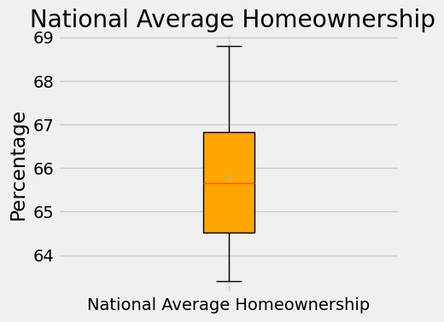
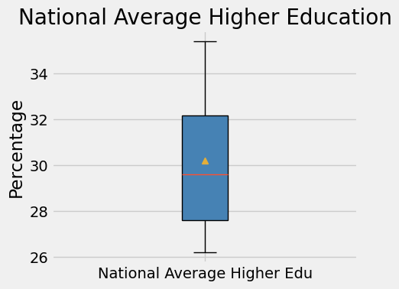
Key Observations:
No outliers are present in either dataset as all data points fall within the bounds.
US Avg. Higher Edu shows a slightly broader spread, with mild skewness toward higher values.
US Homeownership is more symmetrical and consistent across the data points.

Slide 5
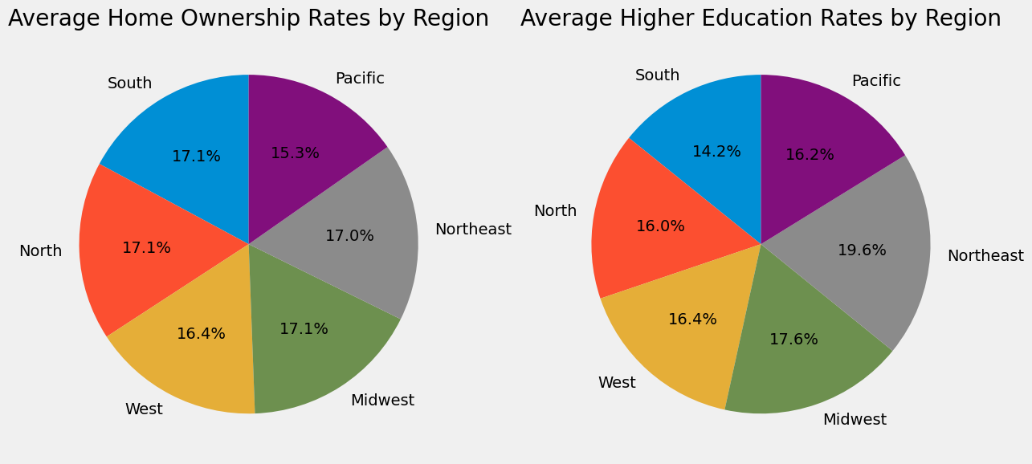
Percentage of Home Ownership and Higher Education Rates by Region
States in the Northeast and Midwest regions generally show higher education rates
The Southern regions tend to have lower average higher education rates
South, North and Midwest regions typically having higher home ownership rates compared to the West and Pacific
The South shows higher home ownership rates but lower higher education rates.

