Slide 1

U.S. Housing
Constraints

Slide 2
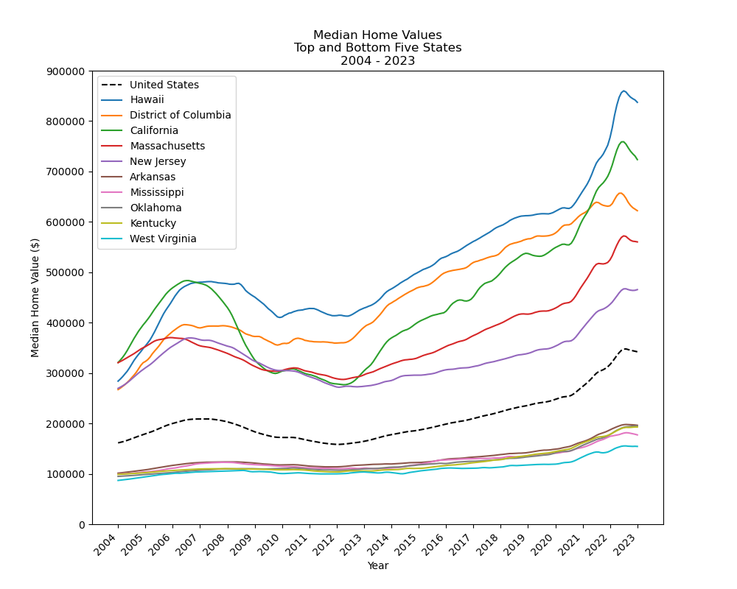
Median Home Value Top and Bottom 5 States
Range between highest and lowest increased by 191% ($448,730) since 2004
U.S. median increased by 112% ($180,759)
Bottom states are more clustered and have little change
Top states have much greater separation and volatility, with large peaks and valleys

Slide 3
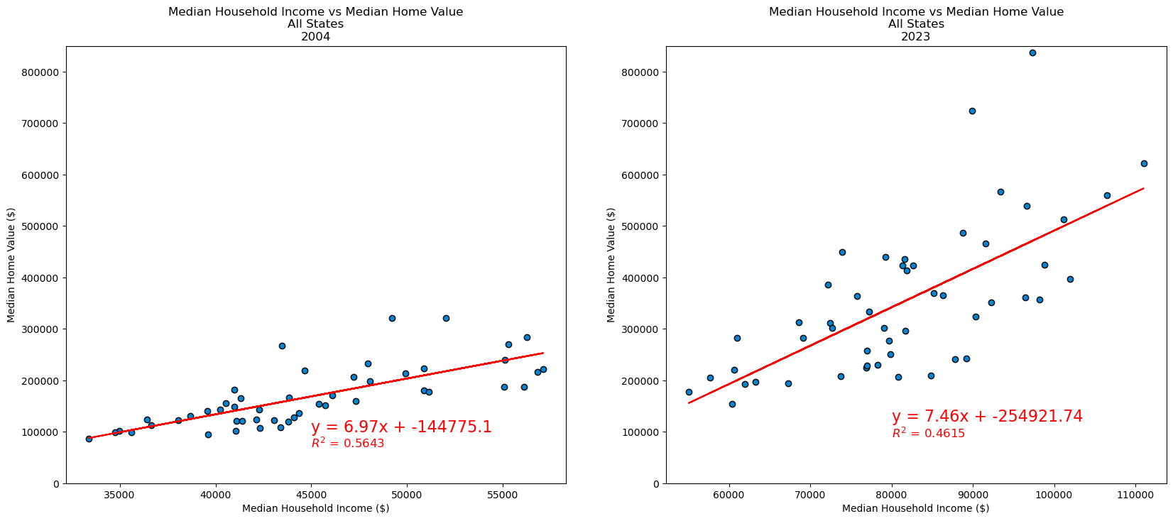
Linear Regression Models Home Value vs Income
Moderate correlation between home value and income
R² decreased from 0.56 in 2004 to 0.46 in 2023, indicating income has become less reliable as a predictor of home value

Slide 4
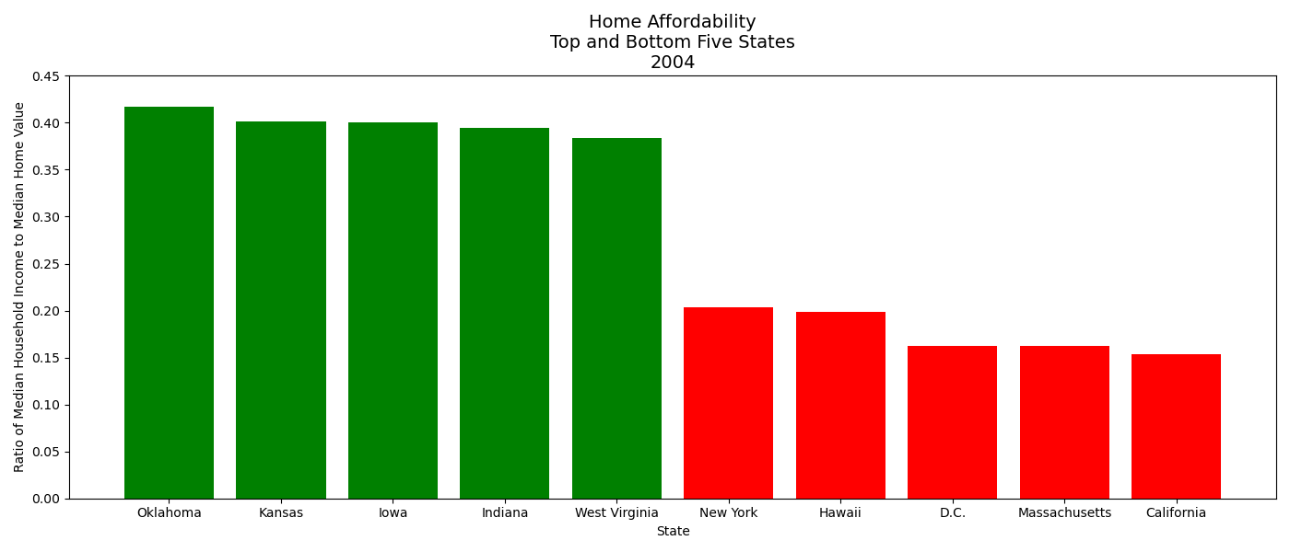
Home Affordability 2004
Median Household Income
Affordability =
Top 5 states are predominantly rural. Bottom 5 (except Hawaii) have large urban areas.
Oklahoma is the most affordable, California the least.
Median Home Value

Slide 5
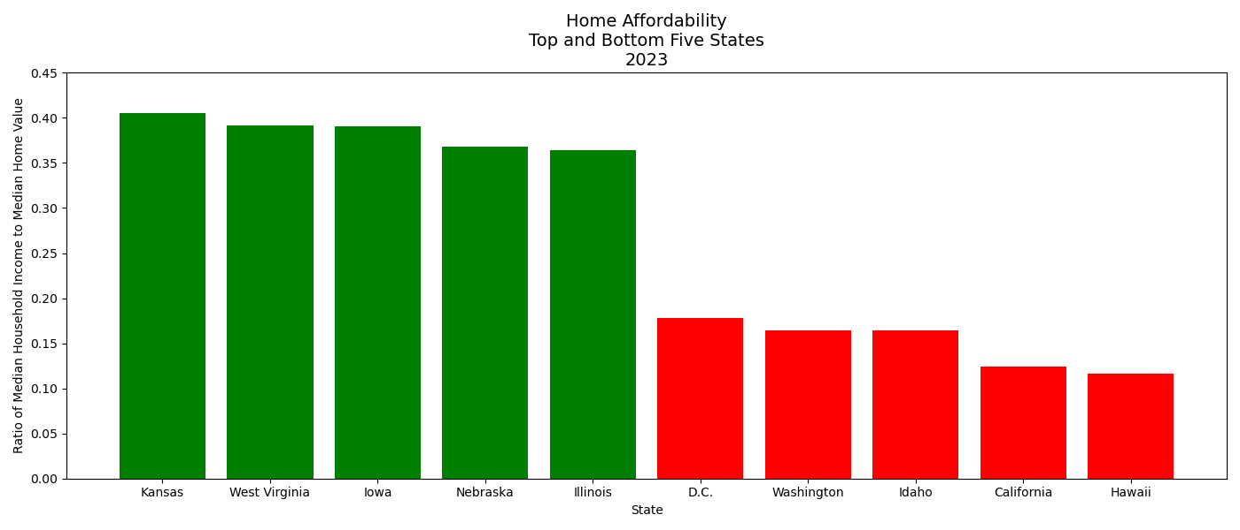
Home Affordability 2023
Overall, affordability has decreased compared to 2004
Kansas is most affordable. Oklahoma no longer in the Top 5.
Illinois is 5th most affordable, despite having the 3rd largest U.S. city (Chicago)
Hawaii is least affordable, overtaking California
But California is less affordable than in 2004
Idaho is 3rd least affordable

Slide 6
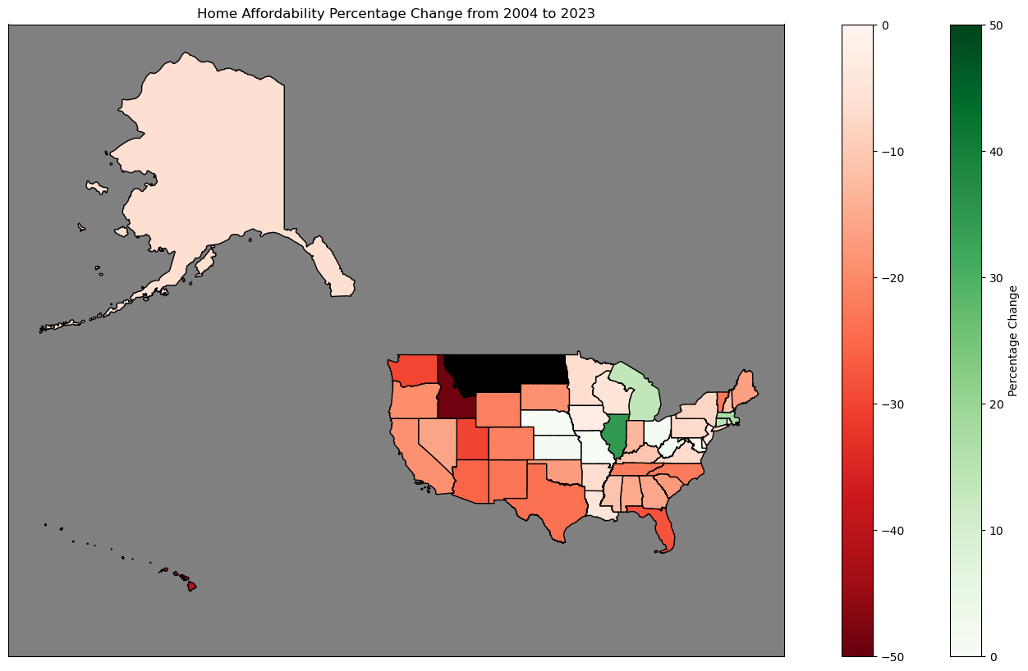
Home Affordability Percentage Change 2004-2023
Most states have decreased in affordability (red). Few have increased (green).
Largest increase: Illinois (+34%)
Largest decrease: Idaho (-50%)
Note: No Home Value data for Montana and North Dakota in 2004

Slide 7
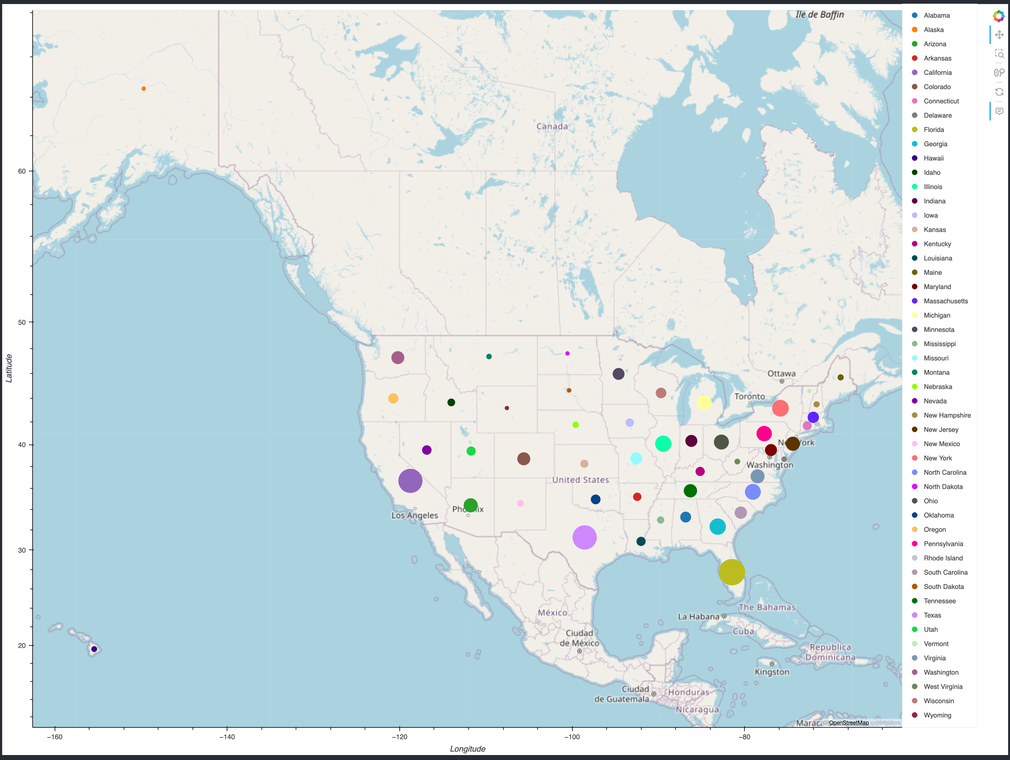
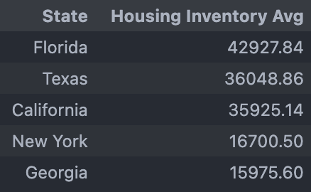
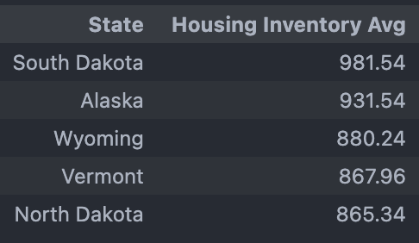
New Home Listings Averages (2004-2024)
Top 5 States
Bottom 5 States

Slide 8
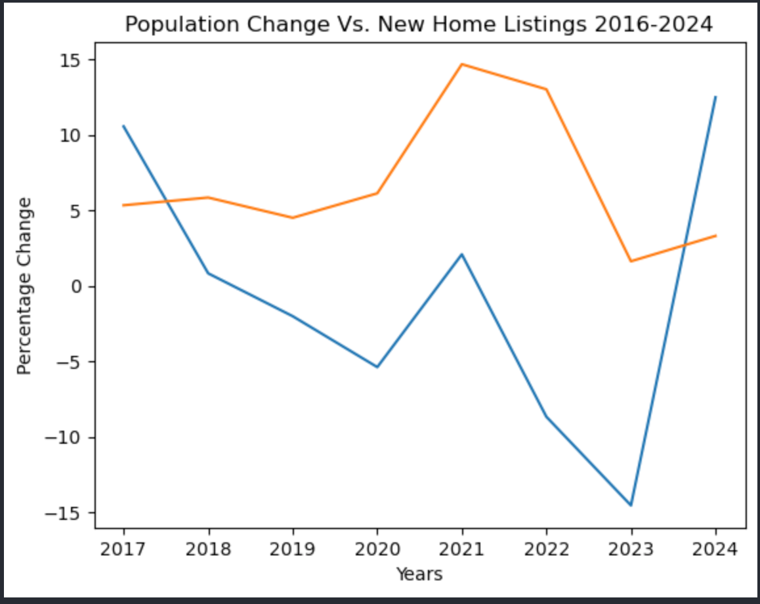
U.S. Population vs New Home Listings (2016 - 2024
The compounded annual growth rate for the U.S. Population was 6.03% between 2016 and 2024
The compounded annual growth rate for New Home Listings Between 2016 and 2024 was -0.95%.
The U.S. Population growth rate out paced new home listings by 6.98% (Difference Between the two growth rates)

Slide 9
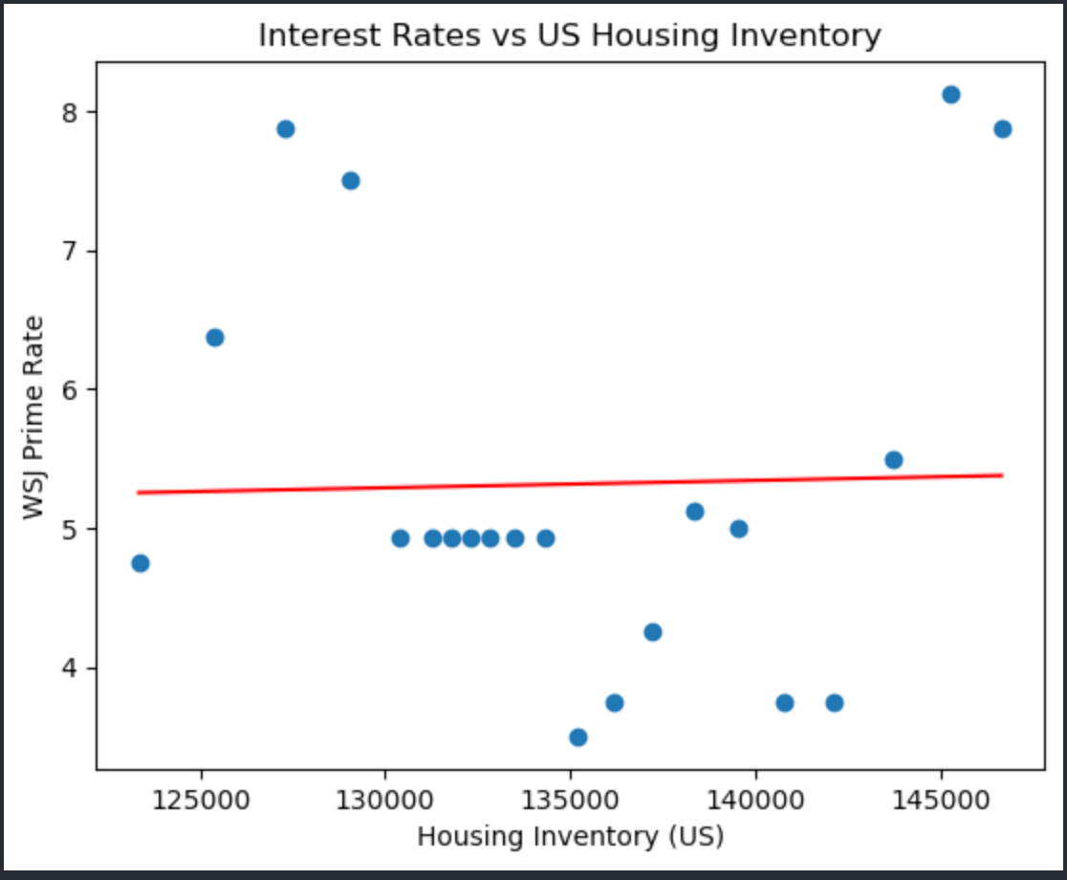
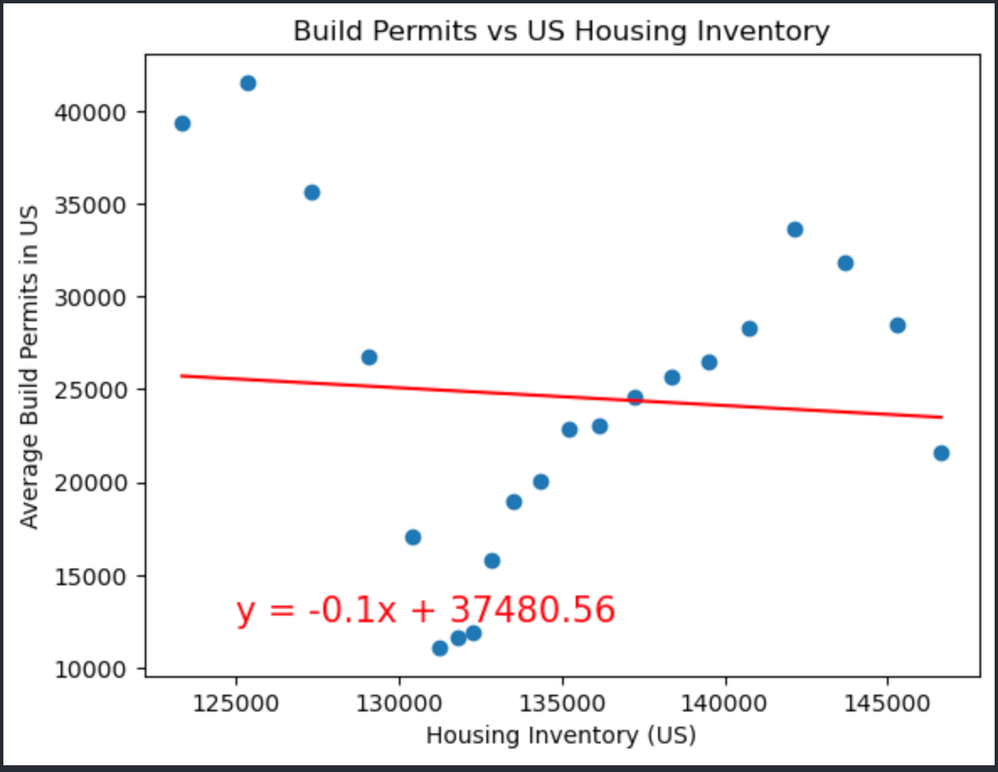
U.S. Housing Inventory (By New Home Listings)
R-value: 0.0005703265458220814
R-value: 0.004945153088260975

Slide 10
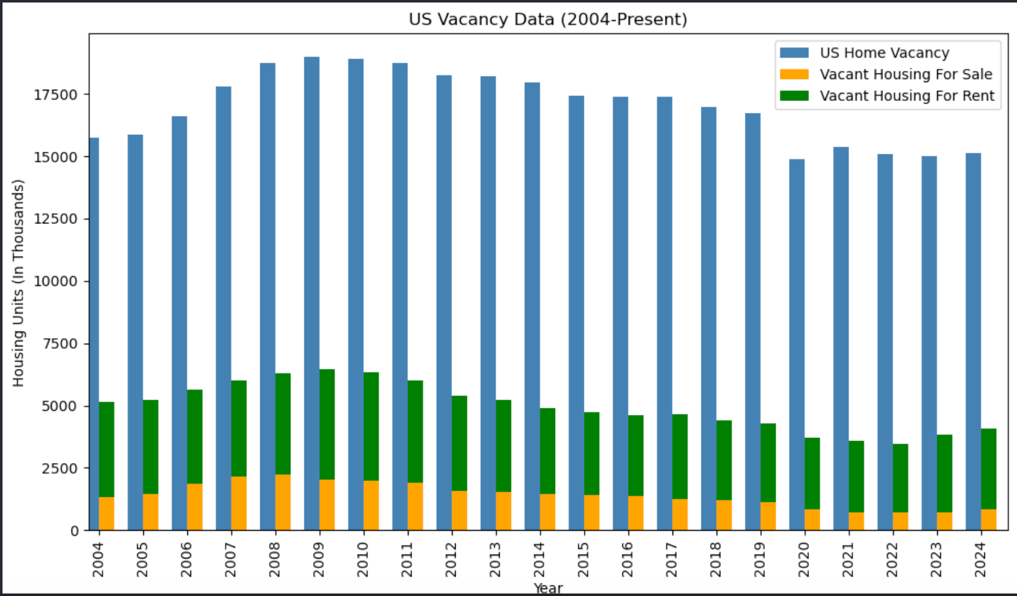
U.S. Home Vacancies
Many of the homes that are vacant in the U.S. are not available for sale or rent.
Home could be attributed to the following:
Unhabitable Homes
In need of Renovation.
Currently being renovated.
Holding for speculative purposes.
Housing currently in development.
Second home/vacation home.
Etc…
Reducing the number of home vacancies that are not up for sale or rent could help reduce or alleviate some of the housing constraints in the U.S..

