Slide 1

Exploration Of Housing Data
Housing Data And Higher Education over Time

Slide 2
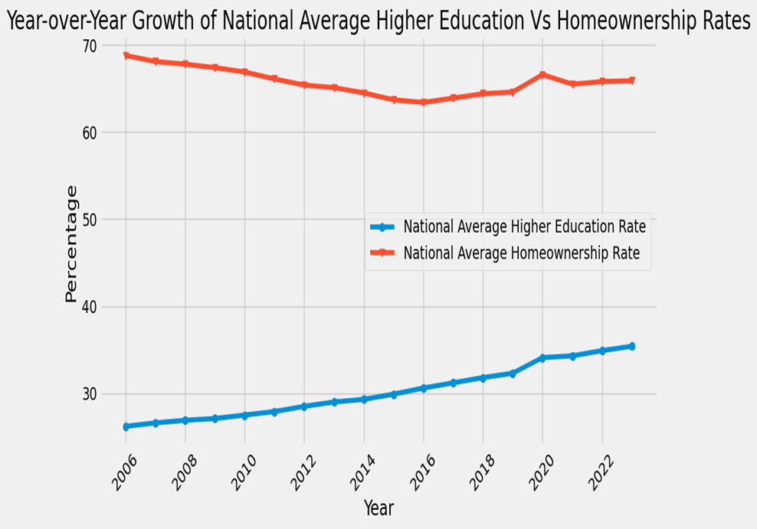
Analysis of Trend Over Time
Peaks:
Home ownership: 2006, at 68.8%,
higher education: 34.1% in 2020
Trough:
Home ownership: 63.4% in 2016
Higher education: No significant decline was observed
Overall Observations:
Higher Education shows consistent growth
Homeownership shows has faced steady decline
No correlation between seen

Slide 3
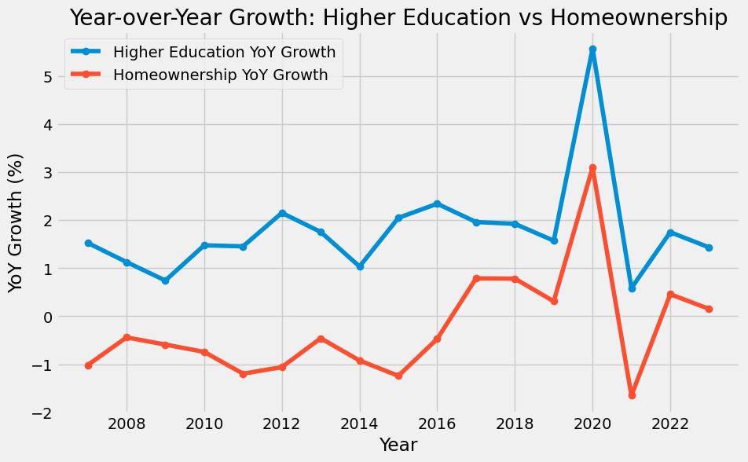
Analysis of Percentage Year Over Year Change
Periods of Growth And Decline: Significant percentage growth was seen in 2020 Significant percentage decline occurred in 2021

Slide 4
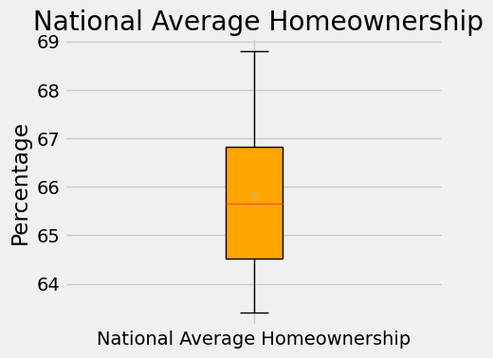
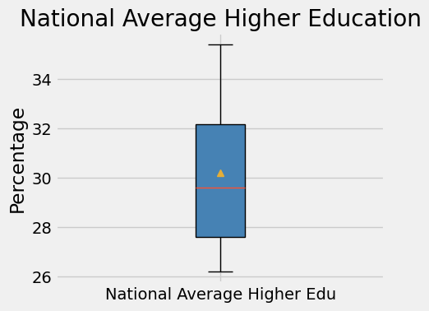
Key Observations:
No outliers are present in either dataset as all data points fall within the bounds.
US Avg. Higher Edu shows a slightly broader spread, with mild skewness toward higher values.
US Homeownership is more symmetrical and consistent across the data points.

Slide 5
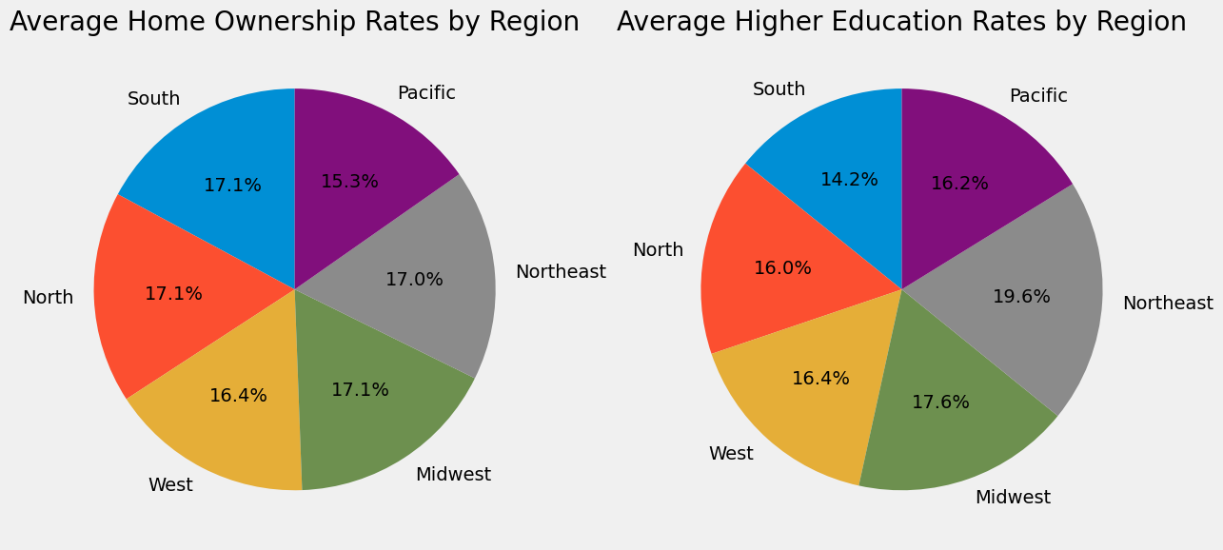
Regional Trends:
The South region have higher home ownership rates
The Northeast and West could have higher education rates
Pacific regions show a relatively higher rate of higher education but lower home ownership
Percentage of Home Ownership and Higher Education Rates by Region

Slide 6
Summary
States in the Northeast and West regions generally show higher education rates
The South and Midwest regions tend to have lower average higher education rates
South and Midwest regions typically having higher home ownership rates compared to the West and Northeast
The District of Columbia consistently shows much lower home ownership rates compared to most states
The South often shows higher home ownership rates but lower higher education rates.
The Northeast and West tend to have higher education rates, but home ownership is generally lower due to higher housing costs.

