Slide 1

U.S. Housing
Constraints

Slide 2
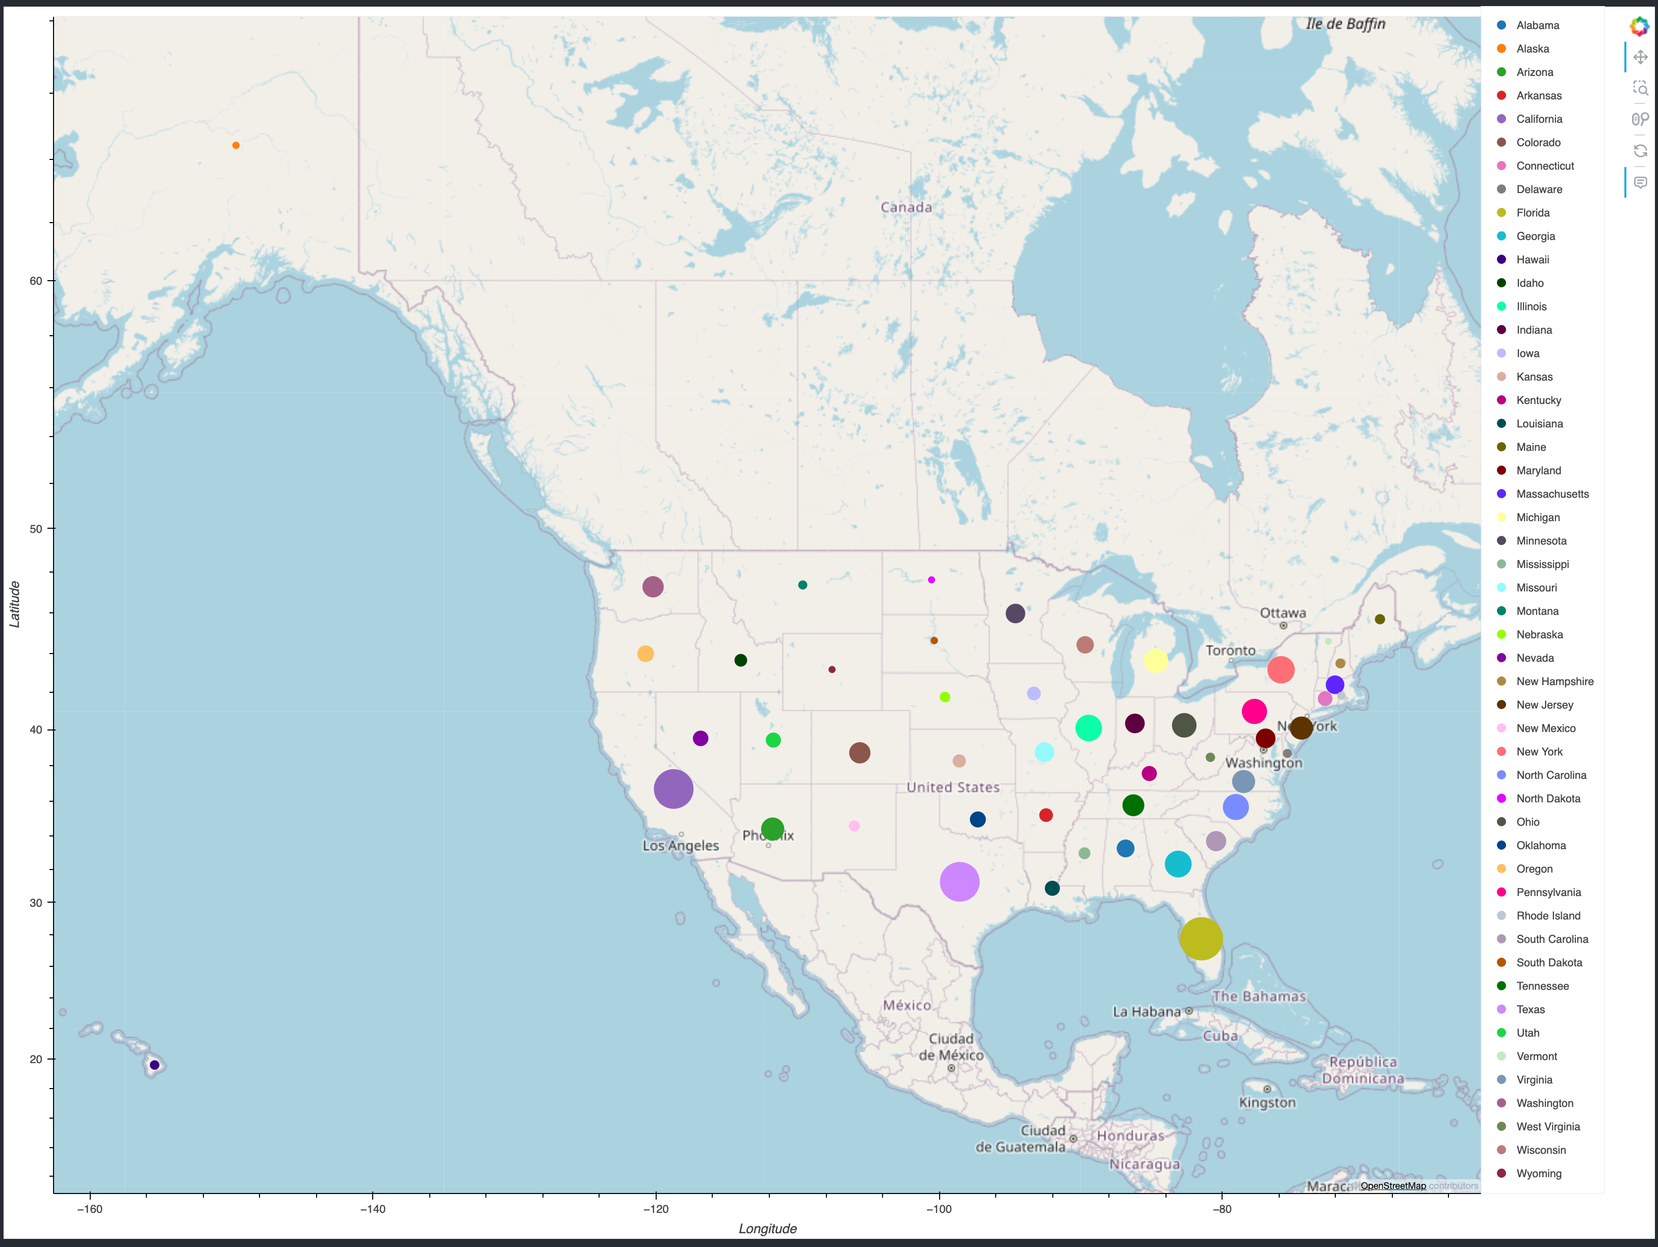
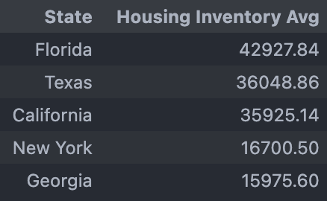
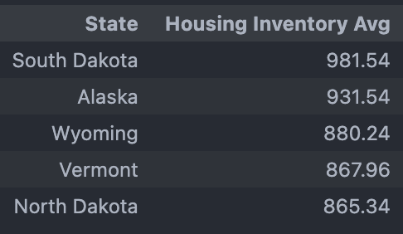
New Home Listings Averages (2004-2024)
Top 5 States
Bottom 5 States

Slide 3
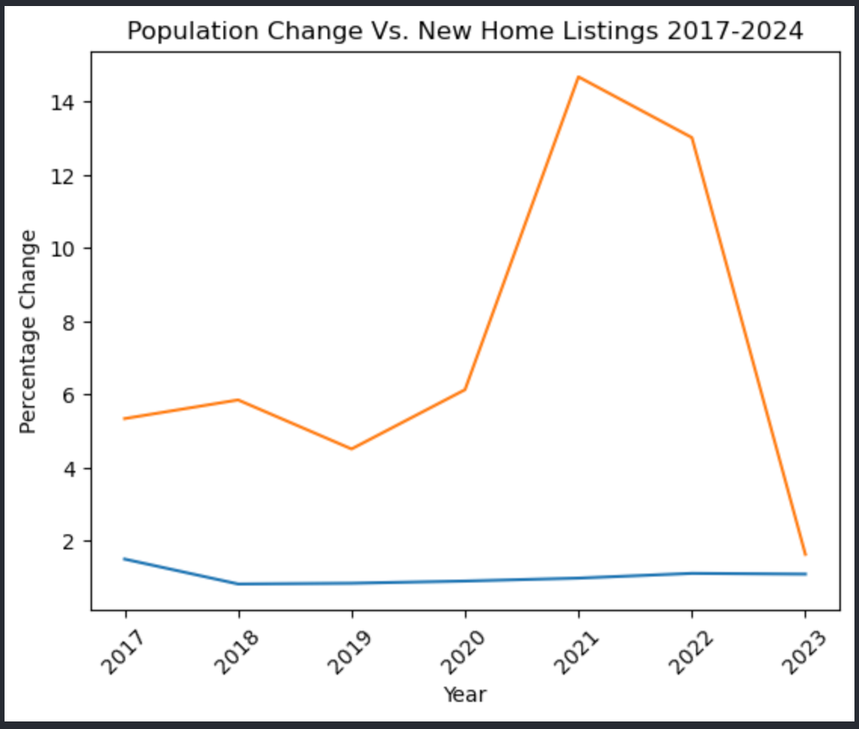
U.S. Population vs New Home Listings (2016 – 2024)
The compounded annual growth rate for the U.S. Population was 7.54% between 2017 and 2023
The compounded annual growth rate for New Home Listings Between 2017 and 2023 was 1.0096%.
The U.S. Population growth rate out paced new home listings by 8.5% (Difference Between the two growth rates)

Slide 4
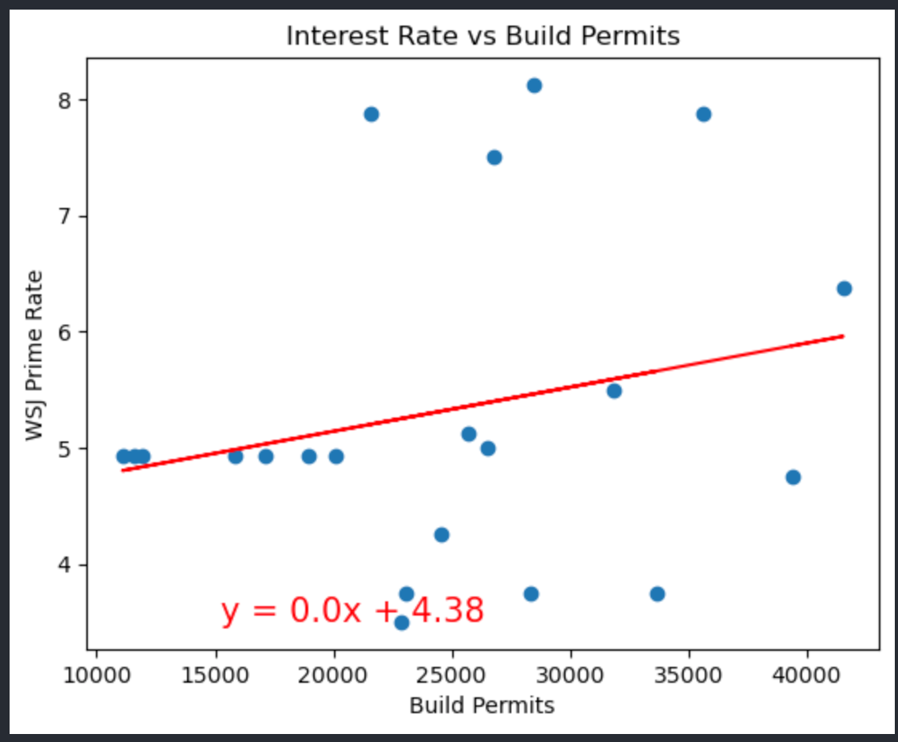
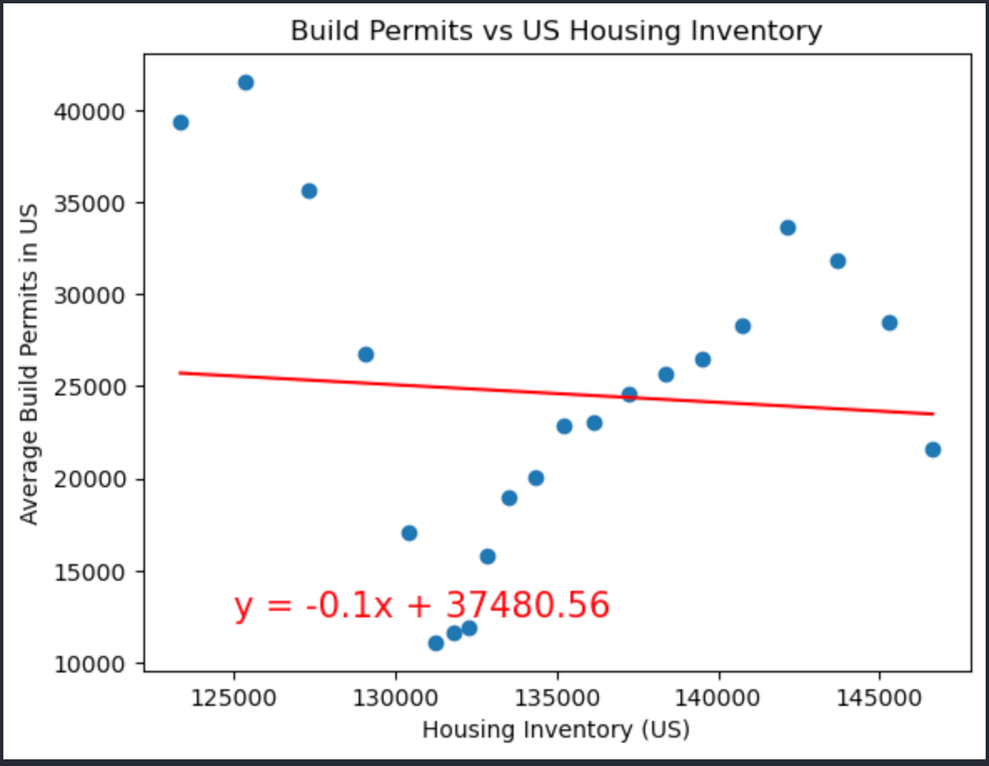
U.S. Housing Inventory (By New Home Listings)
R-value: 0.054175994767244995
R-value: 0.004945153088260975

Slide 5
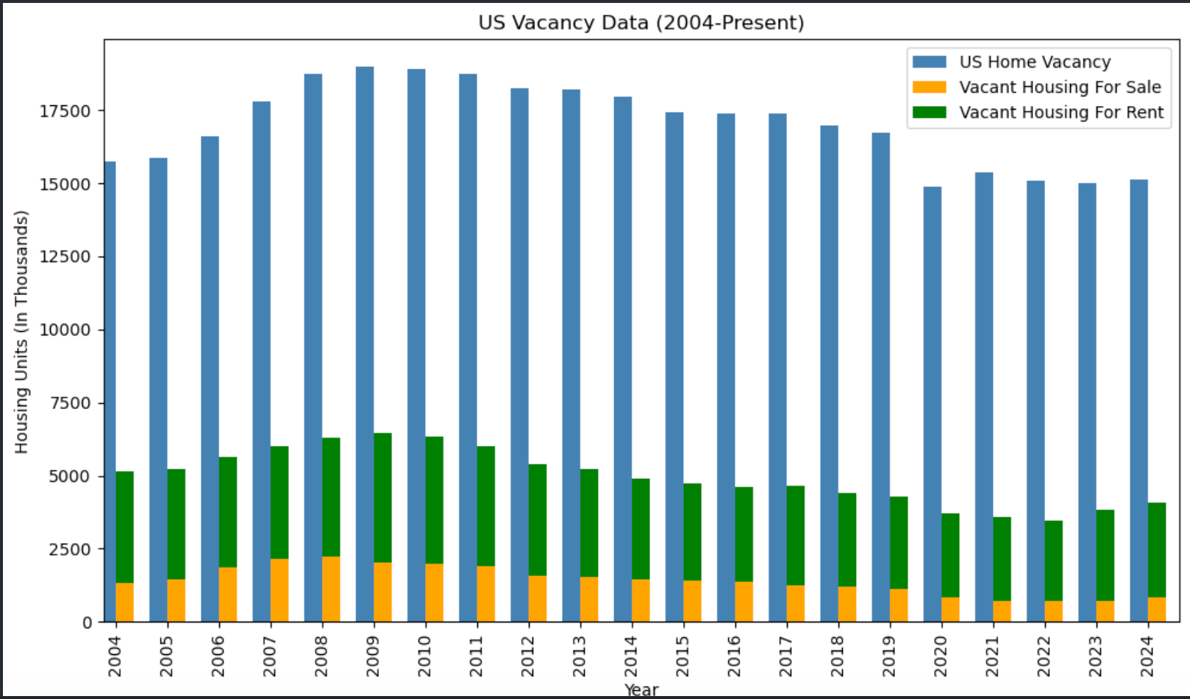
U.S. Home Vacancies
Many of the homes that are vacant in the U.S. are not available for sale or rent.
Home could be attributed to the following:
Unhabitable Homes
In need of renovation.
Currently being renovated.
Holding for speculative purposes.
Housing currently in development.
Second home/vacation home.
Reducing the number of home vacancies that are not up for sale or rent could help reduce or alleviate some of the housing constraints in the U.S.

