Slide 1
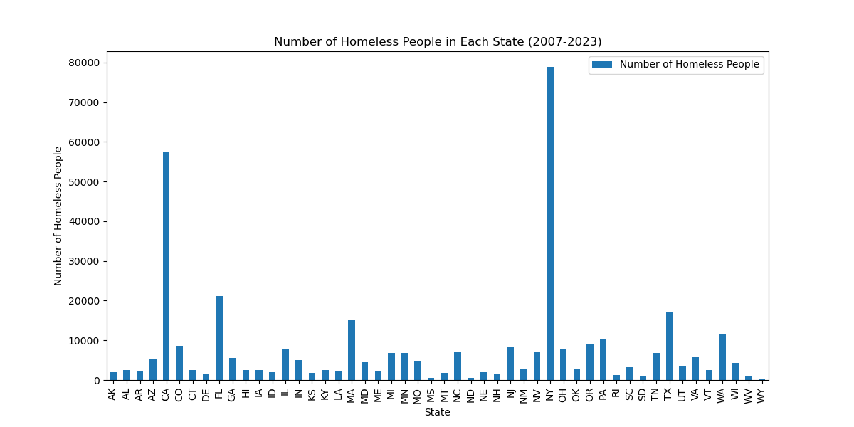
Homelessness Total Number of Homeless Individuals in Each State Aggregated from 2007-2023
States with highest homeless count:
New York: 78,920
California: 57,468
Florida: 21,121

Slide 2
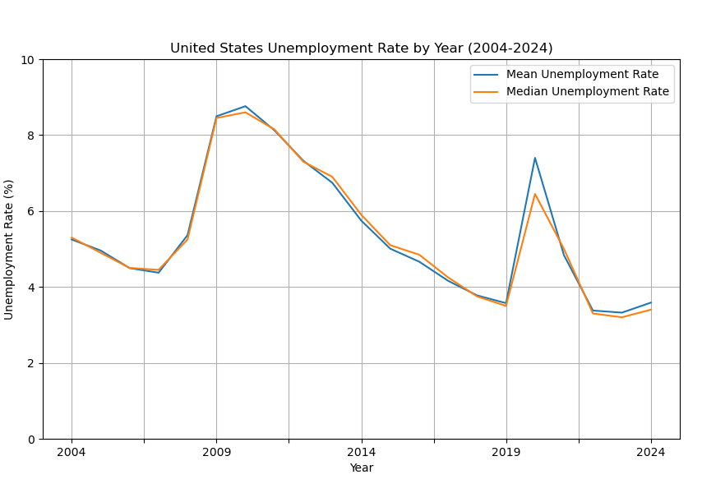
Unemployment Rates
The average and the median unemployment rates per year.
Unemployment started climbing after the 2008 crash.
It peaks at around 2010.
We see a steady decline for about 10 years, until 2020, when Covid-19 hit.

Slide 3
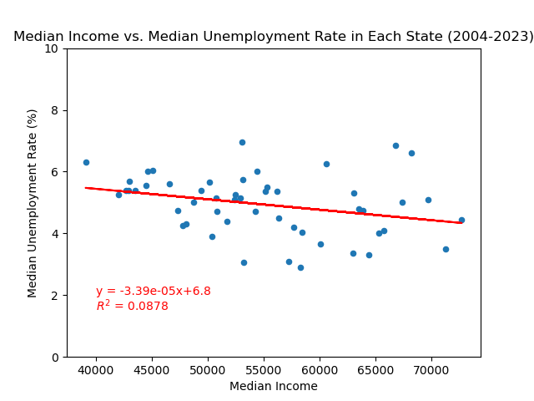
Median Unemployment Rate vs. Median Income
Relationship between median income and median unemployment rates.
The value of R squared is less than 0.5.
There is almost no correlation between the median unemployment rates and median incomes.

Slide 4
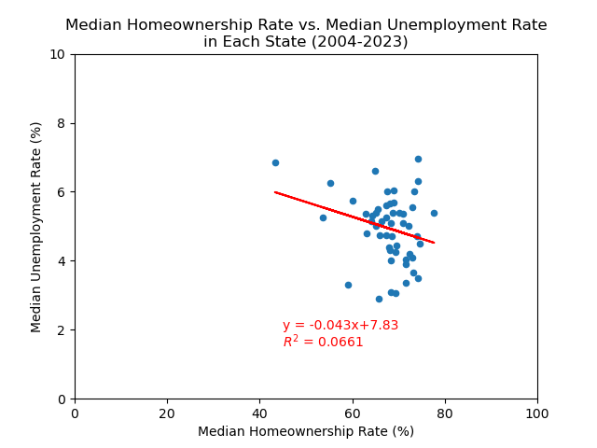
Median Unemployment Rates vs. Median Homeownership Rates
Comparison between unemployment rates and Homeownership rates.
After calculating the correlation, the R squared value is less than 0.5, meaning that there is little to no correlation.

Slide 5
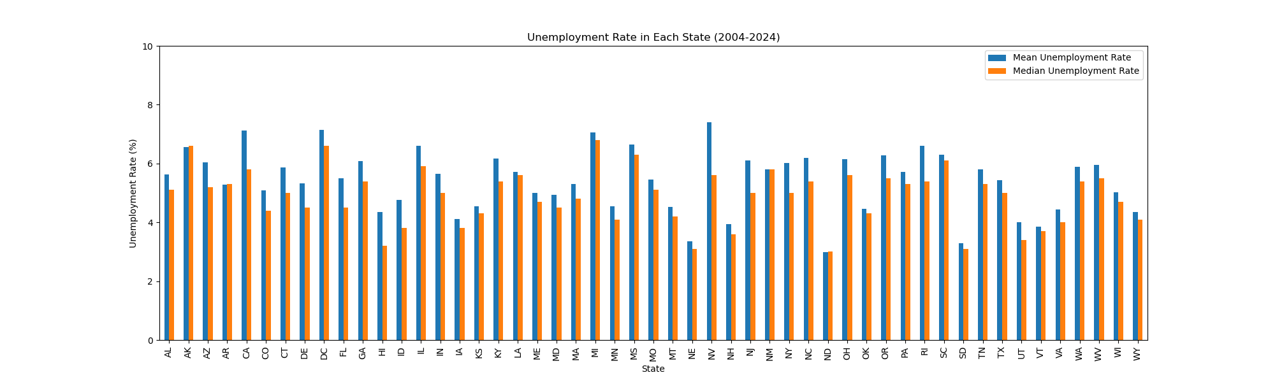
Mean Unemployment Rate vs. Median Unemployment Rate
Mean per state tends to be larger than median measurements.

