Slide 1
The Open Source DAS Ecosystem
Derrick Chambers
Galileo Fiber Optic Conference, 2026

Slide 2
Why Give a Talk About Tools?

Slide 3
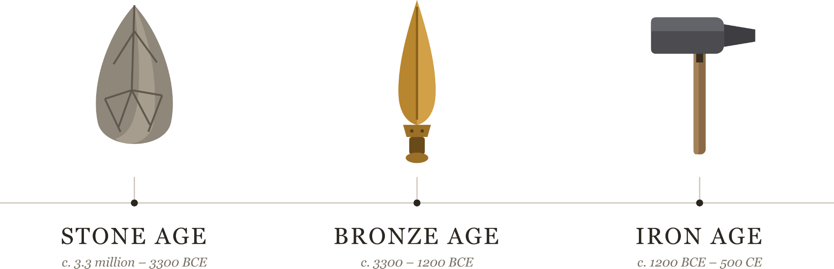
Motivation
*Three Age System, developed to classify prehistoric artifacts

Slide 4
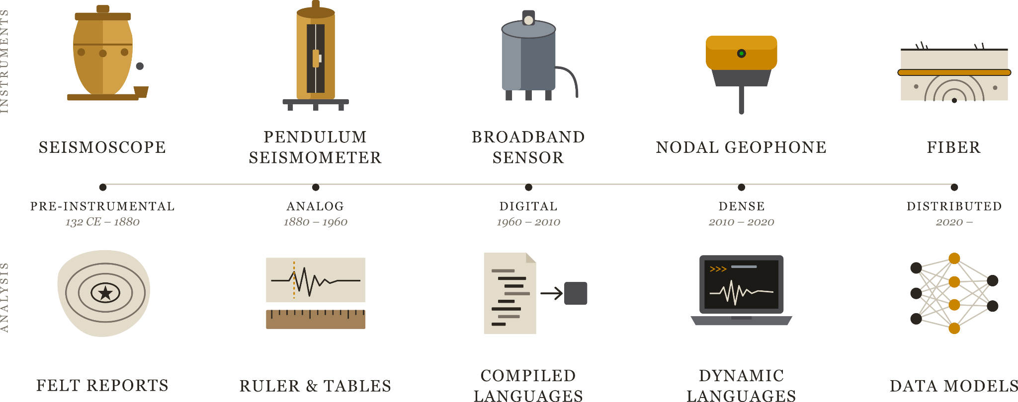
Motivation

Slide 5
Motivation

Slide 6
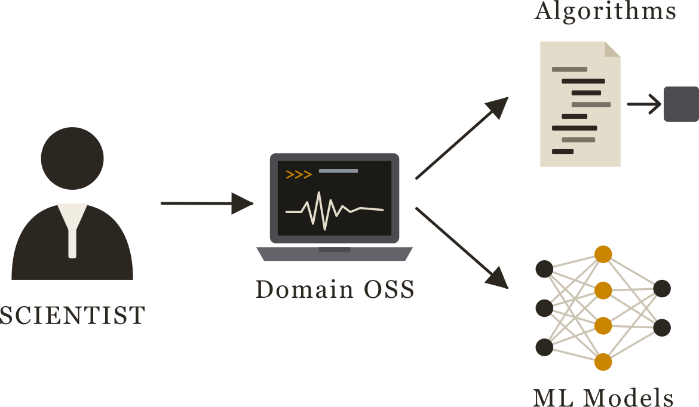
Motivation

Slide 7
What Open DAS Tools Exist?

Slide 8
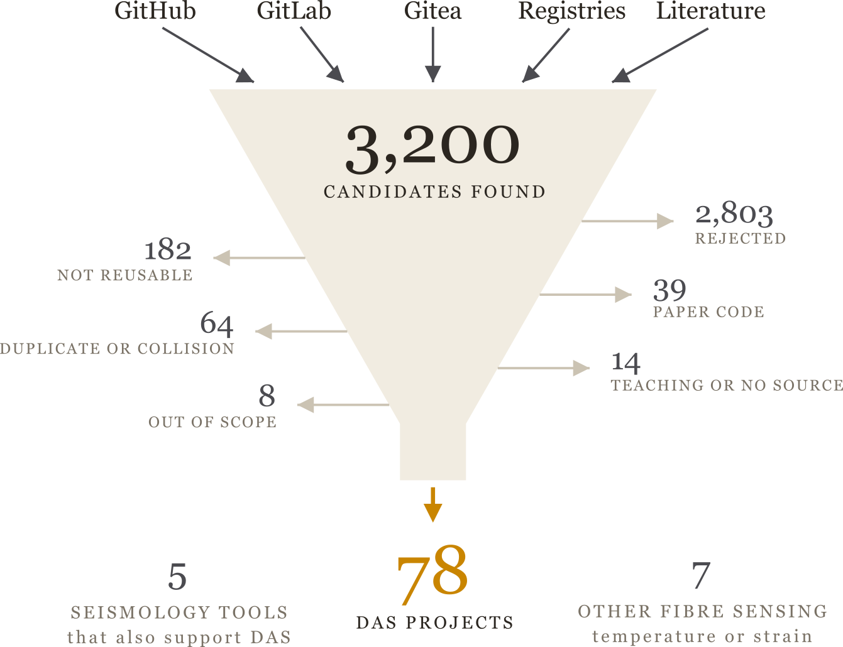
The Tools

Slide 9
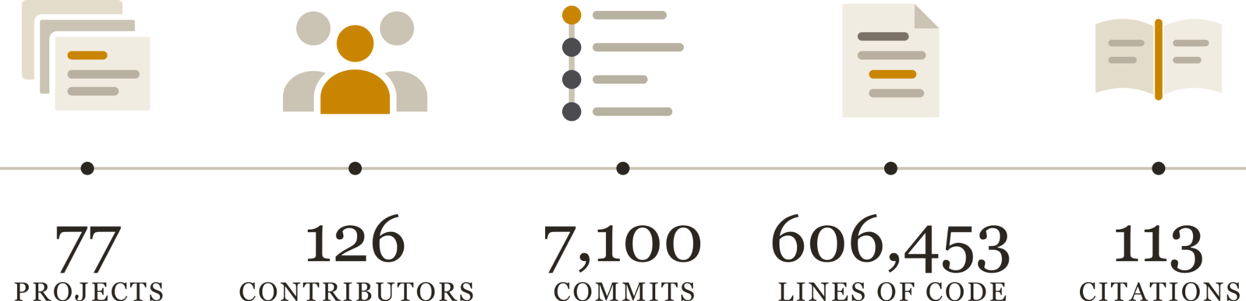
The Tools

Slide 10
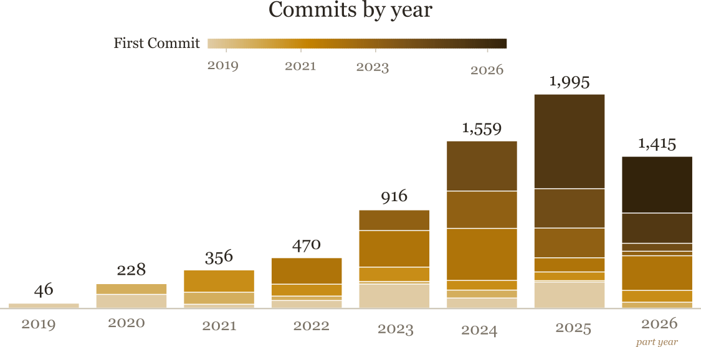
The Tools

Slide 11
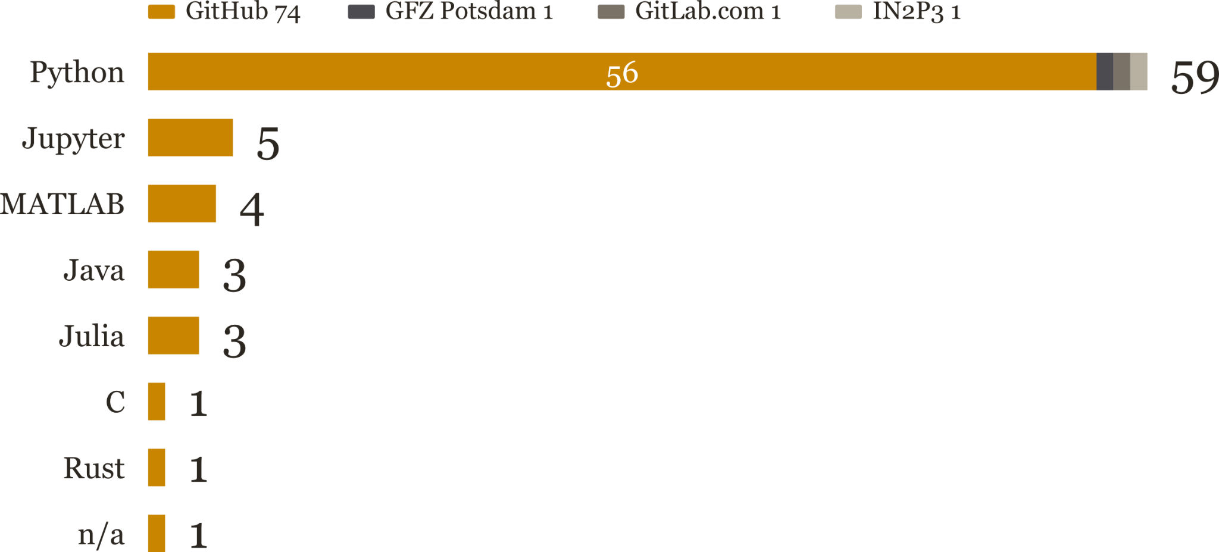
The Tools

Slide 12
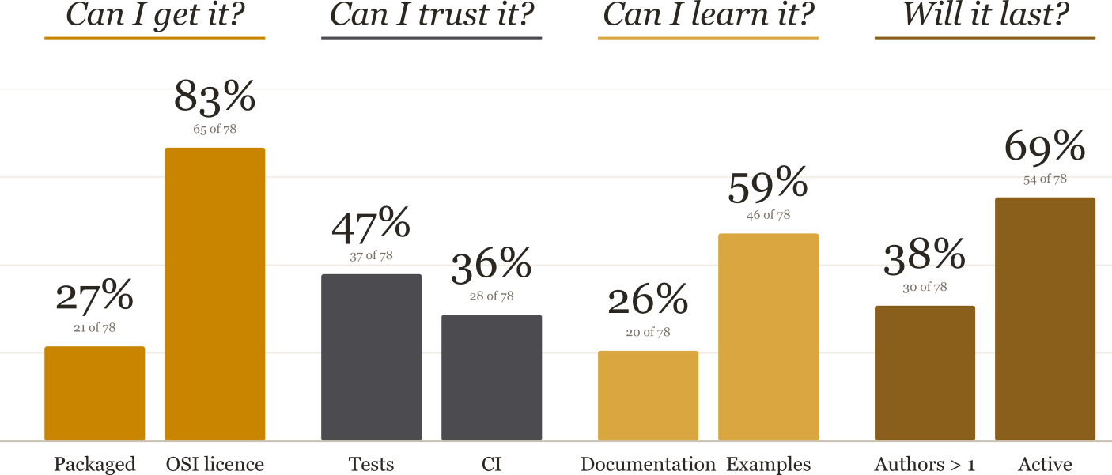
The Tools

Slide 13
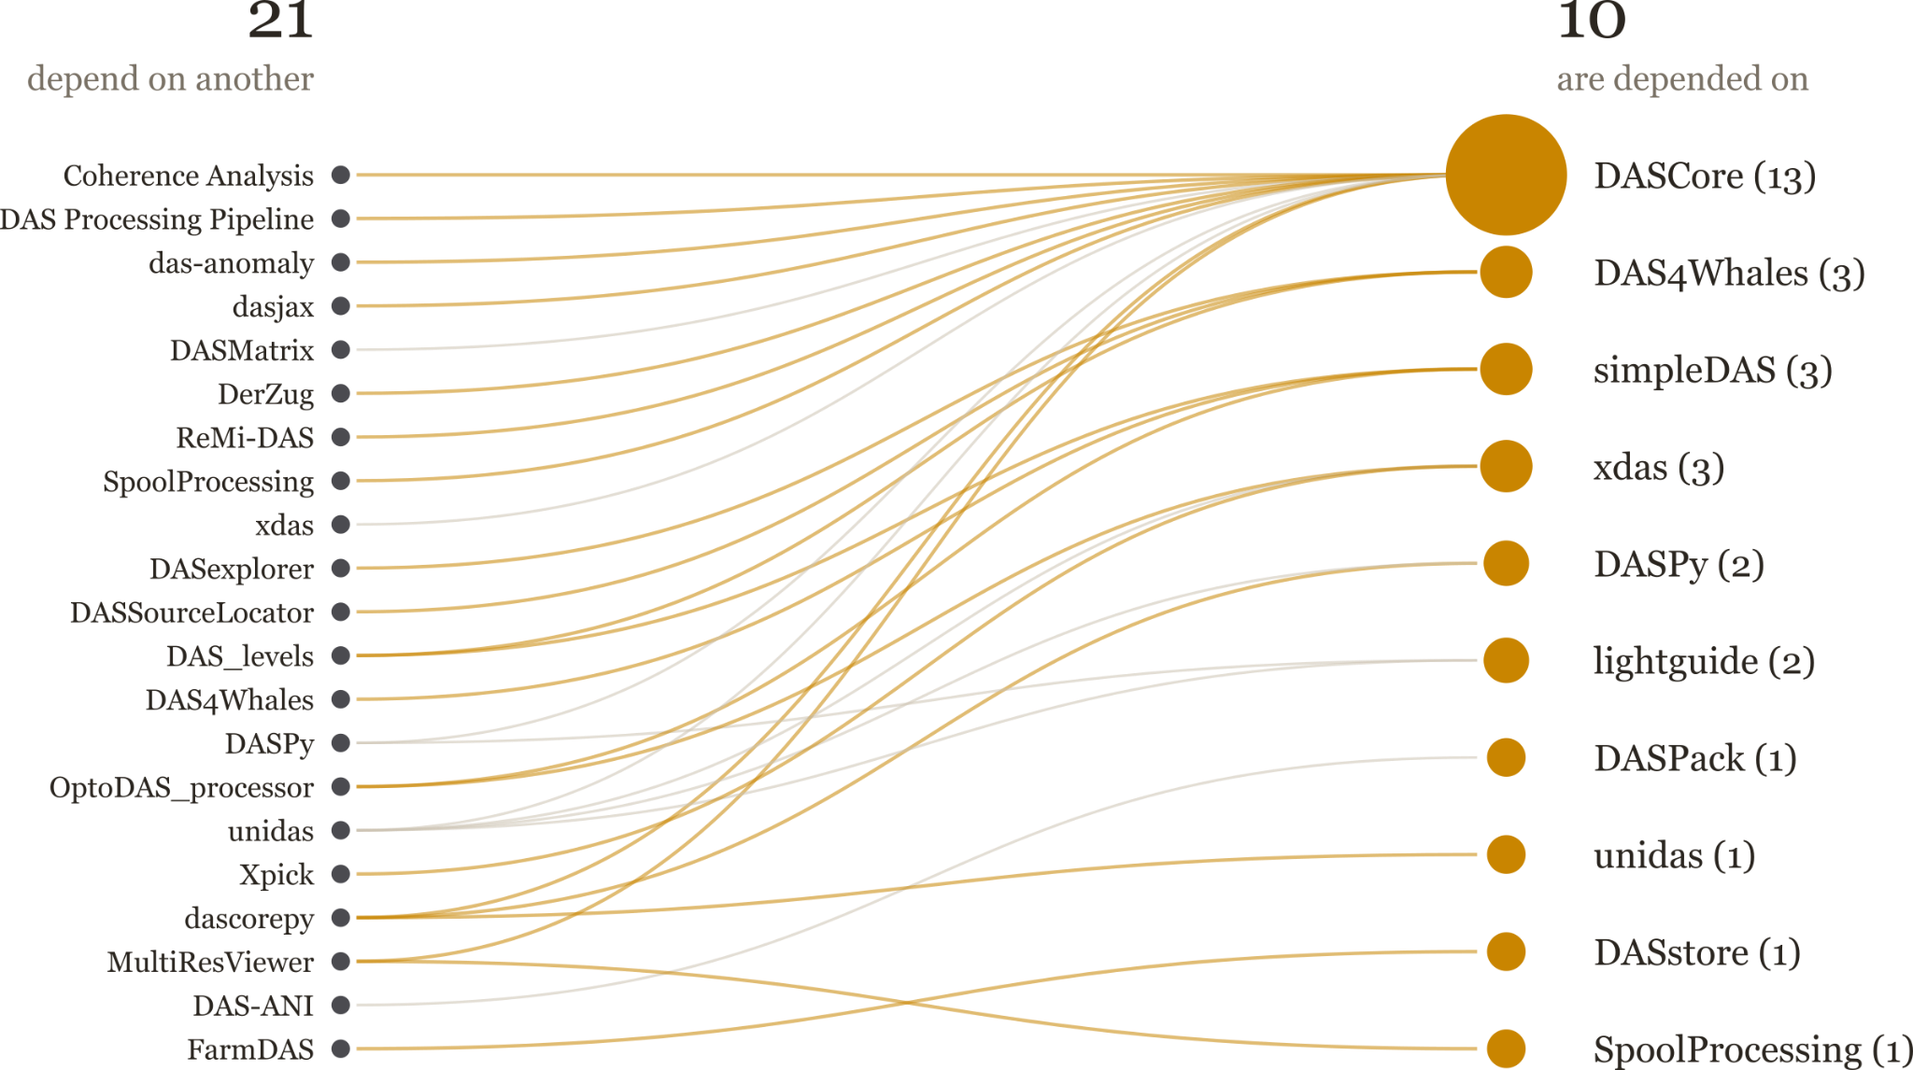
The Tools

Slide 14
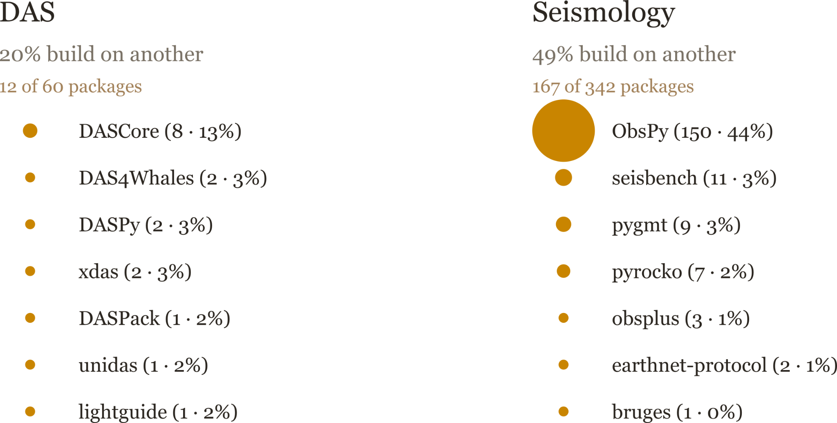
The Tools

Slide 15
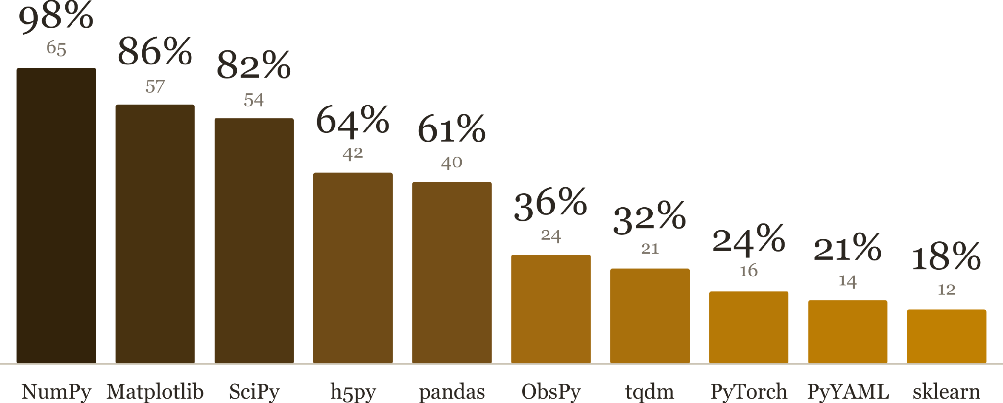
The Tools

Slide 16
Which Projects to Build on?
Disclaimer: I am biased

Slide 17
Infrastructure
Infrastructure
I/O for DAS files
Internal data structures
Processing
Visualizations
More than 1 contributor
at least 1 year old and active
In code registry

Slide 18
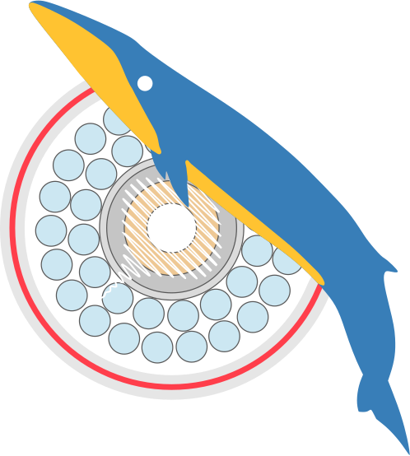
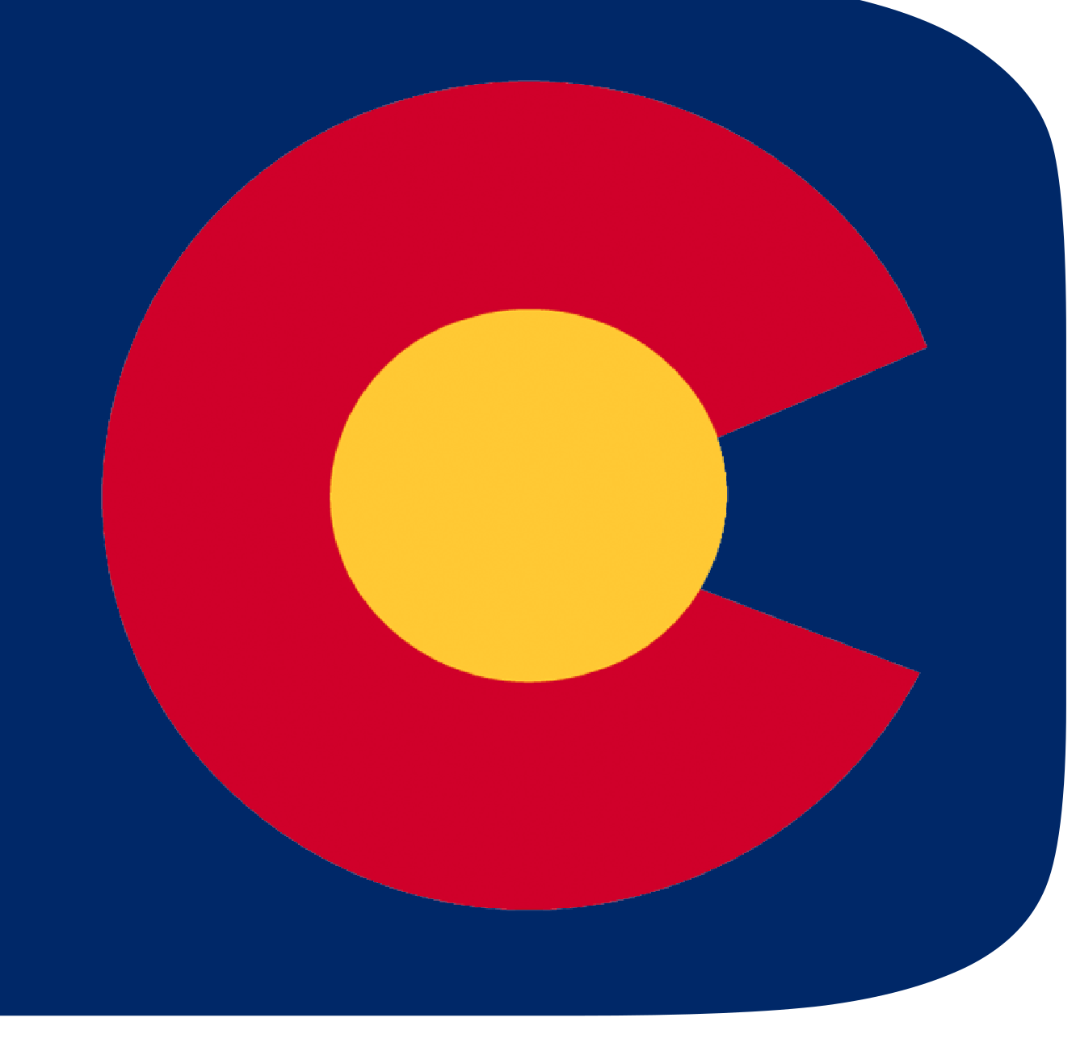
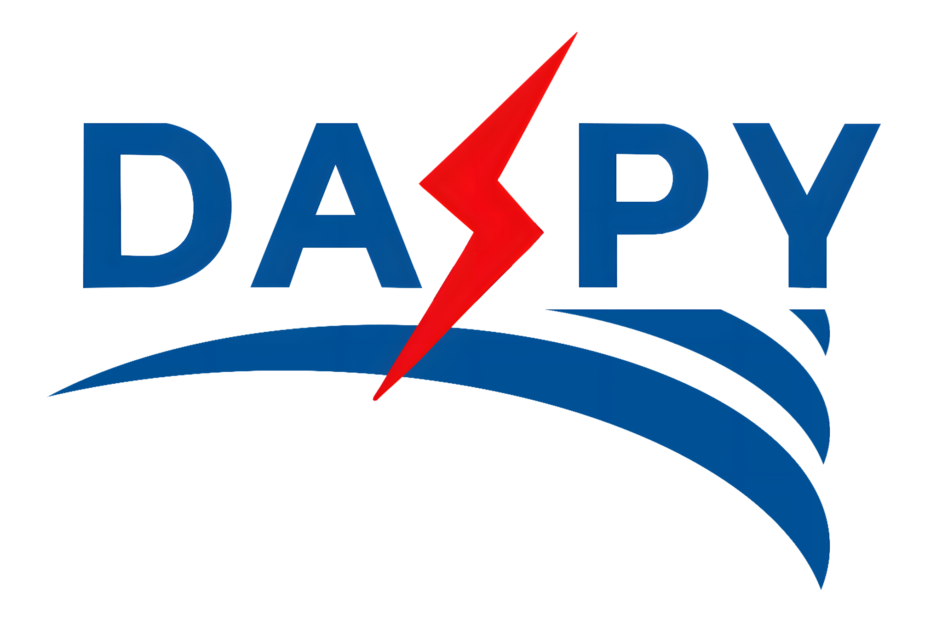
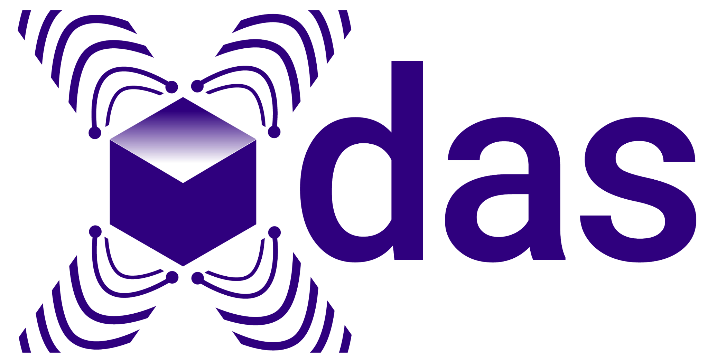

Infrastructure

Slide 19
Infrastructure
Non-Commercial
GPL
LGPL
MIT
Licence Permissivity

Slide 20
The Tools
DAS4Whales
Curvelet-transform denoising
Curvelet wavefield decomposition
Curvelet-based strain-to-velocity conversion

Slide 21
The Tools
DASpy
Curvelet-transform denoising
Curvelet wavefield decomposition
Curvelet-based strain-to-velocity conversion

Slide 22
The Gaps
DASCore
Curvelet-transform denoising
Curvelet wavefield decomposition
Curvelet-based strain-to-velocity conversion

Slide 23
The Gaps
Xdas
Curvelet-transform denoising
Curvelet wavefield decomposition
Curvelet-based strain-to-velocity conversion

Slide 24
The Gaps
LightGuide
LightGuide

Slide 25
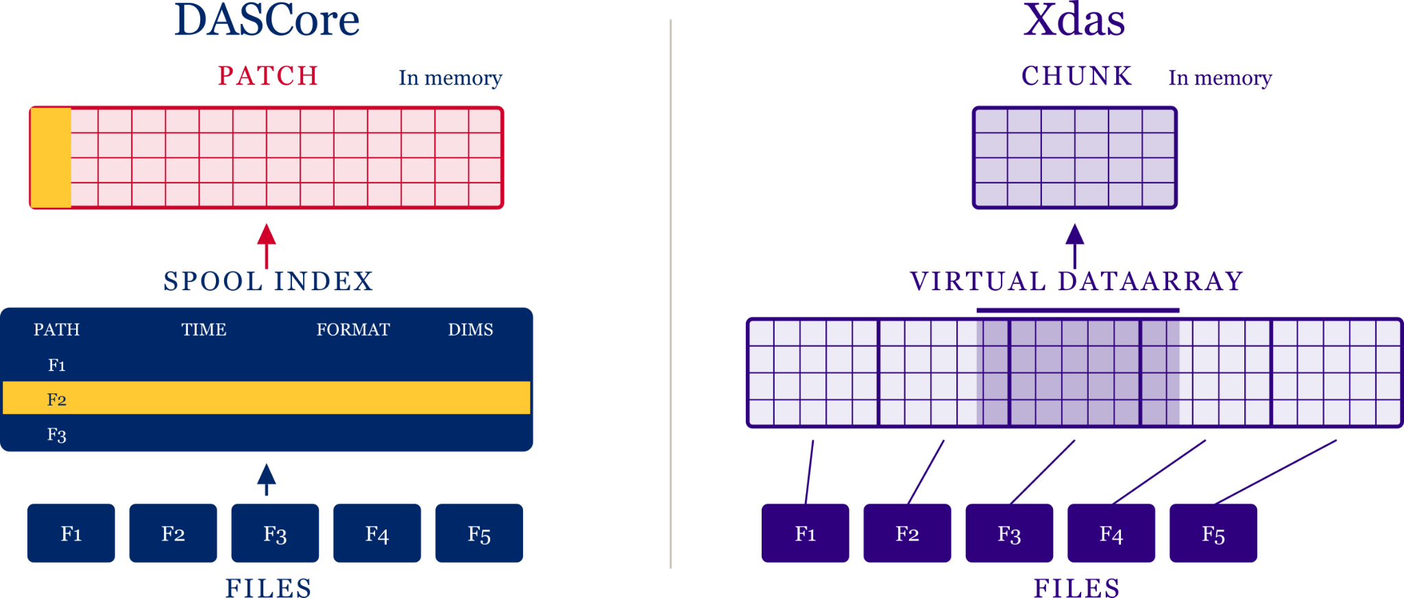
The Gaps

Slide 26
The Gaps
popularity

Slide 27
What Are the Gaps and Opportunities?

Slide 28
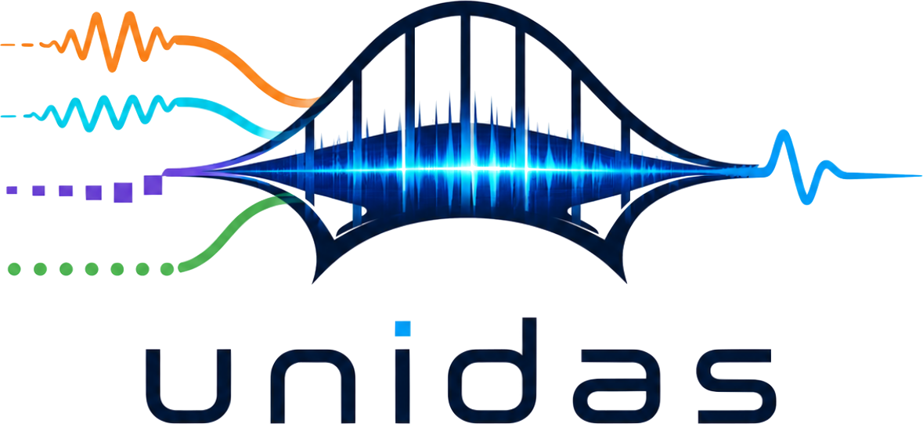
The Gaps
Interoperability
5+ tribes forming
Overlap can lead to innovation
Segmentation hurts users
Call for interoperability

Slide 29
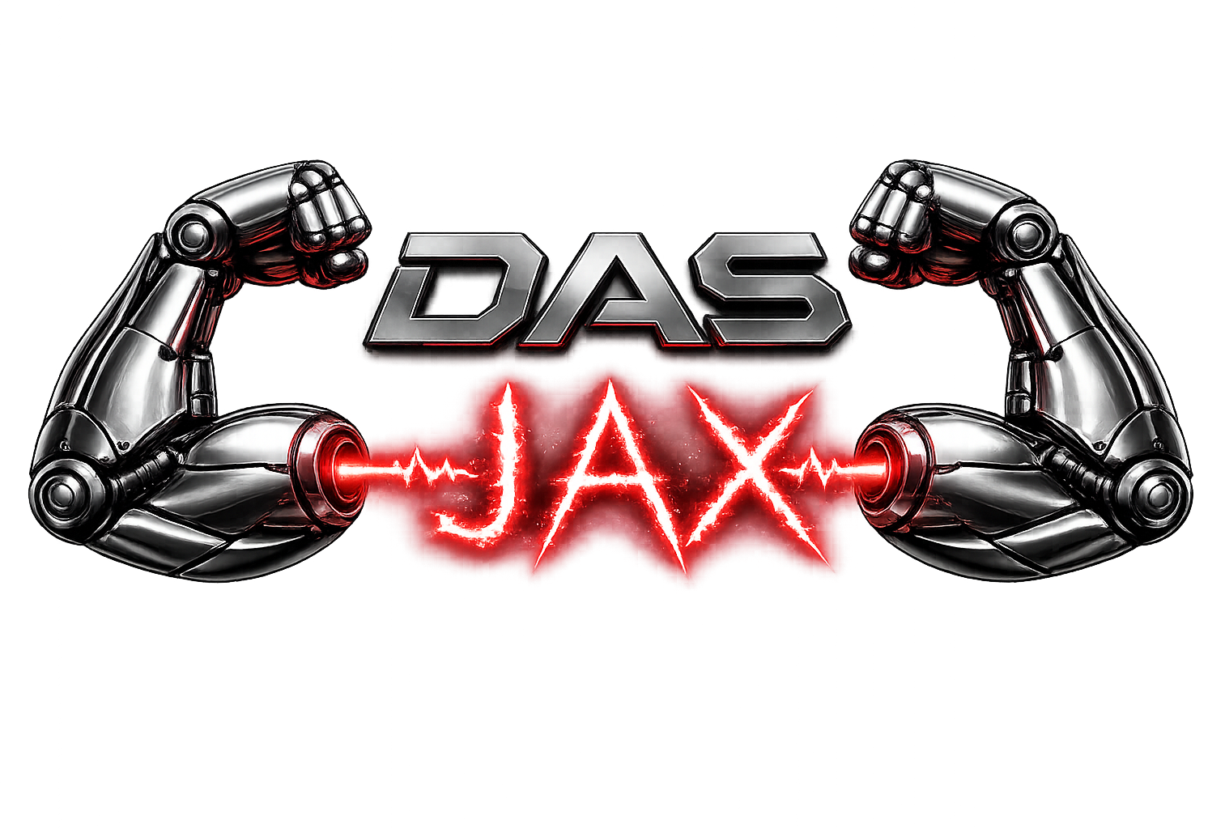
The Gaps
GPU accelerated processing
Moving beyond numpy
Array API support
Seperate Kernel (data) from metadata; two tracked operations
Tensor compilation
Other projects to watch: Coordax, xarray_jax, wax-ml, einx

Slide 30
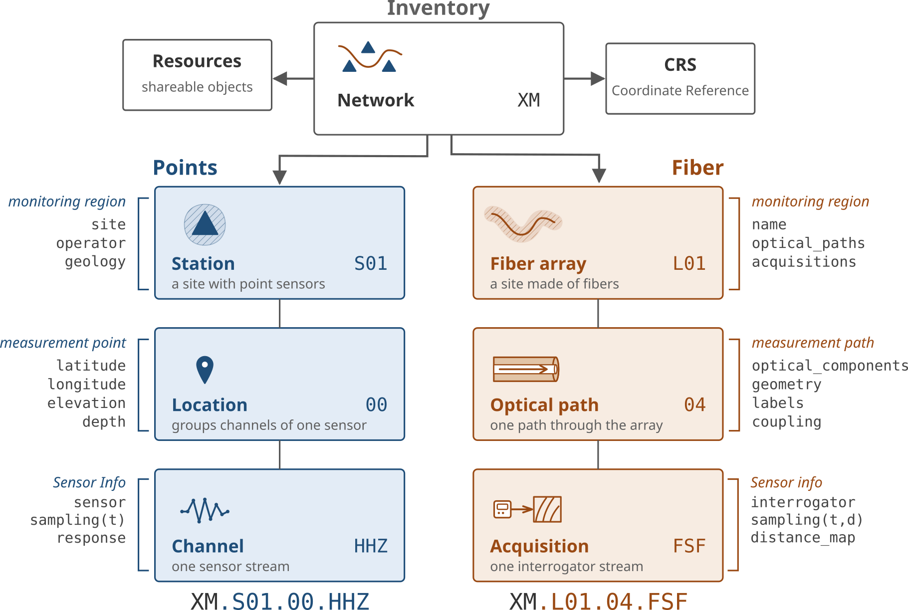
The Gaps
Robust Metadata management
An Integrated inventory
Comprehensive, reusable
Array API support
Speed ups

Slide 31
The Gaps
Large-scale Visualizations
An Integrated inventory
Comprehensive, reusable
Array API support
Speed ups

Slide 32
The Gaps
Large Scale visualizations

Slide 33
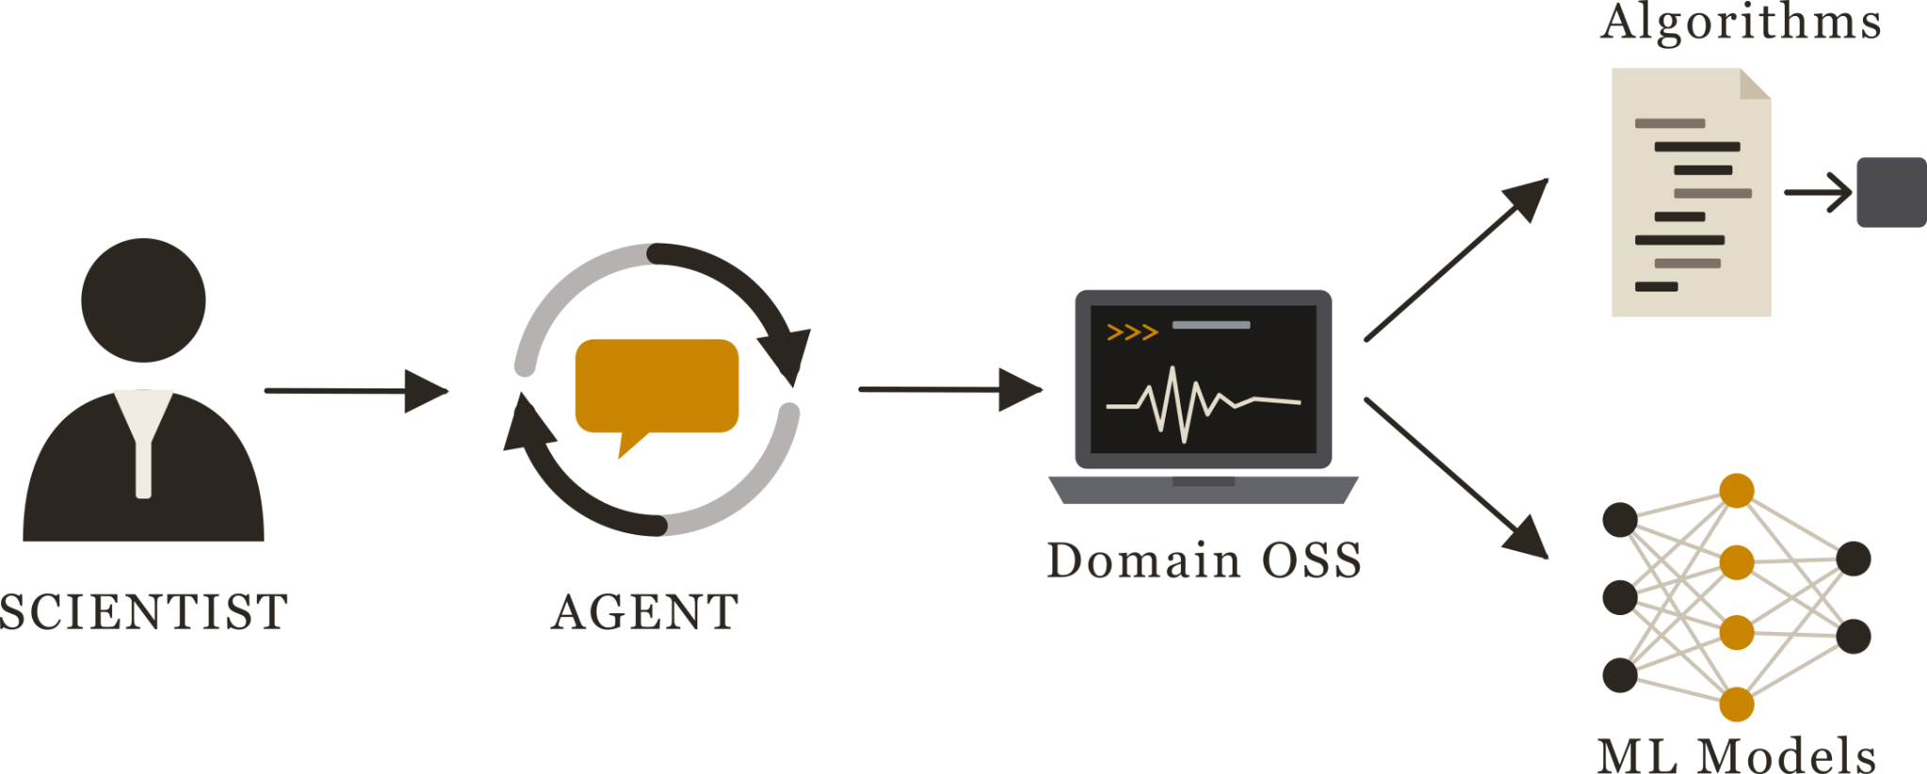
The Gaps
Opportunity:
Become Agent Friendly

Slide 34
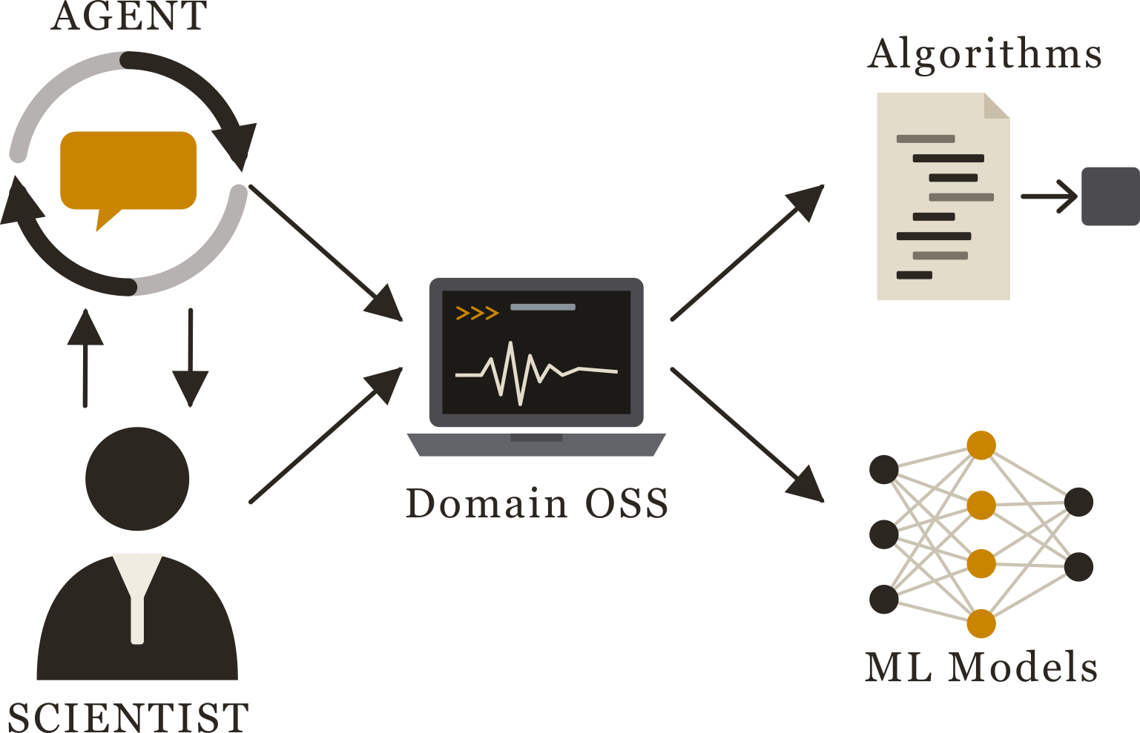
The Gaps
Opportunity:
Agent-Human Collaboration

Slide 35
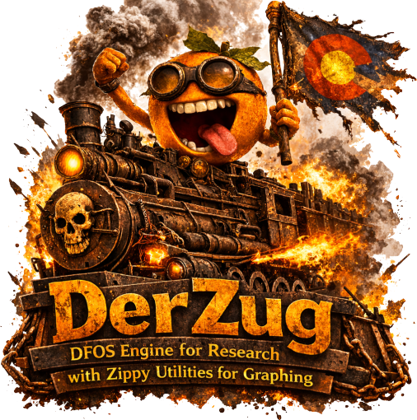
The Gaps
What does Agent/Collaborative software look like?

Slide 36
Conclusions
The DAS OSS ecosystem is still young
Projects are largely disconnected
A few sub-ecosystems are forming
Fragmentation remains a concert
Five “infrastructure” level packages exits
Each with its own unique feature set
Existing opportunities for:
GPU computing
Meta data
Large-scale visualization
Agent integrations

Slide 37
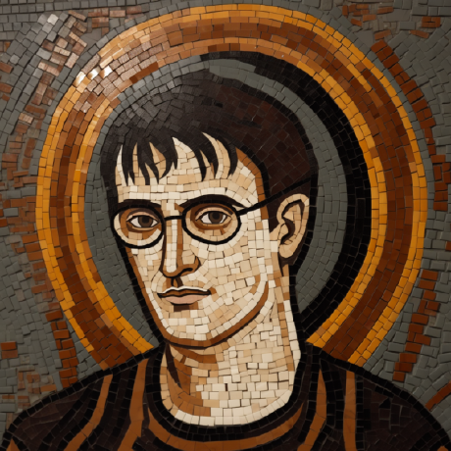
Thank you!
Derrick.chambers@ineris.fr
d-chambers@github.com

Slide 38
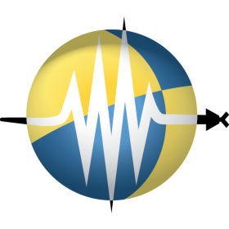
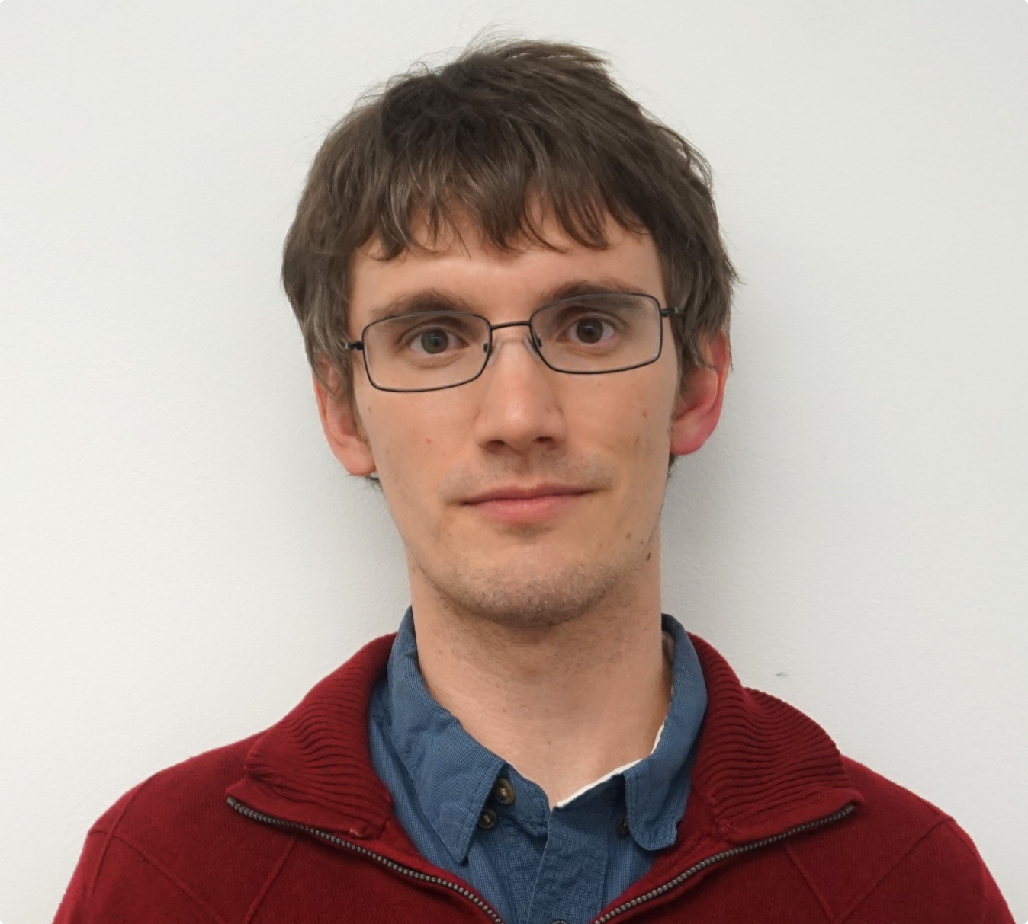
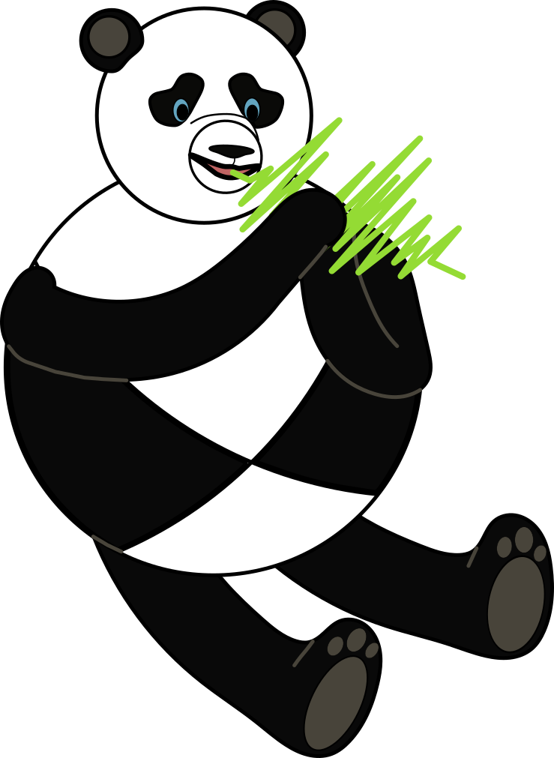
Thank you!

Slide 39
Thank you!

Slide 40
Call to Action
- 21 are installable — on PyPI, conda or Julia. This is the "Packaged" bar on the engineering slide and "On PyPI" on the composition slide.
- 51 are set up as a package — a root pyproject.toml or setup.py — but 30 of those never published.
- 60 declare their dependencies somewhere, which is the bar the ecosystem comparison uses, because it's the only bar you can apply identically to 677 seismology repos read over an API.

Slide 41
Infrastructure
Non-Commercial
GPL
LGPL
MIT
Popularity (Downloads/Stars)

Slide 42
Infrastructure
XArray-Inspired
labeled-multidimension
Unified object, fixed dimensional semantics
Arrays/dicts of metadata
More flexible/General
More complex
Simpler, Less flexible

