Slide 1
Desiatkin Dmitrii
Fake Image Task

Slide 2
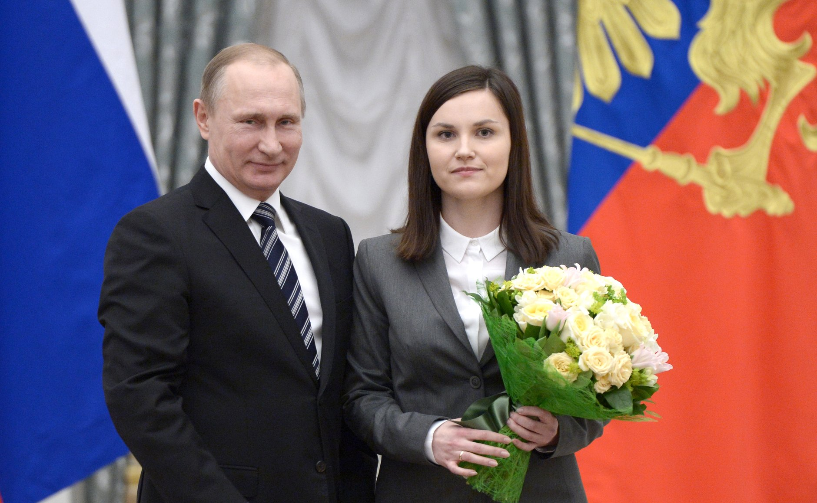
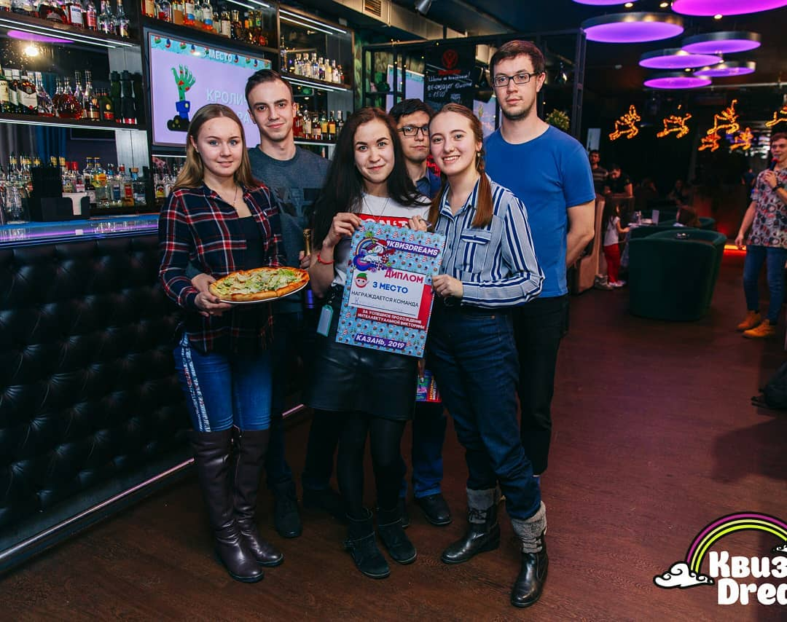
Originals
Reflect.tech

Slide 3


Fakes
This pictures could be used by swindlers on their personal site, to increase credibility
information that they want to promote.

Slide 4
AMI - agent
Actor type: unofficial
Level of organization:
Type of motivation: social
Level of automation: human
Intended audience: social group
Intend of harm: yes / no
Intend to mislead: yes

Slide 5
AMI - message
Duration: long or short term
Accuracy: fabricated
Legality:
Imposter type: individual
Message target: Individual / social group

Slide 6
AMI - Interpreter
Message reading: Hegemonic
Action taken: Ignored

