Slide 1
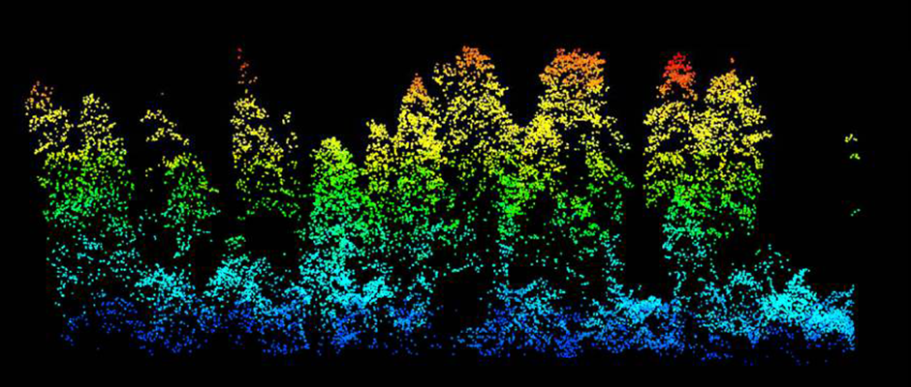
forest3D
David Diaz, Martin Bagaram, Zhehao Li
wildlife.org

Slide 2
Tree Data Pre-Processing
functional requirements:
Read in raw tree list data in text (*.txt, *.csv) and geospatial (*.shp) file formats
Retain desired attributes from different data sources, reformat to consistent specs
Identify coordinate reference system, if present; project locations to known coordinate system

Slide 3
Tree Data Pre-Processing
Pandas, GeoPandas
ArcPy, ArcGIS, QGIS
How it works
Pandas + geometry data type
Advantages
Flexible,
Light weight,
Easy to incorporate in a project
Disadvantages
quite slow for large datasets
How it works
Full GIS packages / Arcpy and qGIS python library for inline GIS operations
Advantages
Prebuild-ins, GUI, Intuitive
Disadvantages
Expensive (ArcGIS), proprietary,
Not so flexible, requires special environment

Slide 4
Point Cloud Pre-Processing
functional requirements:
Read raw lidar point clouds (*.las, *.laz)
Generate non-closed surface mesh/manifold from 3D point cloud
Translate points in mesh to numpy arrays

Slide 5


Point Cloud Pre-Processing
PDAL
python-PCL
Open-source C++ library (PCL)
Partial coverage with Python bindings by Univ. Lab
Point Cloud I/O, processing, state-of-the-art algorithms.
Open-source C++ library with Python extension for point cloud I/O and processing.
Pipelines with multiple steps can be specified in JSON.
Some API connections to PCL routines.
Kazhdan algorithms
Open-source C++ algorithms for surface reconstruction, Windows binary executables for processing ascii/PLY point clouds with normals

Slide 6
Point Cloud Pre-Processing
PDAL
python-PCL
61 (7 core) contribs +
v1.0 2015, now v1.8 ++
Python API by core team ++
Thorough ReadtheDocs. Numerous examples. +++
Focus on pipelines and data translation, Pipelines +
Python: 21 (2 core) contribs PCL: 331 (20 core) contribs +++
PCL v1.0 2011, now v1.9 ++ Python since 2013.
Python API by small community team -
Limited Python docs. - Few examples. - C++ functions documented. +/-
Focus on algorithm dev.
Kazhdan algorithms
3 (1 core) contribs
Peer-reviewed algorithms
Command line examples, flat files only

Slide 7
3D Visualization
functional requirements:
Produce interactive 3D plots—scatter and mesh (triangulated surface)—for point clouds and simulated trees
Handle many thousands to millions of points (webGL under the hood)
Enable easy user control and updates/callbacks from (ipy)widgets in Jupyter Notebooks

Slide 8
3D Visualization
Plotly & ipyvolume
Open source, free, conda- installable
Use WebGL for rendering lots of data
Native support for ipywidgets
Easily manipulated in Jupyter Notebook
Good documentation, many examples
Declarative syntax to build interactive visualizations

Slide 9
3D Visualization
Plotly
GUI importing and analyzing data into a grid
More pre-loaded data annotations (e.g., pop-ups on hover)
More polished toolkit for interation (e.g., changing 3D navigation)
Company supported, 8 core contributors
https://plot.ly/python/3d-mesh/
ipyvolume
Related to Vaex package aimed at exploring large tabular datasets
Community supported, single core contributor
https://ipyvolume.readthedocs.io/en/latest/

