Slide 1
U.S. Food Insecurity and Impacts
November 19th, 2023
Daniel Craig

Slide 2
Overview
High Food Security | No limitations related to food access or availability
Marginal Food Security | Concern that food may run out before ability to afford more
Low Food Security | Reduced variability, quality, or desirability of available food
Very Low Food Security | Disrupted eating patterns and reduced intake
Food Insecurity is thought of as a problem that undeveloped countries struggle with and it’s presence ignored in the U.S.
Do the United States of America still struggle with Food Insecurity and what are the impacts on people as they grow?
Treated as ‘Food Insecure’ in studies
Notes:
Hurricane Facts: Weather Underground (wunderground.com)
Joplin Tornado Fact: 2011 Joplin tornado - Wikipedia

Slide 3
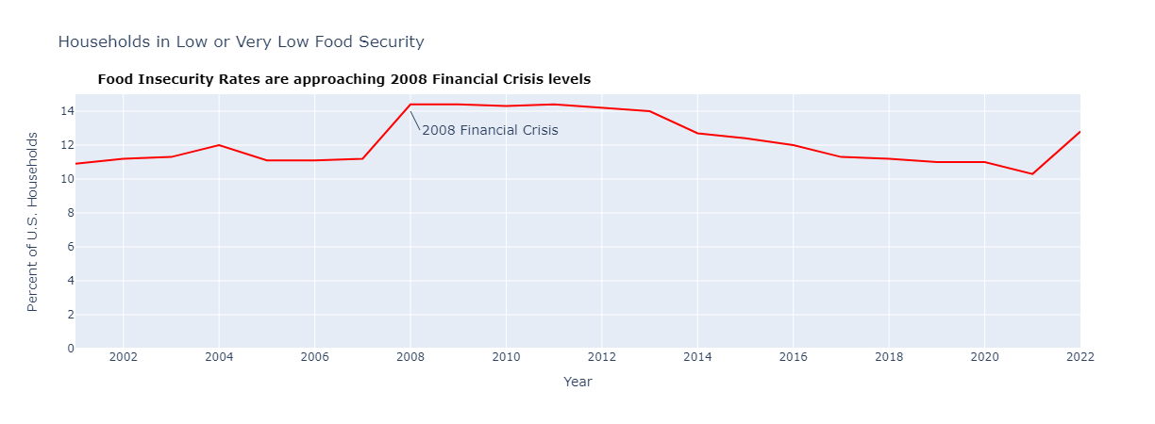
Prevalence
Hurricanes: Saffir-Simpson Wind Scale
2021 held the lowest percent of Food Insecure Households for the past 20 years near 10%, but 2022 is approaching the 2008’s record at around 14.2%
Notes:
Tornado EF Scale Pic: How damage determines a tornado's rating: From Fujita to Enhanced Fujita - ICC (iccsafe.org)

Slide 4
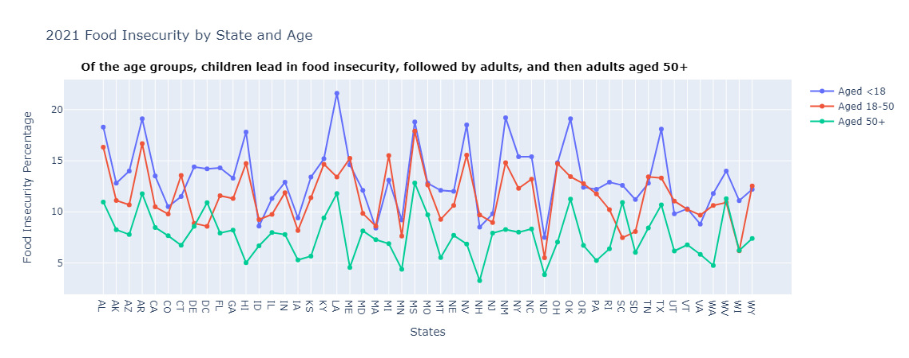
Prevalence
Hurricanes: Saffir-Simpson Wind Scale
Arizona, Louisiana, Mississippi, New Mexico, Oklahoma, and Texas have the highest child food insecurity percentages
Notes:
Tornado EF Scale Pic: How damage determines a tornado's rating: From Fujita to Enhanced Fujita - ICC (iccsafe.org)

Slide 5
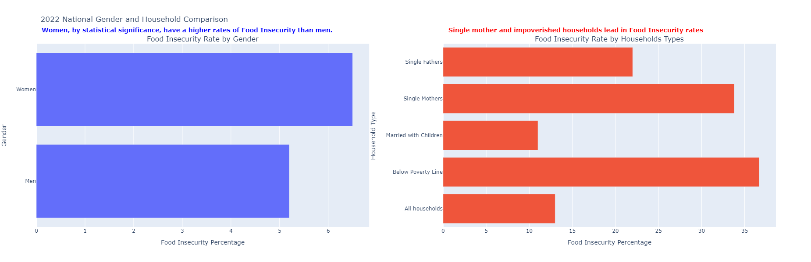
Gender and Poverty Connection
Hurricanes: Saffir-Simpson Wind Scale
Women | 6.5%
Men | 5.2%
Single Mother Households | 33.8%
Single Father Househoulds | 22%
Below Poverty Line Households | 36.7%
Notes:
Tornado EF Scale Pic: How damage determines a tornado's rating: From Fujita to Enhanced Fujita - ICC (iccsafe.org)

Slide 6
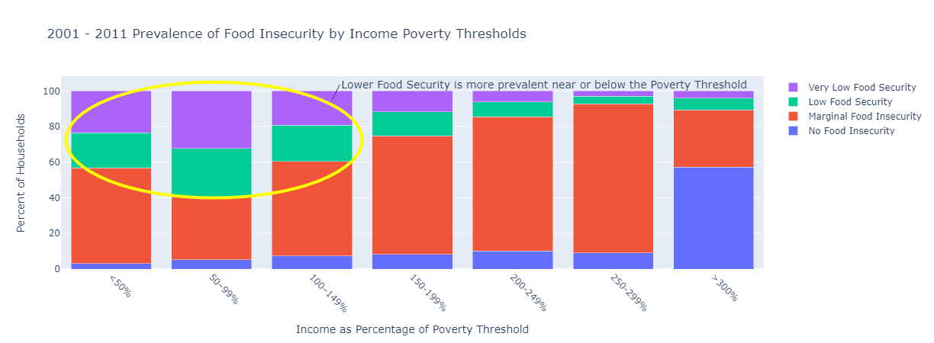
Gender and Poverty Connection
Hurricanes: Saffir-Simpson Wind Scale
Grouping households by income reveal a connection to the poverty threshold. Income is expressed as a percentage of Poverty Threshold since each State has its own Poverty Threshold to help account for unique Costs of Living
Notes:
Tornado EF Scale Pic: How damage determines a tornado's rating: From Fujita to Enhanced Fujita - ICC (iccsafe.org)

Slide 7
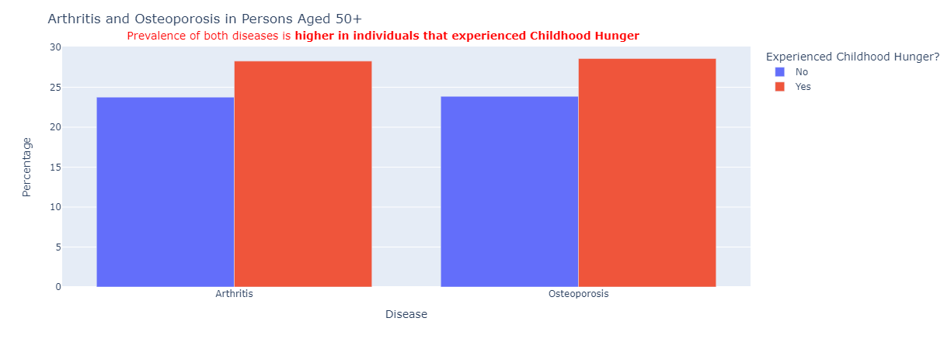
Later Outcomes in Life
Hurricanes: Saffir-Simpson Wind Scale
 | Arthritis | Osteoporosis
Childhood Hunger Yes | 28.27 | 28.59
Childhood Hunger No | 23.86 | 23.86
Notes:
Tornado EF Scale Pic: How damage determines a tornado's rating: From Fujita to Enhanced Fujita - ICC (iccsafe.org)

Slide 8
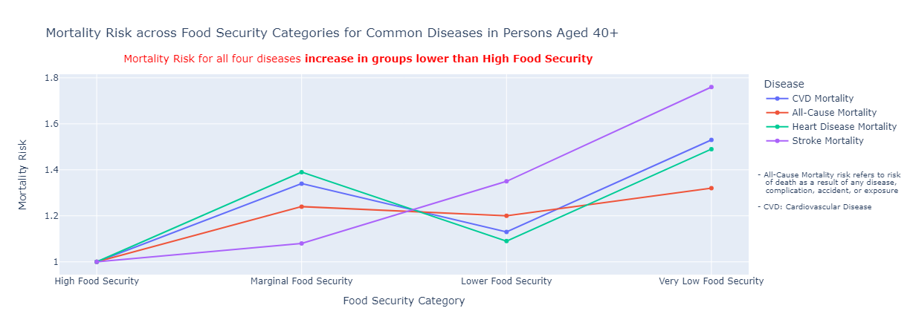
Later Outcomes in Life
Hurricanes: Saffir-Simpson Wind Scale
Mortality Risk measures the probability of death caused by the disease in each food security group relative to their probability of death caused by the disease in the High Food Security group
Notes:
Tornado EF Scale Pic: How damage determines a tornado's rating: From Fujita to Enhanced Fujita - ICC (iccsafe.org)

Slide 9
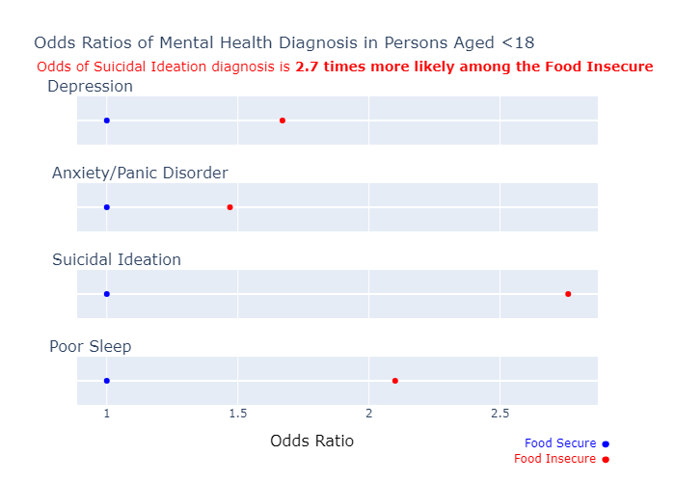
Later Outcomes in Life
Odds Ratios are used to compare the odds of one group being affected relative to another group’s odds of being affected.
Odds are calculated by dividing the probability of an event occurring by the probability of it not occuring
Hurricanes: Saffir-Simpson Wind Scale
Notes:
Tornado EF Scale Pic: How damage determines a tornado's rating: From Fujita to Enhanced Fujita - ICC (iccsafe.org)

Slide 10
Data Sources/Code Appendix:
Github: https://github.com/d-ev-craig/DATA608/tree/main/Major%20Assignments/Story%206
MMG2023 - Overall & Children by State https://www.feedingamerica.org/research/map-the-meal-gap/by-county
CDC Household Pulse Survey - Men v Women https://www.cdc.gov/nchs/products/databriefs/db465.htm#section_1 https://www.cdc.gov/nchs/data/databriefs/db465-tables.pdf#1
ERS - Long Term Trends of Food Scarcity Prevalence https://www.ers.usda.gov/topics/food-nutrition-assistance/food-security-in-the-u-s/key-statistics-graphics/#trends
Census - Households that experienced food scarcity last 7 days https://www.census.gov/data-tools/demo/hhp/#/?s_state=
Census - Population Counts - https://www.census.gov/data/tables/time-series/demo/popest/2020s-state-total.html

Slide 11
Data Sources/Code Appendix:
Link between Food Insecurity and Poverty
NCBI - https://www.ncbi.nlm.nih.gov/pmc/articles/PMC4096937/

Slide 12
Data Sources/Code Appendix:
Effects of Food Insecurity Later in Life
JAHA - Effect of Food Insecurity on CVD and mortality - https://www.ahajournals.org/doi/full/10.1161/JAHA.119.014629
springer - Effect of Food Insecurity on Diabetes - https://link.springer.com/article/10.1007/s11606-007-0192-6
JAH Adolescent Health - Poorer Mental Health - https://www.jahonline.org/article/S1054-139X(19)30419-7/fulltext
CDC - Adolescent Dietary Behavior and Grades - https://www.cdc.gov/healthyschools/health_and_academics/health_academics_dietary.htm
NCBI - Long Term effect on Arthtritis and Osteoporosis - https://www.ncbi.nlm.nih.gov/pmc/articles/PMC8021205/#:~:text=The%20multivariate%20analysis%20revealed%20that,adults%20who%20did%20not%20experience

