Slide 1
Self Control Capacity and Habit Execution
DATA606 Final Project
Daniel Craig
5/21/23
Rpubs: RPubs - DATA606 Final Project [https://rpubs.com/devcraig/DATA606projFinal]
Github: DATA606/Project at main · d-ev-craig/DATA606 (github.com) [https://github.com/d-ev-craig/DATA606/tree/main/Project]

Slide 2
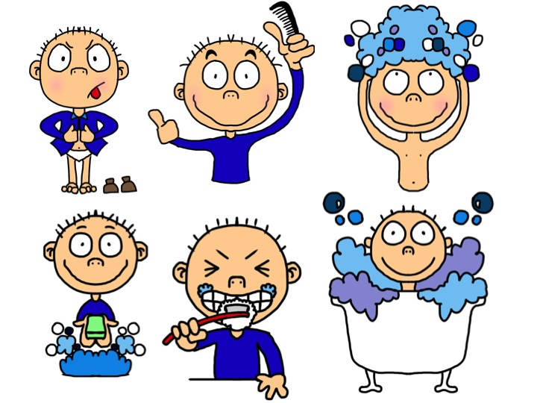
Overview
Research Question: Does an individual’s capacity for self control impact their ability to perform a desired action?
Dependent Variable: Daily Habit Execution Score Average
Context: Group of participants agreed to log daily habit executions, measure their self control capacity, and measure their habit strength with a phone app
Data Source: Frontiers | How to Form Good Habits? A Longitudinal Field Study on the Role of Self-Control in Habit Formation (frontiersin.org)
Important Notes on Context:
The data was gathered from a study that was focused on the progression of habit formation over time and the role self control capacity played in that formation. Their study gathered the data this analysis works with, but for a different purpose. Not all of the original study’s data was used to perform this analysis due to the lack of relevancy from the change in research question. Limitations and issues created by this will be mentioned at the end.

Slide 3
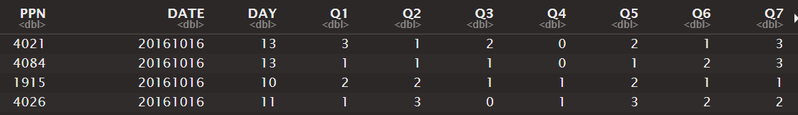
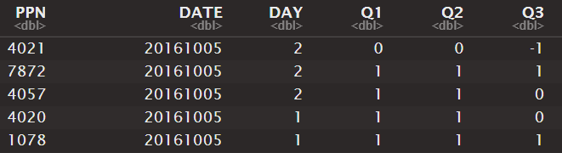
Data Structure
Self Control Capacity
Daily Habit Execution
Self-control capacity was measured using a bi-weekly Brief Self-Control Scale which consisted of 13 statements describing their level of self control in general with responses on a Likert scale (1 to 5, with 1 being "not at all" and 5 being "very much")
Habit execution was measured with by the daily phone app questions in 3 questions. These questions are translated and while a part of their meaning may be lost, their rough effects for the study are maintained.
1. Did the context you chose for your habit occur today? (ie. Did you have breakfast today?)
2. Did you perform your chosen habit today? (ie. Did you eat fruit toay?)
3. Did you perform your chosen habit in the chosen context today? (ie. Did you eat fruit at breakfast today?)
Brief Self Control Scale: (https://onlinelibrary.wiley.com/doi/10.1111/j.0022-3506.2004.00263.x)

Slide 4
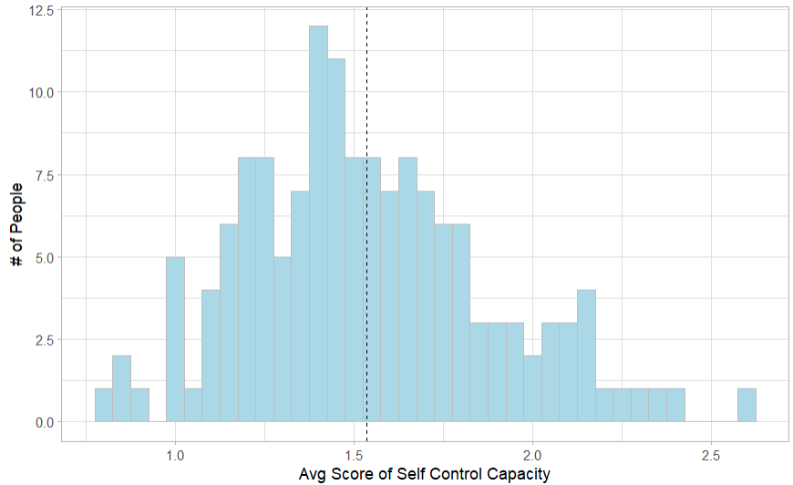

Summary Stats | Self Control
Self Control Capacity
Classifier Creation
Classifiers of “Low”, “Mid”, and “High” were determined by the 3 quantiles represented here to label if an individual inside a particular time period were of a certain level of Self Control

Slide 5
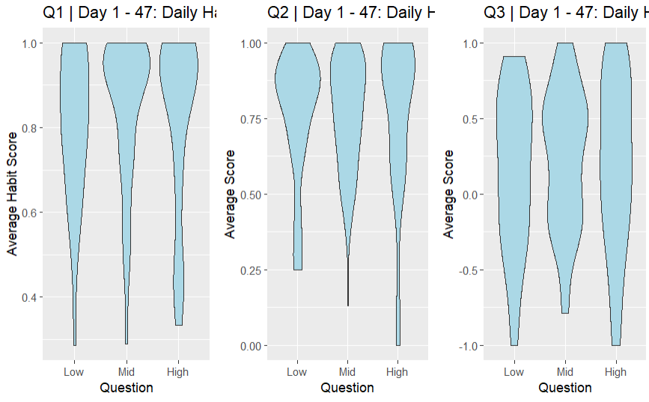
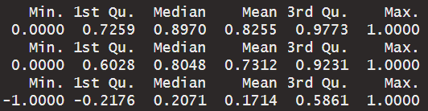
Summary Stats | Habit Execution Day 1 - 47
Habit Execution was segmented into 3 time segments.
Days : 1 - 47 | 48 - 95 | 96+
This was to remove any influence of a habit becoming stronger over time and keep interpretation focused on the relationship between Self Control Capacity and executing a desired behavior.
Do any of the Low, Mid, or High groups have a noticeably better distribution of average habit score?

Slide 6
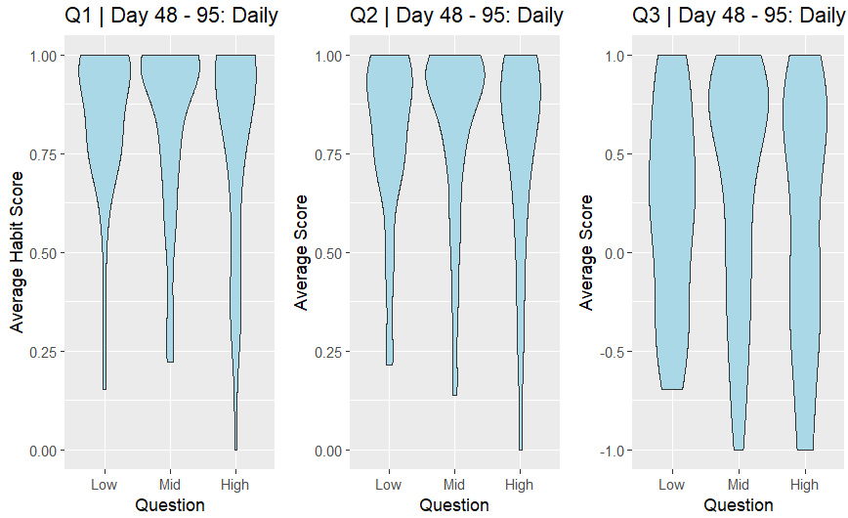
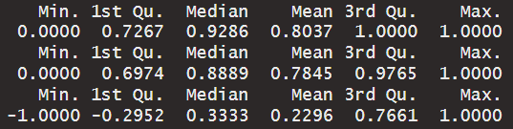
Summary Stats | Habit Execution Day 48 - 95
Habit Execution was segmented into 3 time segments.
Days : 1 - 47 | 48 - 95 | 96+
This was to remove any influence of a habit becoming stronger over time and keep interpretation focused on the relationship between Self Control Capacity and executing a desired behavior.
Do any of the Low, Mid, or High groups have a noticeably better distribution of average habit score?

Slide 7
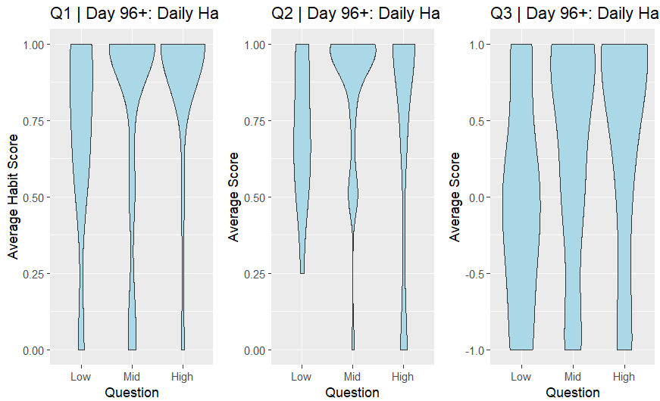
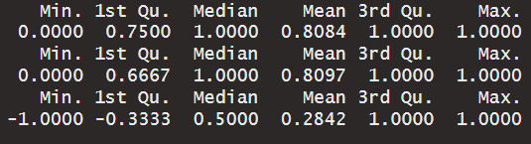
Summary Stats | Habit Execution Day 1 - 47
Habit Execution was segmented into 3 time segments.
Days : 1 - 47 | 48 - 95 | 96+
This was to remove any influence of a habit becoming stronger over time and keep interpretation focused on the relationship between Self Control Capacity and executing a desired behavior.
Do any of the Low, Mid, or High groups have a noticeably different distribution of average habit score?

Slide 8
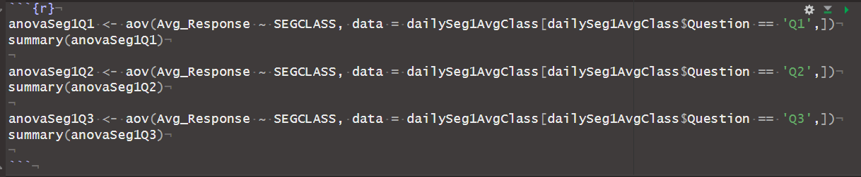
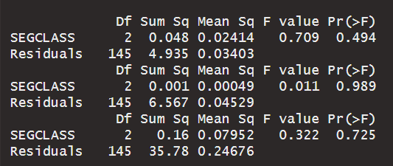
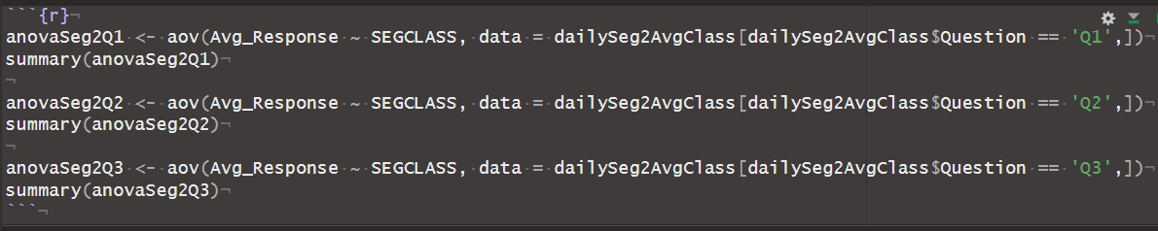
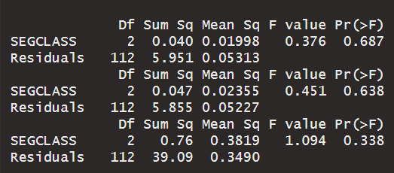
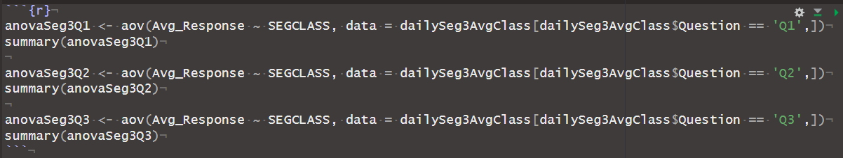
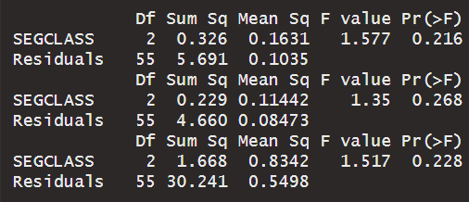
Inference & Testing
Ho: u₁= u₂ = u₃
Ha: at least one mean is different
Test: ANOVA

Slide 9
Conclusion
Regardless of the time spent building a habit, this analysis shows there is no evidence to suggest that higher self control capacity aids in the execution of a desired habit as analysis of variance does not show significant difference between average scores in daily execution of the three self control groups
Importance: Those that believe they have low self control, may find it more useful to perform a different action in place of another, rather than abstinence motivated by self control
Limitations/Criticisms:
Misalignment between original data collection method and intended research question
Using score averages rather than analysis in differences of count
Does not speak towards self control impacting ability to restrict behavior, only as a catalyst for behavior

Slide 10
Citations
[Main Study](https://www.frontiersin.org/articles/10.3389/fpsyg.2020.00560/full#B28)
van der Weiden A, Benjamins J, Gillebaart M, Ybema JF and de Ridder D (2020) How to Form Good Habits? A Longitudinal Field Study on the Role of Self-Control in Habit Formation. Front. Psychol. 11:560. doi: 10.3389/fpsyg.2020.00560
[Brief Self Control Scale](https://onlinelibrary.wiley.com/doi/10.1111/j.0022-3506.2004.00263.x)
Tangney, J.P., Baumeister, R.F. and Boone, A.L. (2004), High Self-Control Predicts Good Adjustment, Less Pathology, Better Grades, and Interpersonal Success. Journal of Personality, 72: 271-324. https://doi.org/10.1111/j.0022-3506.2004.00263.x

