Slide 1
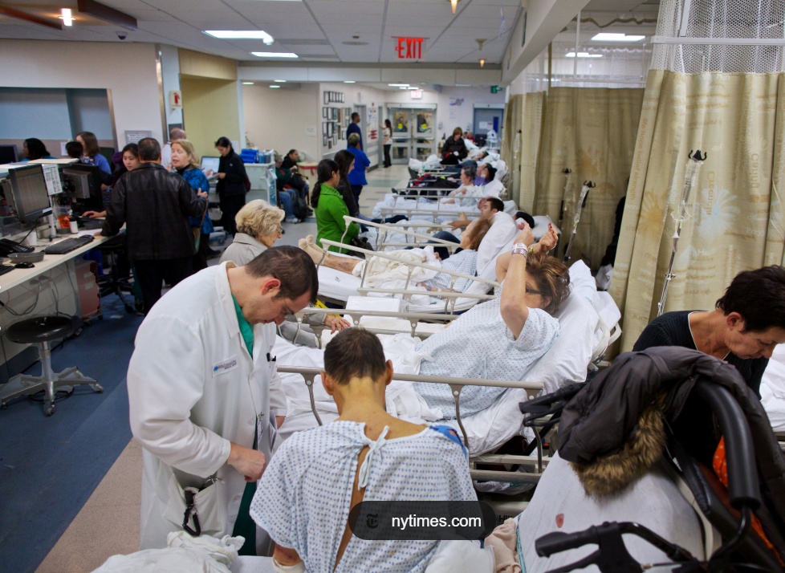
Why is this important?
“For each additional patient added to a nurse’s workload, the odds of a patient dying within 30 days increased by 16%”
Lasater et al.(2021)
Nurse staffing on medical-surgical units across Illinois hospitals

Slide 2
Executive Summary
Machine Learning Methods for Healthcare Operations Risk Management
Operational Definition: Capacity risk in healthcare is the threat that patient care demands will exceed the available clinical staffing or their capabilities.
Problem: Quality lapses, safety incidents, throughput bottlenecks, or financial strain.
Business Case: U.S hospitals and healthcare systems face significant capacity risk due to workforce shortages, demand shortages, burnout, and misaligned skill mix across nurses, physicians, and support staff
Method Summary: Predictive early warning model with an operational decision layer to estimate the likelihood of multi-class and binary classifications. Configured to balance ‘Sensitivity’ and ‘Specificity’
High, Normal, Low (Distribution defined: Q1 = Low, IQR = Normal, Q2 = High)
High, Not High (Threshold defined: >85% staffed-capacity utilization)
Governance: Use is governed through periodic performance review, threshold assessment, and monitoring for unintended workload impact. Documentation of use supports transparency and continuous improvement

Slide 3
Concept
Predicting Capacity Risk t + Horizon
Do we need to escalate staffing or capacity management actions?
PAST
FUTURE
T-3
T-2
T-1
T
T+1
T+3
T+7
T+30
high
high
normal
not high
low
Where t = today

Slide 4

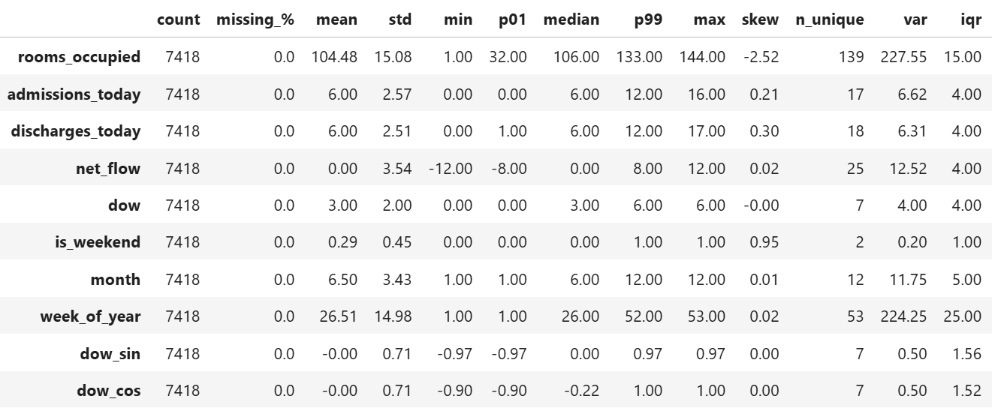
Synthetic Healthcare Data
Input
Output
+10k patient records
Admission / discharge dates
Diagnoses & treatments
Billing & Payer info
Aggregate daily table
Create ‘flow variables’
Derive capacity signal
Add time intelligence
Descriptive Statistics
Notes:
Started from a synthetic healthcare dataset and transformed it into a daily operational capacity time series by aggregating flows and adding calendar features for forecasting / risk modeling.
Data Engineering Steps:
Aggregated to daily level
Created flow variables:
Admissions/day
Discharges/day
Net flow
Derived capacity signal:
Rooms occupied
Added time intelligence:
Day of week, weekend
Month, week of year
Cyclical encoding (sin/cos)

Slide 5
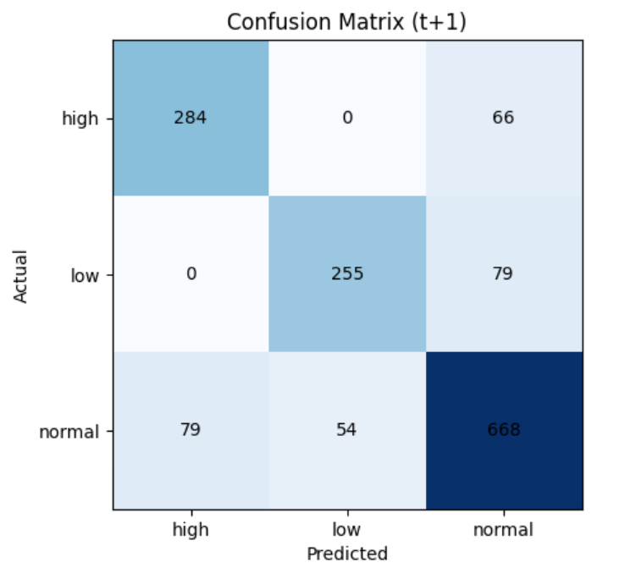
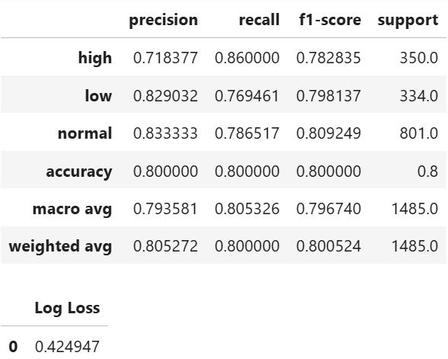
Baseline Model
Predicting Room Occupancy by t + 1 – Logistic Regression
🟢 reliably detect high‑utilization days with strong recall
❌ most mistakes are near state boundaries

Slide 6
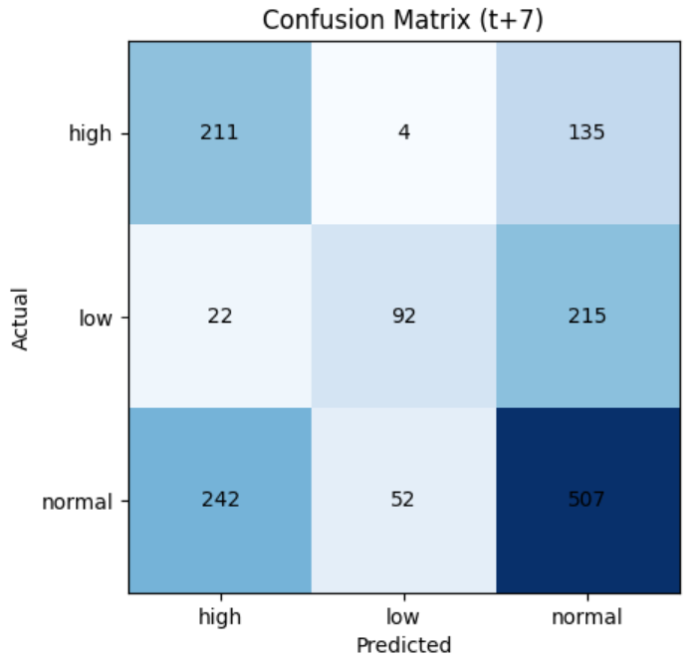
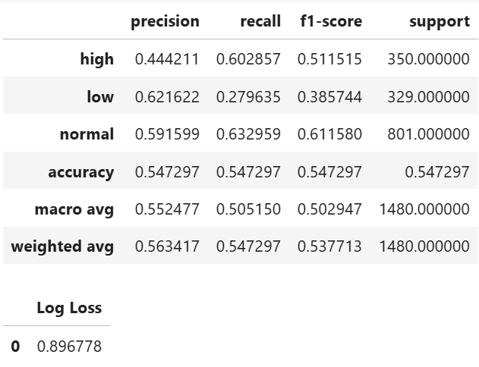
Baseline Model
Predicting Room Occupancy by t + 7 – Logistic Regression
🟢 valuable early warning
❌ prediction uncertainty is high, not suitable for decision making

Slide 7
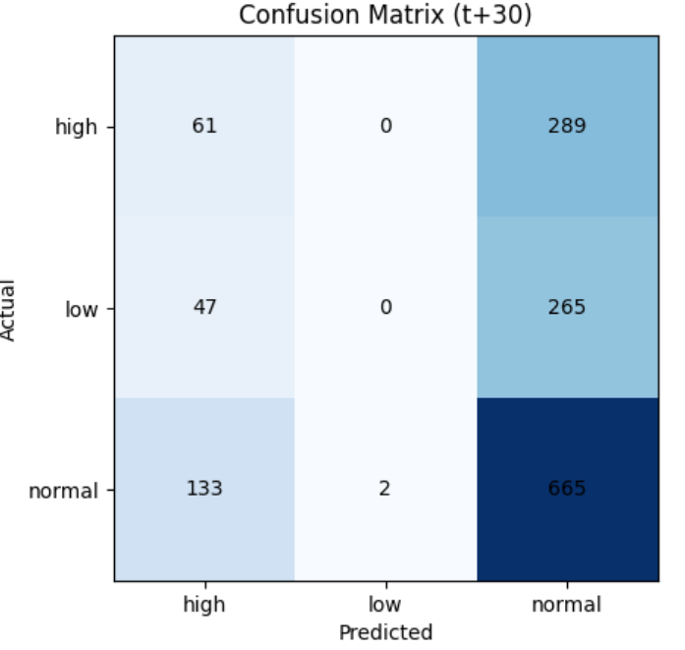
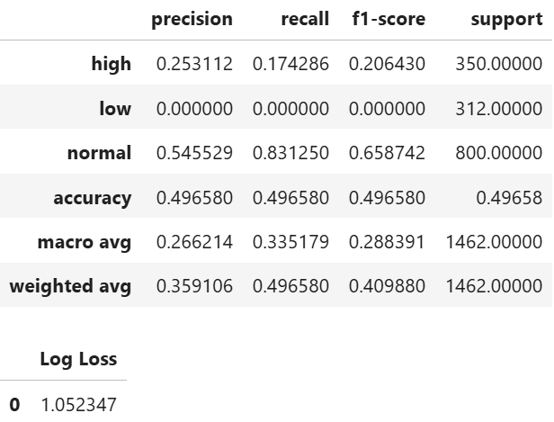
Baseline Model
Predicting Room Occupancy by t + 30 – Logistic Regression
❌ prediction uncertainty is high, not suitable for decision making

Slide 8
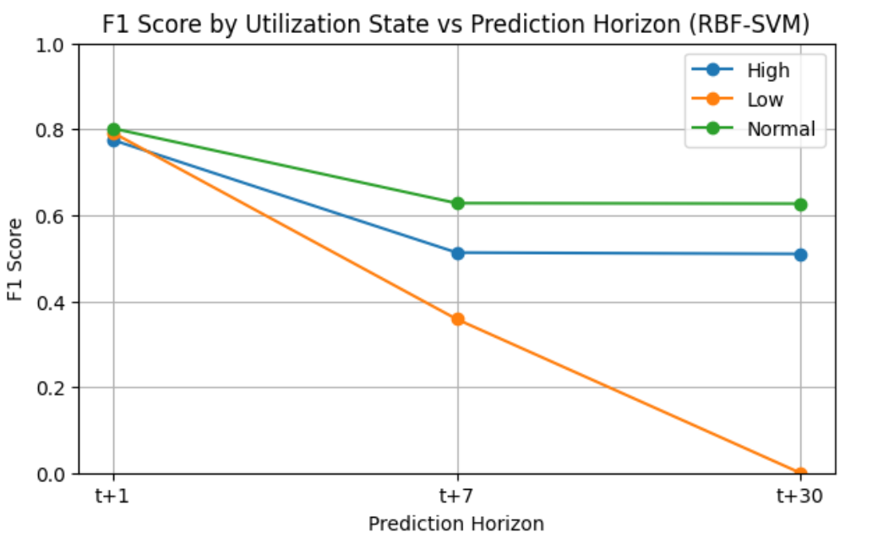
(C=1,y=scale)
Improved Baseline Model
Predicting Room Occupancy by t + Horizon – RBF SVM
🟢 t + 1 forecast are reliable for operational use
⚠️ t + 7 forecast provides early warning
❌ t + 30 forecast exceeds available signal
t = Today
(C=1,y=scale)

Slide 9
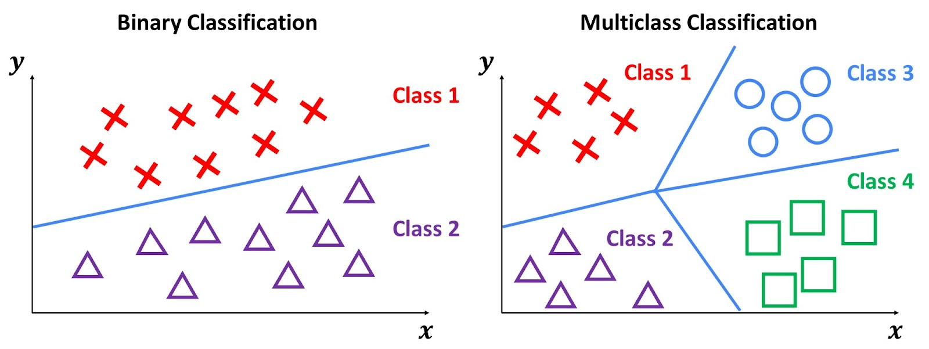
Model Refinement
Refined Model – Binary Classification for Staffed Capacity Risk
Additional Steps Taken
Modify Capacity Definition: ‘Room Occupancy’ ➜ ‘Staffed Capacity Risk’
Adjust Prediction Scope: t + 30
Feature Engineering: Time Series Lag Features
Machine Learning Methods: ‘SVM’ ➜ ‘GBM’ ➜ ‘Ensemble’ (SVM + GMB)

Slide 10
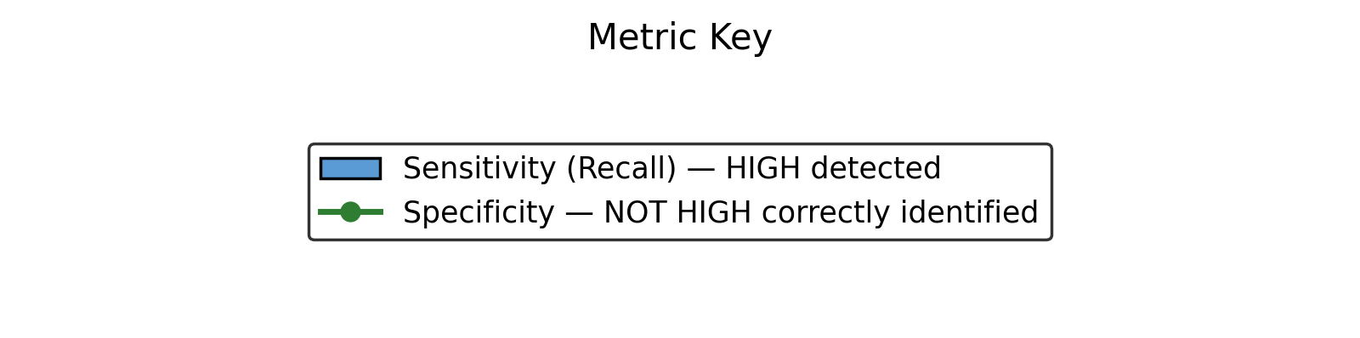

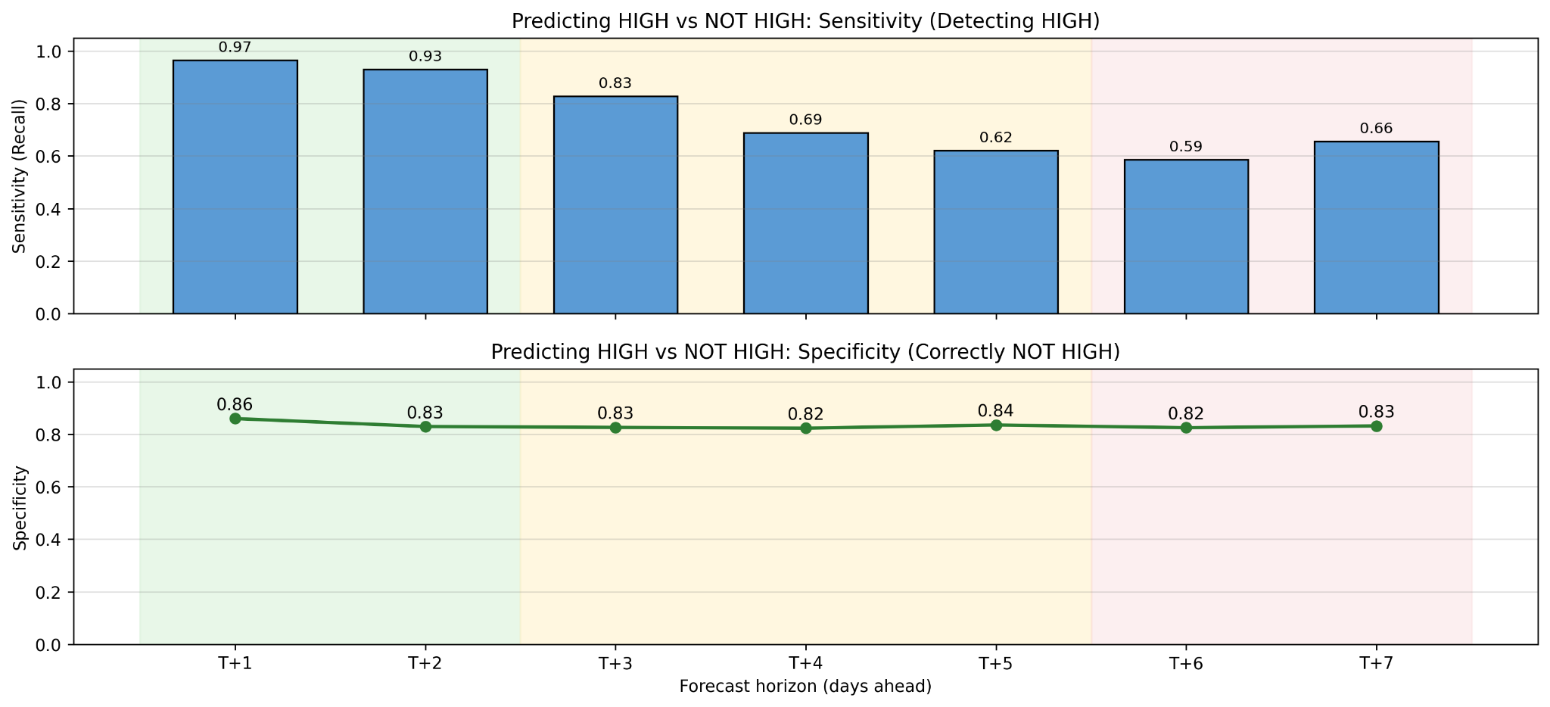
Model Selection
Predicting Staffed Capacity Risk (GBM+SVM)
🟢 triggers early warnings and enables proactive actions to safeguard patient care
HIGH = >85% Staffed Capacity

Slide 11
Executable Script
Python Code
Baseline
Refined

Slide 12
READ.ME
User Manual (Click to read)

