Slide 1
android.database.sqlite
Satish Mulgi
smulgi7@gmail.com
satishkumarmulgi@dypvp.edu.in

Slide 2
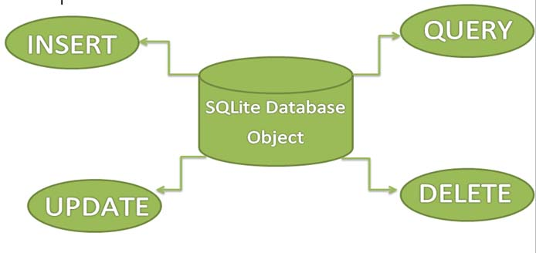
Introduction to SQLite
SQLite is a Structure query base database, open source, light weight, no network access and standalone database. It support embedded relational database features.

Slide 3
Introduction to SQLite
Android has built in SQLite database implementation.
It is available locally over the device(mobile & tablet) and contain data in text format.
It carry light weight data and suitable with many languages. So, it doesn’t required any administration or setup procedure of the database.

Slide 4
Creating And Updating Database In Android
For creating, updating and other operations you need to create a subclass or SQLiteOpenHelper class.
SQLiteOpenHelper is a helper class to manage database creation and version management.
It provides two methods
onCreate(SQLiteDatabase db);
onUpgrade(SQLiteDatabase db, int oldVersion, int newVersion);
The SQLiteOpenHelper is responsible for opening database if exist, creating database if it does not exists and upgrading if required.
The SQLiteOpenHelper only require the DATABASE_NAME to create database.
After extending SQLiteOpenHelper you will need to implement its methods onCreate, onUpgrade and constructor.

Slide 5
Creating And Updating Database In Android
onCreate(SQLiteDatabase sqLiteDatabase) method is called only once throughout the application lifecycle.
It will be called whenever there is a first call to getReadableDatabase() or getWritableDatabase() function available in super SQLiteOpenHelper class. So SQLiteOpenHelper class call the onCreate() method after creating database and instantiate SQLiteDatabase object. Database name is passed in constructor call.
onUpgrade(SQLiteDatabase db,int oldVersion, int newVersion) is only called whenever there is a updation in existing version. So to update a version we have to increment the value of version variable passed in the superclass constructor.
In onUpgrade method we can write queries to perform whatever action is required. In most example you will see that existing table(s) are being dropped and again onCreate() method is being called to create tables again. But it’s not mandatory to do so and it all depends upon your requirements.
We have to change database version if we have added a new row in the database table. If we have requirement that we don’t want to lose existing data in the table then we can write alter table query in the onUpgrade(SQLiteDatabase db,int oldVersion, int newVersion) method.

Slide 6
EmpModel Example
public class EmpModel extends SQLiteOpenHelper
{ public static final String DATABASE_NAME = "Employee.db"; public static final String TABLE_NAME = "emp_data"; public static final String COL_1 = "eno"; public static final String COL_2 = "ename"; public static final String COL_3 = "sal"; public EmpModel(Context context ) { super(context, DATABASE_NAME, null, 1); } @Override public void onCreate(SQLiteDatabase db){ db.execSQL("create table "+TABLE_NAME+"("+COL_1+" int primary key, "+COL_2+" text, "+COL_3+" int)"); } @Override public void onUpgrade(SQLiteDatabase db, int oldVersion, int newVersion) { db.execSQL("drop table "+TABLE_NAME); onCreate(db); } }

Slide 7
Insert, Read, Delete & Update Operation In Sqlite:
To perform insert, read, delete, update operation there are two different ways:
Write parameterized queries (Recommended)
Write raw queries
Parameterized Queries: These are those queries which are performed using inbuilt functions to insert, read, delete or update data. These operation related functions are provided in SQLiteDatabase class.
Raw Queries: These are simple sql queries similar to other databases like MySql, Sql Server etc, In this case user will have to write query as text and passed the query string in rawQuery(String sql,String [] selectionArgs) or execSQL(String sql,Object [] bindArgs) method to perform operations.

Slide 8
Example of raw query to insert data:
public void insertItem(Item item) {
String query = "INSERT INTO " + ItemTable.NAME + " VALUES (0,?,?)";
SQLiteDatabase db = getWritableDatabase();
db.execSQL(query, new String[]{item.name, item.description});
db.close();
}
While using raw queries we never come to know the result of operation,
however with parameterized queries function a value is returned for success or failure of operation.

Slide 9
Insert
To perform insert operation using parameterized query we have to call insert function available in SQLiteDatabase class.
insert() function has three parameters like
tableName is name of table in which data to be inserted.
NullColumnHack may be passed null, it require table column value in case we don’t put column name in ContentValues object so a null value must be inserted for that particular column,
values are those values that needs to be inserted-
ContentValues is a key-pair based object which accepts all primitive type values so whenever data is being put in ContentValues object it should be put again table column name as key and data as value.
insert function will return a long value i.e number of inserted row if successfully inserted, – 1 otherwise.
public long insert(String tableName, String nullColumnHack, ContentValues values);

Slide 10
Insert
public boolean insertData(int id,String name,int sal) { SQLiteDatabase db = this.getWritableDatabase(); ContentValues contentValues = new ContentValues(); contentValues.put(COL_1,id); contentValues.put(COL_2,name); contentValues.put(COL_3,sal); long result = db.insert(TABLE_NAME,null,contentValues); db.close(); if(result == -1) return false; else return true; }

Slide 11
Update
Update function is quite similar to insert but it requires two additional parameters, it doesn’t required nullColumnHack.
It has total four parameters two are similar to insert function that is tableName and contentValues. Another two are whereClause(String) and whereArgs(String[]).
Here whereClause is tell the database where to update data in table,
it’s recommended to pass ?s (questions) along with column name in whereClause String.
Similarly whereArgs array will contain values for those columns whose against ?s has been put in whereClause.
Update function will return number of rows affected if success, 0 otherwise.
//Item is a class representing any item with id, name and description public void
public int update(String tableName, ContentValues contentValues, String whereClause, String[] whereArgs)

Slide 12
Update
void updateItem(Item item) {
SQLiteDatabase db = getWritableDatabase();
ContentValues contentValues = new ContentValues();
contentValues.put("id", item.id);
contentValues.put("name", item.name);
contentValues.put("description", item.description);
String whereClause = "id=?";
String whereArgs[] = {item.id.toString()};
db.update("Items", contentValues, whereClause, whereArgs);
}

Slide 13
Viewing databases from Android Studio
Open Device File Explorer via View > Tool Windows > Device File Explorer
Go to data > data > PACKAGE_NAME > database, where PACKAGE_NAME is the name of your package.
Right click on the database and select Save As.... Save it anywhere you want on your PC.
Now, open the SQLiteBrowser you installed. Click on 'open database', navigate to the location you saved the database file, and open. You can now view the contents of your database.

