Slide 1
Services
Satish Mulgi
smulgi7@gmail.com
satishkumarmulgi@dypvp.edu.in

Slide 2
Services
A Service is an application component that can perform long-running operations in the background, and it does not provide a user interface.
Once started, a service might continue running for some time, even after the user switches to another application
That is, another application component can start a service, and it continues to run in the background even if the user switches to another application.
Additionally, a component can bind to a service to interact with it and even perform inter process communication (IPC). For example, a service can handle network transactions, play music, perform file I/O, or interact with a content provider, all from the background.
Service is an Android Component without an UI
It is used to perform long running operations in background. Services run indefinitly unless they are explicitly stopped or destroyed
It can be started by any other application component. Components can even infact bind to a service to perform Inter process- Communication
It can still be running even if the application is killed unless it stops itself by calling stopself() or is stopped by a Android component by calling stopService().
If not stopped it goes on running unless is terminated by Android due to resource shortage
The android.app.Service is subclass of ContextWrapper class.

Slide 3
Services
Note: Service always runs on the main thread by default. When the doc says “long running processes in background” it means that processes without an UI. So if you are performing a time consuming task you must be creating a background thread in the service.
A service can essentially take two states :
Started : A service is started when an application component, such as an activity, starts it by calling startService(). Once started, a service can run in the background indefinitely, even if the component that started it is destroyed.
Bound : A service is bound when an application component binds to it by calling bindService(). A bound service offers a client-server interface that allows components to interact with the service, send requests, get results, and even do so across processes with inter process communication (IPC).

Slide 4
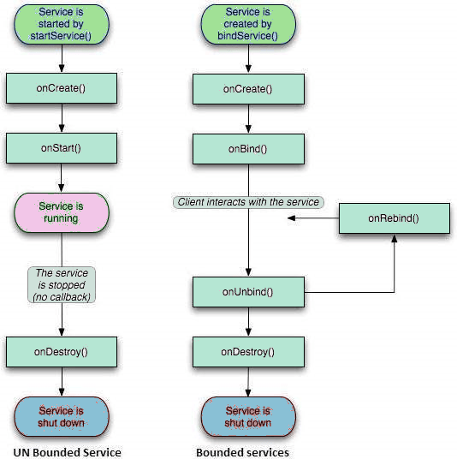
Android Service Lifecycle

Slide 5
Services
BOUND SERVICES
An application component starts the service, and it would continue to run in the background, even if the original component that started it is destroyed. You will use the startService() method to start an unbound service.
onCreate()
onBind()
onUnbind()
onDestroy()
UNBOUND SERVICES
An Android component may bind itself to a Service using bindService () to perform interactivity and inter process communication. When the component binding to the bound service is destroyed, the service stops.
onCreate()
onStartCommand()
onDestroy()

Slide 6
Services
onStartCommand()
The system calls this method when another component, such as an activity, requests that the service be started, by calling startService(). If you implement this method, it is your responsibility to stop the service when its work is done, by calling stopSelf() or stopService() methods
onBind()
The system calls this method when another component wants to bind with the service by calling bindService(). If you implement this method, you must provide an interface that clients use to communicate with the service, by returning an IBinder object. You must always implement this method, but if you don't want to allow binding, then you should return null.
onCreate()
The system calls this method when the service is first created using onStartCommand() or onBind(). This call is required to perform one-time set-up.
onDestroy()
The system calls this method when the service is no longer used and is being destroyed. Your service should implement this to clean up any resources such as threads, registered listeners, receivers, etc.

Slide 7
Services
onUnbind()
The system calls this method when all clients have disconnected from a particular interface published by the service.
onRebind()
The system calls this method when new clients have connected to the service, after it had previously been notified that all had disconnected in its onUnbind(Intent).

Slide 8
Bound Service
The Methods for Bound Service
1. bindService
Syntax
public abstract boolean bindService (Intent service, ServiceConnection conn, int flags)
- Connect to an application service, creating it if needed.
- This defines a dependency between your application and the service.
-Parameters
Service - Identifies the service to connect to.
The Intent must specify an explicit component name
Conn – ServiceConnection :
Receive the information as the service is started and stopped.
This must be a valid ServiceConnection object; it must not be null.
Flag – BIND_AUTO_CREATE – Automatically create the services as long as the binding exists.

Slide 9
Bound Service
IBinder – Ibinder is a interface that provides the programming interface that client can use to interact with the service.
LocalBinder() - The binder implementation for this service The binder provides API access to this service to the clients who wish to access methods provided by the Service.

