Slide 1
A
Presentation on
Soil based crop prediction and whether forecasting

Slide 2
Overview
Introduction
Problem Statement
Literature survey
Existing system
Proposed model (Add Architecture)
Algorithm
Mathematical model
UML diagrams
Advantages
Future Scope
Conclusion
References
Publications

Slide 3
INTRODUCTION
There are so many soil series available in India. Every soil series have different features and every soil is suitable for different crop. Sometimes or we can say every time it happens that farmer soil is best for some specific crop but as he don’t know. The main purpose of the proposed work is to create a suitable model for classifying various kinds of soil series data along with suitable crops suggestion.
Series are recognized by machine learning methods using various chemical features and possible crops for that soil series are suggested using geographical attributes. Soil is one of the key components in agricultural field for yielding crops. Soil classification philosophies follow the existence knowledge and practical circumstances. On the land surfaces of earth, classification of soil creates a link between soil samples and various kinds of natural entity.

Slide 4
Problem Statement
Crop prediction is one of the challenging problems in precision agriculture, and many models have been proposed and validated so far.
This problem requires the use of several datasets since crop yield depends on many different factors such as climate, weather, and soil, use of fertilizer etc. To develop Soil detection and Crop predication system.

Slide 5
Literature survey
Sr.No | Author Name | IEEE Paper Name | Description
1. | Prof. A. V. Deorankar. Ashwini A. Rohankar. | An Analytical Approach for Soil and Land Classification System using Image Processing (2020) | The emphasis is focused on the analytical study of various advanced and efficient classification mechanisms and techniques.
2. | Dr. Y. Jeevan Nagendra Kumar, V. Spandana, V.S. Vaishnavi, K. Neha | Supervised Machine learning Approach for Crop Yield Prediction in Agriculture Sector (2020) | Crop yield prediction incorporates forecasting the yield of the crop from past historical data which includes factors such as temperature, humidity, ph, rainfall, crop name.
3. | Supriya S. Shinde, Mayura Kulkarni | Review Paper on Prediction of Crop Disease Using IoT and Machine Learning (2017) | The proposed system gives more emphasis to predict diseases of the crop with the use of the Internet of Things and machine learning algorithms. Different sensors collect the real-time data of environmental parameters like temperature, humidity, rainfall, light intensity.

Slide 6
Literature survey
Sr.No | Author Name | IEEE Paper Name | Description
4. | Rakesh Kumar , M.P. Singh , Prabhat Kumar and J.P. Singh | Crop Selection Method to Maximize Crop Yield Rate using Machine Learning Technique (2015) | This paper proposed a method named Crop Selection Method (CSM) to solve crop selection problem, and maximize net yield rate of crop over season and subsequently achieves maximum economic growth of the country. The proposed method may improve net yield rate of crops.
5. | M. Kalimuthu, P. Vaishnavi, M. Kishore | Crop Prediction using Machine Learning (2020) | The seed data of the crops are collected here, with the appropriate parameters like temperature, humidity and moisture content, which helps the crops to achieve a successful growth.

Slide 7
Existing System
In existing system, traditionally without knowing the type of soil, without knowing suitable crop.
Farmer plants his farm and it many times gives him loss. Farmer don’t have the knowledge of crop and soil also.
Crop yield prediction incorporates forecasting the yield of the crop from past historical data.

Slide 8
Proposed System
We need to know the features and characteristics of various soil types to understand which crops grow better in certain soil types.
Machine learning techniques can be helpful in this case.
Then apply apriority Mining process to generate an association rule for finding suitable crops for the specific soil.
Soil series and land type combine represents the soil class in the database.
The machine learning methods are used to find the soil class (i.e. soil series and land type). Algorithm are used: CNN.

Slide 9
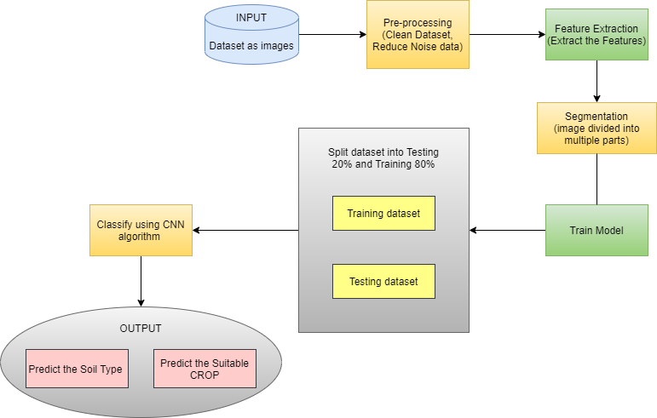
Architecture diagram

Slide 10
Mathematical Model
Let S be the Whole system S= {I, P,O}
I - input
P - procedure
O - output
Input( I)
I={ Input as soil image Dataset }
Where,
1. Dataset contain Soil images dataset.
Procedure (P),
P= {1. Train the dataset (Soil image dataset)
2. Pre-processing
3. Feature Extraction
4. Segmentation
4. Classification (used CNN algorithm)
5. Create Model.}
Output (O)-
O= {1. System detect Soil type.
2.Predict the suitable Crop. And weather}

Slide 11
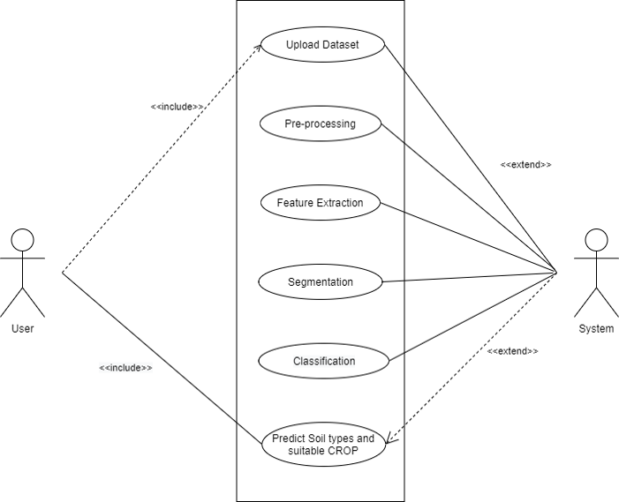
UML Diagrams
1. Use case Diagram

Slide 12
UML Diagrams
2. Activity
Diagram

Slide 13
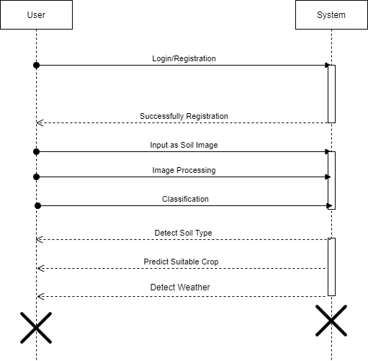
UML Diagrams
3. Sequence
Diagram

Slide 14
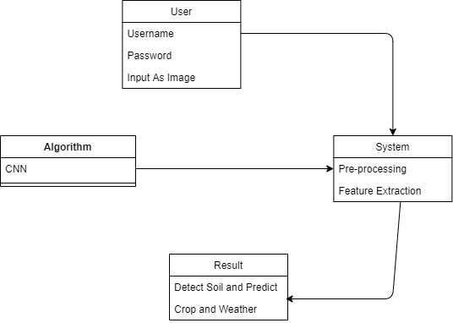
UML Diagrams
4. Class
Diagram

Slide 15
Advantages
Easy to collect information about Soils and Crops.
It is User friendly.
An accurate crop prediction model can help farmers to decide on what to grow and when to grow.

Slide 16
SOFTWARE REQUIREMENT
Operating system : 64 bit Windows 10.
Coding Language : Python(TKinter)
IDE : Spyder.
Python Library : Tensorflow, Keras, Opencv, Matplotlib
Database : DBSqlite3

Slide 17
HARDWARE REQUIREMENT
System Processors : Core2Duo
Speed : 2.4 GHz
Hard Disk : 150 GB
RAM : 8 GB

Slide 18
Future Work
In reference to rainfall can depict whether extra water availability is needed or not. This research work can be enhanced to higher level by availing it to whole India.
Crop diseases detection using Image Processing where users can upload picture of diseased crop and get pesticides recommendations.
Implementation of Smart Irrigation System to monitor weather and soil conditions, plant water usage etc. to automatically alter watering schedule.

Slide 19
Conclusion
A model is proposed for predicting soil series and providing suitable crop yield suggestion for that specific soil and weather.
The model has been tested by applying different kinds of Deep algorithm.
CNN shows highest accuracy in soil classification and suggests crops with less time. It gives us more accuracy as compared to existing system and gives more benefit to farmers.

Slide 20
References
[1]Y Jeevan Nagendra Kumar; V. Spandana; V.S. Vaishnavi; K. Neha;V.G.R.R Devi., 2020. Supervised Machine learning Approach for Crop Yield Prediction in Agriculture Sector.
[2]Fatin Farhan Haque; Ahmed Abdelgawd; Venkata Prasanth Yangmbaka; Kumar Yelamarathi.,2020,Crop Yield Analysis Using Machine Learning Algorithms.
[3] R. Nikhil; B.S. Anisha; Ramakanth Kumar P., 2020,Real-Time Monitoring of Agricultural Land with Crop Prediction and Animal Intrusion Prevention using Internet of Things and Machine Learning at Edge.

Slide 21

Publication

