Slide 1
AlexNet
AlexNet was designed by Hinton, winner of the 2012 ImageNet competition, and his student Alex Krizhevsky. It was also after that year that more and deeper neural networks were proposed, such as the excellent vgg, GoogleLeNet. Its official data model has an accuracy rate of 57.1% and top 1-5 reaches 80.2%. This is already quite outstanding for traditional machine learning classification algorithms.

Slide 2
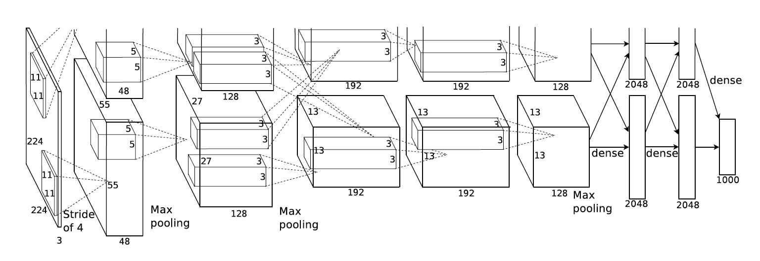

Slide 3
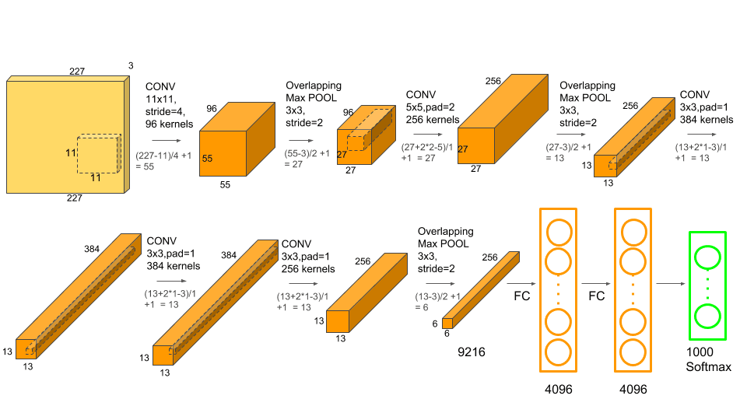

Slide 4
AlexNet is composed of 8 layers, including 5 convolutional layers, 2 fully connected layers, and 1 softmax layer.
Here's a pointwise explanation of the AlexNet architecture:
Input Layer: The input to the network is a 227x227x3 RGB image.
Convolutional Layer 1: The first layer consists of 96 filters of size 11x11x3, with a stride of 4 and no padding. The activation function used is ReLU.
Max Pooling Layer 1: The output of the first convolutional layer is passed through a max pooling layer with a filter size of 3x3 and a stride of 2.
Local Response Normalization Layer 1: After the first pooling layer, a local response normalization (LRN) layer is applied to improve the generalization of the model.
Convolutional Layer 2: The second convolutional layer consists of 256 filters of size 5x5x48, with a stride of 1 and padding of 2. The activation function used is ReLU.
Max Pooling Layer 2: The output of the second convolutional layer is passed through a max pooling layer with a filter size of 3x3 and a stride of 2.
Local Response Normalization Layer 2: Similar to the first LRN layer, a second LRN layer is applied to the output of the second pooling layer.

Slide 5
8. Convolutional Layer 3: The third convolutional layer consists of 384 filters of size 3x3x256, with a stride of 1 and padding of 1. The activation function used is ReLU.
9. Convolutional Layer 4: The fourth convolutional layer consists of 384 filters of size 3x3x192, with a stride of 1 and padding of 1. The activation function used is ReLU.
10. Convolutional Layer 5: The fifth convolutional layer consists of 256 filters of size 3x3x192, with a stride of 1 and padding of 1. The activation function used is ReLU.
11. Max Pooling Layer 3: The output of the fifth convolutional layer is passed through a max pooling layer with a filter size of 3x3 and a stride of 2.
12. Flatten Layer: The output of the last pooling layer is flattened into a 1D vector.
13. Fully Connected Layer 1: The first fully connected layer consists of 4096 neurons, with a dropout probability of 0.5. The activation function used is ReLU.
14. Fully Connected Layer 2: The second fully connected layer consists of 4096 neurons, with a dropout probability of 0.5. The activation function used is ReLU.
15. Softmax Layer: The output of the last fully connected layer is passed through a softmax layer to produce the class probabilities. The number of neurons in the softmax layer is equal to the number of classes in the dataset.

Slide 6
