Slide 1
LeNet:
LeNet-5, from the paper Gradient-Based Learning Applied to Document Recognition, is a very efficient convolutional neural network for handwritten character recognition.
Structure of the LeNet network
LeNet5 is a small network, it contains the basic modules of deep learning: convolutional layer, pooling layer, and full link layer. It is the basis of other deep learning models. Here we analyze LeNet5 in depth. At the same time, through example analysis, deepen the understanding of the convolutional layer and pooling layer.

Slide 2
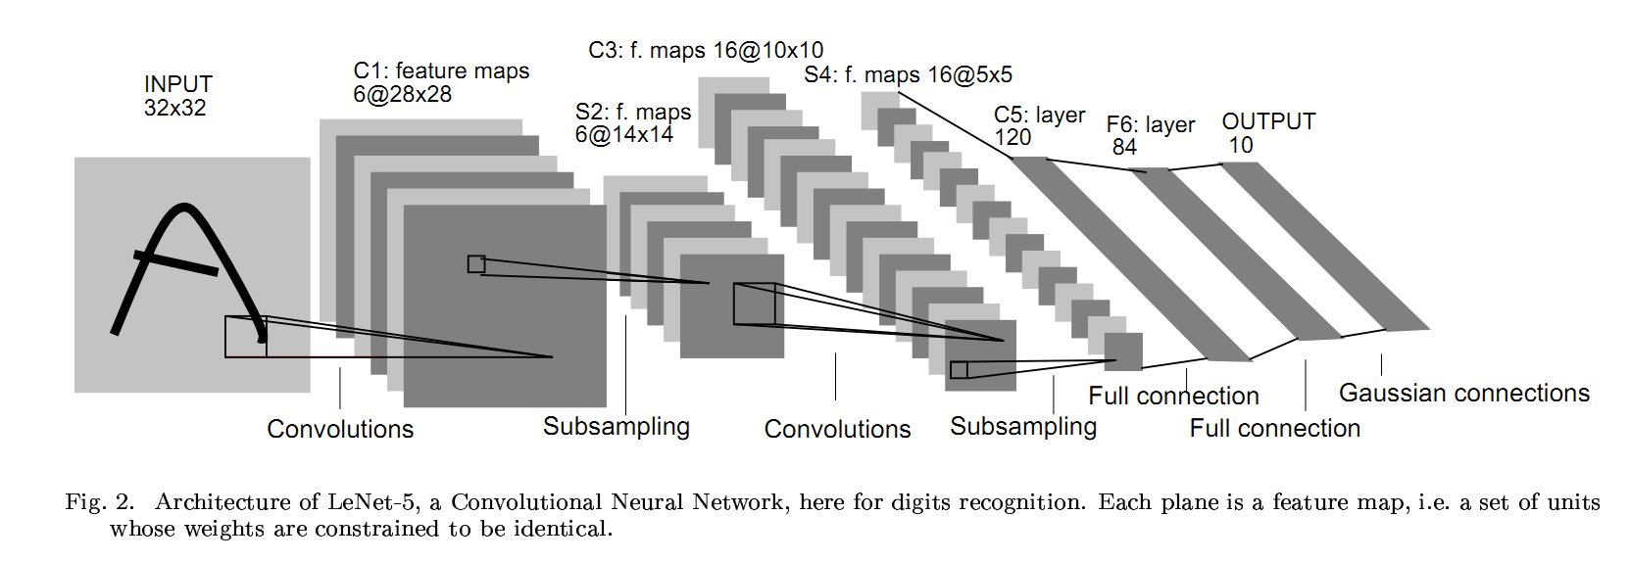

Slide 3
The LeNet architecture is composed of seven layers, including three convolutional layers, two subsampling layers, and two fully connected layers. The architecture is designed to take in a 32x32 pixel grayscale image as input.
Here is a breakdown of the architecture:
Convolutional Layer 1: This layer has 6 kernels of size 5x5. The output is a feature map of 28x28x6. The kernels are applied with a stride of 1 and zero-padding.
Subsampling Layer 1: This layer performs down-sampling on the output of the first convolutional layer. It has 6 non-overlapping regions of size 2x2. The output is a feature map of 14x14x6.
Convolutional Layer 2: This layer has 16 kernels of size 5x5. The output is a feature map of 10x10x16. The kernels are applied with a stride of 1 and zero-padding.
Subsampling Layer 2: This layer performs down-sampling on the output of the second convolutional layer. It has 16 non-overlapping regions of size 2x2. The output is a feature map of 5x5x16.
Fully Connected Layer 1: This layer has 120 neurons, which are fully connected to the previous layer. The output is a feature vector of length 120.
Fully Connected Layer 2: This layer has 84 neurons, which are fully connected to the previous layer. The output is a feature vector of length 84.
Output Layer: This layer has 10 neurons, which are fully connected to the previous layer. Each neuron corresponds to one of the 10 possible classes (0-9).
The LeNet architecture was groundbreaking at the time of its introduction because it demonstrated that convolutional neural networks could achieve high accuracy on complex image recognition tasks. Since then, it has been widely used and adapted for various image recognition tasks.

Slide 4
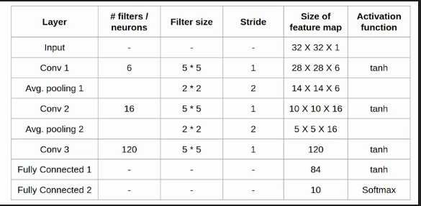
LeNet-5 Total seven layer , does not comprise an input, each containing a trainable parameters; each layer has a plurality of the Map the Feature , a characteristic of each of the input FeatureMap extracted by means of a convolution filter, and then each FeatureMap There are multiple neurons.

Slide 5
C1 layer-convolutional layer
Detailed description:
1. The first convolution operation is performed on the input image (using 6 convolution kernels of size 5 * 5) to obtain 6 C1 feature maps (6 feature maps of size 28 * 28, 32-5 + 1 = 28).
2. Let's take a look at how many parameters are needed. The size of the convolution kernel is 5 * 5, and there are 6 * (5 * 5 + 1) = 156 parameters in total, where +1 indicates that a kernel has a bias.
3. For the convolutional layer C1, each pixel in C1 is connected to 5 * 5 pixels and 1 bias in the input image, so there are 156 * 28 * 28 = 122304 connections in total. There are 122,304 connections, but we only need to learn 156 parameters, mainly through weight sharing.

Slide 6
S2 layer-pooling layer (downsampling layer)
Detailed description:
The pooling operation is followed immediately after the first convolution. Pooling is performed using 2 * 2 kernels, and S2, 6 feature maps of 14 * 14 (28/2 = 14) are obtained.
The pooling layer of S2 is the sum of the pixels in the 2 * 2 area in C1 multiplied by a weight coefficient plus an offset, and then the result is mapped again.
So each pooling core has two training parameters, so there are 2x6 = 12 training parameters, but there are 5x14x14x6 = 5880 connections.

Slide 7
C3 layer-convolutional layer
After the first pooling, the second convolution, the output of the second convolution is C3, 16 10x10 feature maps, and the size of the convolution kernel is 5 * 5. We know that S2 has 6 14 * 14 feature maps, how to get 16 feature maps from 6 feature maps? Here are the 16 feature maps calculated by the special combination of the feature maps of S2. details as follows:
The first 6 feature maps of C3 (corresponding to the 6th column of the first red box in the figure above) are connected to the 3 feature maps connected to the S2 layer (the first red box in the above figure), and the next 6 feature maps are connected to the S2 layer The 4 feature maps are connected (the second red box in the figure above), the next 3 feature maps are connected with the 4 feature maps that are not connected at the S2 layer, and the last is connected with all the feature maps at the S2 layer. The convolution kernel size is still 5 * 5, so there are 6 * (3 * 5 * 5 + 1) + 6 * (4 * 5 * 5 + 1) + 3 * (4 * 5 * 5 + 1) +1 * (6 * 5 * 5 + 1) = 1516 parameters. The image size is 10 * 10, so there are 151600 connections.

Slide 8
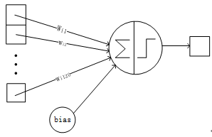
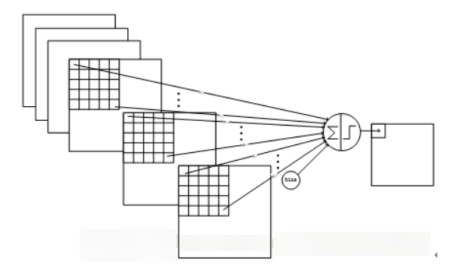

Slide 9
S4 layer-pooling layer (downsampling layer)
Detailed description:
S4 is the pooling layer, the window size is still 2 * 2, a total of 16 feature maps, and the 16 10x10 maps of the C3 layer are pooled in units of 2x2 to obtain 16 5x5 feature maps. This layer has a total of 32 training parameters of 2x16, 5x5x5x16 = 2000 connections.

Slide 10
C5 layer-convolution layer
Detailed description:
The C5 layer is a convolutional layer. Since the size of the 16 images of the S4 layer is 5x5, which is the same as the size of the convolution kernel, the size of the image formed after convolution is 1x1. This results in 120 convolution results. Each is connected to the 16 maps on the previous level. So there are (5x5x16 + 1) x120 = 48120 parameters, and there are also 48120 connections. The network structure of the C5 layer is as follows:

Slide 11
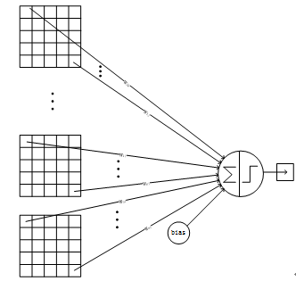

Slide 12
F6 layer-fully connected layer
Layer 6 is a fully connected layer. The F6 layer has 84 nodes, corresponding to a 7x12 bitmap, -1 means white, 1 means black, so the black and white of the bitmap of each symbol corresponds to a code. The training parameters and number of connections for this layer are (120 + 1) x84 = 10164.

Slide 13
Output layer-fully connected layer
The output layer is also a fully connected layer, with a total of 10 nodes, which respectively represent the numbers 0 to 9, and if the value of node i is 0, the result of network recognition is the number i. A radial basis function (RBF) network connection is used. Assuming x is the input of the previous layer and y is the output of the RBF, the calculation of the RBF output is:

Slide 14
