Slide 1
“Indian Food Image Classification with Transfer Learning”
A PRESENTATION ON

Slide 2
Contents
Introduction
Literature Survey
Existing System
1. Architecture(Diagram)
2. Methodology
Proposed System
1.Architecture(Diagram)
2. Methodology
System Architecture
1.Use case Diagram
2.Class Diagram
3.Sequence Diagram
4.DFD-0,1
Software And Hardware Requirements:
1. Software requirement
2. Hardware requirement
Conclusion

Slide 3
Introduction
Training of CNN for image classification can be done mainly in 2 ways: training the CNN from the scratch or using the concept of transfer learning. Transfer learning is a deep learning technique where a model is trained to learn and store the knowledge from one problem and use the same model to other similar problems. i.e., fine tuning already trained CNN models from the huge dataset to food image classification task.
this research an effort has been put to classify Indian food images into their respective classes using transfer learning. Image Classification with deep learning techniques such as Convolution neural network are getting incredible consideration because of their efficiency in learning and classifying complex features. A comparison has been made between the models with respect to accuracy and validation loss.
Statistics show that 95% of the people do not follow any nutritional plan as these are very strict and restricts people from consuming their day-to-day food. Old aged who want to monitor their food intake, patients who want to monitor their health through food due to different dietary restrictions and mainly youth who want to track the calories and nutrition intake to maintain fitness, the importance of food classification has increased. Over the past couple of years, image based dietary and calories extraction has been a challenging task and a lot of research is going on the same.

Slide 4
Literature Survey
Sr. No. | Title &year | Author | Description | Advantage
1. | Food Classification from Images Using Convolutional Neural Networks (2017) | David J. Attokaren, Ian G. Fernandes, A. Sriram, Y.V. Srinivasa Murthy, and Shashidhar G. Koolagudi | In this paper, The process of identifying food items from an image is quite an interesting field with various applications. | Easy Identify Food Classification.
2. | Deep Convolutional Generative Adversarial Network Based Food Recognition Using Partially Labeled Data (2018 ) | Bappaditya Mandal , N. B. Puhan and Avijit Verma | In recent works, convolutional neural networks (CNN) have been applied to this task with better results than all previously reported methods.infrastructures. | Easy Identify Food Recognition.
3. | Few-shot and Many-shot Fusion Learning in Mobile Visual Food Recognition (2018) | Heng Zhao , Kim-Hui Yap , Alex C. Kot , Lingyu Duan , Ngai-Man Cheung | As a Result they are not amenable for deployment on mobile devices. In this paper, we address these issues by proposing a new few-shot and many-shot fusion learning for mobile visual food recognition, it has a compact framework and is able to learn from existing dataset categories, and also new food categories given only a few sample images.

Slide 5
Existing System
Many People in India are unable to find proper Indian food.
Some People Can’t read Other languages than hindi or native languages.

Slide 6
Methodology
CNN (Convolutional Neural Networks) –
Convolutional Neural Networks specialized for applications in image & video recognition. CNN is mainly used in image analysis tasks like Image recognition, Object detection & Segmentation.
There are Four types of layers in Convolutional Neural Networks:
1) Convolutional Layer: In a typical neural network each input neuron is connected to the next hidden layer. In CNN, only a small region of the input layer neurons connect to the neuron hidden layer.
2) Pooling Layer: The pooling layer is used to reduce the dimensionality of the feature map. There will be multiple activation & pooling layers inside the hidden layer of the CNN.
3) Flatten: Flattening is converting the data into a 1-dimensional array for inputting it to the next layer. We flatten the output of the convolutional layers to create a single long feature vector.
4) Fully-Connected layer: Fully Connected Layers form the last few layers in the network. The input to the fully connected layer is the output from the final Pooling or Convolutional Layer, which is flattened and then fed into the fully connected layer.

Slide 7
Advantages
Easy to collect information about food and its recipes
Time saving.

Slide 8
Proposed System
In this system, first input as Image dataset provide machine then next step is pre-processing.
Pre-processing Phase is remove the noise from the data, rescale, resize image dataset.
Then Feature Extraction is to extract features like edges, size etc. from dataset.
After Feature Extraction next step is segmentation. In segmentation we divide image multiple parts.
Then after the all steps done we used classifier for the classification. We used CNN algorithm for the classification. Classification is process of categorizing and labelling groups of pixels or vectors within an image based on specific rules.
After All The Training Phase Done Machine create model Then Model Goes To testing Phase and Then Output Provide To user.
Output is to Classify the Food and its recipes and in details .

Slide 9
Methodology
A. The Indian Food Dataset.
The dataset considered for our study is the Indian Food dataset. It contains 20 different classes of food and each class has 500 sample images. The dataset inherently comes with a lot of noise since there are images in which there is more than one food item. The image samples also contain a lot of color and few of them are wrongly labeled too. The figure below shows the sample food images from the Indian Food dataset
B. Image preprocessing
The dataset contains 20 different classes of food images. Each class of image is divided into training and testing images wherein 400 images from each class are considered as training samples and the remaining 100 samples as test samples. Overall, there are 8000 training samples and 2000 test samples. The training set images are fed to the CNN model and validation is made using the test dataset.

Slide 10
Advantages:
The model is evaluated for its classification accuracy
The CNN image model is developed using Keras on top of Tensor flow in the Spyder environment
Time saving.

Slide 11
C. Training the CNN classifier using pretrained models
The greater part of the Computer Vision Problems doesn't have exceptionally huge datasets (10,000 images — 50,000 images). Indeed, even with extraordinary data augmentation procedures it is hard to accomplish respectable accuracy. Building these networks with many parameters over fit the model. So Transfer learning avoids this over fitting. In transfer learning early layers will detects edges, middle layers detect the shapes and the last layers will detect some high level data features. These transfer learning models are useful in many computer vision and image classification problem

Slide 12
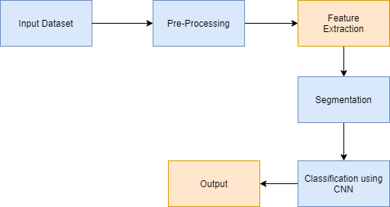
System Architecture
System Architecture –

Slide 13

System Architecture
Data Flow Diagram
dfd 0

Slide 14
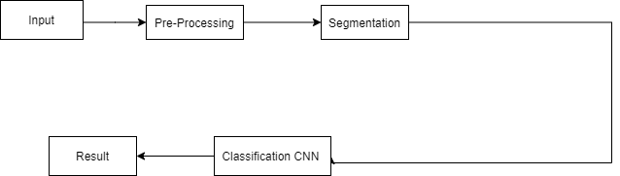
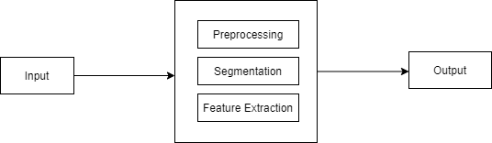
DFD2
DFD1

Slide 15
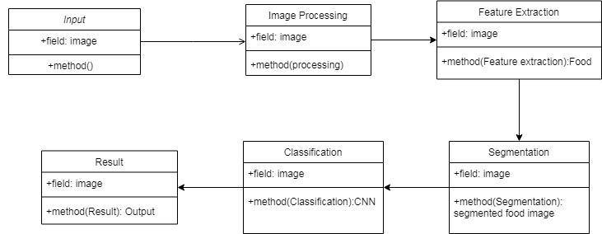
UML Diagram
Class Diagram

Slide 16
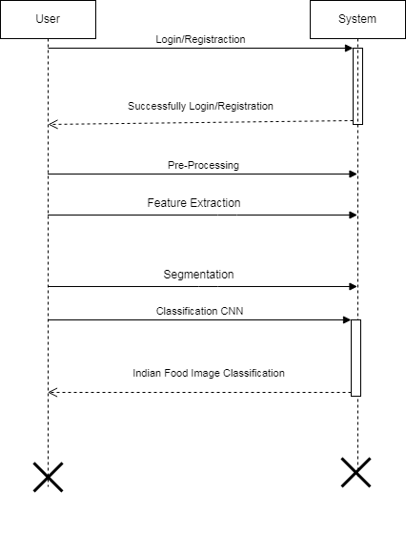
Sequence Diagram

Slide 17
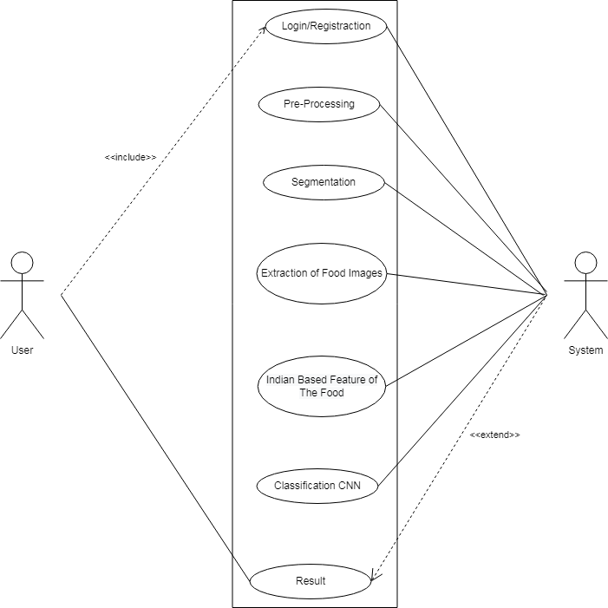
Use Case Diagram

Slide 18
System Requirements
Software Requirements
Operating System: Windows 10
IDE: Pycharm ,Spyder
Programming Language : Python
Hardware Requitrements
RAM : 8 GB
Hard Disk : 40 GB
Processor : Intel i5 Processor

Slide 19
Modules
Dataset
Image Pre-processing
Feature Extraction
Classification (CNN Model)
GUI

Slide 20
Future Scope
As far as the future enhancement is concerned, the task of classification can be improved by removing noise from the dataset.
The same research can be carried out on larger dataset with more number of classes and more number of images in each class, as larger dataset improves the accuracy by learning more features and reduces the loss rate.
The weights of the model can be saved and used to design a web app or mobile app for image classification and further calories extraction of the classified food.

Slide 21
Conclusion
In this proposed system, the Convolutional Neural Network, a Deep learning technique is used to classify the food images in to their respective classes. The dataset considered is the Indian food dataset and train dataset using CNN algorithm. Indian food image classification system, classify the which type of food and recipe and also to automatically analyse the dietary and calorie information

