Slide 1
Lost & Found
Team 2

Slide 2
Context
TMB runs 165 metro stations and 2,635 bus stops across Barcelona
22,000-27,000 items are lost across the network every year
Current recovery rate: 25-30% -- meaning 7 in 10 items never make it back to their owner
The system exists. The intelligence does not.

Slide 3
Our way
Visited TMB's lost and found point at Sagrada Familia
Mapped the full journey of a lost item through the system - from find to claim
Benchmarked against global systems: Seoul LOST112 (85%), Hong Kong MTR (50%), Tokyo Find Inc.
Research shows 90% of finders try to return items - the gap is not willingness, it is infrastructure

Slide 4
Problems we identified
Registration is manual and Excel-based -- errors and delays from the first moment
Everything goes to one depot (Sagrada Familia) regardless of where the passenger lives or travels
No communication to passengers after they file a claim
Abandoned items treated the same as genuinely lost ones
No intelligence anywhere in the process -- storage is decided by convenience, not by passenger behaviour

Slide 5
Our user
The passenger who loses something on TMB's network
They file a claim, hear nothing back, and eventually give up
They don't lack willingness - the system lacks the intelligence to meet them where they are
Every failed recovery quietly erodes their trust in the infrastructure meant to support them

Slide 6
Where we focus in the system
The lost and found journey has multiple steps: finding, registering, storing, claiming, collecting
We focus on one critical moment: what happens after an item is found
Specifically - where the item gets stored, and how that single decision determines whether recovery is even possible
Today that decision is made by operational convenience. We replace it with intelligence.

Slide 7
Designing for the future
We are not designing for today's Excel spreadsheet
We assume TMB will improve - better data, better infrastructure, better connectivity over time
Our solution is built to grow with it: the GNN improves as more retrieval data accumulates
As the settlement grows and passenger patterns shift, the optimal storage points update too

Slide 8
Assumptions
Passenger movement follows predictable patterns by route, time of day and user profile
TMB has enough historical data to train a GNN meaningfully
The GNN works as a recommendation layer - no need to replace TMB's existing systems
Reducing the detour cost of recovery directly increases the share of passengers who collect

Slide 9
5W2H
Who Passengers who lose items on TMB's metro and bus network
What GNN-powered storage placement and smart locker network
Where Across TMB's 165 metro stations and 2,635 bus stops
When At the moment a found item is logged into the system
Why 70% of items are never recovered -- poor storage placement and no intelligence in the process
How GNN recommends optimal storage location per item based on real movement patterns
How much From 25% to 40-50% recovery - 3,000-4,000 more items returned per year

Slide 10
TMB Lost & Found — 5-Year Plan
From single-station depot to model-routed locker network

Slide 11
Current situation
All items centralized at Sagrada Família depot
Registration delay: 5–10 days after find
Claims only in person, by phone, or via web form
No data captured on passenger preference or convenience

Slide 12
Proposed changes — before the model
Unified database: TMB + City Council + Mossos + Renfe
Staff mobile app: photo → VLM auto-description → instant registration
Chatbot retrieval: natural-language search against the shared ledger
Pickup questionnaire: capture preferred station + item type
Outcome: searchable items in seconds, easier retrieval, labelled data

Slide 13
GNN application
Input: found-at station, item type, time, day-of-week
Output: per-station probability of being the claimant's preferred pickup
Decision rule selects the storage station minimizing expected travel
Aggregating over all events sizes the locker network – how many lockers where

Slide 14
How the GNN is trained
Year 0: collect questionnaire labels at existing pickup points
Pretrain on prior synth data (encoded passenger-profile assumptions)
Fine-tune on real questionnaire data; prior weight decays year by year
Annual retraining on accumulated questionnaire corpus

Slide 15
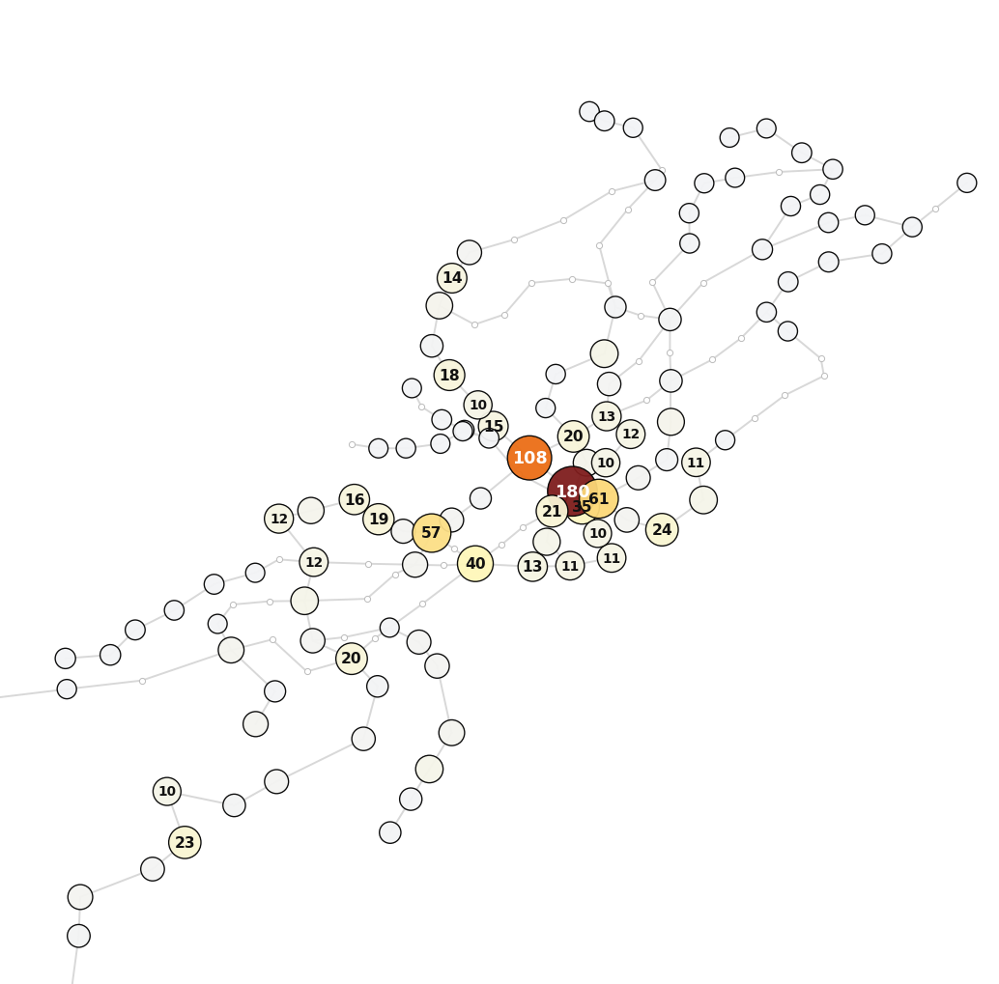
What it tells us and what changes
Per-item: ship directly to the locker the model recommends
Aggregate: which stations host lockers, sized by predicted weekly load
Replaces 'everything to Sagrada' with model-driven routing at find time
Locker map reshapes annually as travel patterns drift
Aggregated prediction for 1 year (avg Items/Week)

Slide 16
Hopeful impact
Convenient pickup → more trust → higher retrieval rate
Faster retrieval → less storage time per item
Positive feedback loop: better data → better model → better placement

Slide 17
TMB — tradeoffs
+ Shorter average storage time per item
+ Fewer items held at any one moment
+ Higher passenger trust in the service
− More distributed storage logistics
− Operational complexity of locker network upkeep

Slide 18
Users
+ Closer pickup points
+ Anytime pickup via locker code (no info-point queue, no opening hours)
+ Less anxiety about the process

Slide 19
Demo idea — full live system
Two laptops, end-to-end flow with audience participation
Laptop 1 — Item registration (VLM)
Scan any item
VLM generates description; entry added to the shared database
Random found-at station/line assigned for the demo
Barcelona map shows where the GNN will store the item
Laptop 2 — Retrieval (LLM chatbot)
Passenger describes the lost item in natural language
LLM matches against the database and returns the pickup locker
Same Barcelona map highlights the storage station

Slide 20
How we measure success
Collection Success Rate
Share of logged items successfully collected, stratified by passenger category (tourist, commuter, etc.)
Time from Registration to Collection
How long from item logged to owner collected - critical for time-constrained passengers like tourists
Customer Satisfaction with Pick-Up Spot
How satisfied passengers are with the assigned collection point — measures whether the GNN is placing items where people actually want to go.

Slide 21
Thank you!

