Slide 1
Machine Learning Model to Predict Loan Eligibility
Anish Dudeja

Slide 2
Data Preprocessing and EDA
The Dataset was first explored through EDA and then prepared for processing in Jupyter Notebooks.
All of the EDA and preprocessing has been laid out in the solution approach document and all of the code is presented in the Final Solution folder.

Slide 3
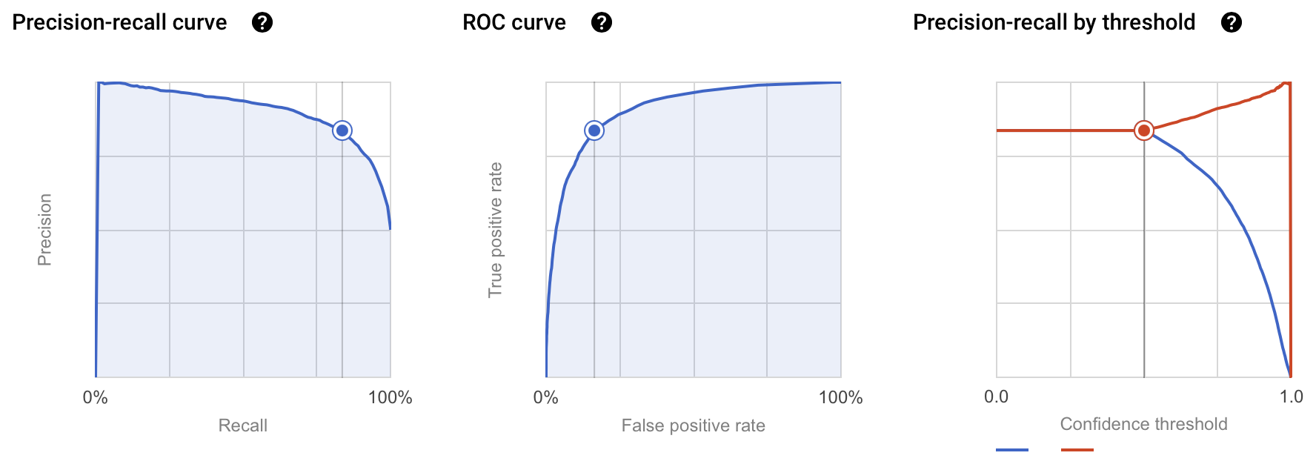
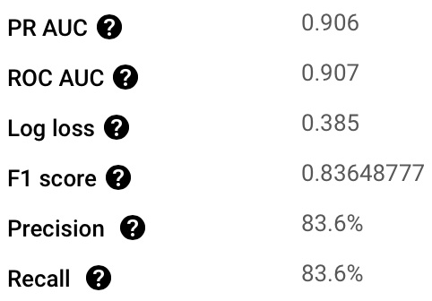
The Model
The model was then trained using the prepared dataset through Vertex AI. The following is a snapshot of all of the model’s labels such as the PR and ROC Curve at a Confidence Threshold of 0.5

Slide 4
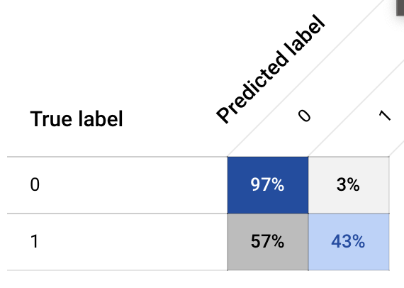
The Model
The Confusion Matrix of the Model is displayed below. It shows that the model was successful in predicting to deny a loan 97% of the time, denied a loan to an applicant who should have gotten one 57% of the time (false negative), gave a loan to an applicant who should not have gotten one 3% of the time (false positive), and accurately gave a loan to an applicant who should get one 43% of the time.
Even though the false negatives are very high, it is good to see that the false positives are extremely low as the risk of approving someone who shouldn’t be eligible for a loan is very low, thereby lowering the risk for the bank in giving out loans.

Slide 5
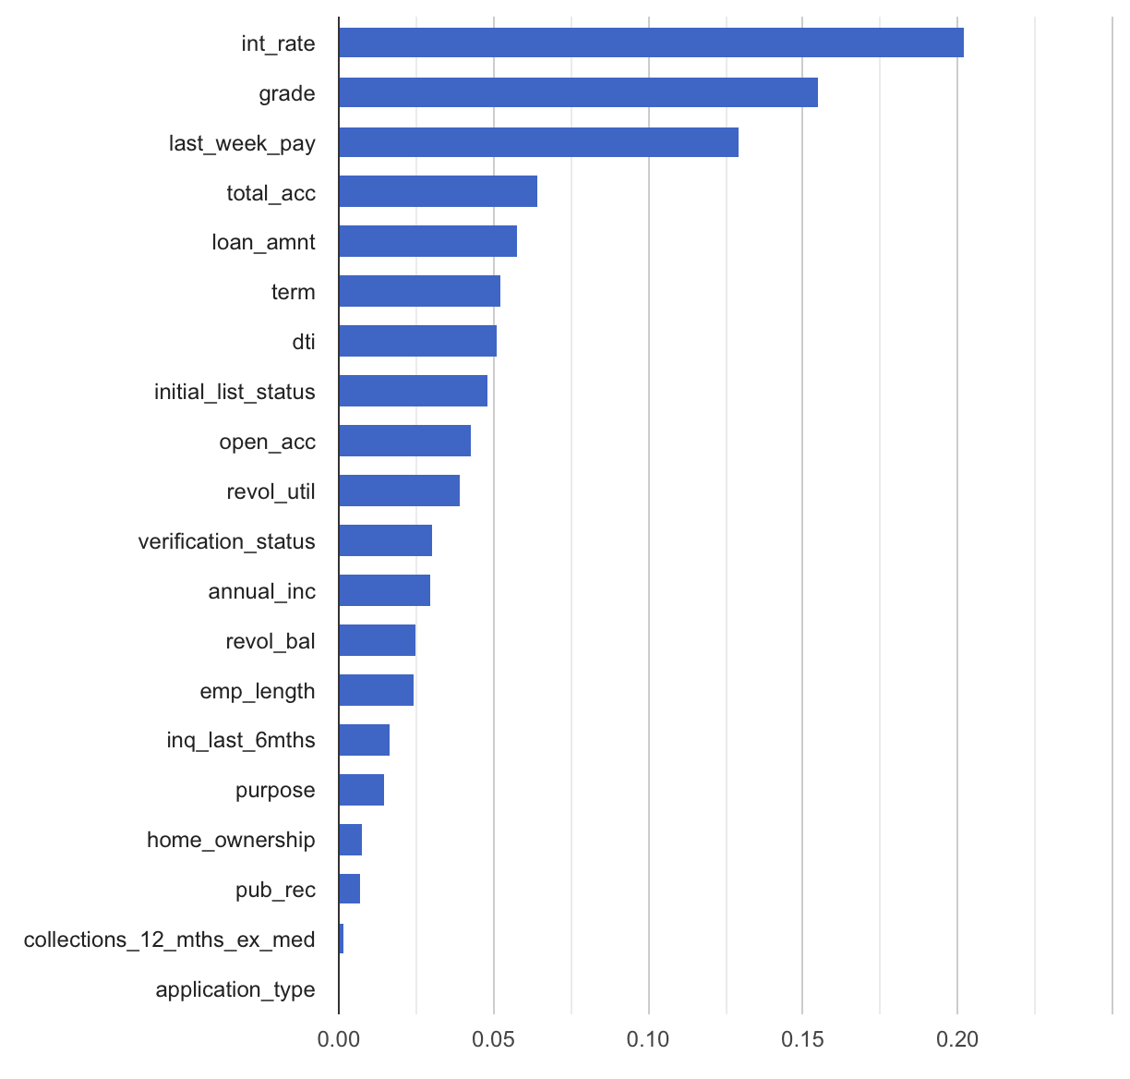
The Model
The following snapshot depicts the importance of each feature in determining whether or not an applicant is to be denied or approved for a loan.
The three most important features are the interest rate, the grade assigned to the loan based on the applicant’s credit history, and the “last_week_pay” category which refers to the last payment week of the loan.

