Slide 1
Three Classification Methods on Breast Cancer Wisconsin Data Set
Dan Kelliher General Assembly Data Science Fall 2017

Slide 2
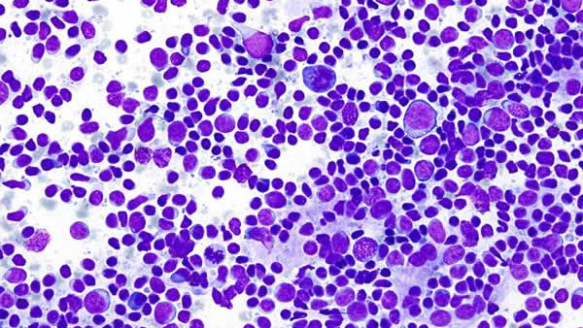
Background
Chose a clean data set in order to focus on Machine Learning techniques
Kaggle data set: Breast Cancer Wisconsin (Diagnostic) Data Set
Features are computed from a digitized image of a fine needle aspirate (biopsy sample) of a breast mass
Features describe characteristics of the cell nuclei present in the image
Objective: Determine if a tumor is Malignant (1) or Benign (0)

Slide 3
Details about the Data Set
This data set was the basis for the development of an earlier machine learning technique: Multi Surface Method-Tree (MSM-T)
MSM-T* is a classification method that uses linear programming to construct a decision tree
*Did not find the MSM-T algorithm in scikit learn
Originally documented here:
K. P. Bennett, "Decision Tree Construction Via Linear Programming." Proceedings of the 4th Midwest Artificial Intelligence and Cognitive Science Society, pp. 97-101, 1992
K. P. Bennett and O. L. Mangasarian: "Robust Linear Programming Discrimination of Two Linearly Inseparable Sets", Optimization Methods and Software 1, 1992, 23-34

Slide 4
Data Description – Measurements of Cell Nuclei
10 Measurements of Cell Nuclei
radius, texture, perimeter, area, smoothness,
compactness, concavity, concave_points, symmetry, fractal_dimension
32 Columns in the Data Set:
1: Sample ID (not used in analysis)
2: Diagnosis (‘M’ or ‘B’ – this was the target variable)
3-12: Mean of the 10 measurements
13-22: “Worst” of the 10 measurements
23-32: Standard error of the 10 measurements

Slide 5
Workflow - General
Feature Selection
Feature set preparation (using Patsy and test_train_split)
Ran 3 algorithms (Logistic Regression, KNN, Random Forrest)
Scoring = ‘roc_auc’ (specified in ‘model_explore’ function only)
For all 3 algorithms:
Grid Search (entire data set)
Fit & Predict hyperparameters from Grid search (train and test sets)
Cross Validation (entire data set)
Feature Ranking
(logit: coefficients, KNN: did nothing, Random Forrest: feature_importances)
Confusion Matrix and Calculations (precision, recall, etc.)

Slide 6
Workflow
Brought Data in and made few adjustments:
Adjusted target variables:
Changed character ‘M’ to ‘1’ – (Malignant)
Changed character ‘B’ and ‘0’ – (Benign)
Replaced spaces with underscores in some of the column names (easier to handle)
Choosing a clean set was a good decision
This allowed me the freedom to focus on other techniques

Slide 7
Selection of Feature Set 1
A Random Forrest (n_estimators=500) was run on the Entire Dataset
Looked at the feature_importances and chose top 5 features:
perimeter_worst
concave_points_mean
concave_points_worst
area_worst
radius_worst

Slide 8
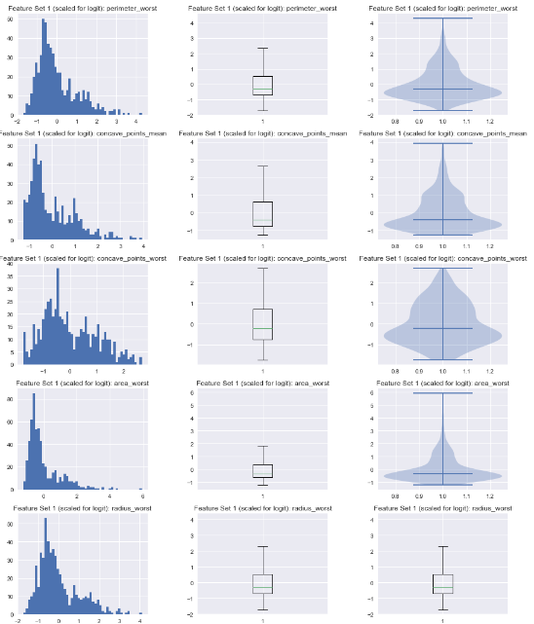
Distributions of Feature Set 1
Histogram, boxplot and violin plots for feature set 1
perimeter_worst
concave_points_mean
concave_points_worst
area_worst
radius_worst

Slide 9
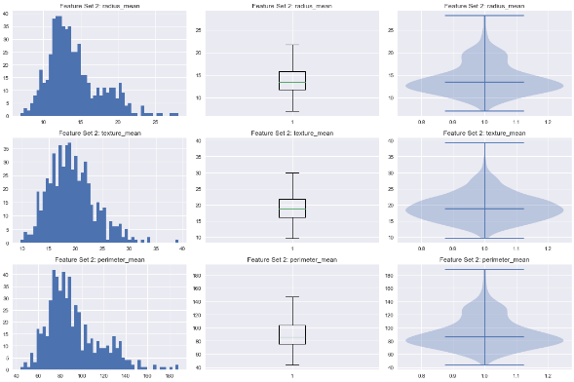
Distributions of Feature Set 2
Feature Set 2 was chosen at random:
radius_mean
texture_mean
perimeter_mean
Histogram, boxplot and violin plots for feature set 2

Slide 10
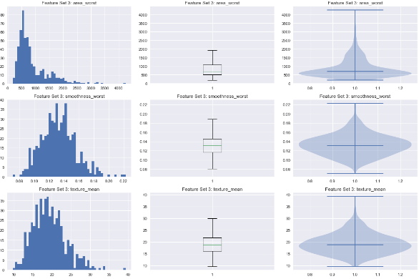
Distributions of Feature Set 3
This is the feature set that author’s used:
area_worst
smoothness_worst
texture_mean
Histogram, boxplot and violin plots for feature set 3

Slide 11
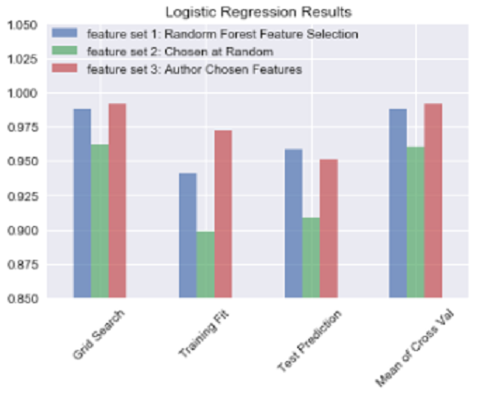
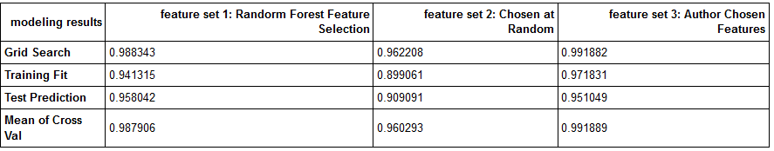
Logistic Regression Results

Slide 12
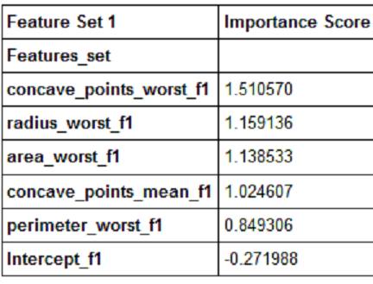
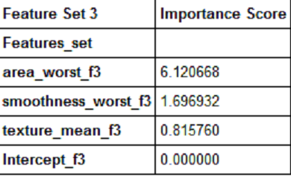
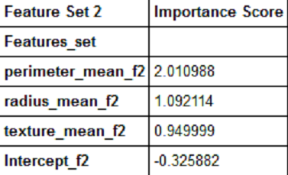
Logistic Regression Coefficients (Feature Rank)

Slide 13
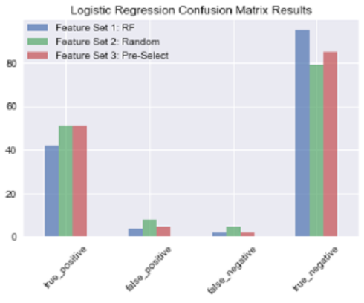
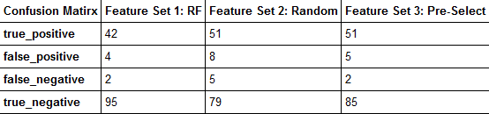
Logistic Regression Confusion Matrix

Slide 14
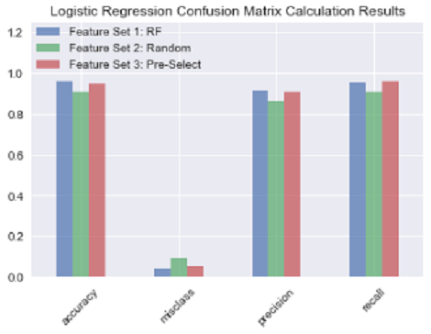
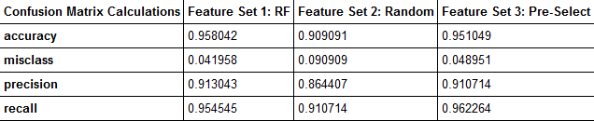
Confusion Matrix Calculations (logit)

Slide 15
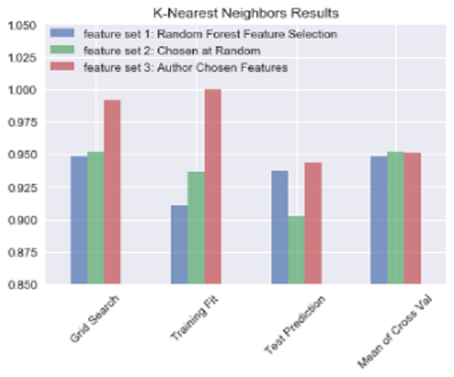
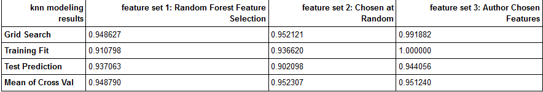
KNN Results

Slide 16
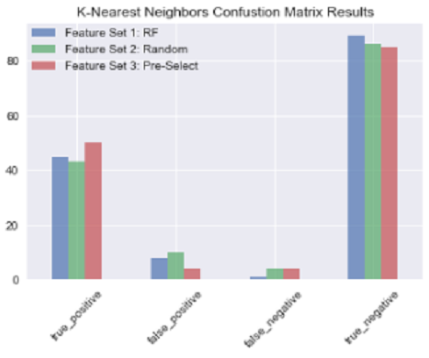
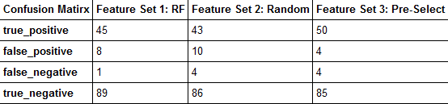
KNN Confusion Matrix

Slide 17
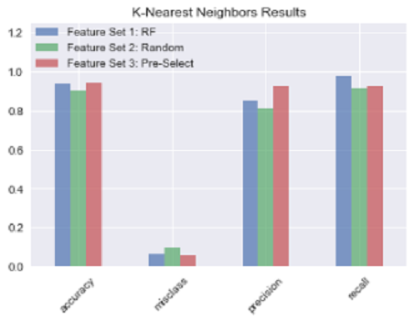
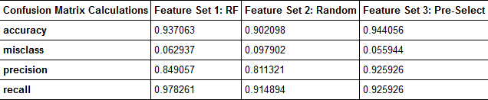
Confusion Matrix Calculations (KNN)

Slide 18
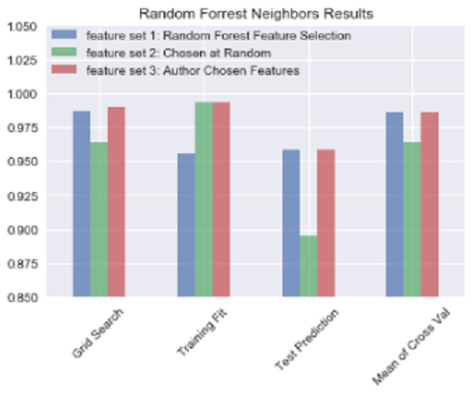
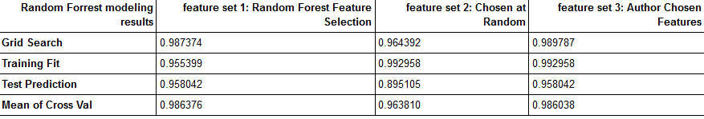
Random Forrest Results

Slide 19
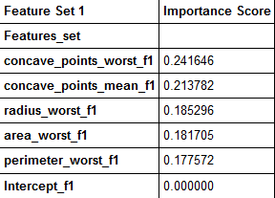
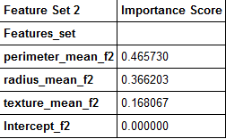
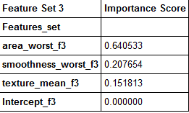
Random Forrest Feature Rank

Slide 20
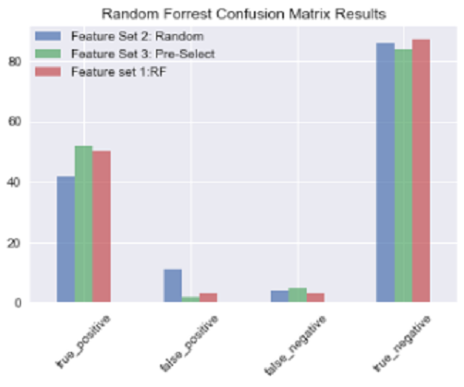
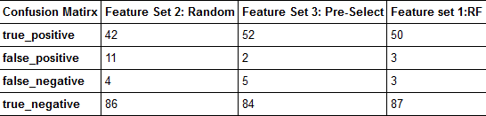
Random Forrest Confusion Matirx

Slide 21
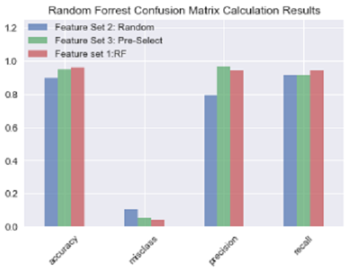
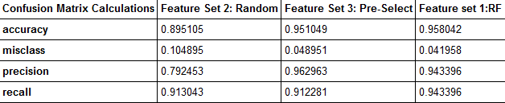
Confusion Matrix Calculations (RF)

Slide 22
Conclusion
Feature selection seems to have had a greater impact
Pitfalls
To much time coding, not enough time interpreting results
Some of the results were excellent, but there is so much more to understand about the algorithm and the underlying mathematical techniques
Hard not to spend time working on functions to cut down on repetitive code- big tradeoff (perfect is the enemy of the good)

Slide 23
Thanks
Thanks to Sri and Ed for teaching the class

