Slide 1
The LV600 The Spiritual Successor to the Tektronix LV500
Norm Gifford
Daniel Khoury
Project Advisor: Ken Stevens

Slide 2
Motivation
CS 6712 requires chip testing, but…
LV500 is unreliable
Calibration fails
Several sectors are dead
Verigy 93000 is not operational
HDD is dead
Support expired
Potential legacy
Fun, challenging project
Notes:
Norm

Slide 3
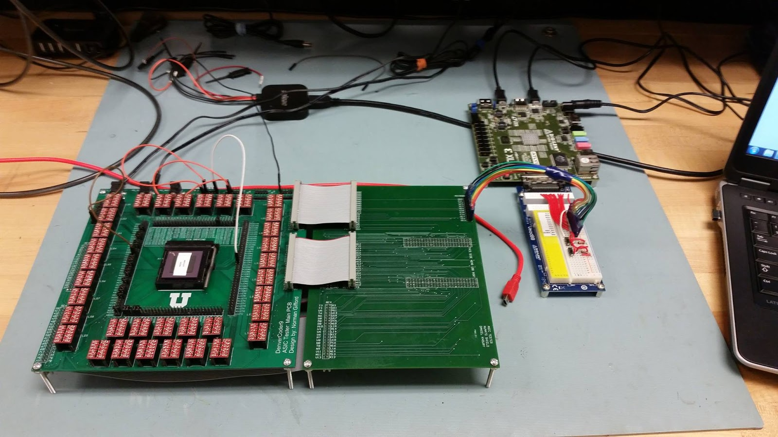
Senior Project (Fall 2014)
Notes:
Norm

Slide 4
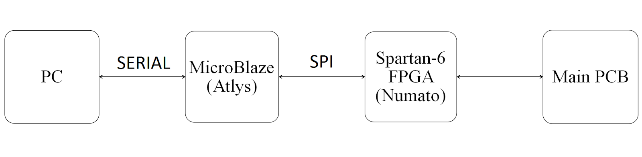
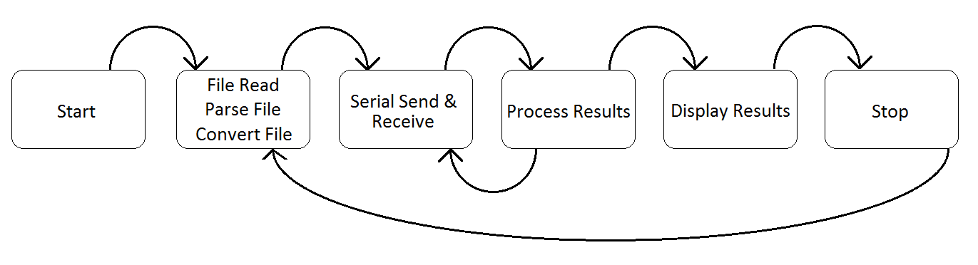
Senior Project (Fall 2014)
Notes:
Norm
Slow system (huge latency between sending test vector and getting output vector)

Slide 5
Senior Project (Fall 2014)
What worked well:
Functional testing!
Unfixed power and ground locations
Manual schmooing
Areas of improvement:
Real-time testing
Autoschmooing
Support for multiple templates
Interface and setup
Configuration options for test cycles
Accurate timing information
Notes:
Norm

Slide 6
Master’s Project: Initial Plan
Redo our senior project, but…
Simplify the user interface and setup
Replace the FPGA logic with a MOSIS-fabricated chip
Try to automate schmooing
Equilibrium tracing (for accurate timing info)
Issues:
Constrained by MOSIS fabrication deadlines
Lack of versatility
Notes:
Daniel

Slide 7
Master’s Project: Revised Plan
Complete revamp of our senior project design
Main goals:
Simpler interface and setup
Real-time testing
Timing information (via equilibrium tracing)
Automated schmooing
More test cycle configurations
Fall 2015 semester dedicated to planning and prototyping
Spring 2016 semester dedicated to implementation
Notes:
Daniel

Slide 8
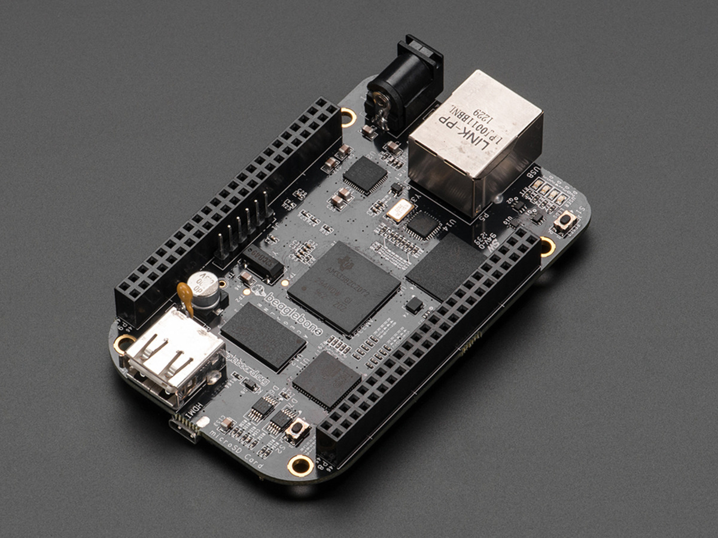
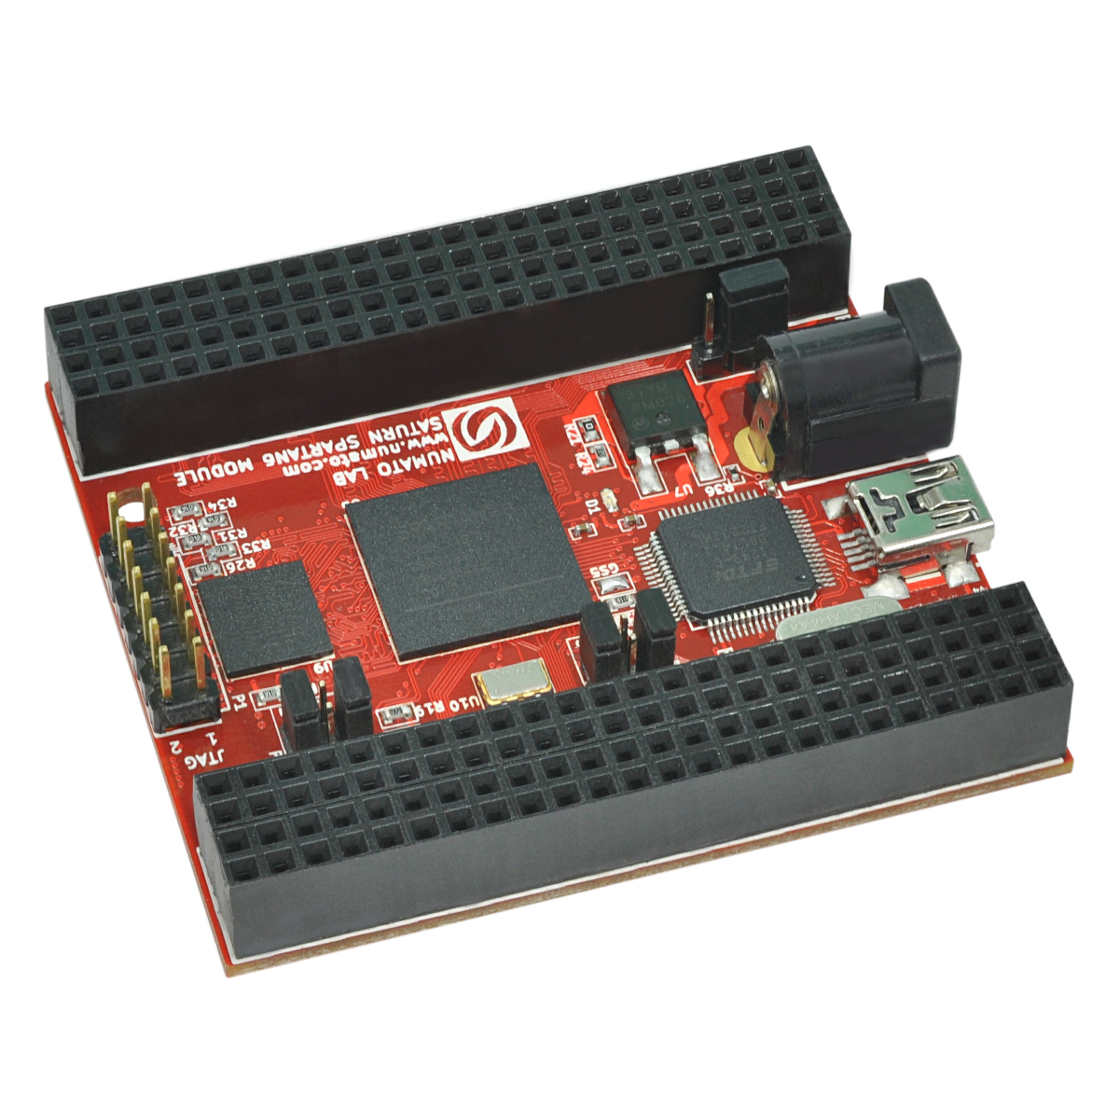
Simpler Interface and Setup
BeagleBone Black web server
Web form to fill out and submit tests
Commands FPGA via RX/TX lines
Numato Saturn FPGA
Configuration programs flashes Verilog onto the board
Notes:
Norm

Slide 9
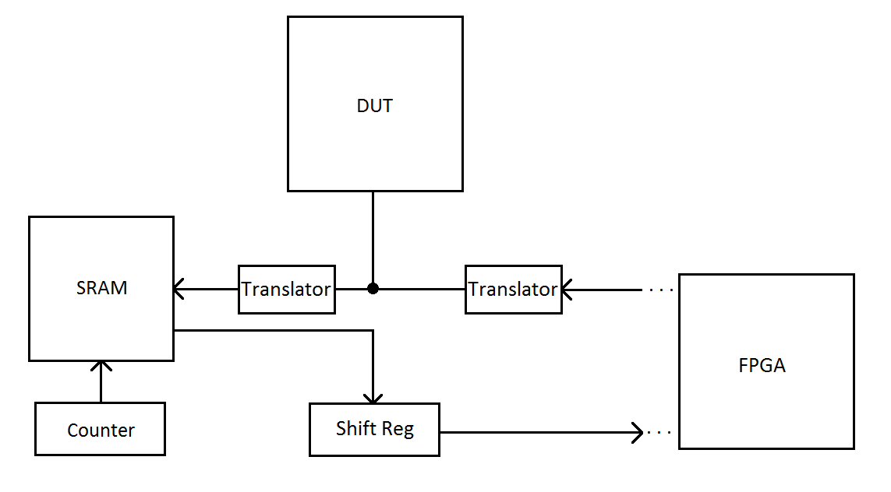
Real-Time Testing
All bit vectors stored in block RAM for fast read access
Notes:
Norm

Slide 10
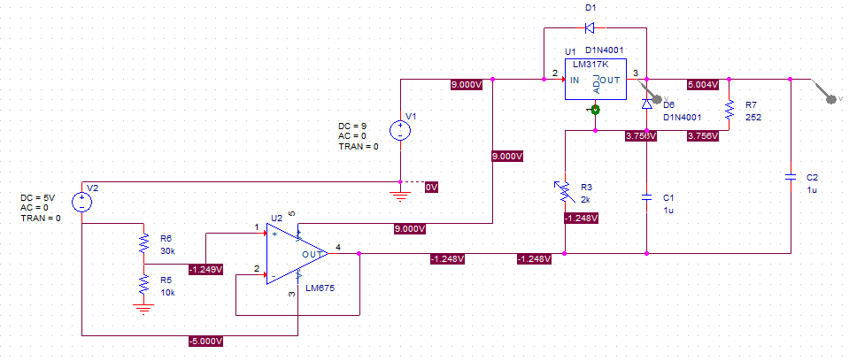
Automated Schmooing
Notes:
Daniel

Slide 11
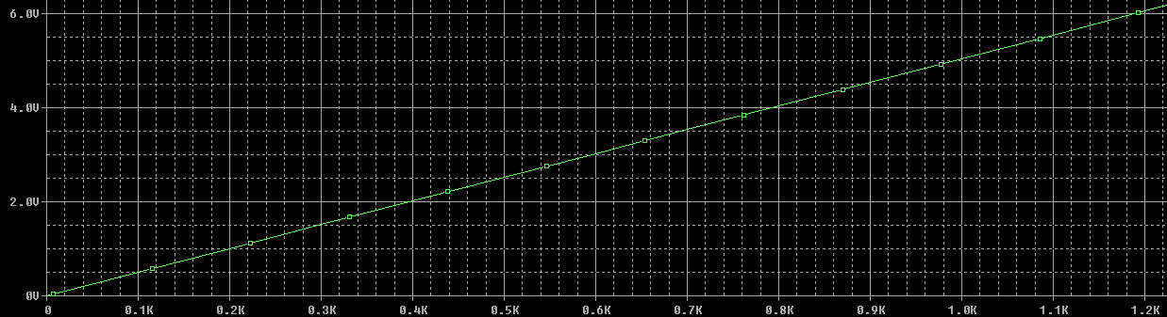
Automated Schmooing
Notes:
Daniel

Slide 12
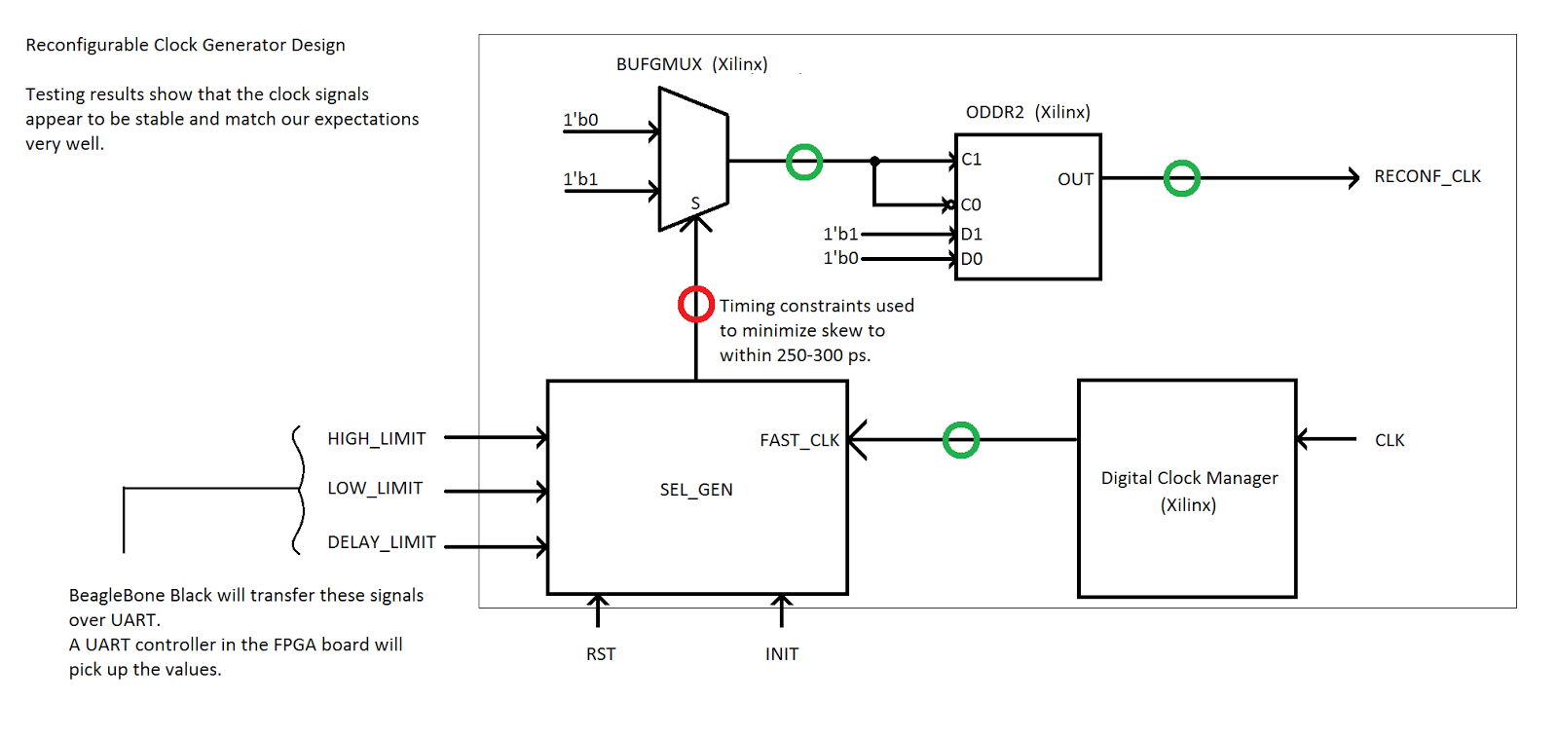
Test Cycle Configurations: Original Idea
Notes:
Daniel

Slide 13
Test Cycle Configurations: Later Idea
Key insight: No need to create the actual test cycle waveforms inside the FPGA
Instead, count clock edges
User specifies leading edges, trailing edge, cycle length as multiples of 10 ns
Notes:
Daniel

Slide 14
PCBs
Three PCBs:
Numato shield
Communication board
DUT board
Boards designed with versatility in mind
Notes:
Norm

Slide 15
PCBs: Numato Shield
Four-layer board
Manually routed
Equilibrium tracing
Surprisingly tedious and difficult
Tolerance: 200 mil
Notes:
Norm

Slide 16
PCBs: Communication Board
Two-layer board
Autorouted
Core functionality:
Connects BBB to FPGA via RX/TX lines
Connects BBB to schmooing circuitry
Connects FPGA to DUT board
Contains voltage translators (between FPGA and DUT)
Notes:
Norm

Slide 17
PCBs: DUT Board
Four-layer board
Autorouted
Trickiest part was component placement
100 minutes to route!
Contains:
ZIF socket (thank you Erik!)
Four counters
Eight SRAM blocks
16 voltage translators
16 parallel->serial shift registers
Notes:
Norm

Slide 18
Software Flow
User fills out and submits web form
BeagleBone Black (BBB) transmits all bit vectors and configuration data to FPGA
BBB instructs FPGA to execute tests
FPGA signals BBB when tests are complete
BBB commands FPGA to send back output vectors
BBB displays test results
Notes:
Norm

Slide 19
Software Flow (Continued)
Mostly PHP and HTML
PHP provides exec function, can call C code that parses web form input
Output stream (printf statements) passed back to web form
AJAX used to dynamically add/remove vectors
(Online)
C code consists of UART and SPI libraries
UART for FPGA communication
SPI to control digital pots in power circuitry
Notes:
Norm

Slide 20
Hardware Flow
Handshaking protocol between BBB and FPGA
Commands BBB can send to FPGA:
Store input vector
Store cycle vector
Store template vector
Store force-format vector
Store cycle configuration data
Execute tests
Send back output vector
Notes:
Daniel

Slide 21
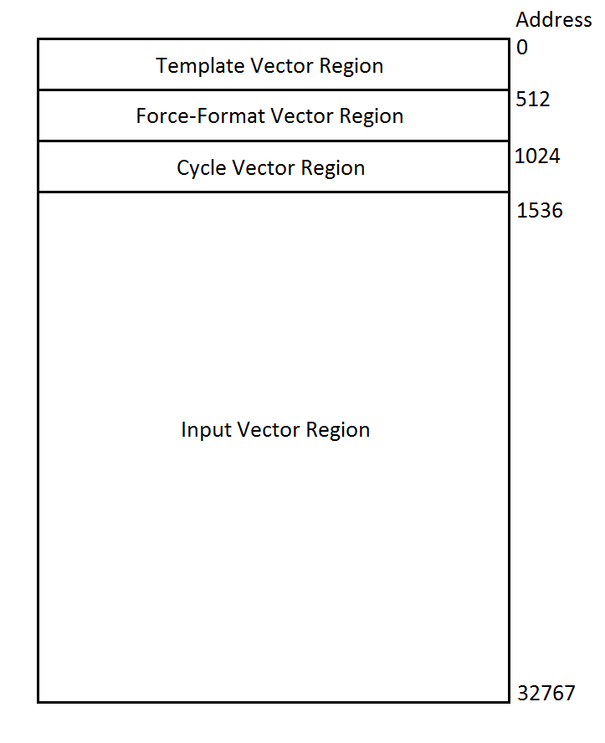
Hardware Flow
All vectors are 128-bit wide
Up to four templates
Total number of input vectors: 244
Good enough for most chips
Notes:
Daniel

Slide 22
Hardware Flow (Continued)
FPGA responds to BBB commands as follows
Store input/cycle/template/force-format vector:
Save vector in block RAM
If input vector, track how many vectors have been written
Store cycle configuration data:
Load counters with delays for leading edges, trailing edge, cycle length
Notes:
Daniel

Slide 23
Hardware Flow (Continued)
Execute tests:
While there are more input vectors to read:
Beginning of cycle: Fetch next input vector
Leading edge: Apply inputs, enable SRAM blocks (write-mode)
Trailing edge: Disable SRAM blocks
End of cycle: Increment counter
If the template associated with the new input vector has not changed, load the fetched input vector
Else pause real-time testing, load the template, cycle, and force-format vectors associated with the new template, then load the fetched input vector and resume real-time testing
Reset the counter
Notes:
Daniel

Slide 24
Design Challenges: PCBs
Communication board failed twice
First time: Short between 3V3 and GND (manufacturing error?) ☹
Second time: Power and ground reversed on barrel jacks ☹
Third time is the charm! ☺
Should have ready mid-May.
Autorouting the DUT board proved difficult
Component placement is key!
Notes:
Norm

Slide 25
Design Challenges: Verilog
Initial Verilog design included R0, R1, DNRZ_L, DNRZ_T force formats (2-bit encoding)
Design required 108% of available LUTs
Removed DNRZ_T and R1 force formats (1-bit encoding)
Design required 70% of available LUTs, but 115% of FPGA area
Removed ability to specify two different test cycles, replaced with one test cycle but two leading edges
Design now utilizes 40% of available LUTs, 70% of available area
Some timing-sensitive FPGA outputs (e.g. counter clock) are glitchy
Capacitors may smooth out glitches – need to investigate
Notes:
Daniel

Slide 26
Demo!
https://www.youtube.com/watch?v=Cojl8VEp_cA

Slide 27
Remaining Contemporary Work
Finish web server code that parses web form into C code arguments
Fix communication board
Documentation
Notes:
Norm

Slide 28
Estimated cost
PCBs: ~$220
Two four-layer boards + shipping: $170
One two-layer board + shipping: $50
Parts for PCBs: ~$250 (not including ZIF socket)
Numato shield: ~$80 (student discount)
BeagleBone Black: ~$50
Total cost: ~$600 (closer to ~$1000 if we include failed boards and repurchasing parts)
Notes:
Norm

Slide 29
Future Ideas: Web Server
Security measures…
Anyone can log in as root right now…
User accounts and passwords
Store test vectors in database
Schmooing plots
Notes:
Norm

Slide 30
Future Ideas: Hardware
Bigger, better FPGA
Xilinx Spartan-6 isn’t designed to handle very high frequencies
7-series Xilinx FPGAs are designed for fast clock speeds, but are extremely expensive
Snickerdoodle board: https://www.crowdsupply.com/krtkl/snickerdoodle
ZYNQ SoC (ARM processor + FPGA)
Provides 150 I/O pins
$150
Conditional test vectors may be possible with two FPGAs, or an FPGA with ~300 pins
Area of further investigation
Notes:
Daniel

Slide 31
Design Challenges: Verilog
Initial Verilog design included R0, R1, DNRZ_L, DNRZ_T force formats (2-bit encoding)
Design required 108% of available LUTs
Removed DNRZ_T and R1 force formats (1-bit encoding)
Design required 70% of available LUTs, but 115% of FPGA area
Removed ability to specify two different test cycles, replaced with one test cycle but two leading edges
Design now utilizes 40% of available LUTs, 70% of available area
Notes:
Daniel

Slide 32
Reflection and Impact
Project pushed us to our limits
Verilog is over 2000 lines, more than 50 states for “main” FSM
Hardware boards by far the most complicated we have ever designed
Proud of our design choices
Things we learned (amongst other things):
How to utilize hierarchical schematics and autorouting rules in Altium
The Spartan-6 FPGA is (relatively) limited!
Glitch-free FPGA outputs can be difficult to achieve
Double-buffering signals seems to help
PHP can call C executables!
Notes:
Daniel

Slide 33
Special Thanks
Ken Stevens
Awesome project advisor, provided useful feedback
Erik Brunvand
Provided (expensive) ZIF socket, FPGA boards, and useful feedback
Advanced Circuits
Reasonable prices (and free popcorn with every board purchase)
Notes:
Daniel and Norm wrap up talk

