Slide 1
Testing with the LV-500
Tektronix LV-500
Built in 1989-1991
I.e. Ancient technology!
eBay is a good source for spare parts these days…
Specifically designed to be a stand-alone tester for ASICs
I.e. More testing features than a basic logic analyzer

Slide 2
What’s an ASIC Tester?
Ours is built on a Tektronix DAS 9200 logic analyzer platform
The main differences are in the test head, the pattern/error cards, and the Schmoo
The test head has up to 256 bi-directional pins where each pin has programmable electronics
voltage drive, current drive, voltage sense, etc.
The pattern/error cards store and compare the test vectors at up to 50MHz
fast for 1989!
A Schmoo lets you run repeated tests while the tester alters one or two independent variables like threshold, delay, cycle length, voltage, etc.

Slide 3
Flavors of LV500s
Common Features
Test speeds up to 50MHz
Up to 64,000 unique test vectors
Network connection for uploading tests
Thinlan ethernet
8 Meg of RAM
21 or 43 Meg hard drive
5.25 floppy (1.2M floppy)

Slide 4
Flavors of LV500s
LV514
192 test channels (12 sectors)
160 are usable (two sectors are bad)
Pre-wired test card for class chips
(should really be called LV513, but that’s a long story)
LV512
128 test channels (8 sectors)
All channels are usable
Used mostly for tutorial purposes
No pre-wired class chip test card yet…

Slide 5
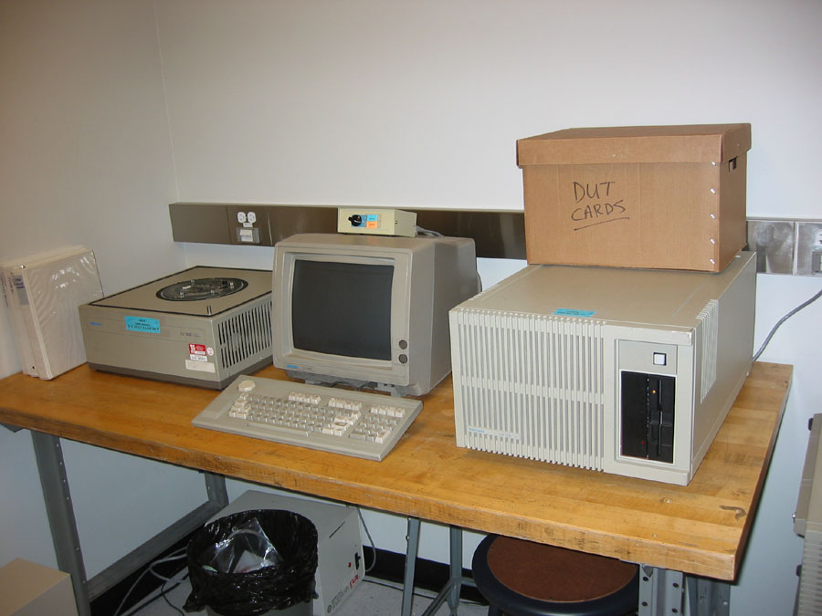
LV514

Slide 6
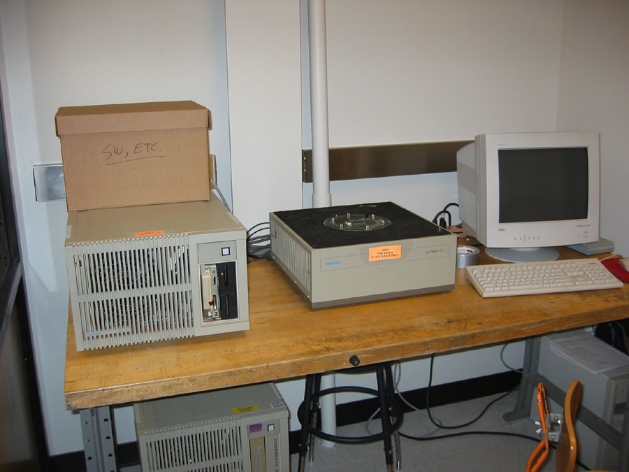
LV512

Slide 7
The Big Picture
1010010100100 1001000010100 1110101001110 1010100010011 0100100010001
DUT (Device Under Test)
Actual
Output
Vectors
Input Vector Table
Pass/Fail Display
Compare
11010100101010 11110101010101 00101001010100 10010100010101 01010010010101
Expected Output
Vectors
Expected Output Vector Table

Slide 8
The More Detailed Picture
Conceptually this is simple, in practice there are lots of details…
Define the input and expected-output vectors
Can do this using your Verilog simulations
Define which signals are inputs and outputs on your chip
Define how those signals are mapped to tester channels
Wire up the DUT card so that those channels map to your chip pins
Define the timing and electrical characteristics of your test

Slide 9
Three Essential Parts of a Test
A properly wired DUT (Device Under Test) card
This electrically connects each of your chip pins to the correct tester channels
A properly configured LV-500
Configure the timing of when inputs are applied, when outputs are checked, what the voltages and currents are, etc.
A complete set of test vectors
Vectors are applied and checked on each cycle
“Force data” are inputs to your chip
“Compare data” are expected outputs from your chip

Slide 10
Tester Channels
The 256 possible pins (channels) on the test head are grouped into 16 “sectors” labeled 0-f
Each sector has 16 channels
Labeled sector.channel (I.e. 0.2, d.3, a.c)
On each cycle, each channel may be either a “force” channel or a “compare” channel, but not both
If you have bi-directional pins on your chip, you need to define which are inputs and which are outputs on each cycle!

Slide 11
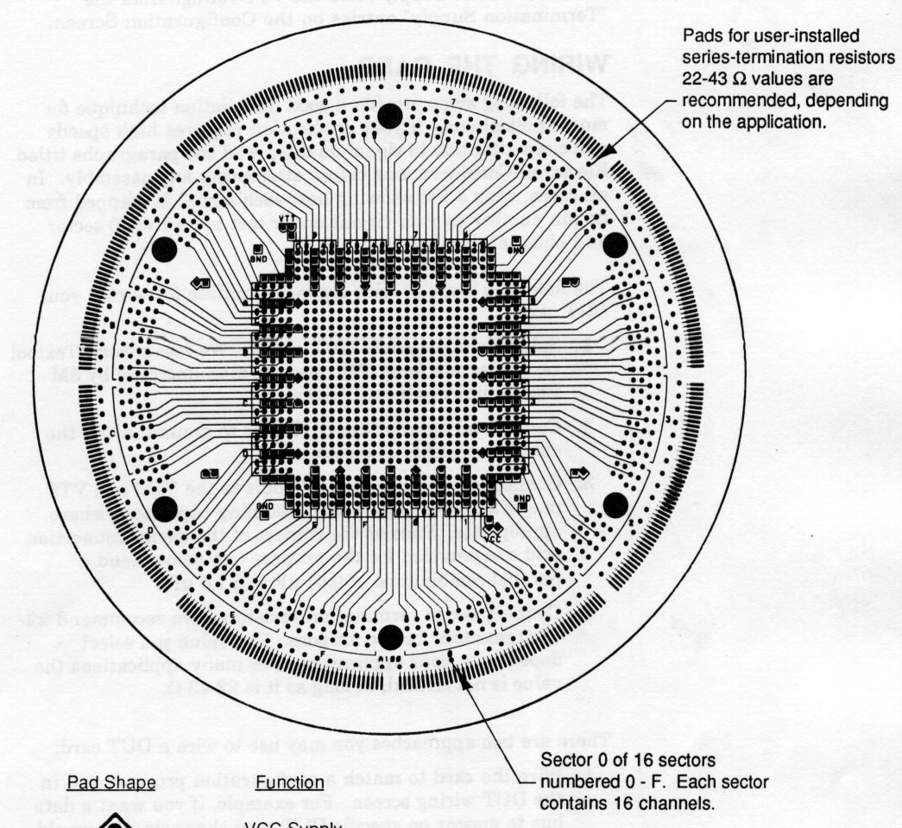
DUT Card
8
7
9
6
A
5
B
4
C
3
D
2
E
1
F
0

Slide 12
LV514 Usable Channels
8
7
9
6
A
5
B
4
C
3
D
2
E
1
F
0

Slide 13
LV512 Usable Channels
8
7
9
6
A
5
B
4
C
3
D
2
E
1
F
0

Slide 14
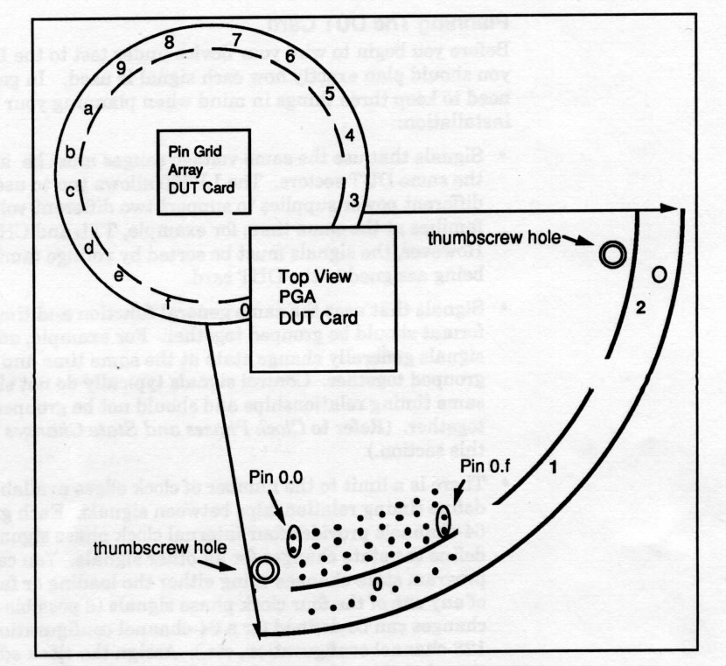
DUT Card Sectors & Channels

Slide 15
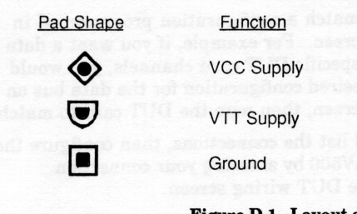
DUT Cards
The DUT cards are how you wire from tester channels to chip pins
These cards also have VDD, VTT and GND power supply connections
VDD and VTT are two independently controllable power supply voltages

Slide 16
Wiring the DUT Card
Essentially two choices:
Solder wires on a PGA DUT card
Remember that VDD and GND are not connected to tester channels
Probably only want to do this once for the whole class
Which means standardizing VDD and GND!
Use a “Quick-Connect” card
Uses 3M Scotch-Connect to wire (using wire-wrap wire) from the tester channels to the chip socket
Can also use quick-connect for VDD and GND

Slide 17
Quick-Connect DUT Card

Slide 18
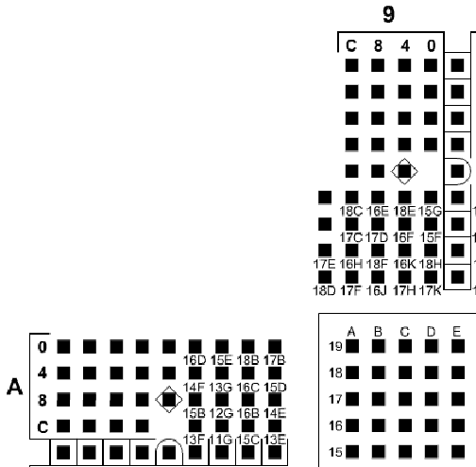
Quick-Connect DUT Card

Slide 19
Knowing What to Wire
A “Bonding Diagram” is a picture that shows how your chip was bonded to the chip frame
It also shows how the chip frame is connected to the chip pins

Slide 20
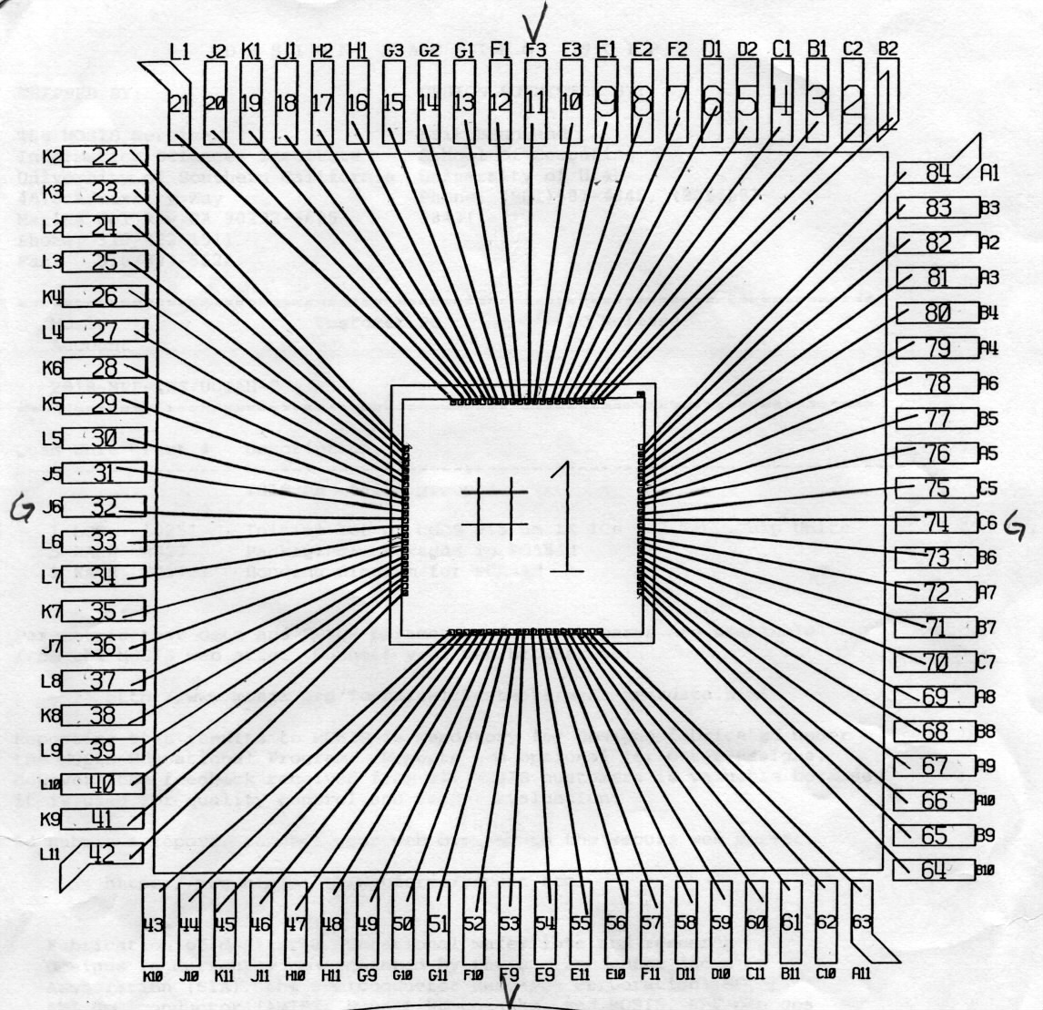
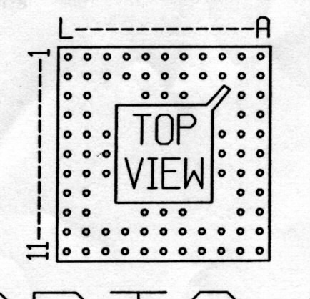
Bonding/Chip Diagram

Slide 21
Map Your Pins to Channels
Pick tester sector.channel assignments for each of your pins
Signals that need the same voltage characteristics should be grouped in the same sector
Each sector gets common voltage ranges
More on this later…
Signals that need the same timing should be grouped in the same quadrant
Sectors 0-3, 4-7, 8-b, c-f are the four quadrants
More on this later…
Wire things up!
Remember to keep a list of what you’ve wired!

Slide 22
Class DUT Card
Pre-wired for class chips
84 pin PGA with specific VDD and GND placements in the pad ring
/usr/local/contrib/elb/lv500/DUTmap.txt

Slide 23
DUTmap.txt
PAD-PIN-TESTER CHANNEL MAP FOR CS/EE 5710 DUT CARD
Pad locations are taken from MOSIS bonding diagram
PGA locations are taken from 84pin PGA bonding diagram
Tester channels 6,7,8,9,A are used. The notation is sector.channel
Vdd and GND connections are as per 5710 standard pad frame
TESTER SIGNAL
PAD PGA sec.chn NAME (no spaces)
---------------------------------
1 B02 6.C
2 C02 7.7
3 B01 6.B
4 C01 7.6
5 D02 7.D
6 D01 7.C
7 F02 GND GND
8 E02 8.1
9 E01 8.0
10 E03 8.7
12 F01 8.6
13 G01 8.A etc….

Slide 24
Finished DUT Card
Now you have part 1 – a wired DUT card that connects your chip to the tester
On to part 2 – configuring the tester…

Slide 25
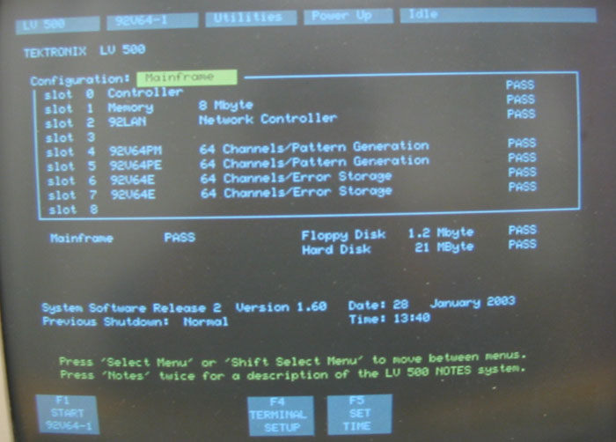
LV512 Boot Menu

Slide 26
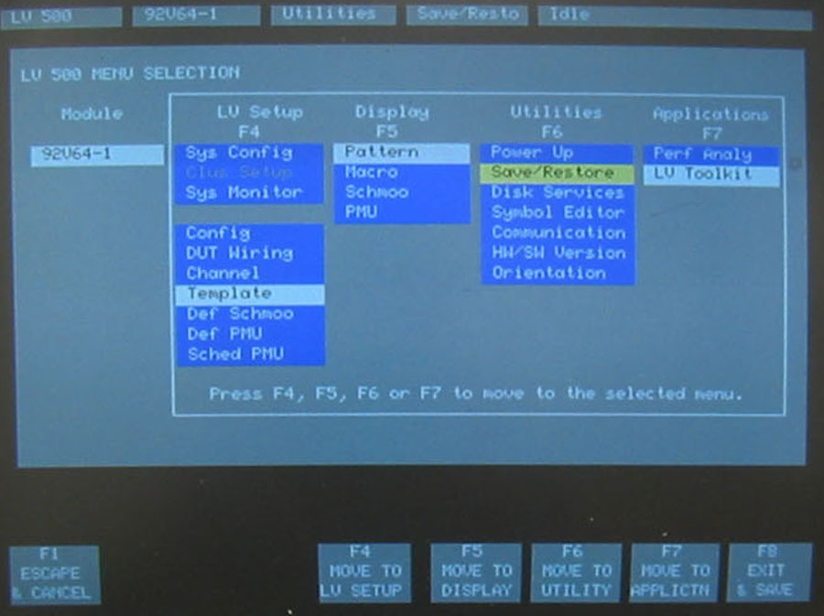
LV500 Main Menu

Slide 27
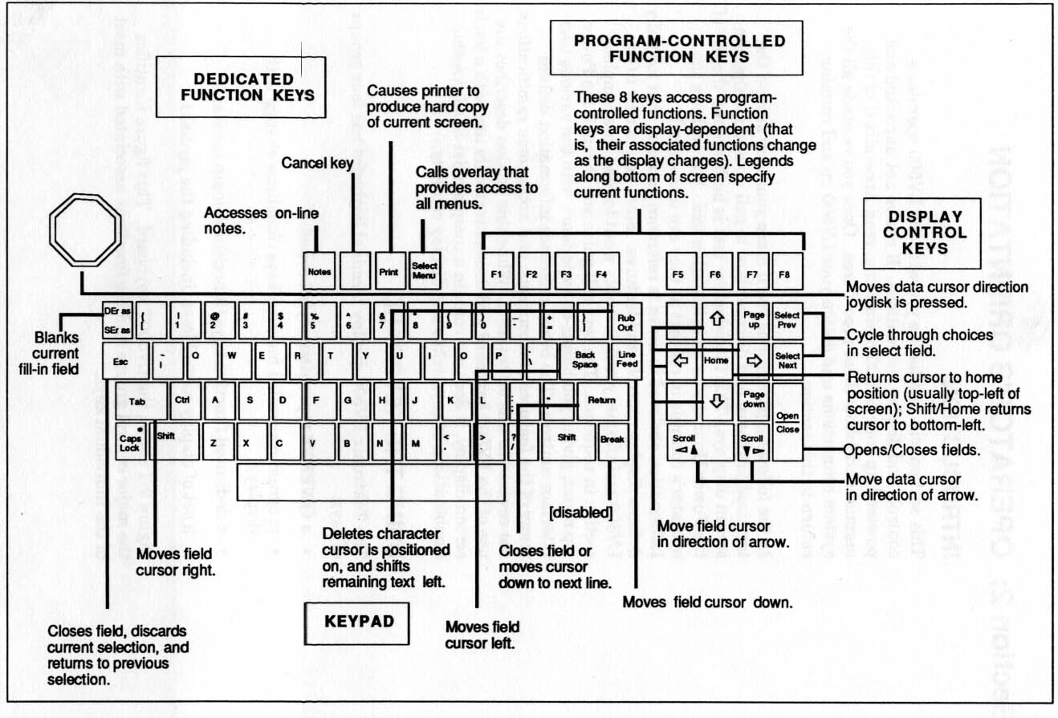
LV500 Keyboard Layout

Slide 28
Important Menu Choices
Config Menu
Defines voltages for VDD, VTT, GND
Defines voltages for two force/compare sets
DUT Wiring menu
Defines how your signals are assigned to tester sector.channels
Channel menu
Defines how your signals are collected into groups (I.e. buses)
ALL signals must be a part of some group
Groups are assigned to specific timing templates (clock phases)

Slide 29
Important Menu Choices
Template Menu
Defines timing of tests
When to force data?
When to compare data
When to ignore data?
Schmoo Menu
Defines which variables to vary, and by how much
Pattern Menu
Defines data vectors for each tester cycle

Slide 30
Basic Procedure…
Tell tester which chip signals are connected to which channels (DUT wiring menu)
Combine signals into groups (Channel menu)
Define timing for each group (Template menu)
Only four “clock phases” per quadrant
A “template” assigns clock phases to groups, and timing of clock phases…
Define patterns (Pattern menu)
Each pattern starts with a template
Includes force, compare, and mask data for each test cycle

Slide 31
Config Menu
Defines the electronics for this test
VDD, VTT, GND, current limit, etc.
You can also define two different “force” and “compare” voltage sets for data channels
Each sector uses one of these two sets

Slide 32
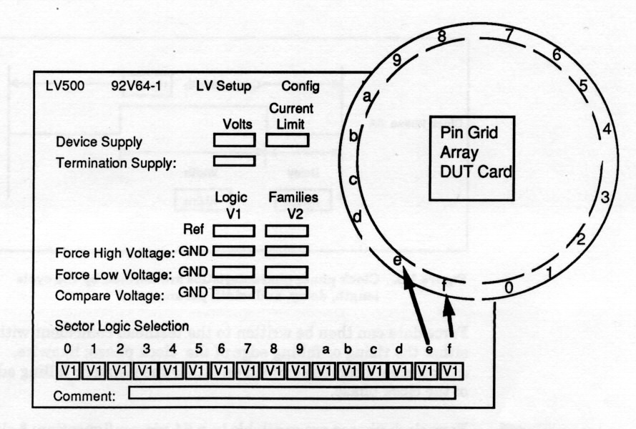
Config Menu (diagram)

Slide 33
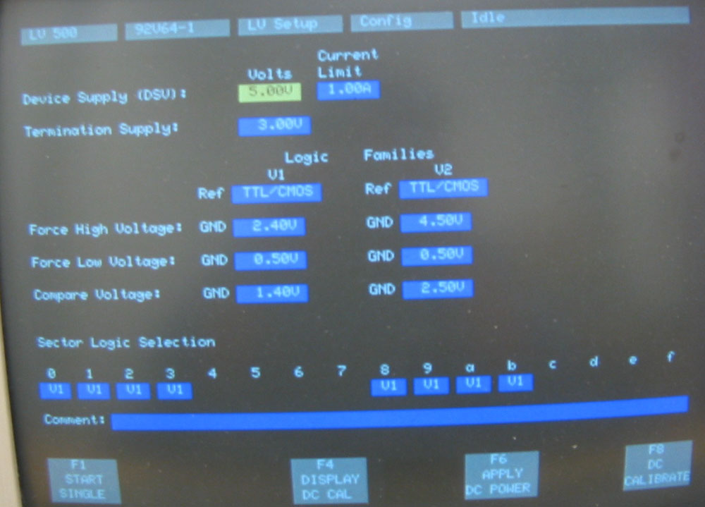
Config Menu (LV512)

Slide 34
DUT Wiring Menu
Defines how your signals are assigned to tester sector.channels
List signal names
Define which tester channels they connect to
Optionally define which actual chip (DUT) pins they are connected to
This is just a comment for documentation

Slide 35
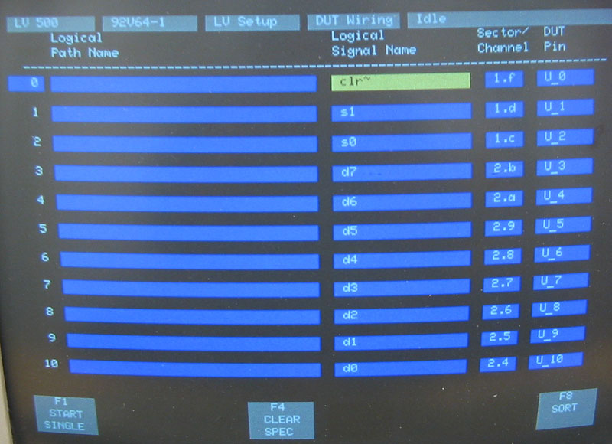
DUT Wiring Menu

Slide 36
Channel Menu
Defines how your signals are collected into groups
EVERY signal must be a part of some group (even single signals)
Groups can make data entry and evaluation easier
Can define how group data is printed
Dec, Hex, Oct, Bin
Can specify timing once for the whole group
In general, inputs vs. outputs is a good group…
Or control vs. data, etc.

Slide 37
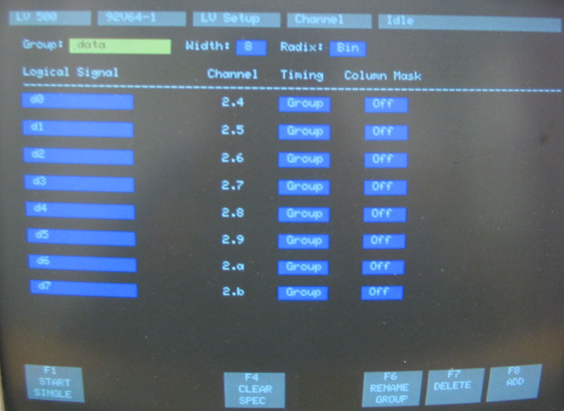
Channel Menu (LV500)

Slide 38
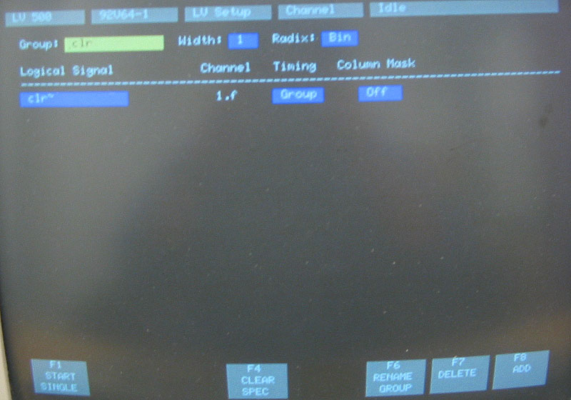
Channel Menu (LV500)

Slide 39
Templates
Templates
Defines timing of tests
When to force data?
When to compare data
When to ignore data?
Set up using a “clock phase”
Bad name – really a timing waveform
Defines when things happen in each tester cycle
You can define up to four clock phases per quadrant

Slide 40
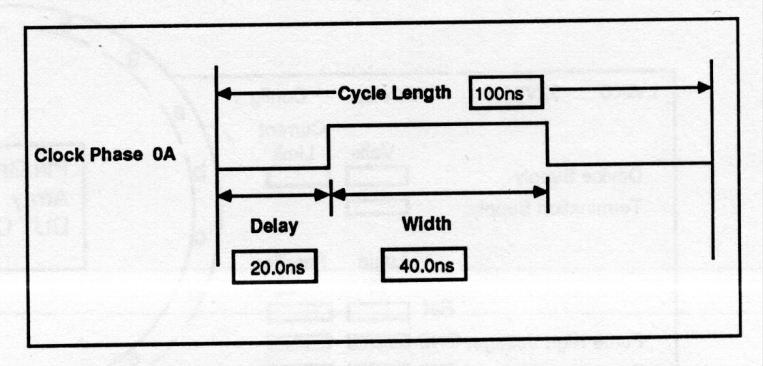
Clock Phases
Cycle Length: 20ns – 496ns
Delay is delay to Leading Edge
Can be 0ns
Width is delay from Leading to Trailing edge

Slide 41
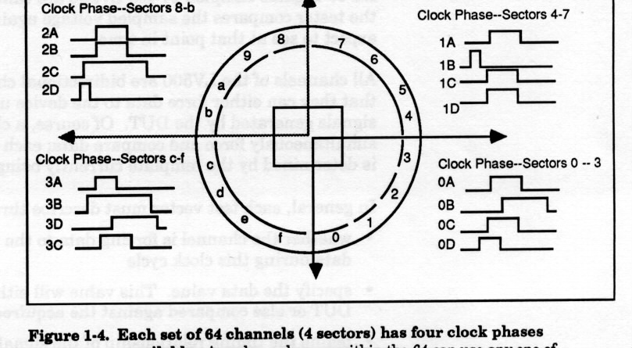
DUT Card Quadrants
Each quadrant has up to four timing waveforms you can use to control signal timing (called “Clock Phases” in LV500-speak)

Slide 42
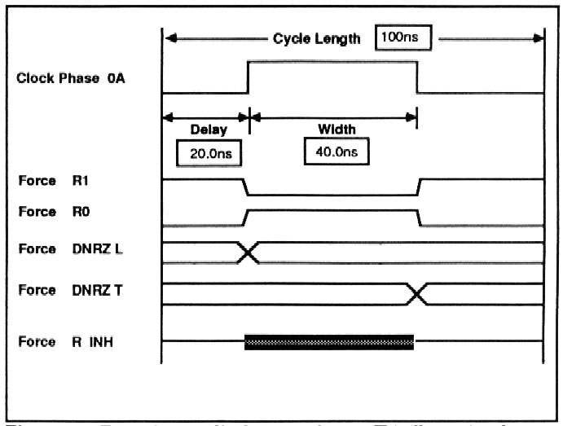
Force Formats
Within a clock phase, you can define when values are “forced” to your chip in relation to the edges

Slide 43
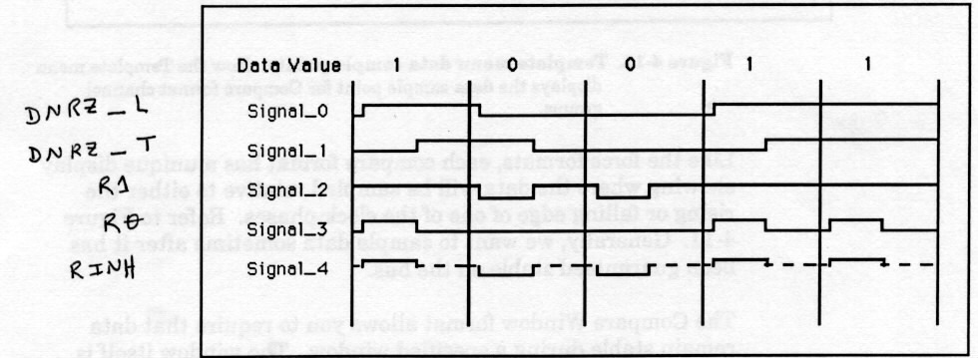
Force Formats Example
This is an example of a pattern driven on five consecutive tester cycles with each of the different force formats

Slide 44
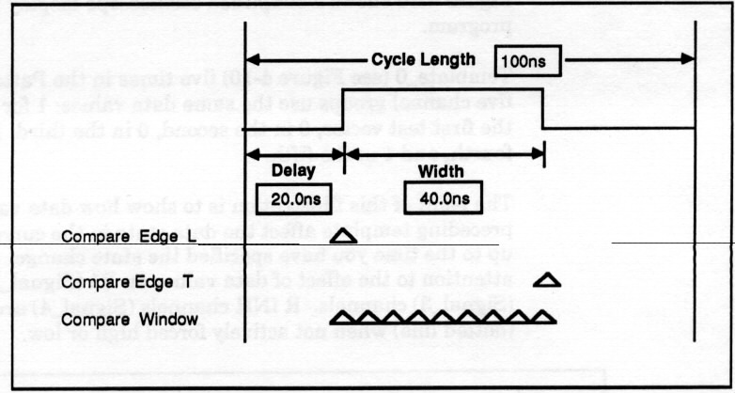
Compare Formats
You can also define when you Compare outputs in relation to the clock phase edges

Slide 45
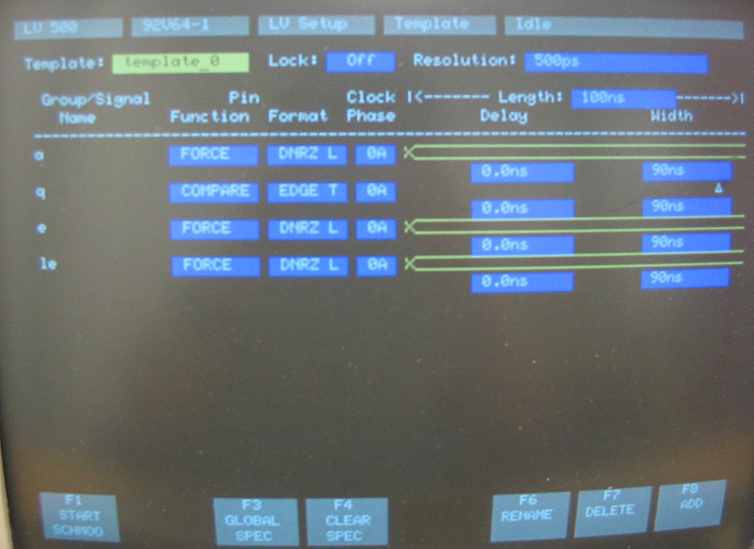
Template Menu

Slide 46
Pattern Menu
Defines data vectors for each tester cycle
Data for each signal is defined in the data vector
Some of those signals are “Force”, some are “Compare” and some are “Mask”
These are set in the templates
Assign a template to each vector
On each tester cycle, the next vector, with that vector’s template, is applied to the DUT and compared

Slide 47
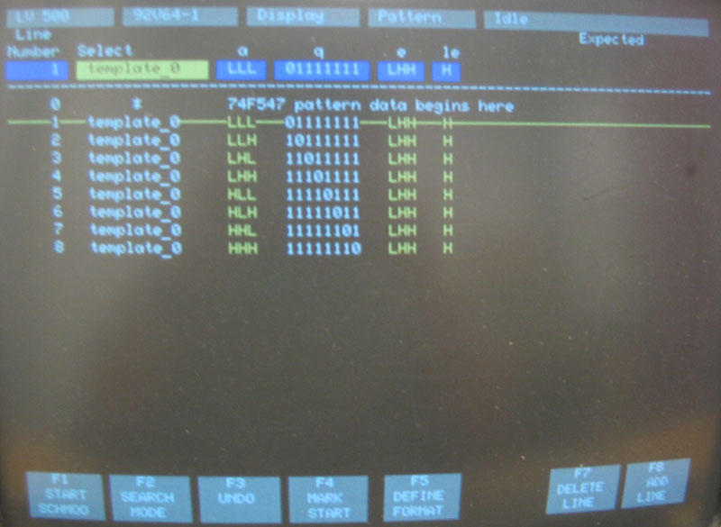
Pattern Menu

Slide 48
Pattern Display
The Pattern screen is where you see the results of your test
Before the test you can see all the vectors (and their templates) that you will be using
After running the test you see the same display with any errors highlighted in red
Red means that the output of the DUT didn’t match the expected output vector
You run the test with F1-Start (the F1 function key)

Slide 49
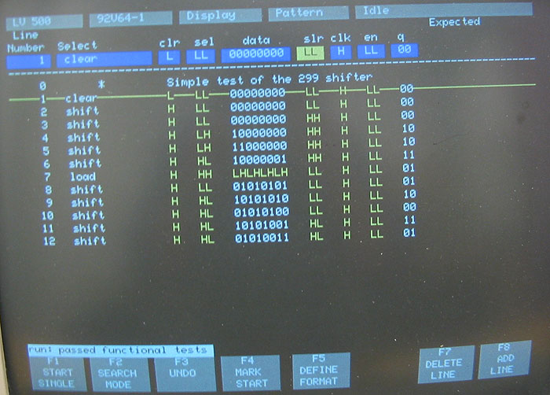
Successful Test

Slide 50
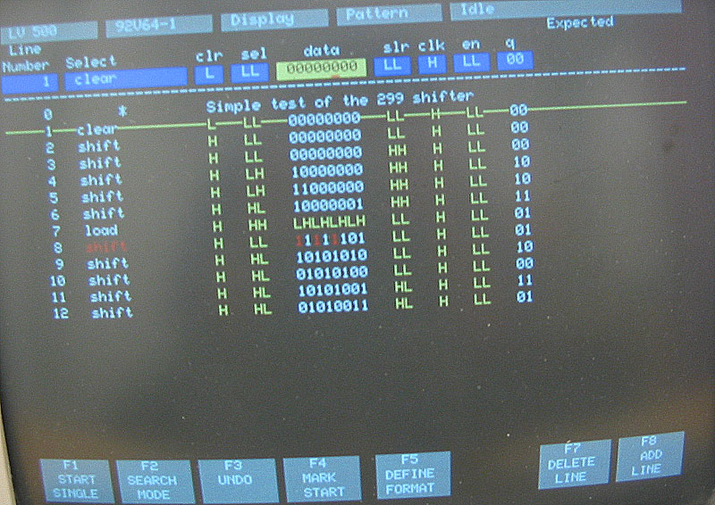
Failed Test

Slide 51
Schmoo Menu
After you have your basic test working, you can run a Schmoo test
Repeat the test while changing 1 or 2 variables
Variables can be things like VDD voltage, delay time, cycle time. Compare voltage, etc.
Generates a graph showing where the part worked or didn’t work

Slide 52
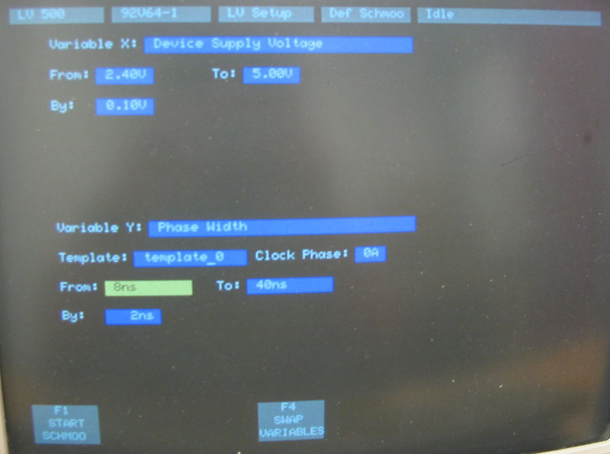
Schmoo Menu

Slide 53
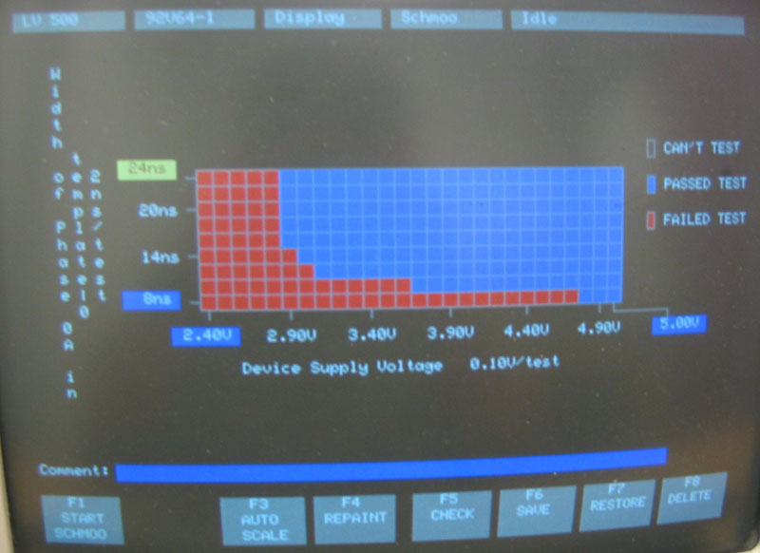
Schmoo Result

Slide 54
Logistics
The LV500 is old and cranky…
Basic rule – if you’re not SURE about what you’re doing, ask me first!!!!
Replacement parts are very hard (impossible?) to find.
Leave terminal ON
Turn down brightness when you leave,
Check brightness when you come into the lab
Do NOT turn the LV500 off without good cause!
We’ll leave the LV512 up and running for tutorials, and then switch to the LV514 when chips come back…

Slide 55
Logistics continued
Be very gentle with the DUT cards
They connect to the machine through elastomer connectors
These are basically rubber-like connectors wrapped with wire
They are very fragile, and a little worse for wear
We have no replacements…
Schedule some time with me to run tests!
Once you’ve got some LV500 time under you belt you can go it alone…

Slide 56
Tester Setup Simplified
All this stuff can be defined in a .msa file
Module Setup, Ascii
Each section of the .msa file corresponds roughly to a tester menu
You can (fairly easily) write your own .msa file
Templates on /usr/local/contrib/elb/lv500/

Slide 57
Tester Setup with msa Files
You can ftp to the lv500 and upload the .msa file which defines your test
You can ONLY ftp from vlsi-nat.cs.utah.edu so ssh to there first!
lv512.cs.utah.edu, lv514.cs.utah.edu
No username/password required…
Put your .msa file into the Simulation directory on the LV500
Convert to tester setup using the LV Toolkit menu

Slide 58
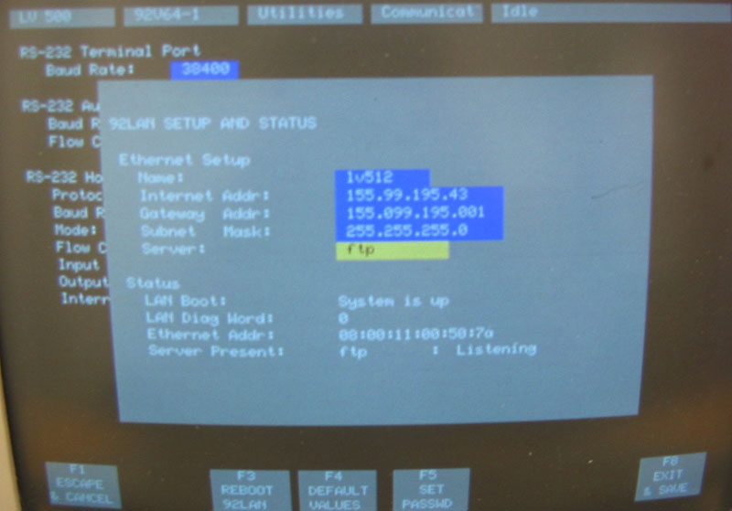
LV512 LAN Screen

Slide 59
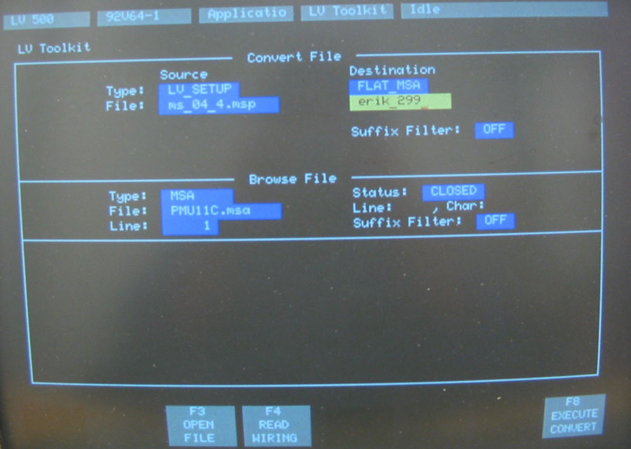
LV Toolkit Menu (LV512)

Slide 60
LV Toolkit Issues
Note that the conversion process goes to an ms_04_4.msp file (or something close to that)
You are not allowed to change this name!
If you want to save this setup under a different name you need to convert to the standard name, and then save the setup to a new name using the Disk Services menu.
Once the .msa is converted, you can look at the setup using all the previous menus

Slide 61
Running Tests
The .msa conversion is a great first step
But, after that’s running you may want to change things or try new things
Like Schmoo, or changing parameters
You can change the data using the menus shown earlier
You can also save the changed tests into new .msa files
And you can retrieve those new .msa files using FTP if you like

Slide 62
Overview
On every tester cycle the LV500:
Applies a set of signals to the DUT
The data to “Force” is defined in the Pattern
Which signals are “Forced” on this cycle is defined in the template
When the data are applied is defined relative to the “clock phase” template
The names of the signals and which tester channels they are on are defined in the DUT wiring menu
At the right time (defined in the template) the tester captures and compares the data from the DUT
Compares against the data in the Pattern

Slide 63
Procedure
Get your bonding diagram and map where your signals are on your chip
Decide how those pins will map to tester channels (DUTmap.txt)
Decide on timing templates for all signals
Generate test vectors that include pin names, templates, and data vectors for every cycle
Put it all in a .msa file

Slide 64
Procedure 2
Upload the .msa file to the LV500
Convert the .msa file to a tester setup file
Check all menus to make sure things are how you want them
Config
DUT wiring
Channel
Template
Pattern

Slide 65
Procedure 3
Fix or modify test parameters
Run your test
Look at the results
Celebrate!
Or diagnose and debug…
Or decide to schmoo to get more info…

Slide 66
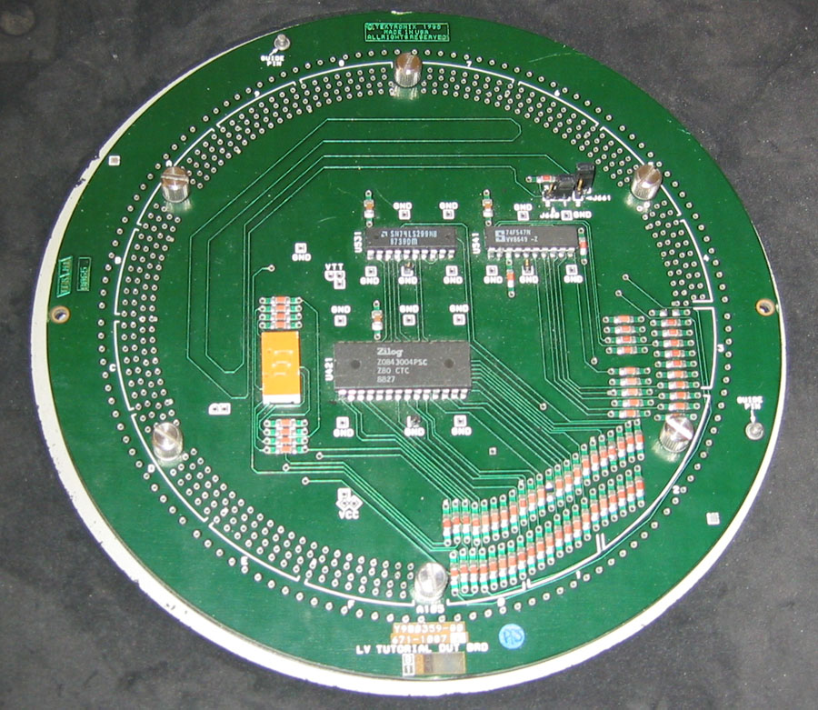
Tutorial DUT Card

Slide 67
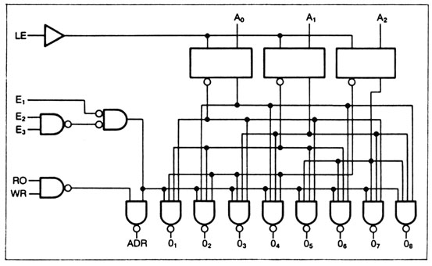
Tutorial 1: 74LS547
3 to 8 decoder

Slide 68
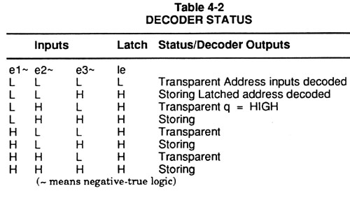
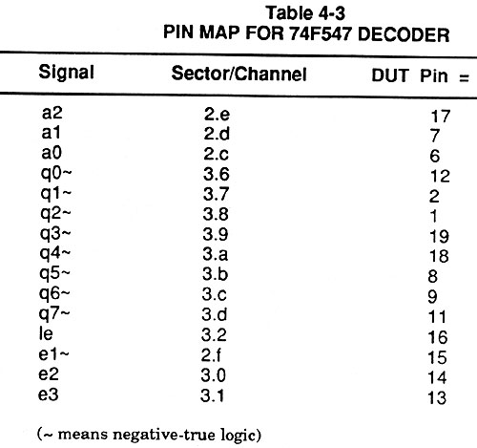
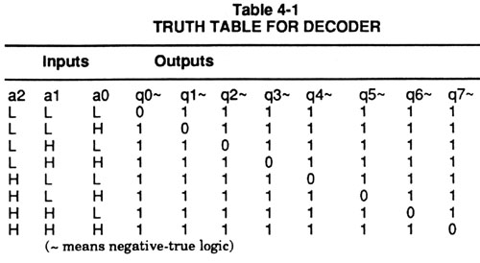
74LS547

Slide 69
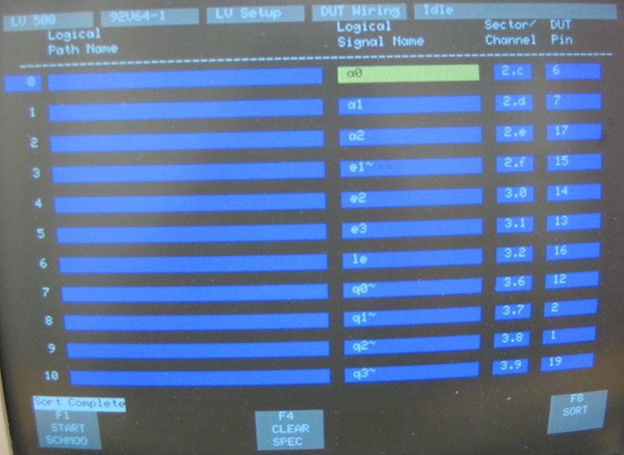
547 DUT Wiring

Slide 70
547 Template

Slide 71
547 Pattern

Slide 72
547 Schmoo

Slide 73
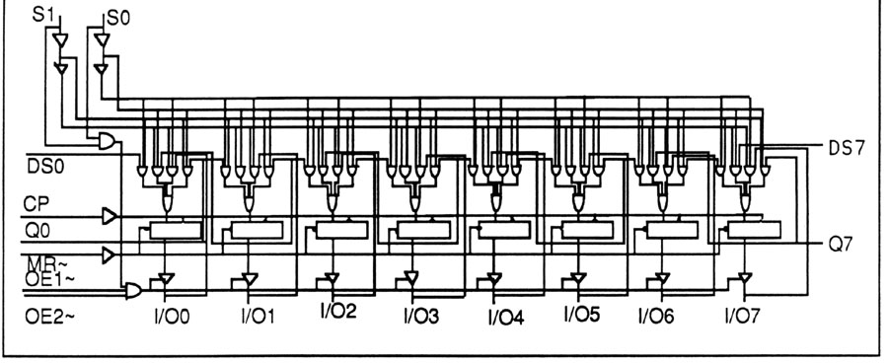
Tutorial 2: 74LS299
Shift Register, shift L or R, parallel load and output
Bidirectional data bus

Slide 74
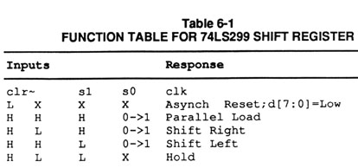
74LS299 Timing
Control should be set up ahead of the clock
Data should be sampled after the rising edge of the clock
Data should be driven after the control is set up
Avoid drive fights on bidirectional path

Slide 75
74LS299 Timing
Cycle = 200ns
Control signals
Clock
Shift data
Delay = 0ns, Width = 100ns
Delay = 40ns, Width = 100ns
Delay = 20ns, Width = 80ns

Slide 76
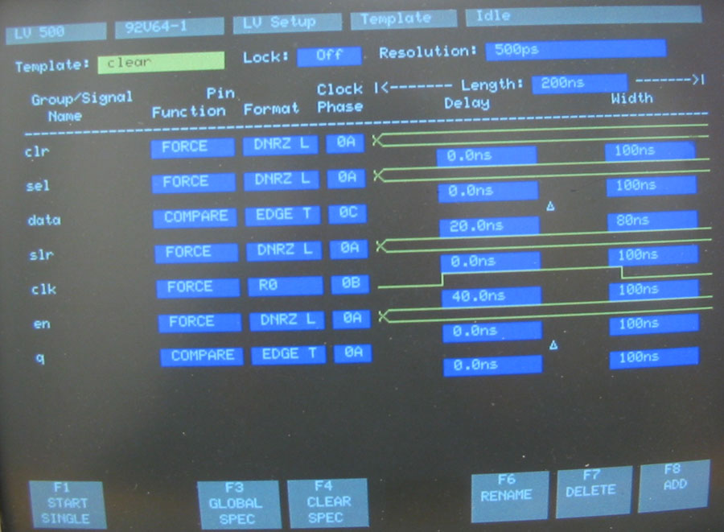
74LS299 Shift/Clear Template

Slide 77
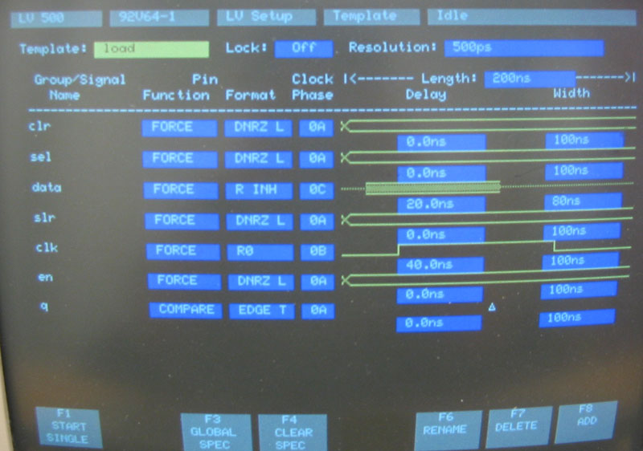
74LS299 Load Template

Slide 78
74LS299 Pattern

