Slide 1
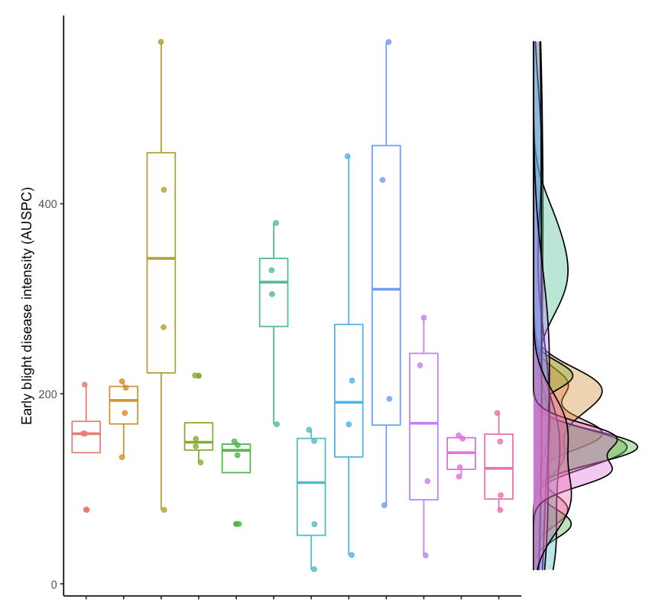
Untreated control
Warrior 1.92 FL OZ/A;Manzate 1.6 QT/A;NIS .25 % V/V
Warrior 1.92 FL OZ/A;NIS .25 % V/V
Manzate 1.6 QT/A;NIS .25 % V/V
Luna Tranquility 16 FL OZ/A;NIS .25 % V/V
Beleaf 2.8 FL OZ/A;Luna Tranquility 16 FL OZ/A;NIS .25 % V/V
Beleaf 2.8 FL OZ/A;NIS .25 % V/V
Beleaf 2.8 FL OZ/A;Bravo WS .75 PT/A;Bravo WS 1.5 PT/A;NIS .25 % V/V
Bravo WS .75 PT/A;Bravo WS 1.5 PT/A;NIS .25 % V/V
Warrior 1.92 FL OZ/A;Luna Tranquility 16 FL OZ/A;NIS .25 % V/V
Beleaf 2.8 FL OZ/A;Manzate 1.6 QT/A;NIS .25 % V/V
Warrior 1.92 FL OZ/A;Bravo WS .75 PT/A;Bravo WS 1.5 PT/A;NIS 0.25 % V/V

Slide 2
Untreated control
Warrior 1.92 FL OZ/A;Manzate 1.6 QT/A;NIS .25 % V/V
Warrior 1.92 FL OZ/A;NIS .25 % V/V
Manzate 1.6 QT/A;NIS .25 % V/V
Luna Tranquility 16 FL OZ/A;NIS .25 % V/V
Beleaf 2.8 FL OZ/A;Luna Tranquility 16 FL OZ/A;NIS .25 % V/V
Beleaf 2.8 FL OZ/A;NIS .25 % V/V
Beleaf 2.8 FL OZ/A;Bravo WS .75 PT/A;Bravo WS 1.5 PT/A;NIS .25 % V/V
Bravo WS .75 PT/A;Bravo WS 1.5 PT/A;NIS .25 % V/V
Warrior 1.92 FL OZ/A;Luna Tranquility 16 FL OZ/A;NIS .25 % V/V
Beleaf 2.8 FL OZ/A;Manzate 1.6 QT/A;NIS .25 % V/V
Warrior 1.92 FL OZ/A;Bravo WS .75 PT/A;Bravo WS 1.5 PT/A;NIS 0.25 % V/V

