Slide 1
Design Rules Summary
for Drawing Layers
2026/06/09
Reflected GitHub issues
https://github.com/OpenSUSI/TR-1um/issues

Slide 2
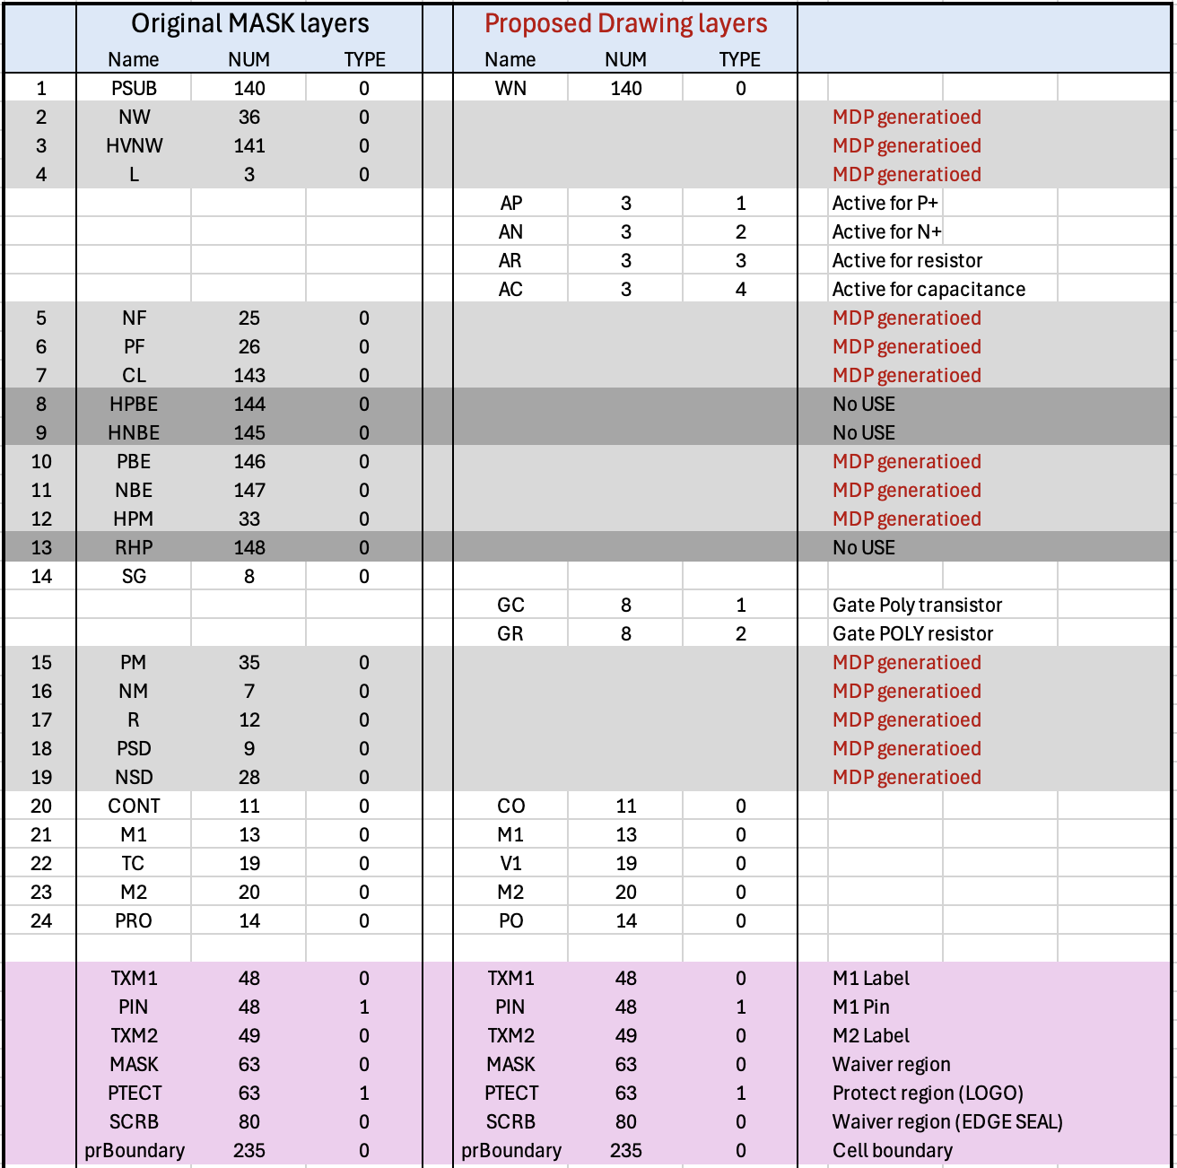
Drawing Layer Table
*IMPORTANT*
DBU: 0.001um
Scale Factor: 1.0
Min Grid: 0.05um

Slide 3
Cat-1: Prohibited
WN
WN
WN
PO
Rule | L1 | L2 | Func | MIN | MAX
WN.Z1 | WN(R) | AP | None | 0.0
WN.Z2 | WN(C) | AP | None | 0.0
WN.Z3 | WN(C) | AR | None | 0.0
CO.Z1 | CO | AA+GC+GR | None | 0.0
CO.Z3 | CO | M1 | None | 0.0
V1.Z1 | V1 | M1 | None | 0.0
V1.Z2 | V1 | M2 | None | 0.0
PO.Z1 | PO | M1 | None | 0.0
PO.Z2 | PO | M2 | None | 0.0
PO.Z3 | PO | V1(P) | Exist | 0.0
V1(P)
AR
AC
AC
AP
AP
AR
CO
V1
PO
Function: Wmin/max: L1 Width min/max
Smin/max: L1 Space min/max (L1=L2)
Smin/max: L1 Separate L2 min/max
Emin/max: L1 Enclosed L2 min/max
Fmin/max: L1 Enclosing L2 min/max
ECmin: MOS Endcap min
Wfix: L1 Windth equal
Sfix: Space equal
Donut: L1 Souuounded by L2
None: Not Exist
AP+AN
+AC+AR
+GC+GR
M1
M1
M1
M2
M2
V1(P)：V1 on PE

Slide 4
Cat-2: WN to AP/AN/AR/AC related
Rule | L1 | L2 | Func | MIN | MAX
WN.W1 | WN |  | Wmin | 8.0
WN.S1 | WN | WN | Smin | 12.0
WN.S2 | WN | WN(R) | Smin | 9.5
WN.S3 | WN | WN(C) | Smin | 12.0
WN.S4 | WN(R) | WN(C) | Smin | 9.5
WN.S5 | WN(R) | WN(R) | Smin | 8.0
WN.S6 | WN(C) | WN(C) | Smin | 12.0
WN.AP | WN | AP | Smin | 5.0
WN.AN | WN | AN | Smin | 10.0
AR.S1 | AR | AR | Smin | 4.0
AR.WR | AR | WN(R) | Emin | 10.0
AN.WR | AN | WN(R) | Emin | 5.0
AR.AN | AR | AN | Smin | 4.0
AC.W1 | AC |  | Wmin/max | 28.5 | 120.0
AC.S1 | AC | AC | Smin | 6.4
AC.WC | AC | WN(C) | Emin | 8.0
AN.WC | AN | WN(C) | Emin | 3.0
AC.AN | AC | AN | Sfix | 2.8 | 2.8
AC.GC | AC | GC | Efix | 1.4 | 1.4
AC.R1 | AC | AN(C) | Donut | 0.0
WN
(R)
WN
(R)
WN
WN.S2
WN.S5
AR
AR
AN
AN
AR.S1
WN.AN
WN.AP
AP
AR.WR
AR.AN
AN.WR
AN
AP
WN.S4
WN.S1
WN
(C)
WN
(C)
WN
WN.S6
WN.S3
WN.W1
AC
AN
AC
AP
AC.GC
AC.S1
AC.AN
WN.AN
WN.AP
AC.WC
AC.W1
AN.WC
WN.AN
WN.AP
WN(R)：WN overlapped AR
WN(C)：WN overlapped AC
AN(C)：AN in WN(C)
AN
AP
AN
AP

Slide 5
Cat-3: MOS transistor related
Rule | L1 | L2 | Func | MIN | MAX
AP.W1 | AP |  | Wmin | 1.4
AP.S1 | AP | AP | Smin | 1.4
AP.AN | AP | AN | Smin | 2.8
AP.WM | PMOS | AP-GC | Wmin/max | 3.4 | 60.0
AP.LM | PMOS | GC-AN | Lmin/max | 1.0 | 30.0
AP.WN | AP | WN | Emin | 7.0
DP.W1 | DP |  | Wmin | 2.8
DP.S1 | DP | DP | Smin | 1.4
DP.AP | DP | AP(M) | Smin | 2.8
DP.AN | DP | AN | Smin | 2.8
AN.W1 | AN |  | Wmin | 1.4
AN.S1 | AN | AN | Smin | 1.4
AN.AP | AN | AP | Smin | 2.8
AN.WM | NMOS | AN-GC | Wmin/max | 3.4 | 60.0
AN.LM | NMOS | GC-AN | Lmin/max | 1.0 | 30.0
AN.WN | AN | WN(M) | Emin | 5.0
DN.W1 | DN |  | Wmin | 2.8
DN.S1 | DN | DN | Smin | 1.4
DN.AP | DN | AP | Smin | 2.8
DN.AN | DN | AN(M) | Smin | 2.8
WN
DP.W1
AN
DP.S1
AP.S1
AN.S1
AN
AP
(D)
AP
(M)
AP.LM
AP.WM
DP.AN
DP.AP
AP.AN
AN.W1
AP.WN
AP.WN
AN.WN
GC
DN.AP
AN
(D)
DN.AN
AN
(M)
AN.AP
AP.W1
AP
AN.LM
AN.WM
DN.S1
AP.S1
AN.S1
AN(M)：AN-DN
AP(M)：AP-DP
WN(M)：WN overlapped AN/AP
DN.W1
AP

Slide 6
Cat-4: Contact and Poly related
Rule | L1 | L2 | Func | MIN | MAX
GC.W1 | GC |  | Wmin | 1.0
GC.S1 | GC | GC | Smin | 1.2
GC.AP | GC | AP | Smin | 0.4
GC.AN | GC | AN | Smin | 0.4
GC.EP | PMOS | GC | ECmin | 1.2
GC.EN | NMOS | GC | ECmin | 1.2
CO.W1 | CO |  | Wfix | 1.0 | 1.0
CO.S1 | CO | CO | Smin | 1.0
CO.WD | CO(D) |  | Wfix | 1.2 | 1.2
CO.AD | CO(D) | AP+AN | Emin | 1.2
CO.AP | CO | AP | Emin | 0.8
CO.AN | CO | AN | Emin | 0.8
CO.GG | CO | GC(G) | Smin | 1.0
CO.GC | CO | GC+GR | Emin | 0.8
WN
GC.EP
AP
AN
CO.AD
CO.WD
CO.W1
GC.W1
CO.AP
AP
(D)
GC.S1
CO.S1
CO.S1
CO.AN
GC(G)
CO.W1
CO.GG
GC.AP
CO.GC
GC
CO.S1
CO.W1
GC.AN
CO(D)
CO.W1
CO.AD
CO.AN
CO.WD
CO.S1
AP(D)：AP not interacted GC
AN(D)：AN not interacted GC
CO(D)：CO on AP(D)/AN(D)
GC(G)：GC for PMOS/NMOS
CO.S1
GC(G)
CO.AP
AN
(D)
CO.GG
CO.W1
AN
AP
GC.EN

Slide 7
Cat-5: Resistor(AR/RS) and Capacitor(AC) related
GC
(R)
GC
(R)
Rule | L1 | L2 | Func | MIN | MAX
AR.W1 | RR | RR(L) | Wmin/max | 2.8 | 20.0
AR.L1 | RR | RR(W) | Lmin/max | 13.0 | 100.0
AR.GC | GC | AR | Smin | 1.0
AR.PW | GC(R) |  | Wmin | 2.0
AR.XY | AR | Bevel | XYmin | 1.0
GC.AN | GC(R) | AN | Smin | ??? | ???
GC.R1 | AR | GC(R) | Donut | 0.0
GC.R2 | GC(R) | WN(R) | TieDown | 0.0
GR.W1 | RS | RS(L) | Wmin/max | 4.0 | 20.0
GR.L1 | RS | RS(W) | Lmin/max | 20.0 | 100.0
GR.S1 | RS | RS | Smin | 2.0
CR.W1 | CO(RR) |  | Wmin | 1.0
CR.W2 | CL(RR) |  | Wmin/max | 1.0 | 97.5
CR.AT | CO(RR) | AR(T) | Emin | 1.5
CR.AS | CO(RR) | AR(S) | Emin | 1.0
CC.W1 | CO(C) |  | Wfix | 1.2 | 1.2
CC.S1 | CO(C) | CO(C) | Sfix | 1.2 | 1.2
CC.AC | CO(C) | AC | Emin | 2.9
CC.AN | CO(C) | AN | Emin | 1.2
WN(R)
AR.PW
GC(AR)
GC.AN
AR
AN
AR.GC
GR.W1
GR.S1
AR.L1
CO(RR)
GR.L1
RS
AR.XY
WN
(C)
AR.XY
AN
CR.AT
CC.AC
CC.AN
CR.W1
CR.W2
CR.AS
AC
RR
CL(RR)
CC.S1
CC.S1
GC(AR)：GC in WN(R)
RS(L) ：Length of AR effective
RS(W) ：Width of AR effective
CO(RR)：CO short side on AR
CL(RR)：CO large side on AR
AR(T) ：AR top fringe
AR(S) ：AR side fringe
AR.L1 ：allow only 4,6,12,20
CO(C) ：CO on AC
CC.W1
CC.W1
AR.W1
AR
R.Effective region

Slide 8
Cat-6: M1/V1/M2 related
Rule | L1 | L2 | Func | MIN | MAX
M1.W1 | M1 |  | Wmin/max | 1.8 | 10.0
M1.W2 | M1(W) |  | Wmin | 10.0
M1.S1 | M1 | M1 | Smin | 1.4
M1.SC | M1(C) | M1(C) | Sfix | 10.0 | 10.0
M1.CO | M1 | CO(S) | Fmin | 0.8
M1.CC | M1 | CO(C) | Fmin | 1.3
M1.CL | M1 | CO(L) | Fmin | 1.2
M1.SW | M1(W) | M1 | Smin | 2.0
V1.W1 | V1 |  | Wfix | 1.4 | 1.4
V1.S1 | V1 | V1 | Smin | 1.5
V1.M1 | V1 | M1 | Emin | 1.0
V1.GC | V1 | GC | Smin | 1.2
V1.CO | V1 | CO | Smin | 1.0
V1.CL | V1 | CO(L) | Smin | 1.4
M2.W1 | M2 |  | Wmin | 3.0
M2.S1 | M2 | M2 | Smin | 2.0
M2.V1 | M2 | V1 | Fmin | 1.0
M1(W)
M1
M1
M2
M2
M1.CL
M1.CO
M2.V1
V1.W1
M1.W1
M1.S1
V1.S1
M1.W2
M1.SW
M2.W1
M2.S1
V1.M1
M1(C)
V1.CO
CO(S)
AC
M1.SC
V1.GC
M1
M1(C)：M1 in WN(C)
CO(C)：CO on AC
CO(S)：CO small contact
CO(L)：CO large contact (only on AR)
M1(W)：Wide M1
CO(C)
GC
CO(L)
M1.CC
V1.CL

Slide 9
Cat-7: ESD MOS transistor related
Rule | L1 | L2 | Func | MIN | MAX
APE.WM | PMOSE | APE-GC | Wmin/max | 11.0 | 60.0
APE.LM | PMOSE | GC-ANE | Lmin/max | 2.0 | 30.0
APE.AN | APE | AN | Smin | 10.0
APE.XY | APE | Bevel | XYmin | 1.4
APE.CO | APE | CO | Smin | 2.0
ANE.WM | NMOSE | ANE-GC | Wmin/max | 11.0 | 60.0
ANE.LM | NMOSE | GC-ANE | Lmin/max | 2.0 | 30.0
ANE.AP | ANE | AP | Smin | 10.0
ANE.XY | ANE | Bevel | XYmin | 1.4
ANE.CO | ANE | CO | Smin | 2.0
COE.W1 | CO(E) |  | Wfix | 3.0 | 3.0
COE.S1 | CO(E) | CO(E) | Smin | 1.6
CDE.GC | CD(E) | GC | Smin | 7.0
CSE.GC | CS(E) | GC | Smin | 3.0
COE.AP | CO(E) | AP | Emin | 4.0
COE.AN | CO(E) | AN | Emin | 4.0
WN
AP
APE.XY
AN
APE.XY
SOURCE
APE.LM
DRAIN
COE.W1
APE.WM
COE.AP
COE.S1
APE.AN
CSE.GC
CDE.GC
APE.CO
GC
ANE.CO
ANE.XY
ANE.XY
ANE.AP
ANE.WM
COE.W1
COE.AN
COE.S1
APE/ANE)：AP/AN on ESD)
CO(E)：CO on ESD
CSE.GC
ANE.LM
CDE.GC
AP
SOURCE
DRAIN
ESD

Slide 10
Cat-8: PAD related
Rule | L1 | L2 | Func | MIN | MAX
PO.W1 | PO |  | Wmin | 70.0
PO.S1 | PO |  | Smin | 64.0
M2.PO | M2(P) | PO | Fmin | 5.0
M1.PO | M1(P) | PO | Fmin | 5.0
PO.V1 | PO | V1(P) | Emin | 10.0
PO.AP | PO | AP | Smin | 14.0
PO.AN | PO | AN | Smin | 14.0
PO.GC | PO | GC | Smin | 14.0
PO.M1 | PO | M1 | Smin | 14.0
PO.M2 | PO | M2 | Smin | 14.0
M2.PE | M2 | Extention |  | 19.0
M2.PW | M2 | Extention | Wmin | 40.0
M1.PE | M2 | Extention |  | 19.0
M1.PW | M2 | Extention | Wmin | 40.0
M1(P)
M2(P)
PO
PO
q
q
M1.PO
V1(P)
PO.V1
M2.PO
PO.W1
PO.S1
M2.PE
M1.PE
** Not yet implemented
PO.XX
M2.PW
M1.PW
M1(P)：M1 on PO
M2(P)：M2 on PO
V1(P)：V1 on PO
AA/GC/M1/M2

Slide 11
Design Rule cotrol
DRC integrity

Slide 12
DRC
Document
PCell
run.drc
DR_Table.xls
python/rules_def.py
DR_csv2drc.py
DR_csv2py.py
Cut & Paste
Method
DRC_summary.ppt
python/*.py
# ALL Critical Dimension parameters are referenced by ‘XX.YY’ rule’s name.

Slide 13
Design to Tapeout Process
Mask Data Preparation

Slide 14
Designer
OpenSUSI
Tokai Rika
local
TR-1um_USER_Project
[clone]
TR-1um_MPW_template
Signoff DRC
[push]
remote
TR-1um_USER_Project
TR-1um_MPW_XXX
Fabrication
Download GDSII
[action]
Precheck
DRC
MDP
[action]
Logo insertion
Aggregation
DRC
[Import artifact]
TR-1um_USER_Project
TR-1um_MPW_XXX
PCM TEST
Wafer out

