Slide 1
PROGRAMMABLE GAIN AMPLIFIER DESIGN
Design of a High-Impedance Microphone Pre-Amplifier using Sky130A Technology
Dr. Phillip Allen
Prof. Emeritus, ECE, Georgia Tech
Version 240809

Slide 2
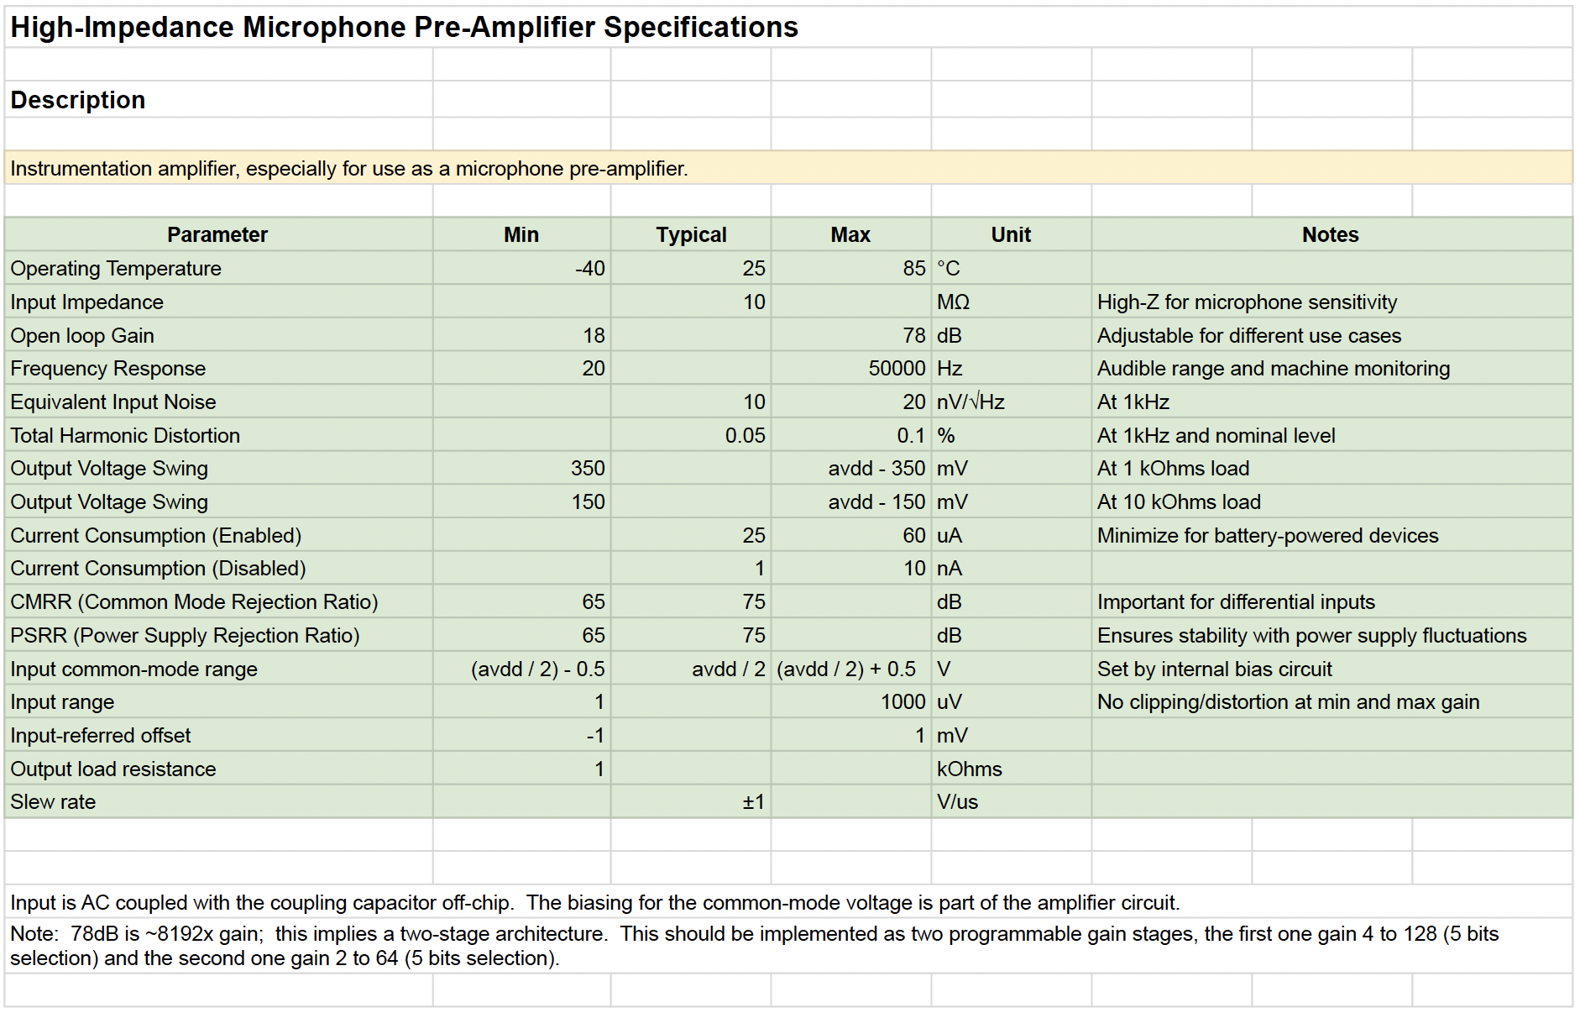
Specifications

Slide 3
Overview of R-2R PGA Architecture
The PGA uses two 5-bit R-2R voltage to current converters to achieve a 10-bit PGA block with gains from 1 to 1024
A differential input stage with a fixed gain of 8 to help meet the noise specification
Bias current requirements is 40µA for the 10-bit PGA block and 40µA for the differential input stage
10-bit PGA block requires thirty-seven 100kΩ, one 3.2MΩ, and two 6.4MΩ resistors

Slide 4
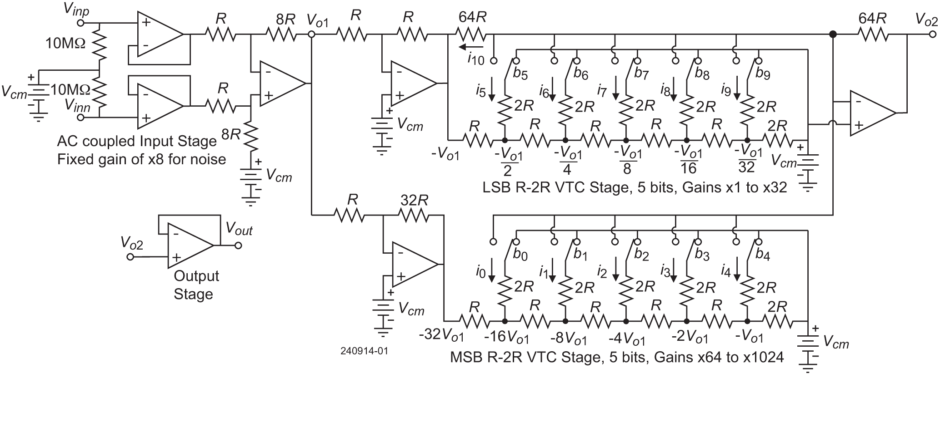
Overview of R-2R PGA Parallel Architecture
3.24µA
12.90µA
12.56µA
23.53µA
3.24µA
13.83µA
Total bias current not including the output stage is approximately 70µA. Output loaded with 100kΩ.

Slide 5
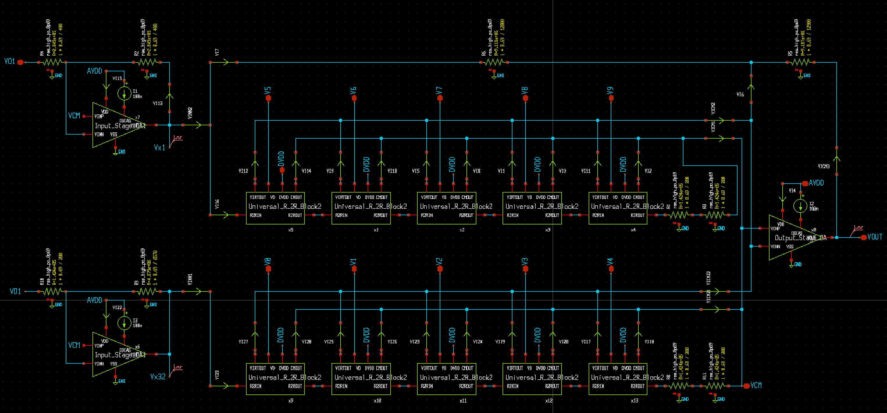
10-Bit PGA Block Schematic
Gain of -1 Stage
Gain of -1 Branch
Gain of -32 Stage
LSB R-2R VTC – Gains of -2 to -64
Summing
output
amplifier
MSB R-2R VTC – Gains of -128 to -2048

Slide 6
Considerations on Architecture Choice
The x-1 and x-32 stages could be replaced by making the resistor difference in the R-2R network of the LSB VTC stage 32 times larger than the resistors in the R-2R network of the MSB VTC stage.
The problem with this is the smaller resistors of the MSB VTC stage require too much current drive. If the LSB resistors are 1MΩ, then the MSB resistors are 31.25kΩ. To get a 1.5V change requires 1.5V/31.25kΩ = 48µA.
For the architecture of the last slide, the output op amp must drive 100kΩ and the output op amp of the input amplifier must drive 50kΩ (two 100kΩ resistances in parallel). This could be increased to approximately 100kΩ by increasing the resistances of the x-1 stage from 100kΩ to 1MΩ.
The basic architecture tradeoff for the 10-Bit PGA block is resistance size versus bias current.

Slide 7
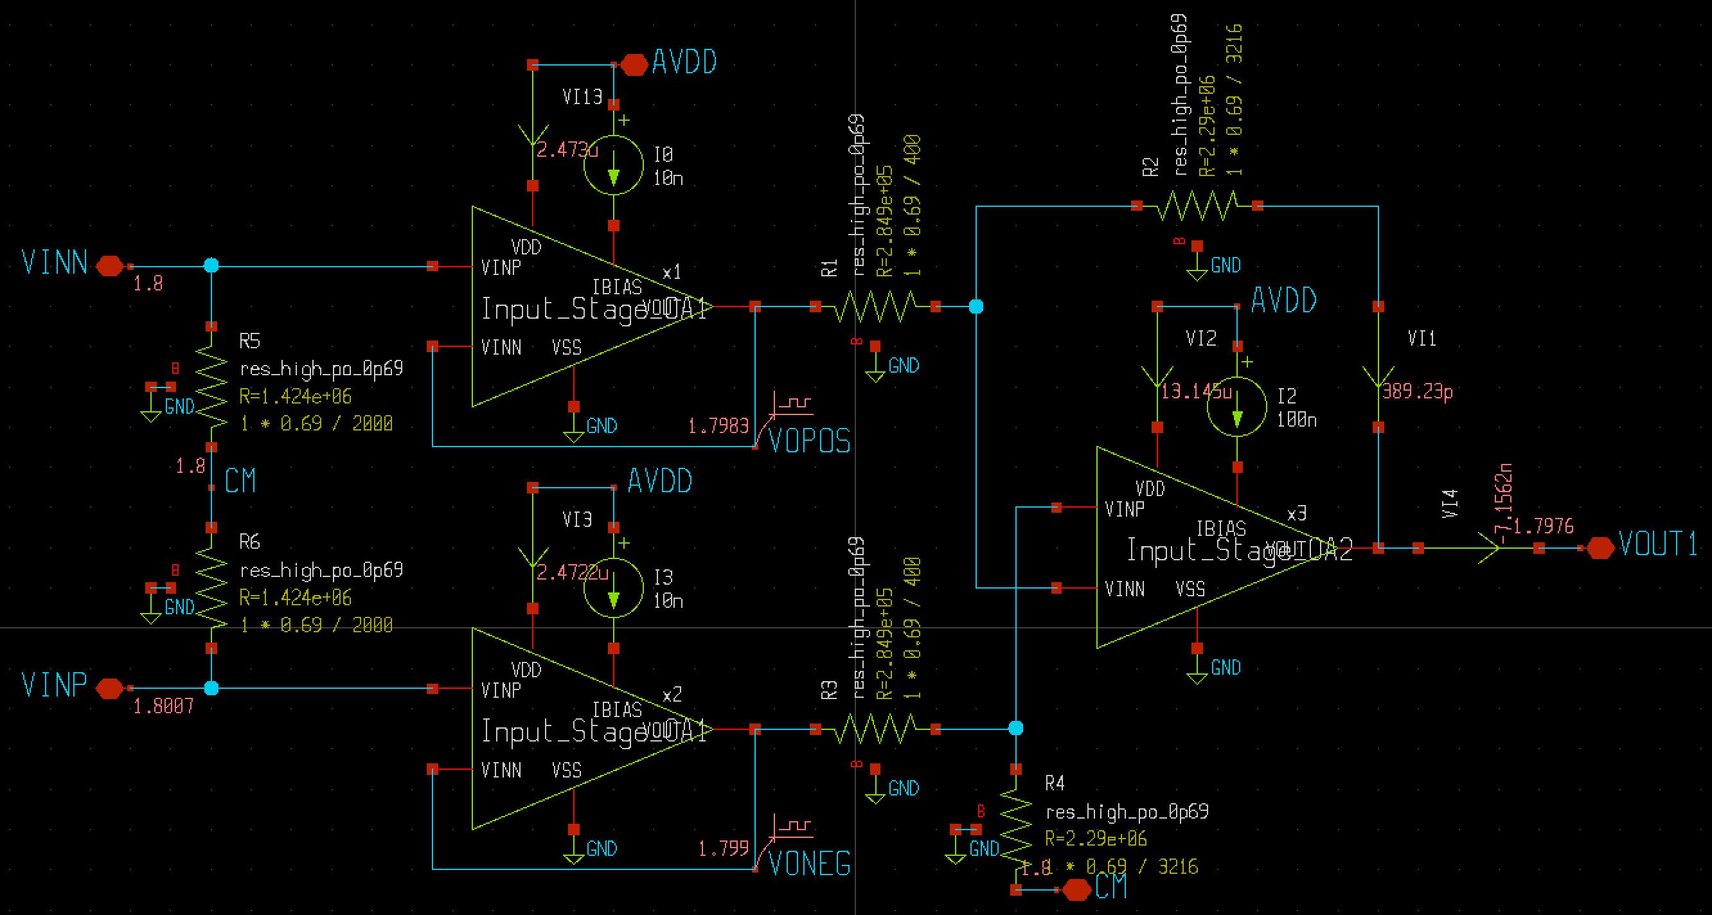
Input Stage Schematic
Total quiescent current ≈ 19.68µA
Op amps are
Miller
compensated
two-stage.
Need the
lower output
resistance to
be able to drive
200kΩ loads.
VOS≈0.8mV when connected to 10Bit PGA BLock

Slide 8
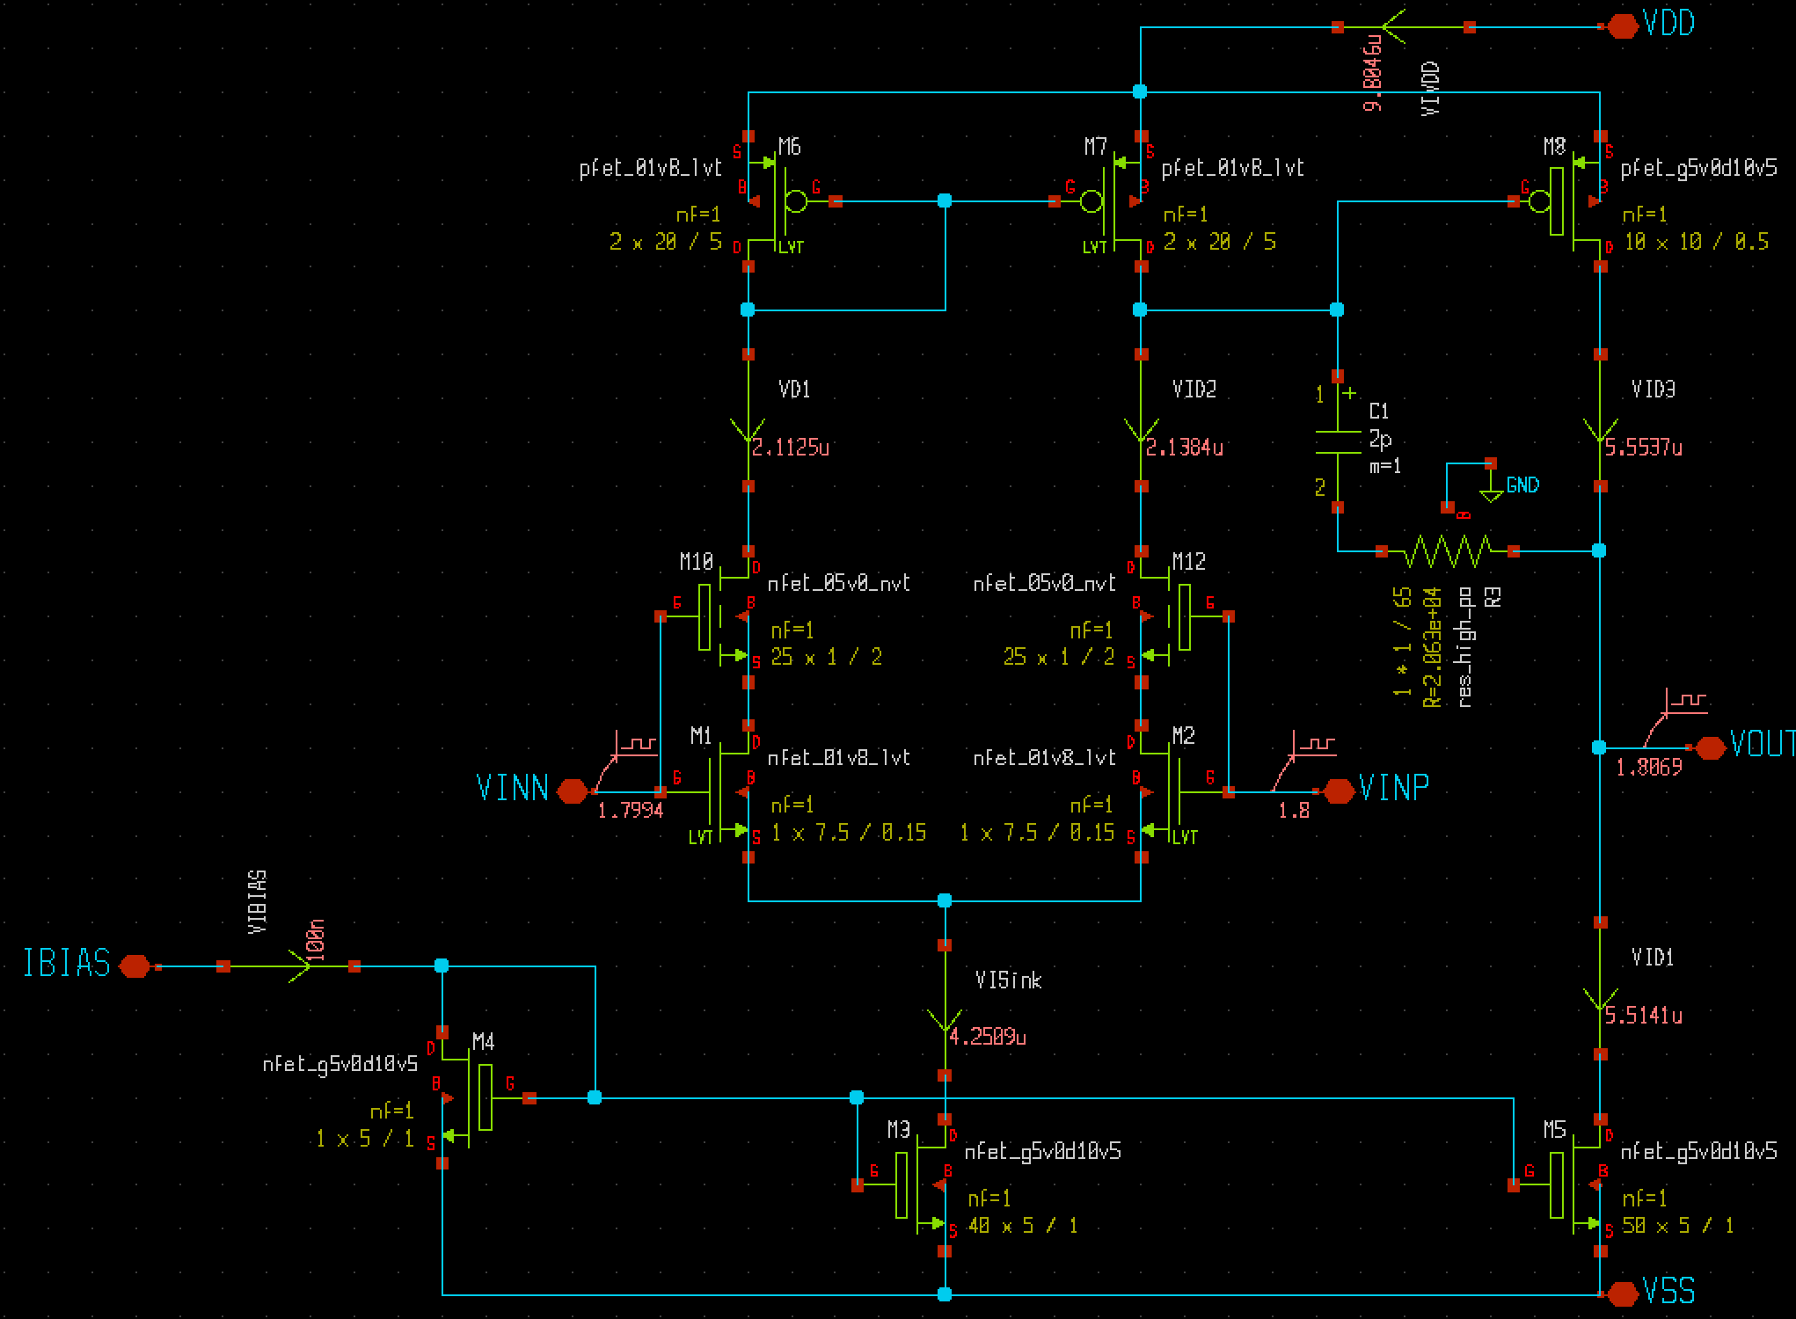

Two-Stage Op Amp
Gain = 88dB
GB = 8MHz (3pF load)
PM = 75° (3pF load)
Bias current = 10µA
Rout ≈ 50kohm
The Class A current sink must
be large enough to pull the
output to its lower voltage
specification. Increase this W
to satisfy the equation below.
$$I_{Sink}≈\frac{1.5V}{R_{Load}}$$

Slide 9
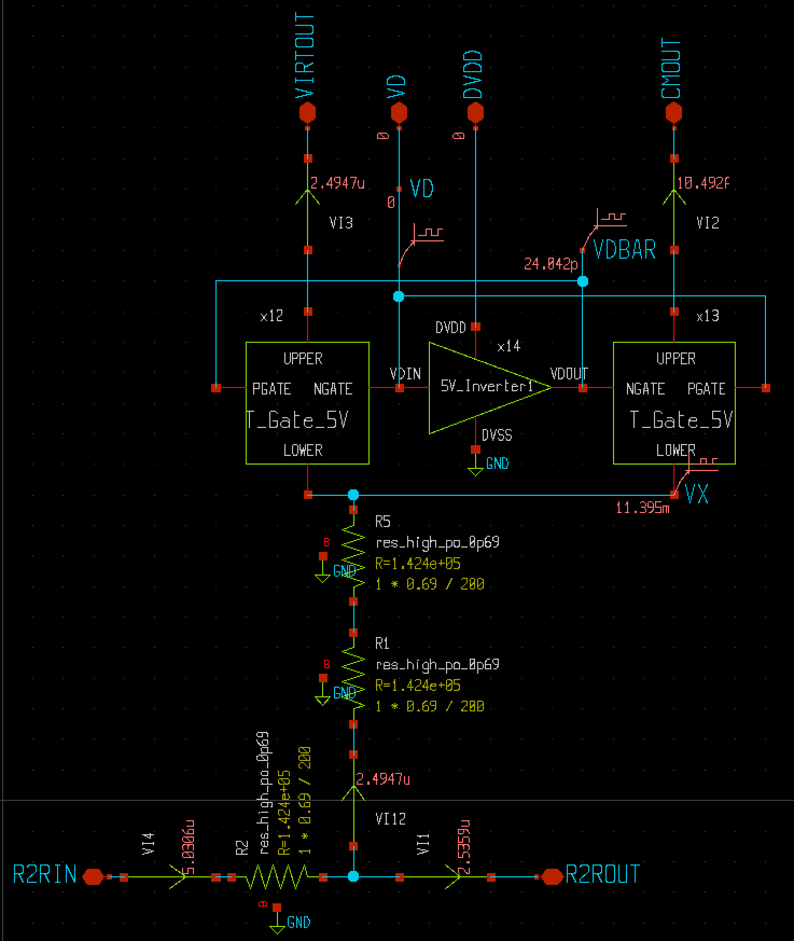
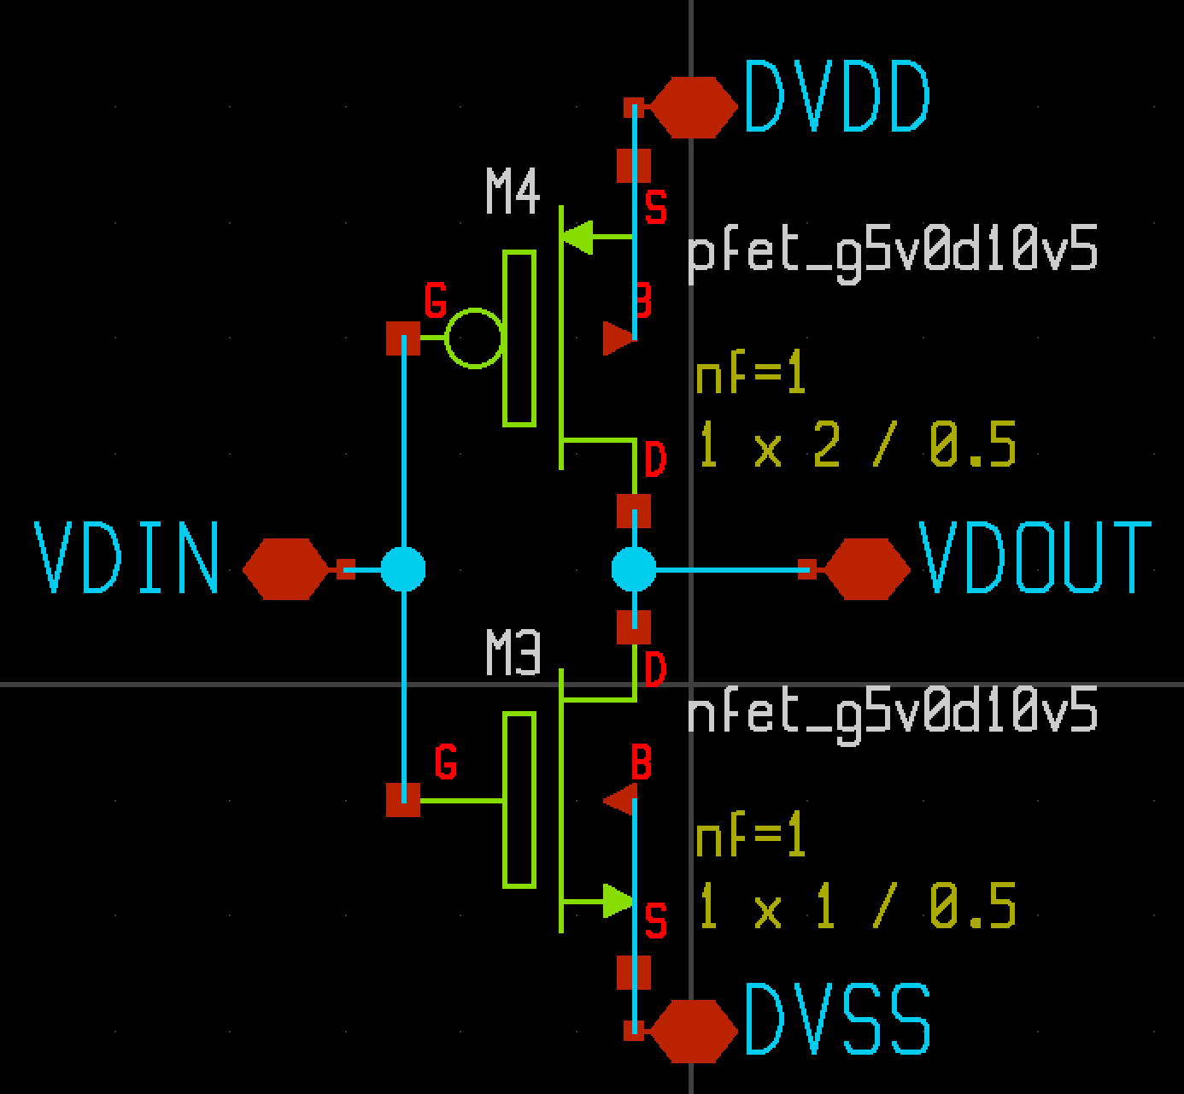
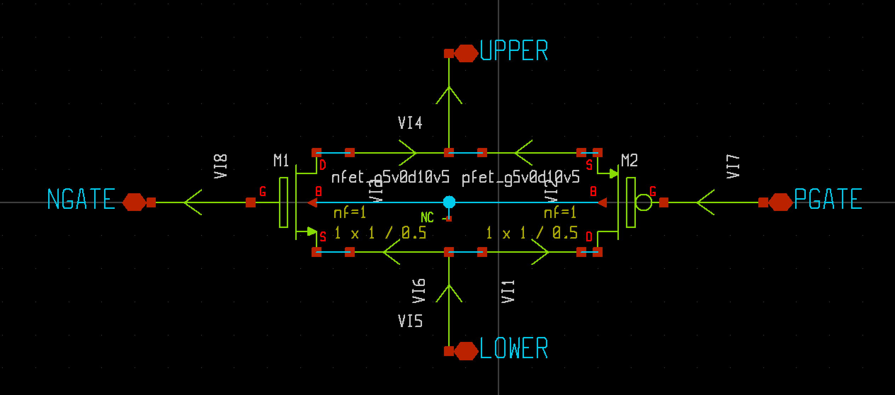
R-2R Schematic

Slide 10
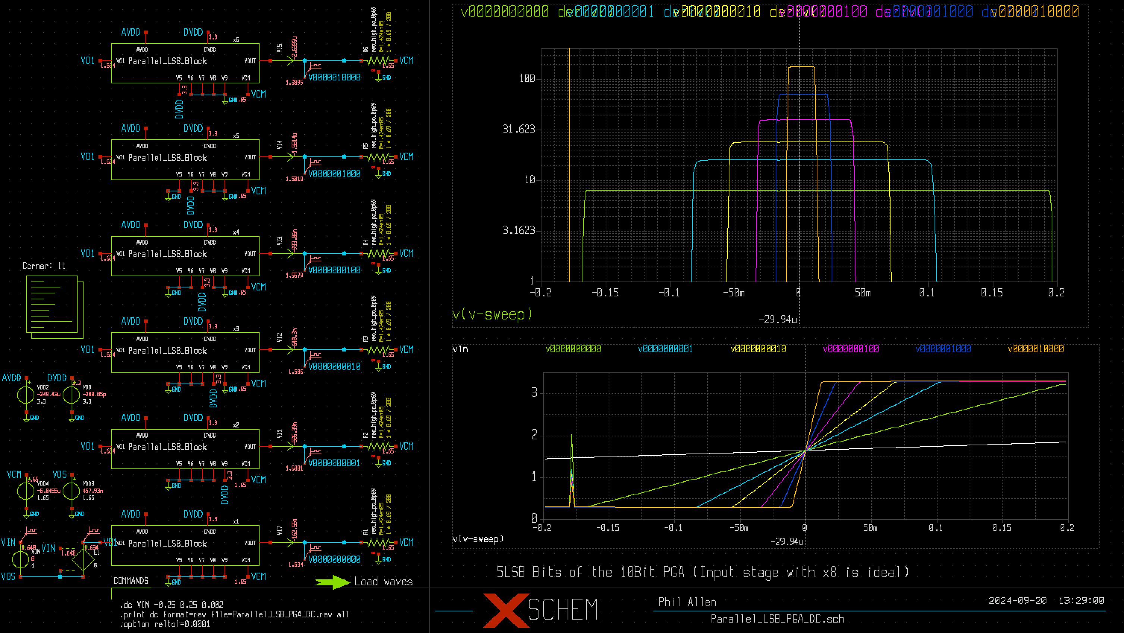
DC Sweep of LSB Bits of 10Bit PGA
Derivative of
the voltage
transfer curve
Ideal input stage
with gain of 8 was
used to simplify
the simulation.
The actual input
stage has an offset
of about 0.6mV
that does not
affect this data.

Slide 11
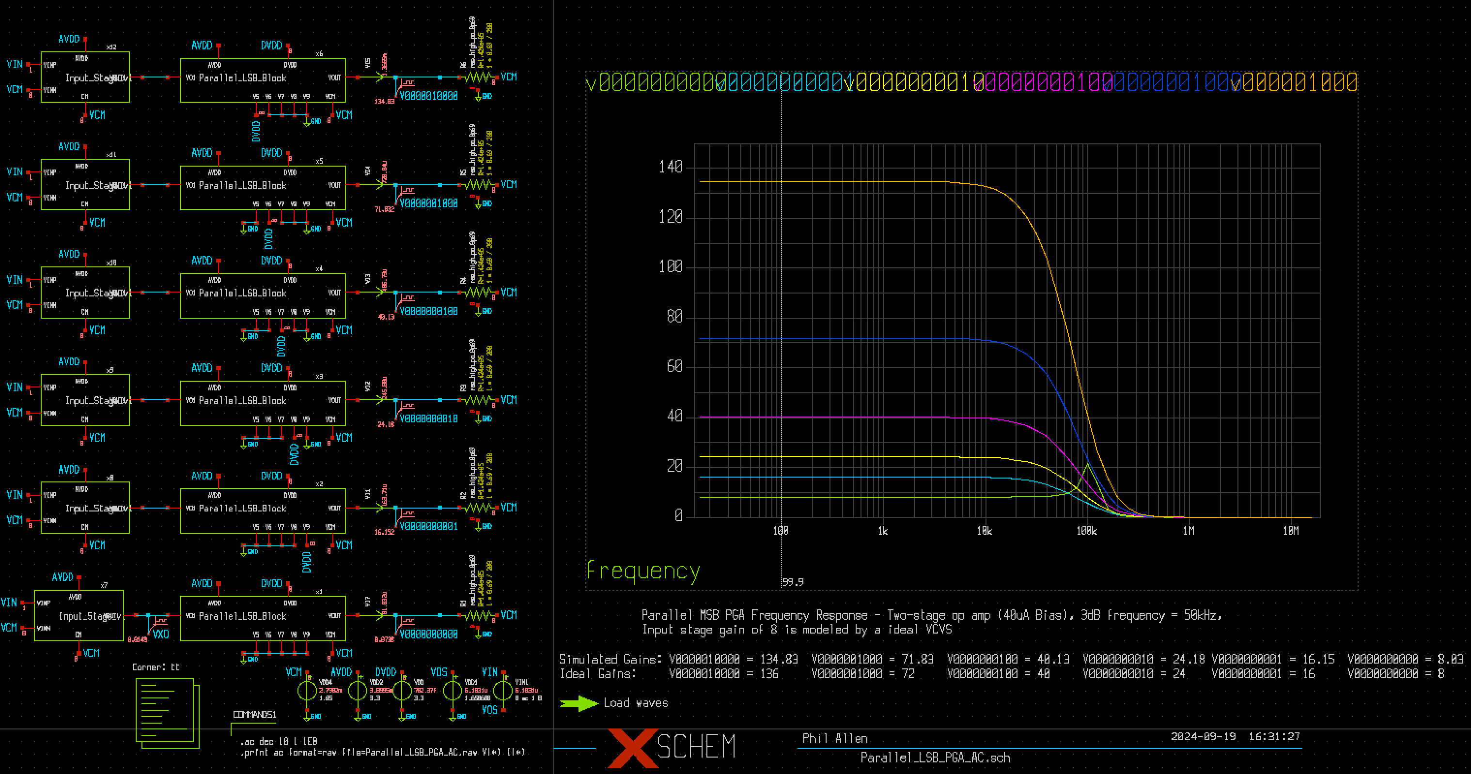
Frequency Response of LSB Bits of 10Bit PGA
LSB Bit | Ideal Gain | Actual Gain
0000000000 | 8 | 8.03
0000000001 | 16 | 16.15
0000000010 | 24 | 24.18
0000000100 | 40 | 40.13
0000001000 | 72 | 71.83
0000010000 | 136 | 134.83
-3dB frequency ≤ 50kHz

Slide 12
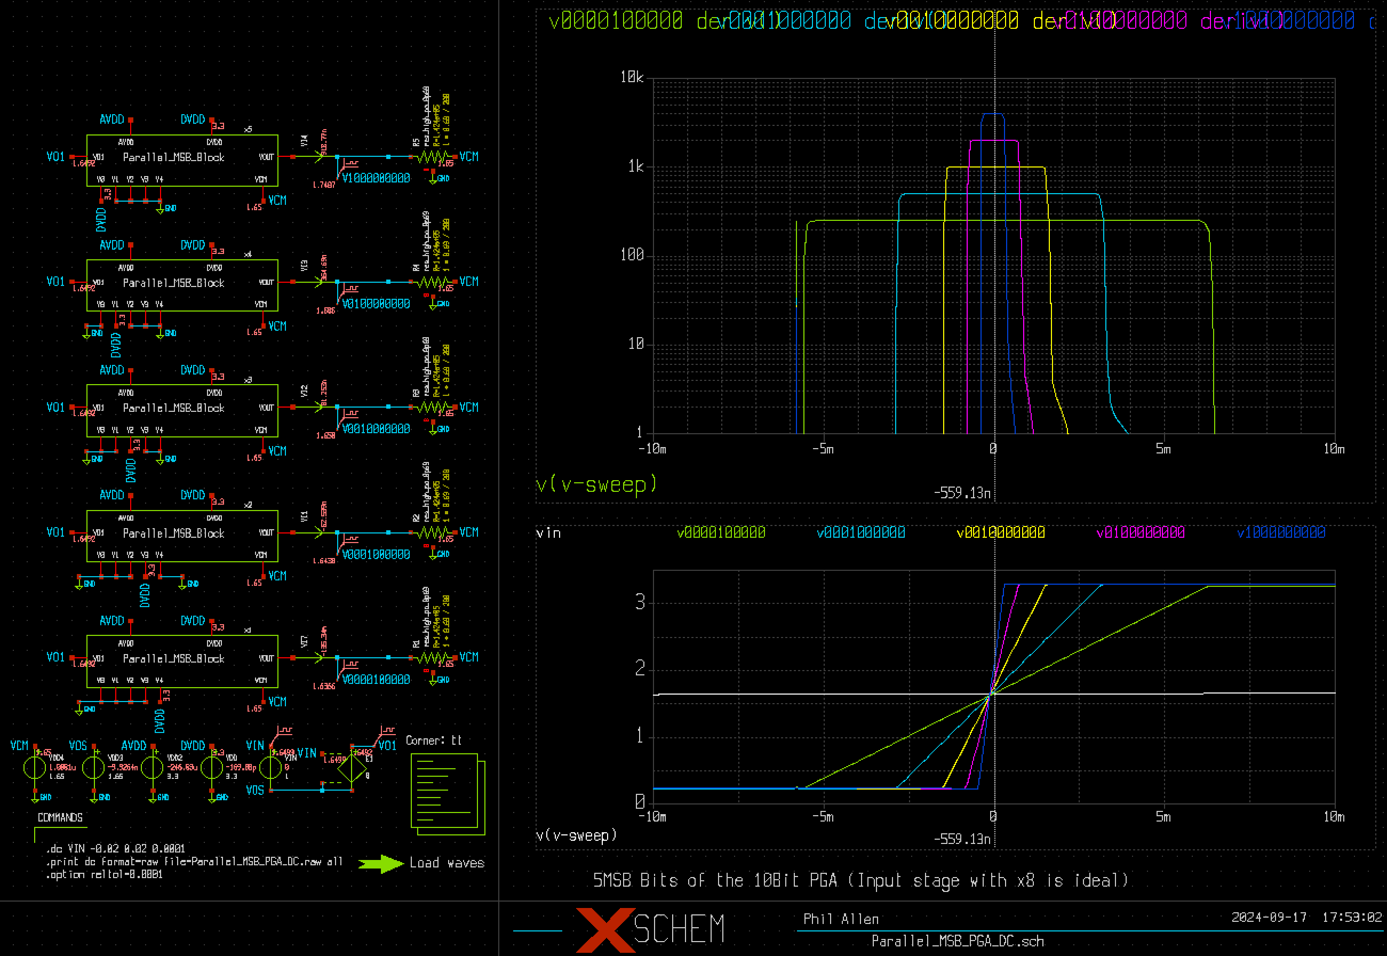
DC Sweep of MSB Bits of 10Bit PGA
Ideal input stage
with gain of 8 was
used to simplify
the simulation.
The actual input
stage has an offset
of about 0.6mV
that must be included
to allow the high gains
to operate in the
correct dc region.
Derivative of
the voltage
transfer curve

Slide 13
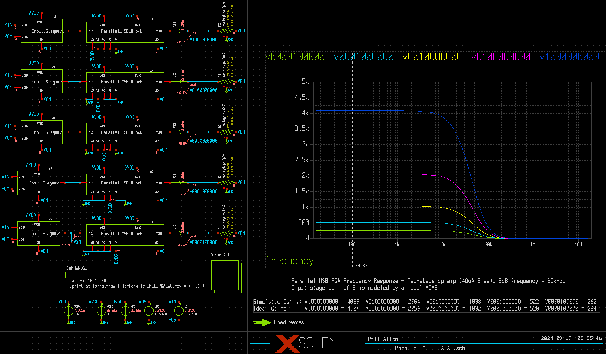
Frequency Response of MSB Bits of 10Bit PGA
MSB Bit | Ideal Gain | Actual Gain
0000100000 | 264 | 262
0001000000 | 520 | 522
0010000000 | 1032 | 1038
0100000000 | 2056 | 2064
0000000000 | 4104 | 4086
-3dB frequency ≤ 30kHz

Slide 14
Resistor Summary
Stage/Block | Resistor Count
5Bit LSB VCT | Seventeen 100kΩ resistors
5Bit MSB VCT | Seventeen 100kΩ resistors
Output Summer | Two 6.4MΩ resistors
x1 Inverter for LSB VCT | Two 200kΩ resistors
x32 Inverter for MSB VCT | One 100KΩ and one 3.2MΩ resistors
Input Amplifier | Two 5MΩ, two 200kΩ, and two 1.6MΩ resistors

Slide 15
To Do
Noise and distortion simulations

Slide 16
Summary
PGA uses two R-2R voltage-to-current converters (VTC) in parallel along with a gain of 1 to achieve the gains from 1 to 1024.
The input differential to single-ended amplifier has a fixed gain of 8 which gives the PGA gains of 8 to 8192.
The programmable gain is determined by identical resistors which should give maximum accuracy
The feedback resistor of the output summer (6.4MΩ) could be used to tune the gains for best match
The x1 and x32 inverters could be eliminated by making the resistor ratio of the LSB VTC to the MSB VTC 32:1. This will require more current to drive the smaller resistors.
An adjustment for VOS will be required to keep the high gains in the linear region of the voltage transfer curve

