Slide 1



Twitter
Search App
Final Project
Team 6
Vivek Reddy Chithari
Manisha Gayatri Damera
Neha Thonta
Notes:
<a href="https://www.freepik.com/free-photos-vectors/business">Business vector created by pikisuperstar - www.freepik.com</a>

Slide 2
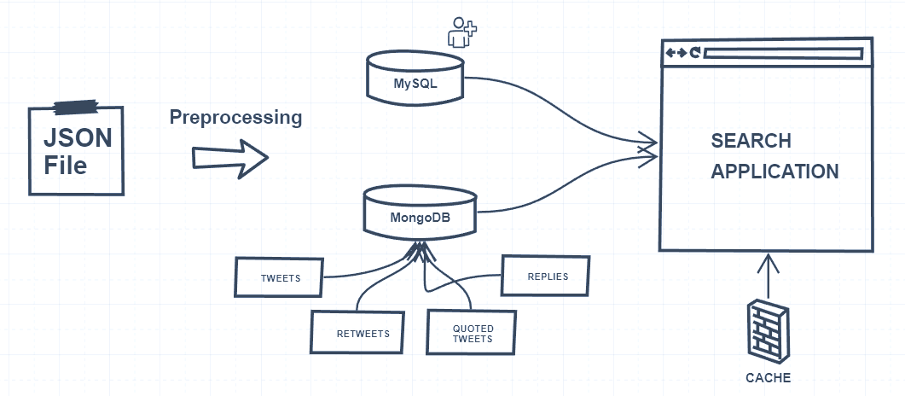
Project Architecture

Slide 3
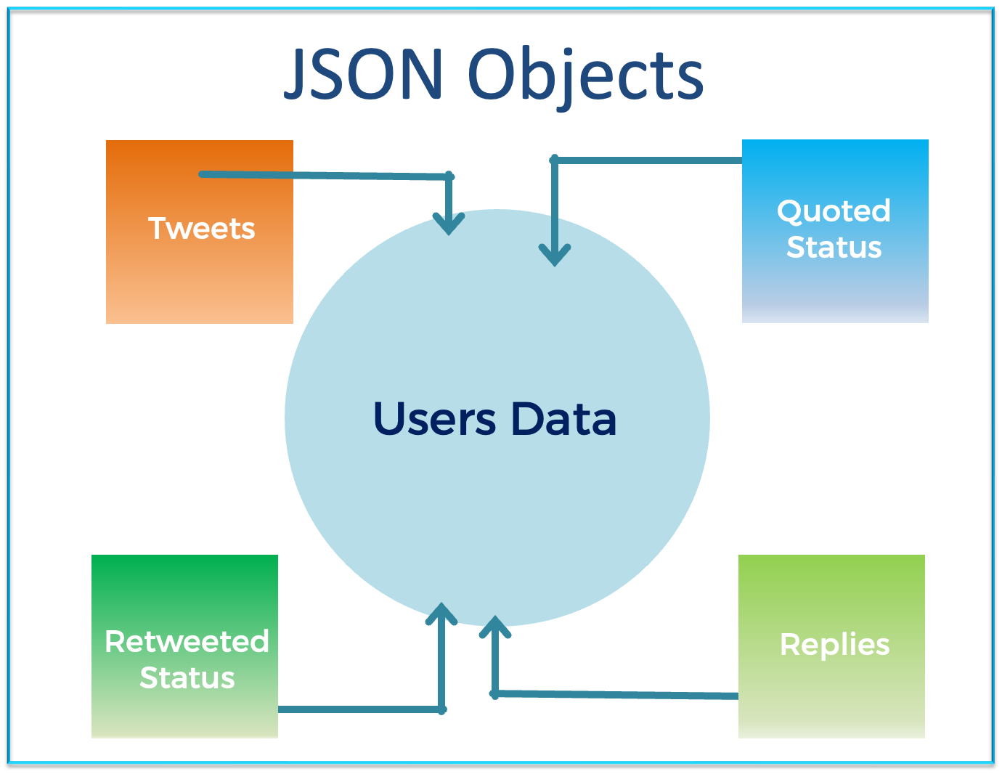


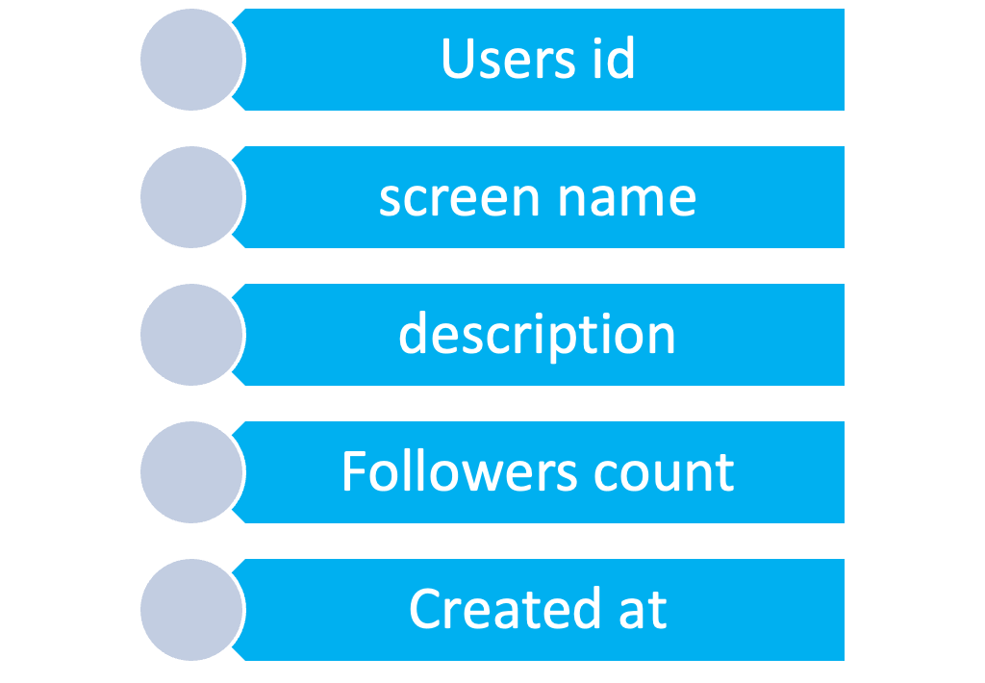
MySQL - Relational
117795
Check Duplicates
Users
“Optimization”
Using Dictionary
Notes:
<a href="https://www.freepik.com/free-photos-vectors/background">Background vector created by freepik - www.freepik.com</a>

Slide 4
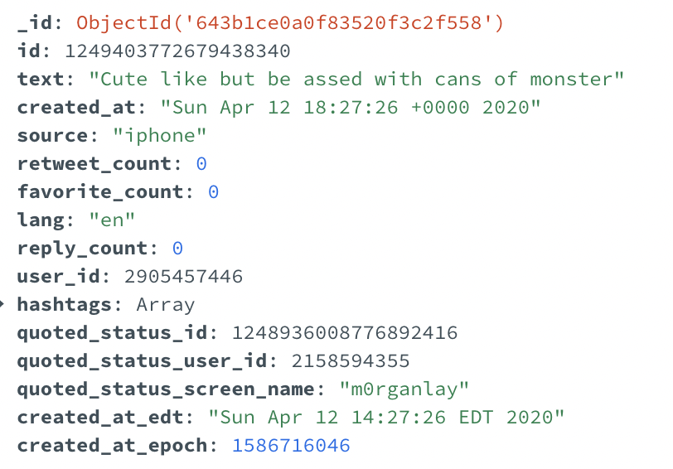
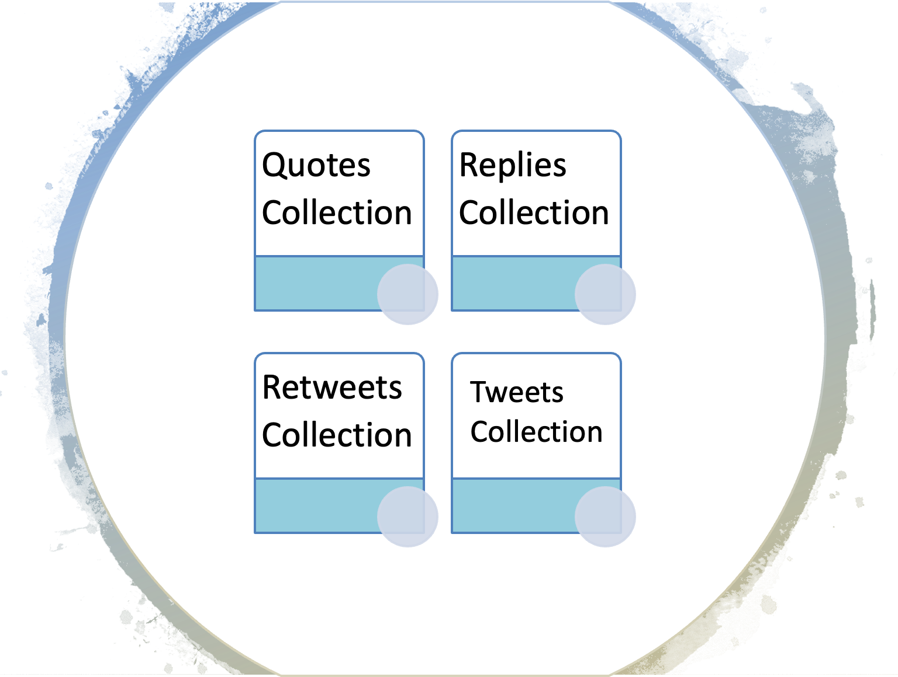
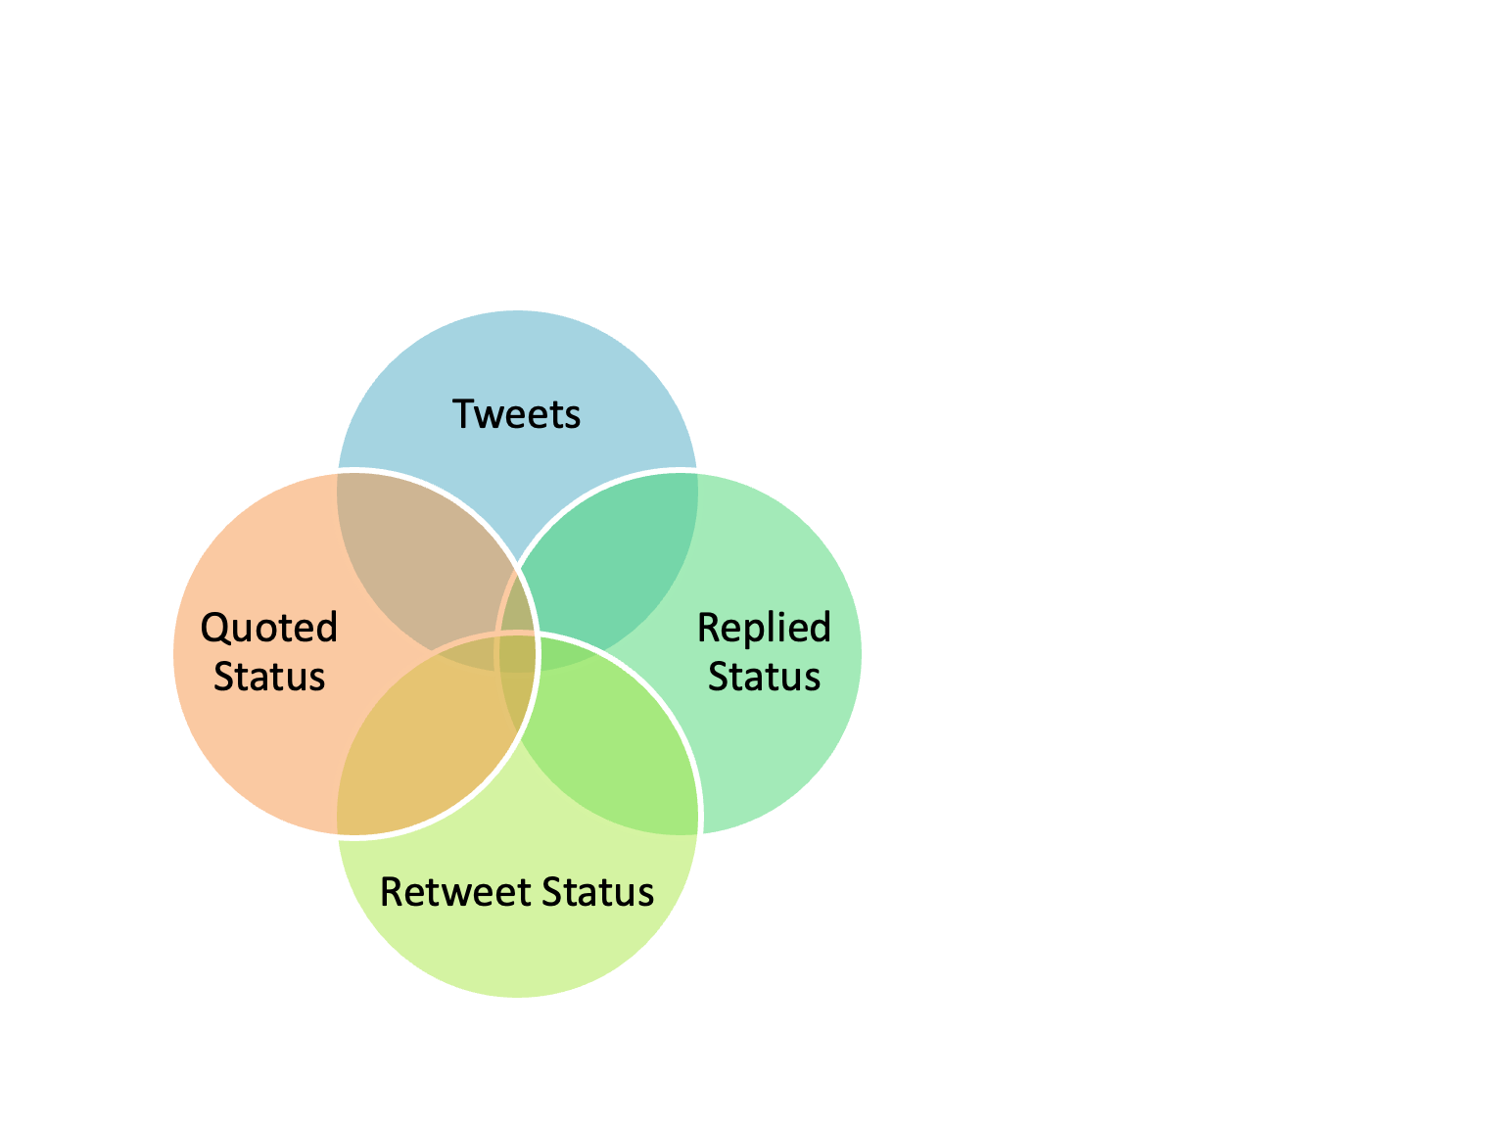
MongoDB - Non Relational
01
02
03
JSON Objects (120434)
Tweet Processing
MongoDB Collections
Tweets
Check Duplicates
Tweets : 41529
Retweets : 72244
Quoted tweets : 8696
Replies : 16132
Notes:
<a href="https://www.freepik.com/free-photos-vectors/business">Business vector created by pikisuperstar - www.freepik.com</a>

Slide 5
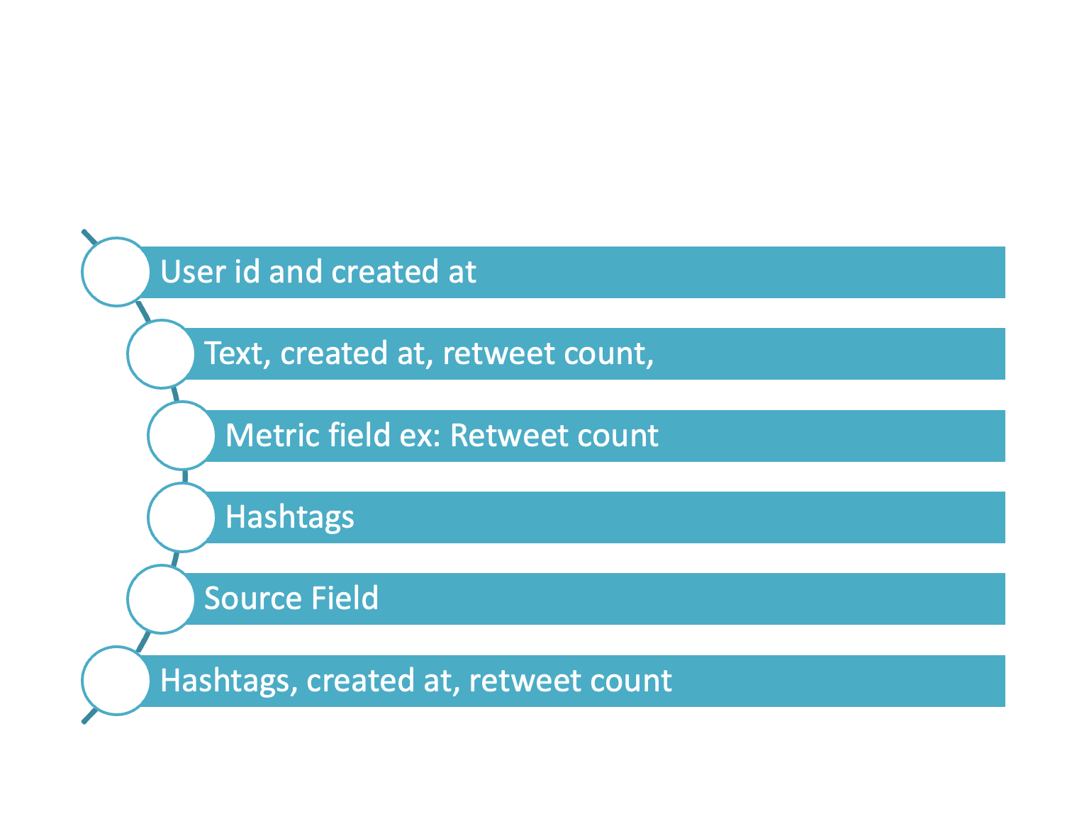
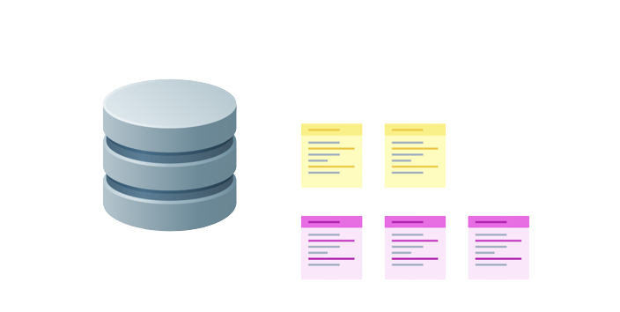
Indexing
MySQL
MongoDB
 |  | Indexed Column
 |  | User ID
 |  | Screen name, Created at, Followers count
 |  | Followers Count
Notes:
<a href="https://www.freepik.com/free-photos-vectors/business">Business vector created by freepik - www.freepik.com</a>

Slide 6
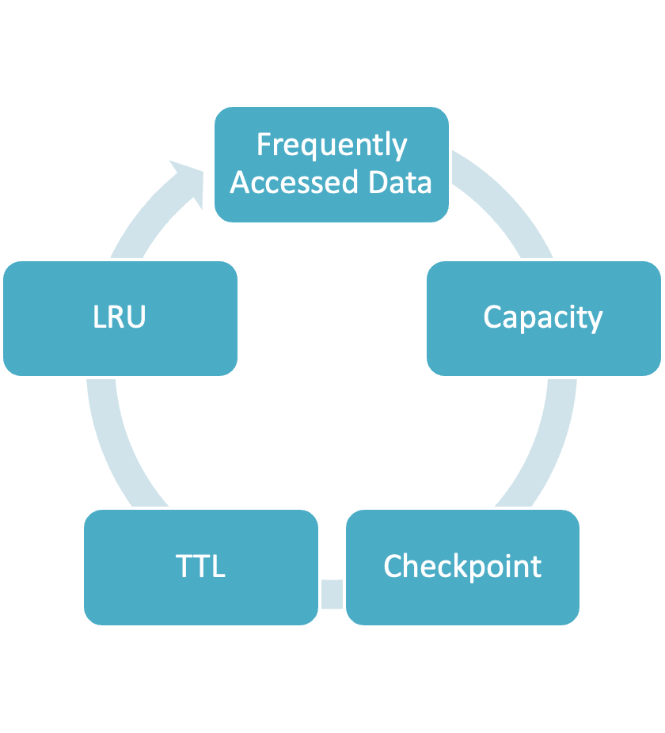
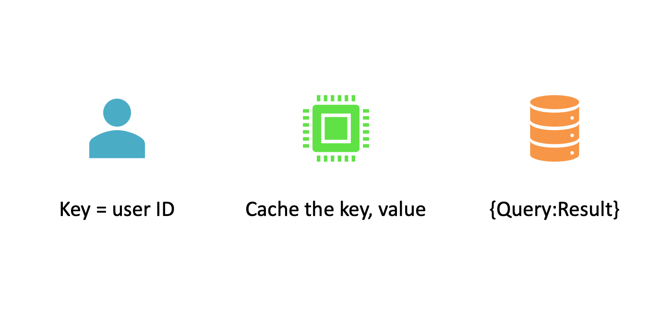

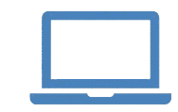

Caching
Stale data
Cache
.
Can response time be improved?
Notes:
<a href="https://www.freepik.com/free-photos-vectors/menu">Menu vector created by freepik - www.freepik.com</a>

Slide 7
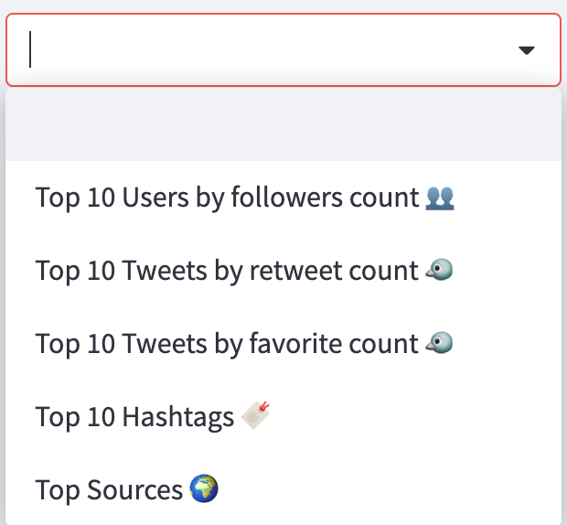
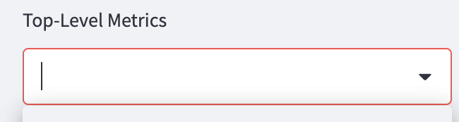
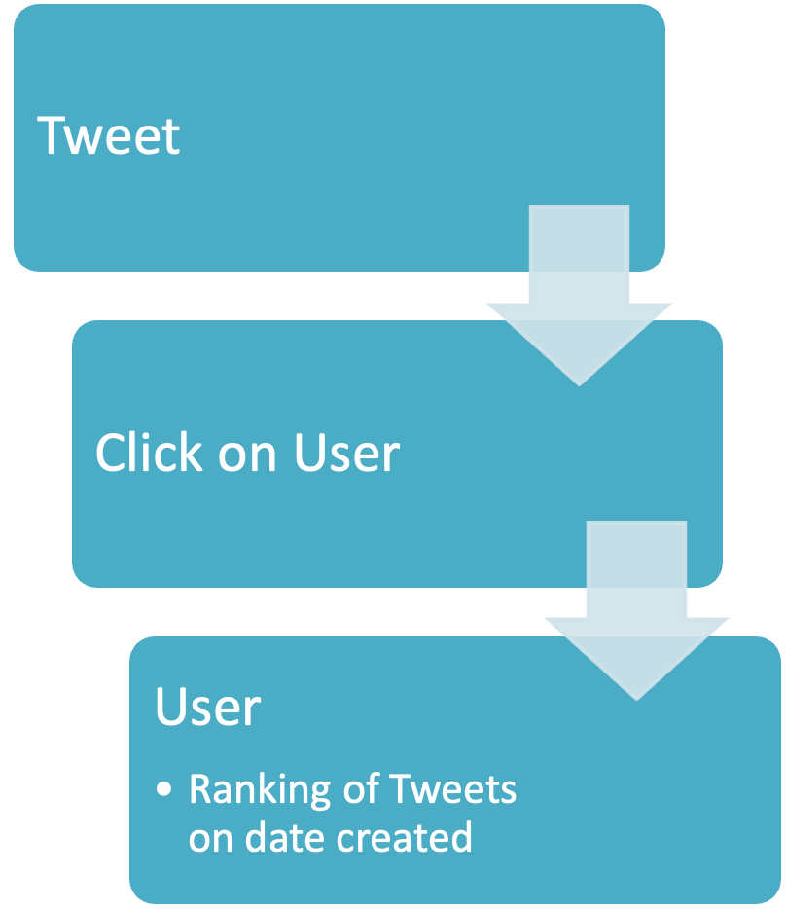
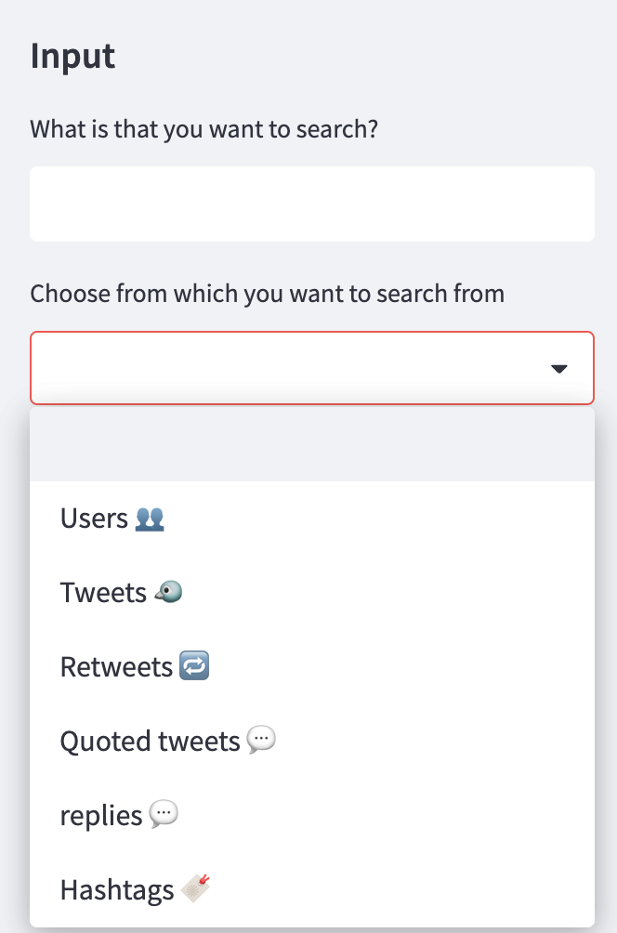
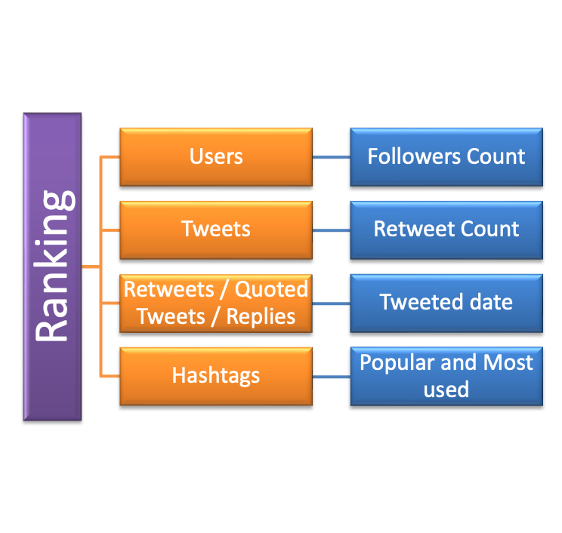
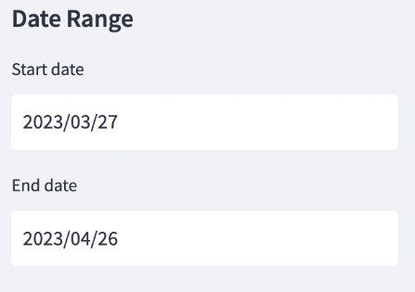
Search Application Functionality
Searches
Notes:
A man bike
<a href="https://www.freepik.com/free-photos-vectors/business">Business vector created by pikisuperstar - www.freepik.com</a>
A man sitting
<a href="https://www.freepik.com/free-photos-vectors/menu">Menu vector created by freepik - www.freepik.com</a>

Slide 8
Twitter App Metadata
User
Tweets
Re-Tweets
Replies
RT - User Screen Name
User ID
Created at
Original User Name
Tweet
Replies Count
Retweets Count
Likes
Source
Hashtag
Screen Name
User ID
Created at
To whom
Replied Text
Replies Count
Retweet Count
Likes
Source
Hashtag
Screen Name
Account Created
Followers Count
Description
Tweets
Quoted Tweets
Replies
User - Screen Name
User ID
Created at
Tweet
Replies Count
Retweets Count
Likes
Source
Hashtag

Slide 9
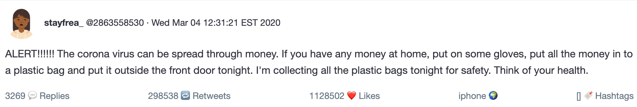
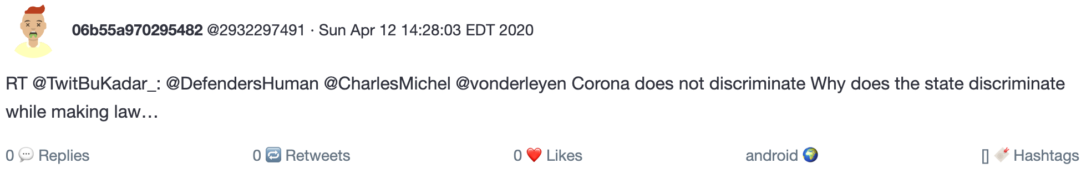
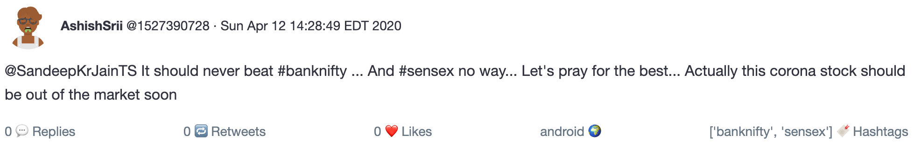
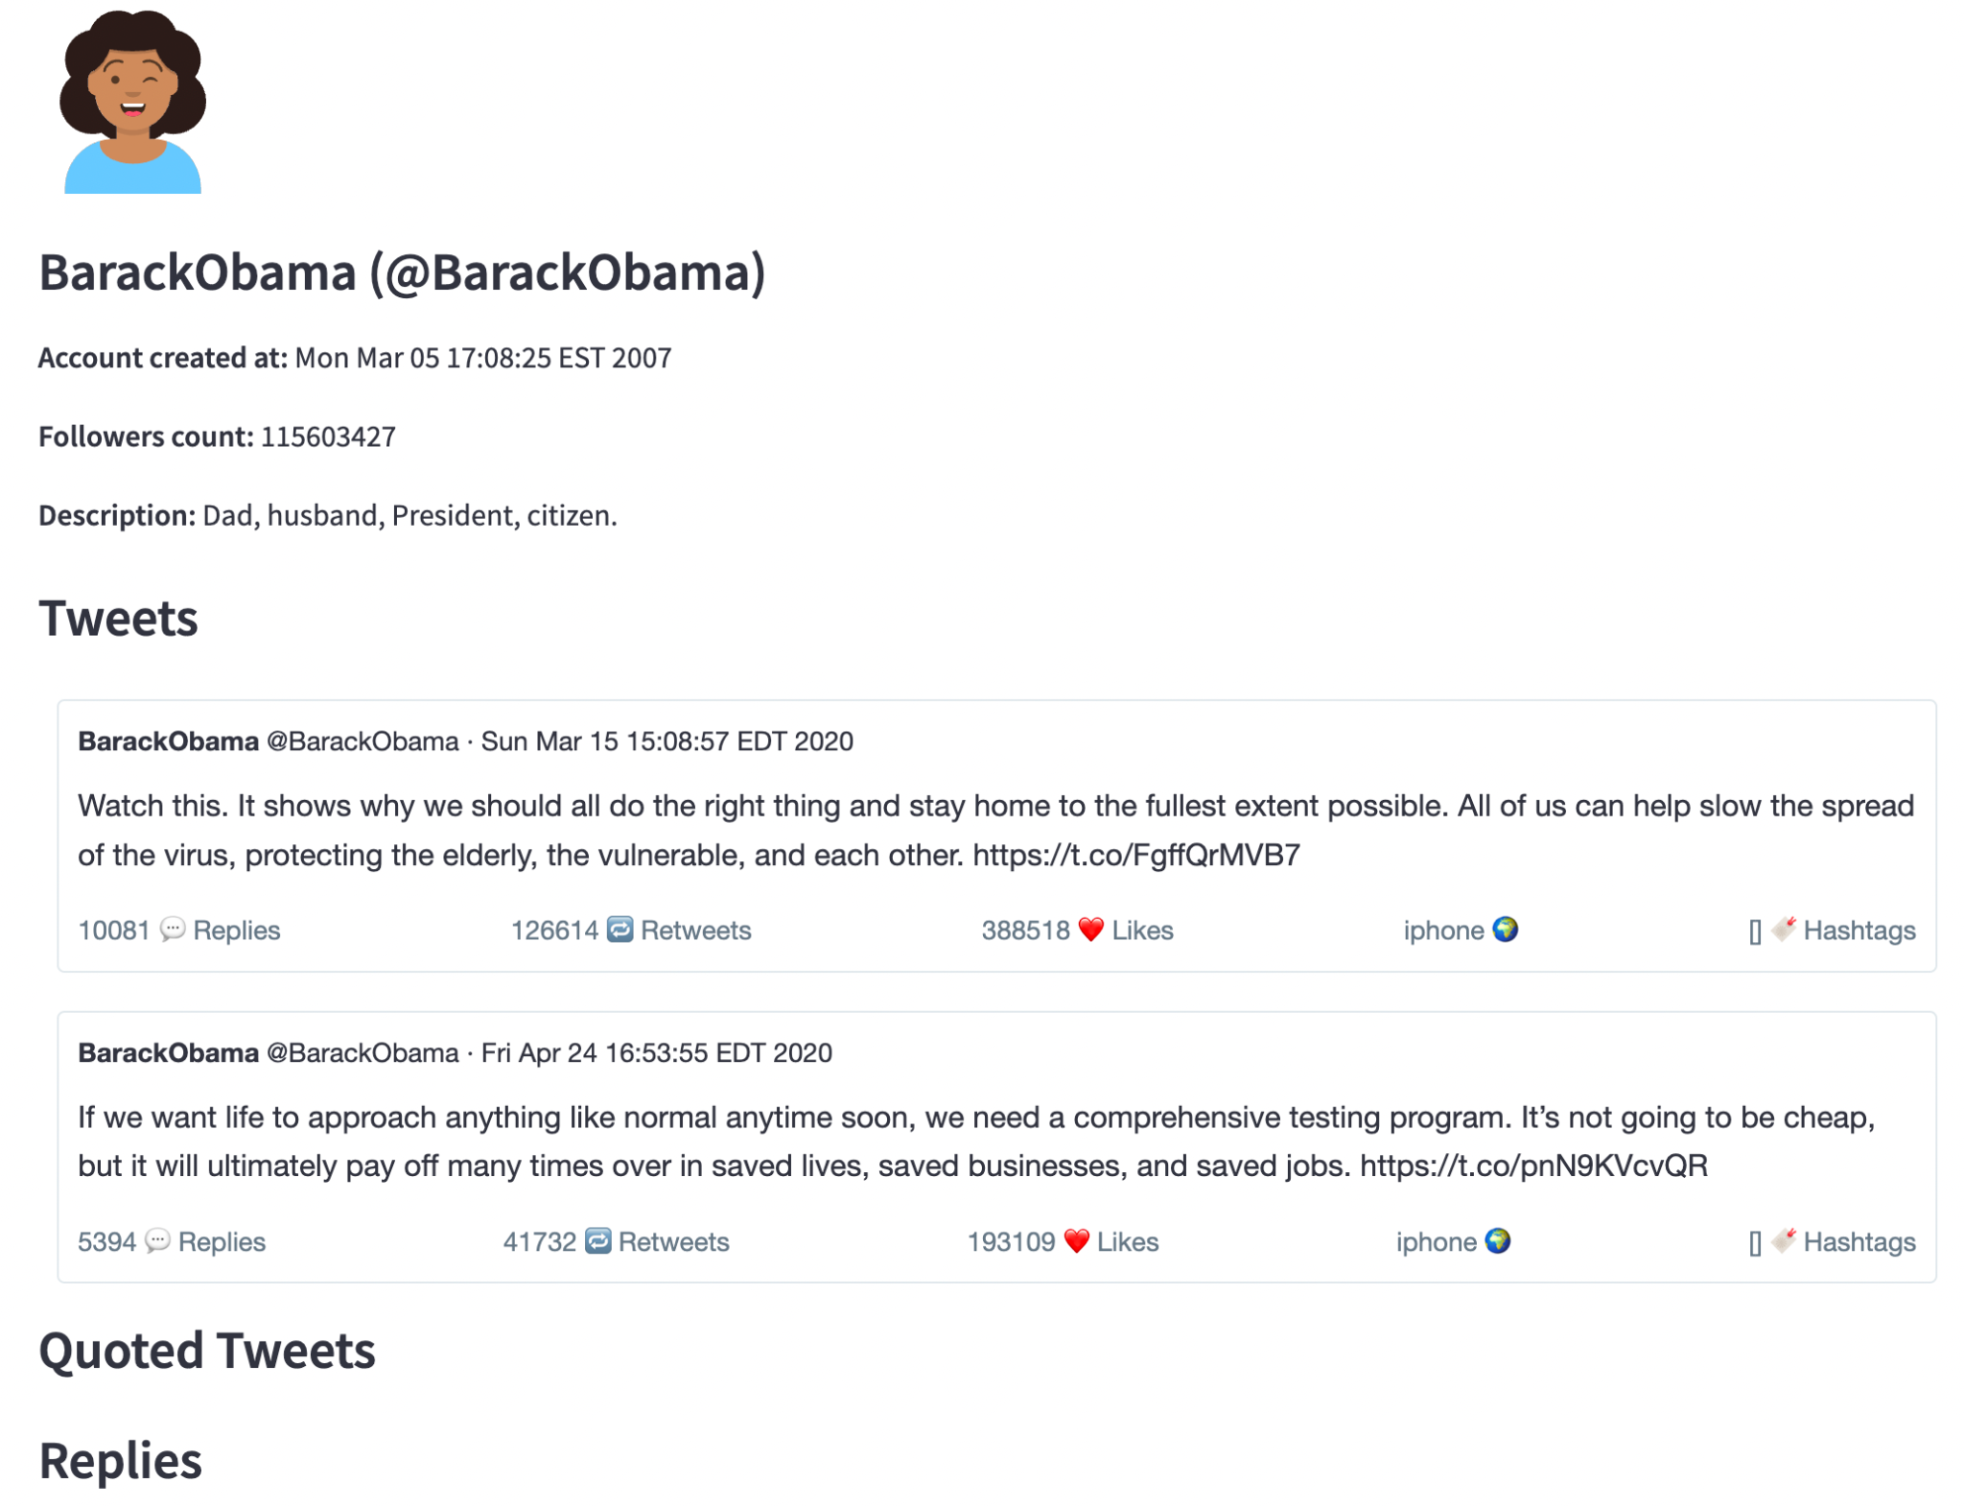
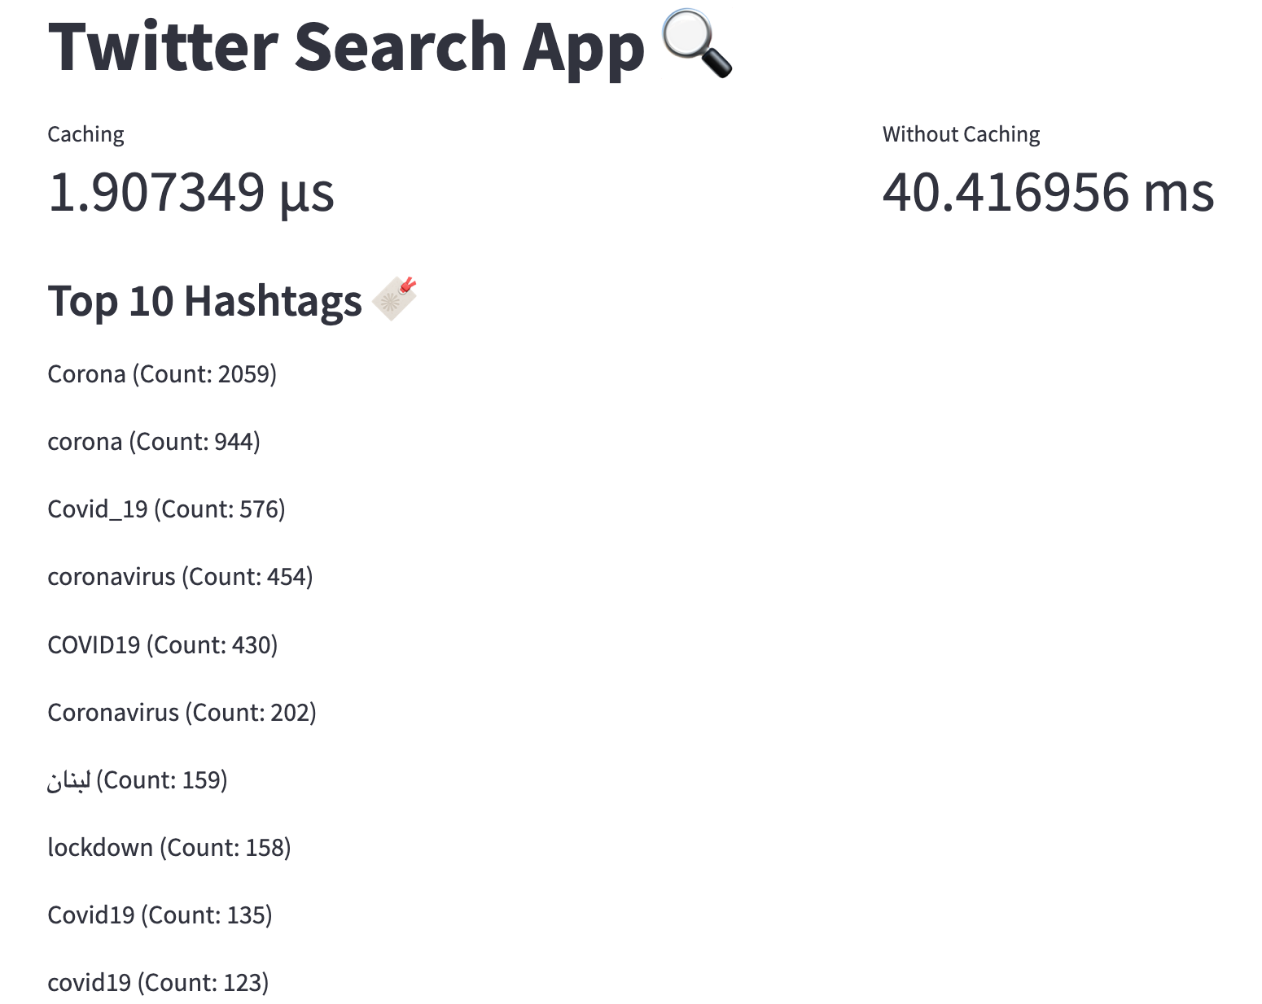
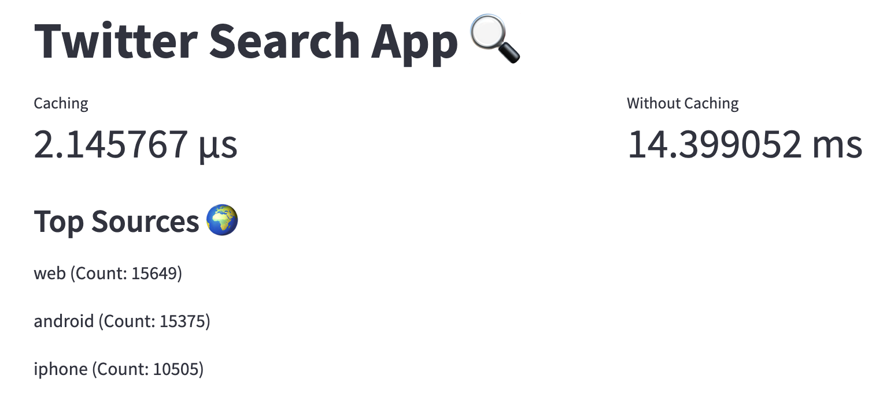
Who to follow
Twitter Search App
Trends For You

Slide 10

Notes:
Smartphone illustration
<a href="https://www.freepik.com/free-photos-vectors/business">Business vector created by freepik - www.freepik.com</a>
Background
<a href="https://www.freepik.com/free-photos-vectors/menu">Menu vector created by freepik - www.freepik.com</a>

Slide 11

THANK YOU
We did the pre-presentation to our cohort!

