Slide 1
Optimal Data Base Design Problem
Group 1
Luigi Amato, Andrea Attili, Valentina Avigliano,
Enzo Bisceglia, Andrea Costa, Michele D’Amico, Giada Morat

Slide 2
Why a Memetic algorithm?
We have chosen to implement a Memetic Algorithm, a Genetic Algorithm integrated with Local Search;
Very efficient in exploring the broad solution space;
Suitable for parallel computation;
It enhances randomization;
Time is the stopping condition.

Slide 3
Chromosome structure
Our population is formed by 200 possible solutions (chromosomes) always feasible;
Each chromosome is an array, as long as the number of queries;
Each gene contains the configuration used to satisfy the corresponding query;
In order not to exceed the available memory, we activate only some genes;
Genes are evaluated in a random order, and they are activated until memory is still available.

Slide 4
Example
Memory available = 30
5 genes for 5 queries
3rd and 4th genes are activated first
2nd and 5th genes are not activate (not enough memory left!)
1st gene is activated
The initial population is generated randomly.
4 (10) | 5 (20) | 23 (6) | 35 (11) | 80 (17)
5 | 3 | 1 | 2 | 4

Slide 5
Generation of the new population
Selection (30% of the times):
4 elements are selected randomly;
the one with the highest fitness is inserted into the new population;
the process is repeated twice;
we obtain two chromosomes for the new population.
Crossover (70% of the times):
two parents are randomly selected;
if they are different, they generate two children.

Slide 6
Crossover
If the first child inherits a gene from the father, the second one inherits the same gene from the mother, and viceversa;
Active / inactive genes are passed on, until there is enough memory left.
!

Slide 7
Crossover. Mutation 1
It’s performed with probability 10/|Q|;
A gene is selected randomly, not depending on its status (activated or not);
The configuration associated to this gene is changed;
If there’s enough memory available for the new configuration, the gene is activated.
12 (8) | 28 (11) | 2 (24) | 23 (10) | 14 (8)
Total memory = 30
The mutated gene is activated since there is enough memory left
12 (8) | 7 (3) | 2 (24) | 23 (10) | 14 (8)

Slide 8
Crossover. Mutation 2
It’s performed with probability 10/|Q|;
An inactive gene is chosen randomly: if there’s enough memory left, it’s activated.
12 (8) | 7 (3) | 2 (24) | 23 (10) | 14 (8)
Total memory = 30
12 (8) | 7 (3) | 2 (24) | 23 (10) | 14 (8)

Slide 9
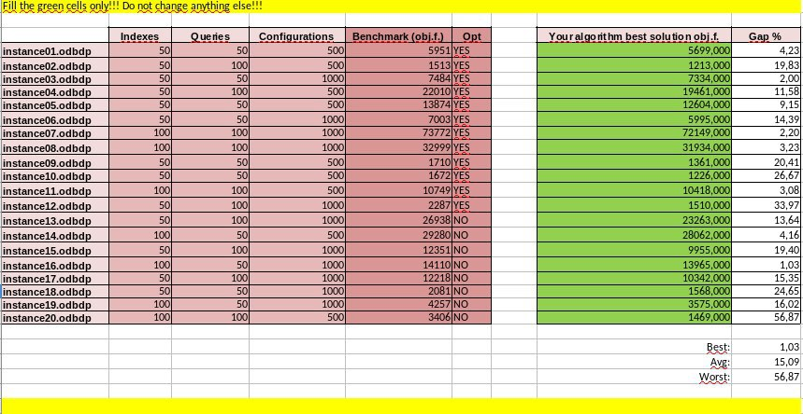
Local Search
Previous Results without Local Search

Slide 10
Local Search
Based on configuration neighborhood.
Performed on both children chromosome separately.
Procedure:
Scanning of the indices used by the active configurations of the chromosome;
Creation of a configuration neighborhood which contains all the configurations (including the ones we are not currently using) that use the same indices of the active configurations;
In random order and for every gene, swapping of the current configuration with one of the neighbor configurations in order to improve the fitness.

Slide 11
Local Search. Example
12 (8) | 7 (3) | 2 (24) | 23 (10) | 14 (8)
Indices in common: 127, 52, 23, 26, 275;
Configuration Neighborhood: 12, 7, 23, 13, 27.
12 (8) | 7 (3) | 12 (8) | 23 (10) | 14 (8)
12 (8) | 7 (3) | 7 (3) | 23 (10) | 14 (8)
The solution with the best fitness is the following:
12 (8) | 7 (3) | 23 (10) | 23 (10) | 14 (8)
12 (8) | 7 (3) | 27 (5) | 23 (10) | 14 (8)
12 (8) | 7 (3) | 13 (10) | 23 (10) | 14 (8)
This is one of the final children chromosome.
We pass to the new generation the best children.
12 (8) | 7 (3) | 27 (5) | 23 (10) | 14 (8)

Slide 12
Selection of the optimal solution
The chromosome with the highest fitness among the whole population will be the current optimal solution
Genes corresponding to configurations that don’t give a positive net gain are inactivated

Slide 13
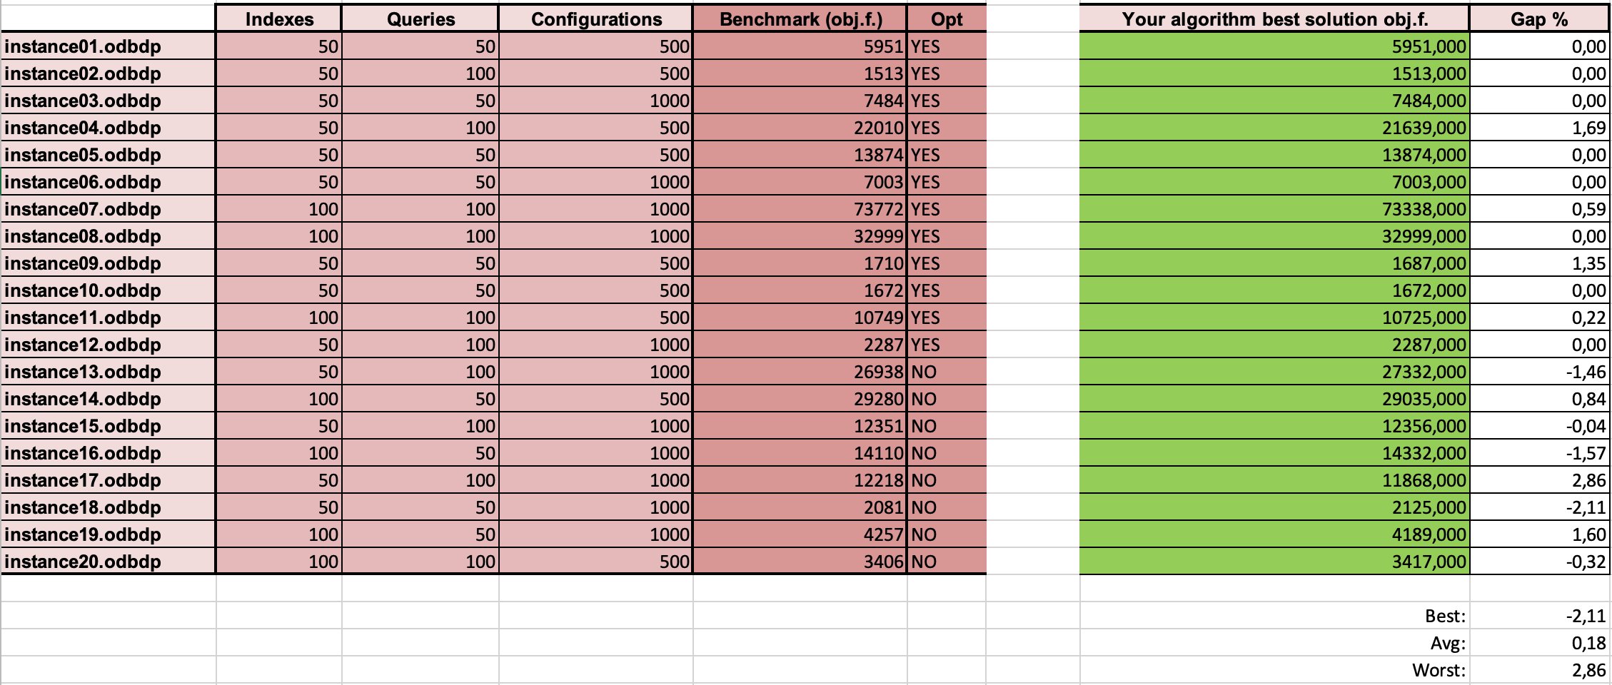
Best final results

Slide 14
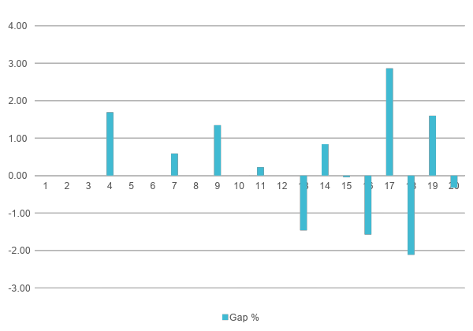
Final Results

Slide 15
Final considerations
Possible Improvements:
Avoiding Local Optima;
We didn’t pay much attention to the strong domain shrinking heuristics;
Tuning Improvement;
Index-based crossover;
Local Search Improvement.

